Slide 1


Temperature Converter using Tkinter
A GUI-based Python application
Created with Tkinter
N KARTHIKEYA-122210701134
M DHANUSH-122210701129
S SRIKANTH-122210701152

Slide 2
Introduction
This project is a temperature converter built using Python and Tkinter. It allows users to convert between Celsius, Fahrenheit, and Kelvin.

Slide 3
Features
- Convert between Celsius, Fahrenheit, and Kelvin
- Graphical User Interface (GUI) using Tkinter
- Input validation for error handling
- Temperature range-based color indicators
- Easy-to-use radio buttons for selection

Slide 4
GUI Setup
- Tkinter is used to create the graphical interface
- Labels, Entry fields, and Buttons are used for user interaction
- Radio buttons allow users to select the conversion type
- The interface is styled with colors and fonts

Slide 5
Conversion Logic
- The function retrieves the user input and selected conversion type
- Depending on the selection, the appropriate formula is applied
- Results are displayed in different colors based on temperature levels
- Error handling ensures only numeric values are processed

Slide 6
Temperature Color Indication
- Red: High temperature (> 85°F)
- Orange: Moderate temperature (60°F - 85°F)
- Green: Normal temperature (< 60°F)

Slide 7
Example Conversion
Example: Converting 25°C to Fahrenheit
Formula: (25 × 9/5) + 32 = 77°F
Displayed result: '25.00°C = 77.00°F' (in orange color)

Slide 8
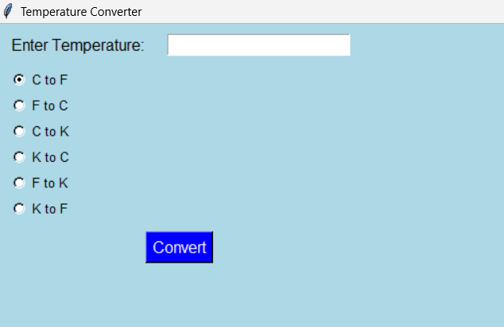
INPUT

Slide 9
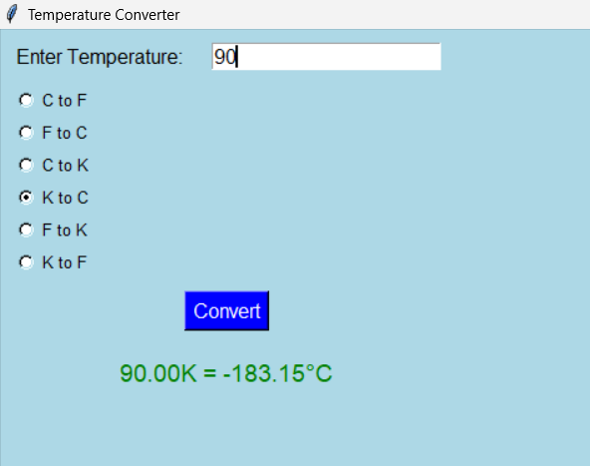
OUTPUT

Slide 10
Conclusion & Future Improvements
- A simple and effective temperature converter using Tkinter
- Future Improvements:
• Add more conversion options (e.g., Rankine, Réaumur)
• Implement graphical temperature indicators
• Enhance UI with better themes and animations

