Slide 1

Heart Disease Dataset Analysis
Data Mining
Data Mining Exploration and Application
BY:
Dhanush Sai Ram Bezawada

Slide 2
Introduction
Dataset Overview:
The dataset contains information on individuals' medical attributes and whether they have heart disease.
Key features include age, cholesterol levels, resting blood pressure, and exercise-induced angina.
Target Variable: target (0 = No Disease, 1 = Disease)
Relevance:
Heart disease is a major global health issue.
Predicting heart disease can improve early diagnosis and treatment.

Slide 3
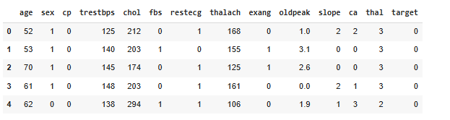
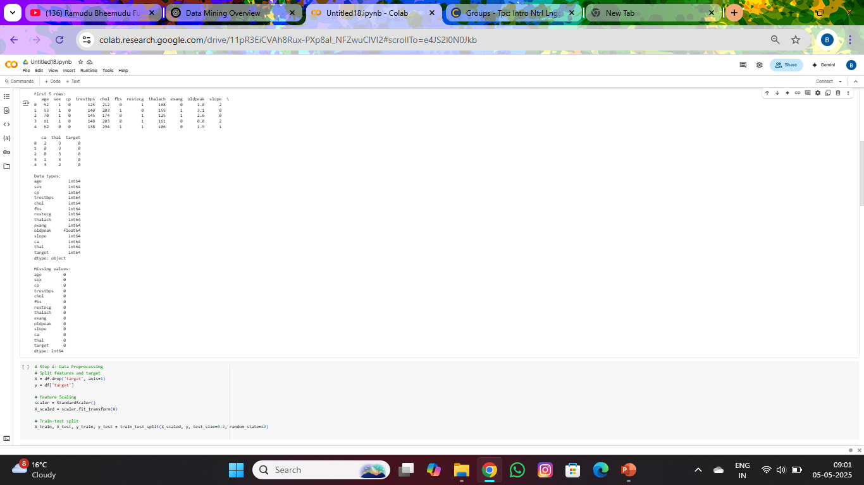
Dataset
Source: Kaggle – Johnsmith
Features: Includes age, sex, cp (chest pain type), chol (cholesterol), thalach (max heart rate), target (heart disease diagnosis), and more.
Statistics:
Entries: 1,025Age
Range: 29–77 years
Cholesterol: 126–564 mg/dL
Heart Rate: 71–202 bpm
Goal: Predict heart disease (target: 1 = Disease, 0 = No Disease) using medical features.

Slide 4
Architecture and Methodology
📈Exploratory Data Analysis (EDA)
Analyze feature distributions
Visualize relationship (scatter plots, heatmaps ..etc.)
Identify trends & patterns
Highlight key correlations
Feature Prepartation
Standardize data
Train-test split(80/20)
Prepare for model training
Ensure balanced dataset
🔍Data Understanding
Load dataset
Check structure & types
Identify missing values
Explore target variable
🛠️Data Cleaning
Duplicates removal
Handling missing values
Ensure clean data
💻 Tools & Libraries Used:
🐼 Pandas – For data manipulation and handling structured data
📊 Seaborn – For creating statistical visualizations (e.g., heatmaps, distribution plots)
📉 Matplotlib – For general-purpose plotting and figure customization
🔍 Scikit-learn – For machine learning modelling (classification, clustering, evaluation metrics)
📐 NumPy – For numerical computations, especially during preprocessing and PC
🗺️Evaluation & Comparison
Compare models using
Accuracy
Precision
Recall
F1 score
Select the best model
📈Machine Learning
Train Models: Logistic Regression, Decision Tree, Support Vector Machine
Use training data
Predict on test data

Slide 5
Data Visualization Exploratory Data Analysis

Slide 6
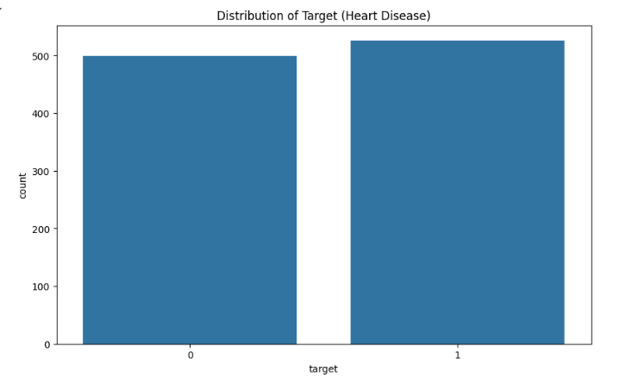
Distribution of Target (Heart Disease)
Key Points:
Bar chart provides a count of individuals with (499) and without heart disease (526).
The similar counts ensure that classification models will not be skewed.
Insight:
Balanced target variable distribution confirms dataset suitability for binary classification.

Slide 7
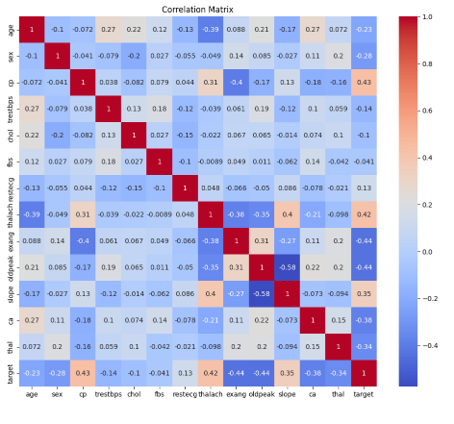
Correlation Matrix
Key Points:
The heatmap highlights the correlation between all features and the target variable.
Strong Positive Correlations: Chest pain type (cp) and maximum heart rate achieved (thalach) with heart disease.
Negative Correlations: Exercise-induced angina (exang) and old peak (oldpeak) with heart disease.
Insight:
Features like thalach, cp, and oldpeak have the strongest relationships with the target variable and are highly relevant for prediction.

Slide 8

Machine Learning Model Performance
Key Points:
This table compares the classification performance of Decision Tree, Logistic Regression, and SVM models using Precision, Recall, F1-Score, Support, and Accuracy.
Decision Tree
Logistic Regression
Support Vector Machine
Observations:
The Decision Tree model outperformed others with 98.5% accuracy, showing excellent balance in precision and recall.
SVM achieved strong performance with 88.8% accuracy, slightly lower but still reliable for prediction.
Logistic Regression lagged behind with 79.5% accuracy, likely due to its linear assumptions not capturing complex patterns.
Insight:
Decision Tree achieves the best overall performance with 98.5% accuracy.
SVM follows with strong metrics across the board and 88.8% accuracy.
Logistic Regression is slightly less effective, particularly in identifying true negatives.
Model | Accuracy | Class | Precision | Recall | F1-Score | Support
Decision Tree | 98.5% | 0 | 0.97 | 1.00 | 0.99 | 102
 |  | 1 | 1.00 | 0.97 | 0.99 | 103
Logistic Regression | 79.5% | 0 | 0.85 | 0.72 | 0.78 | 102
 |  | 1 | 0.76 | 0.87 | 0.81 | 103
SVM | 88.8% | 0 | 0.93 | 0.83 | 0.88 | 102
 |  | 1 | 0.85 | 0.94 | 0.89 | 103

Slide 9
Results Summary
Decision Tree achieved the highest accuracy (98.5%) with excellent classification metrics:
Precision (Class 1): 1.00, Recall: 0.97, F1-Score: 0.99
Confusion Matrix: 102 TN, 100 TP, 3 FN, 0 FP
SVM performed well with 88.8% accuracy and strong F1-Score:
Precision (Class 1): 0.85, Recall: 0.94
Logistic Regression had 79.5% accuracy, with lower precision on positive cases.
Best Model: Decision Tree
due to its high accuracy and balanced classification performance.

Slide 10
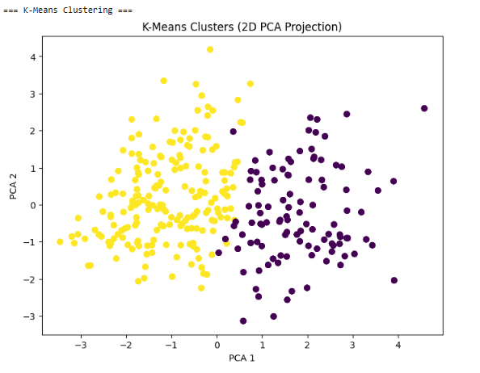
K-Means Clustering with PCA
To group patients based on similarities in features without using the target label, and assess how well the clusters align with actual heart disease presence.
Steps Performed:
Applied K-Means clustering with k = 2 (assuming two groups: disease and no disease).
Features were scaled and reduced to 2D using PCA for visualization.
Clusters visualized in a 2D PCA projection.
Evaluation:
Compared predicted clusters with actual target labels using Adjusted Rand Index (ARI).
Results:
Adjusted Rand Index (ARI): 0.376
Indicates a moderate level of similarity between the clusters and actual labels.
Suggests K-Means does not perfectly align with the true classification but captures some structure in the data.
Insights:
Clustering provides some differentiation but is less reliable than supervised models.
Visualization helps in understanding the natural grouping of the data points.

Slide 11
Conclusion and Future Scope
EDA Insights:
Age, cholesterol levels, and chest pain type are highly significant predictors of heart disease.
Clear differences observed in feature trends between individuals with and without heart disease.
Machine Learning Models:
The Decision Tree model is most effective for predicting heart disease in this dataset.
Impact:
This project demonstrates the effectiveness of machine learning in predicting heart disease with high accuracy, aiding early diagnosis and better patient outcomes.
Future Scope:
Future work can explore ensemble models or deep learning for enhanced performance.
Future improvements may include hyperparameter tuning and ensemble methods.
Incorporating more diverse and real-time data can improve model generalization and clinical relevance.

Slide 12
GitHub Repository for code
https://github.com/DhanushBezawada22/Data-Mining
Dataset: https://www.kaggle.com/datasets/johnsmith88/heart-disease-dataset

