Slide 1


-
-
Medical-RAG
Eliminating Hallucinations with Domain-Specific
Embeddings

Slide 2
-
-
Introduction
  The Challenge: Standard RAG systems often fail in specialized fields like medicine due to "Generic Retrieval."
  Finding Facts vs. Words: Most models find similar words, but medical AI requires finding precise clinical facts.
  The Solution: Fine-tuning a BERT-based embedding model to align vector space with clinical nomenclature.
  The Result: A quantifiable 23.67% reduction in LLM hallucinations.
  Project Scope: An end-to-end pipeline from LoRA fine-tuning to RAGAS automated auditing.

Slide 3
-
-
Objectives
  Domain Adaptation: Adjust the all-MiniLM-L6-v2 model to understand complex PubMed medical triplets.
  Optimized Training: Utilize Unsloth AI for 2x faster, memory-efficient LoRA fine-tuning on a single T4 GPU.
  Retrieval Accuracy: Improve the "Hit Rate" of documents to ensure the LLM receives the most relevant context.
  Local Inference: Build a fully private RAG pipeline using Ollama (Llama 3) for data security.
  Automated Validation: Establish a mathematical baseline for "Truthfulness" using the RAGAS framework.

Slide 4
-
-
Technical Stack
  Fine-Tuning: Unsloth AI (PEFT/LoRA) for high-speed embedding optimization.
  Base Model: unsloth/all-MiniLM-L6-v2 (BERT-based architecture).
  Inference Engine: Ollama (Running Llama 3 8B locally).
  Vector Database: FAISS (Facebook AI Similarity Search) for high-dimensional indexing.
  Evaluation: RAGAS (Retrieval-Augmented Generation Assessment Services).
  Development: Python, HuggingFace Transformers, and PyTorch.

Slide 5
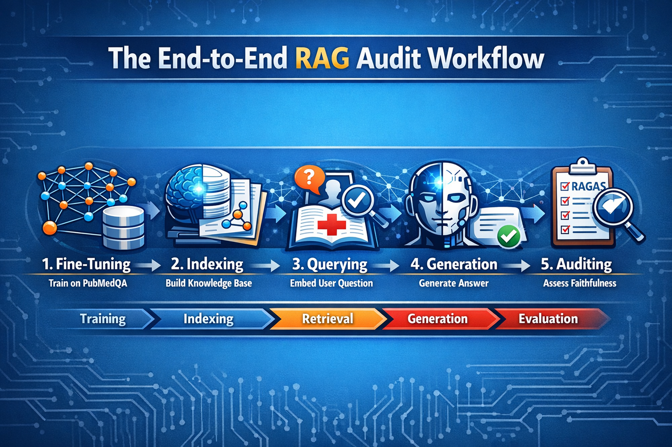
-
-
System Flow Diagram

Slide 6
-
-
Evaluation & Usecases
  The Metric: Achieved a 0.69 Faithfulness score, outperforming the generic baseline by 23.67%.
  Clinical Decision Support: Assisting doctors by retrieving precise peer-reviewed studies instantly.
  Medical Document QA: Automated analysis of patient information sheets and surgical journals.
  Education & Research: A tool for medical students to query complex datasets without AI "guessing."
  Privacy-First AI: A template for healthcare organizations to run specialized AI locally without cloud API leaks.

Slide 7
-
-
Conclusion
  Retrieval is the Anchor: An LLM is only as good as the context it is given.
  Fine-Tuning is Necessary: Generic embeddings are insufficient for high-stakes industries like healthcare.
  Cost Efficiency: Using LoRA and Unsloth allows for "Pro-grade" results on "Consumer-grade" hardware.
  Transparency: RAGAS provides the necessary "Audit Trail" to trust AI outputs in production.

Slide 8
-
-
Thank You

