Slide 1
Factors linked to the Diagnosis on Coronary Heart Disease
Dhanush
Heng-Jui Chu
Nikhilesh
Aditya

Slide 2
Agenda
Introduction
Summary
Proposal
SMART QUESTION
Conclusion

Slide 3
Introduction
This project investigates the relationship between lifestyle factors, health metrics, and the diagnosis of Coronary Heart Disease (CHD).
The analysis uses robust statistical methods, including T-tests, Chi-square tests, and ANOVA, to answer SMART questions.
The dataset was obtained from the CDC's Behavioral Risk Factor Surveillance System (BRFSS) 2024 annual data, which is publicly available at this link: Behavioral Risk Factor Survelliance System
The goal is to provide evidence-based insights that can support public health strategies to mitigate CHD risk factors.

Slide 4
summary
BMI and CHD: There is a statistically significant difference in BMI between individuals with and without CHD, indicating that those with the condition tend to have a higher average BMI.
Smoking and CHD: The analysis showed a very strong relationship between smoking status and CHD, with smokers being significantly more likely to have the disease.
General Health and BMI: A significant variation was found in BMI across different self-reported health levels, suggesting a clear link between an individual's perceived health and their BMI.
Exercise and BMI: The study found a very strong relationship between exercise participation and BMI category, highlighting the crucial role of physical activity in weight management and maintaining a healthier BMI.
Diabetes and CHD: A strong association was confirmed between diabetes status and coronary heart disease, suggesting that individuals with diabetes have a much higher likelihood of developing CHD compared to those without the condition.

Slide 5
proposal
Problem Statement | This project describes a quantitative study aimed at identifying and validating important lifestyle, health, and demographic characteristics that are strongly linked to the diagnosis of coronary heart disease (CHD).
Objective | The main objective is to statistically identify the significant correlations between chosen health measurements, lifestyle decisions, and a diagnosis of coronary heart disease.
Dataset | A big public health dataset from the Behavioral Risk Factor Surveillance System (BRFSS) 2024 is used in this project. The Centers for Disease Control and Prevention (CDC) provided the information.
Methodology | In order to examine the link between CHD and variables including BMI, smoking status, diabetes, and general health, the project uses strong statistical techniques, such as the tests listed below. The findings will offer evidence-based perspectives to help prioritize public health intervention tactics.

Slide 6
Data Cleaning Process
Issues Found:
- Missing values in BMI and Smoking columns
- Inconsistent labels in Gender and Exercise columns
- Outliers in Age and BMI fields
Solutions:
- Median imputation for missing BMI
- Standardized categorical labels (Male/Female)
- Removed outliers beyond 3 standard deviations

Slide 7
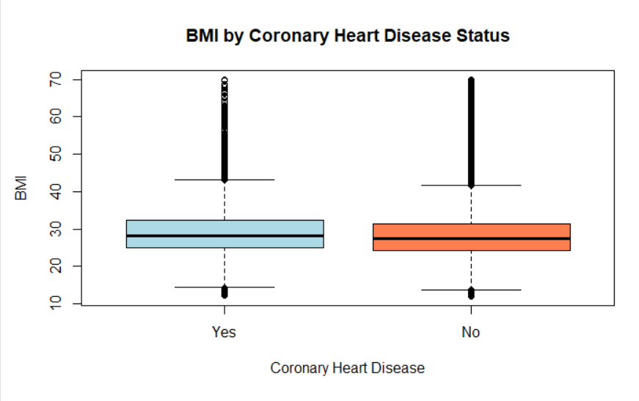
Is there a significant difference in BMI between people with and without coronary heart disease? (T-test)
data: BMI_Value by Coronary_Heart_Disease
t = 20.499, df = 30177, p-value < 2.2e-16
alternative hypothesis: true difference in means between group Yes and group No is not equal to 0
95 percent confidence interval:
0.7451232 0.9026805
sample estimates:
mean in group Yes mean in group No
29.24129 28.41738
Result: There IS a significant difference in BMI between groups (p < 0.05)

Slide 8
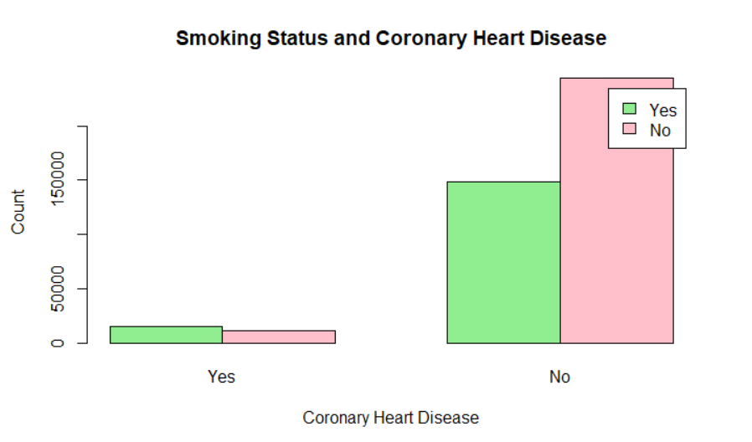
Is smoking status associated with coronary heart disease?
Yes 15013 148797
No 11567 243806
[1] "Percentages by smoking status:"
Yes No
Yes 9.2 90.8
No 4.5 95.5
Pearson's Chi-squared test with Yates' continuity correction
data: smoking_table
X-squared = 3609.9, df = 1, p-value < 2.2e-16
Result: There IS a significant association between smoking and coronary heart disease (p < 0.05)

Slide 9
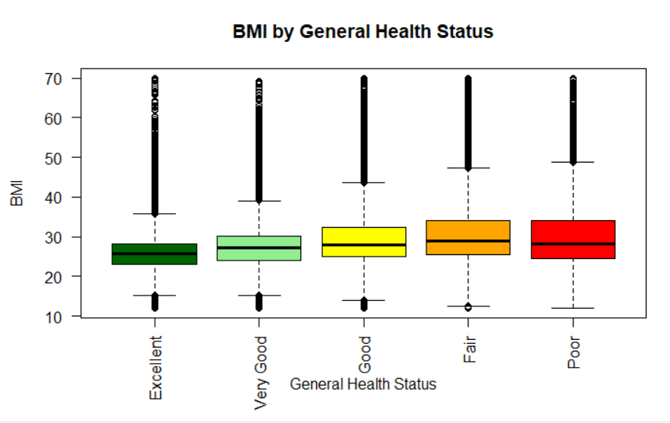
Does BMI vary significantly across different general health status levels?
Df Sum Sq Mean Sq F value Pr(>F)
General_Health_Status 4 815187 203797 5469 <2e-16 ***
Residuals 419178 15621542 37
Signif. codes: 0 ‘***’ 0.001 ‘**’ 0.01 ‘*’ 0.05 ‘.’ 0.1 ‘ ’ 1
Result: BMI DOES vary significantly across general health status levels (p < 0.05)

Slide 10
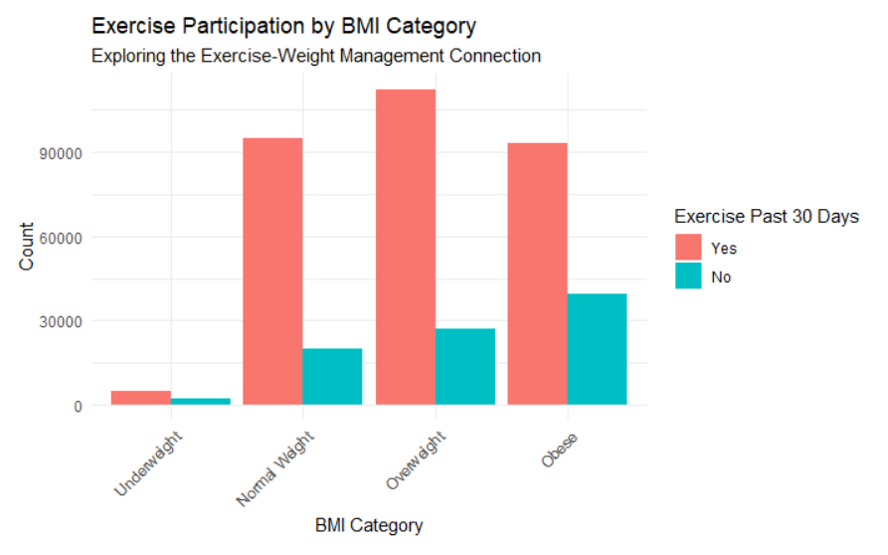
Exercise Participation Across BMI Categories
[1] "Contingency Table: BMI Categories vs Exercise Participation"
Yes No
Underweight 4892 1976
Normal Weight 94928 19778
Overweight 112247 27202
Obese 93187 39410
[1] "Exercise participation rates by BMI category:"
Yes No
Underweight 71.23 28.77
Normal Weight 82.76 17.24
Overweight 80.49 19.51
Obese 70.28 29.72
Pearson's Chi-squared test
data: bmi_exercise_table
X-squared = 6665.5, df = 3, p-value < 2.2e-16

Slide 11
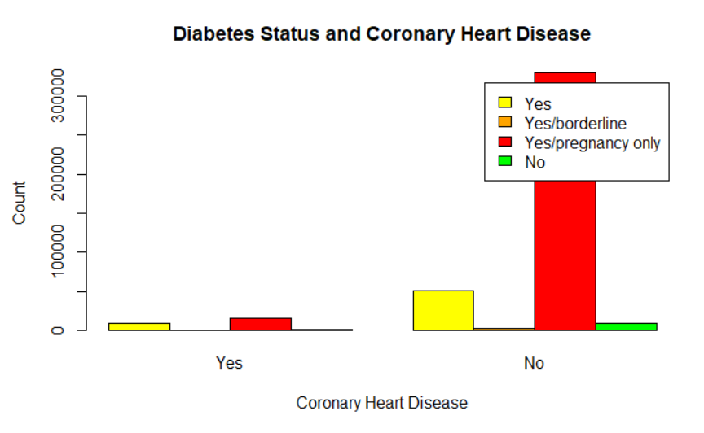
Is diabetes status associated with coronary heart disease?
[1] "Contingency Table:"
Yes 9232 50615
Yes/borderline 103 3001
Yes/pregnancy only 16274 329572
No 971 9415
[1] "Percentages by diabetes status:"
Yes 15.4 84.6
Yes/borderline 3.3 96.7
Yes/pregnancy only 4.7 95.3
No 9.3 90.7
Pearson's Chi-squared test
data: diabetes_table
X-squared = 10081, df = 3, p-value < 2.2e-16
Result: There IS a significant association between diabetes and coronary heart disease (p < 0.05)

Slide 12
Conclusion
Key Findings:
- Strong correlations between CHD and factors like Age, BMI, Smoking, and Diabetes.
- Data insights align with World Bank and CDC data.
Future Work:
- Expand dataset and analyze additional lifestyle factors.

