Slide 1
Factors linked to the Diagnosis on Coronary Heart Disease
- DHANUSH MATHIVANAN
- HENG-JUI CHU
- NIKHILESH DHAVALE
- ADITYA KARANDE

Slide 2


Source links
Git Hub: 6101-mid-term-project
Dataset Link: Behavioral Risk Factor Survelliance System

Slide 3
Agenda
Introduction
Workflow process
Data Overview
SMART QUESTION
Conclusion
Analysis test

Slide 4
Introduction
This project investigates the relationship between lifestyle factors, health metrics, and the diagnosis of Coronary Heart Disease (CHD).
The analysis uses robust statistical methods, including T-tests, Chi-square tests, and ANOVA, to answer SMART questions.
The dataset was obtained from the CDC's Behavioral Risk Factor Surveillance System (BRFSS) 2024 annual data, which is publicly available at this link: Behavioral Risk Factor Survelliance System
The goal is to provide evidence-based insights that can support public health strategies to mitigate CHD risk factors.

Slide 5
Project workflow process diagram
RAW DATA IMPORT FROM US CDC WEBSITE
CLEAN & FILTER DATA FOR EDA
CHECK DATA INTEGRITY & NORMALITY DISTRIBUTION
GRAPHICAL ANALYSIS (HISTROGRAMS, QQPLOT, GGPLOT, Etc)
HYPOTHENISIS TESTING (T-TEST, Z-TEST, CHI-TEST, ANOVA)
TRANSFORM DATA INTO READABLE CSV FORMAT
SUMMARIZE RESULTS AND CONCLUDE MEDICAL FACTORS PREDICTION

Slide 6
Dataset overview
Download raw data file from CDC Portal (.xpt file) SASS
Analyse Codebook Documentation (CDC website) for specific variables mapping definition
Create a python script to read the sass file and generate the table data in .csv file format
Data load in rmd file with just the required column variables data for our EDA Analysis
Clean the data set by checking for missing values and filter the data set for outlier treatment (Impossible/ Dirty data handling)
The 2024 Behavioral Risk Factor Surveillance System (BRFSS) dataset from the U.S. Centers for Disease Control and Prevention (CDC) contains 457,671 observations of medical and behavioral data for U.S. adults across 330 variables. This exploratory data analysis (EDA) focuses on eight key variables: BMI_Value, General_Health_Status, Coronary_Heart_Disease, Sex, Exercise_Past_30_Days, Diabetes_Status, Smoking_Status, and BMI_Category_Alt. Using statistical methods, including T-tests, Chi-square tests, and ANOVA, we analyze these variables to address SMART questions, summarizing findings to deliver actionable insights for public health strategies.
Raw Data Transformation Process:

Slide 7
summary
BMI and CHD: There is a statistically significant difference in BMI between individuals with and without CHD, indicating that those with the condition tend to have a higher average BMI.
Smoking and CHD: The analysis showed a very strong relationship between smoking status and CHD, with smokers being significantly more likely to have the disease.
General Health and BMI: A significant variation was found in BMI across different self-reported health levels, suggesting a clear link between an individual's perceived health and their BMI.
Exercise and BMI: The study found a very strong relationship between exercise participation and BMI category, highlighting the crucial role of physical activity in weight management and maintaining a healthier BMI.
Diabetes and CHD: A strong association was confirmed between diabetes status and coronary heart disease, suggesting that individuals with diabetes have a much higher likelihood of developing CHD compared to those without the condition.

Slide 8
proposal
Problem Statement | This project describes a quantitative study aimed at identifying and validating important lifestyle, health, and demographic characteristics that are strongly linked to the diagnosis of coronary heart disease (CHD).
Objective | The main objective is to statistically identify the significant correlations between chosen health measurements, lifestyle decisions, and a diagnosis of coronary heart disease.
Dataset | A big public health dataset from the Behavioral Risk Factor Surveillance System (BRFSS) 2024 is used in this project. The Centers for Disease Control and Prevention (CDC) provided the information.
Methodology | In order to examine the link between CHD and variables including BMI, smoking status, diabetes, and general health, the project uses strong statistical techniques, such as the tests listed below. The findings will offer evidence-based perspectives to help prioritize public health intervention tactics.

Slide 9
Smart questions
Is there a significant difference in BMI between people with and without coronary heart disease? (T-test)​
Is smoking status associated with coronary heart disease? (Chi-squared test)​
Does BMI vary significantly across different general health status levels? (Anova)​
Does exercise participations vary significantly across different BMI categories, suggesting a role in weight management? (Chi-square test)​
Is diabetes status associated with coronary heart disease? (Chi-square)

Slide 10
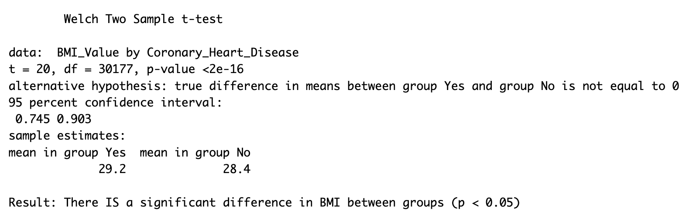
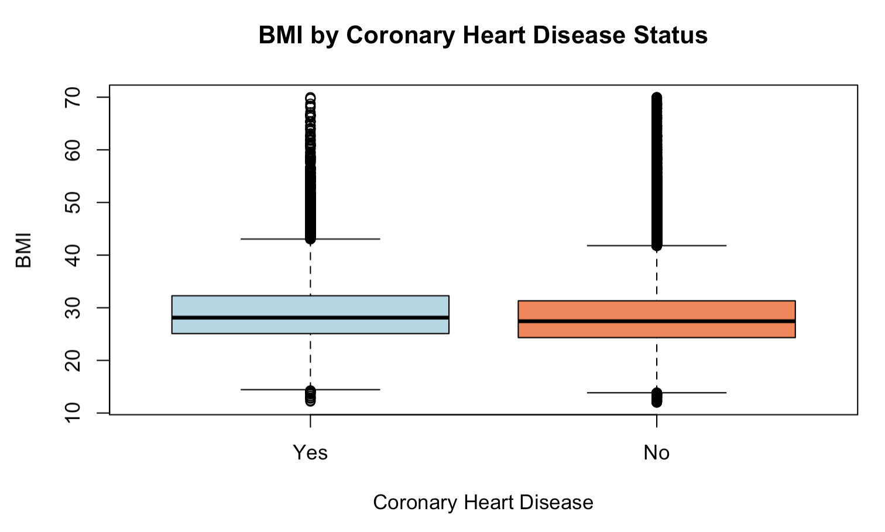
Question 1: Is there a significant difference in BMI between people with and without coronary heart disease?

Slide 11
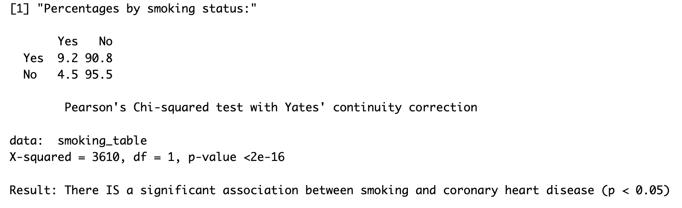
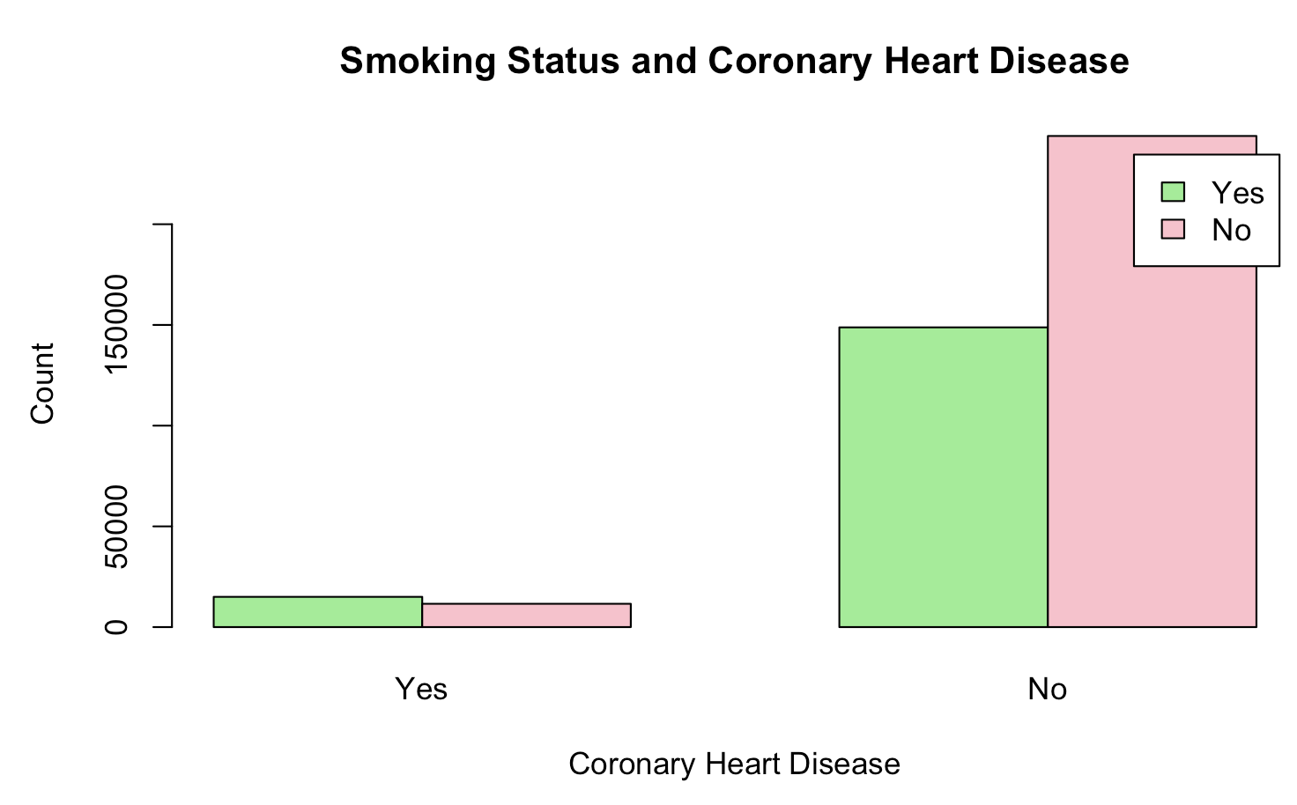
Question 2: Is smoking status associated with coronary heart disease?

Slide 12
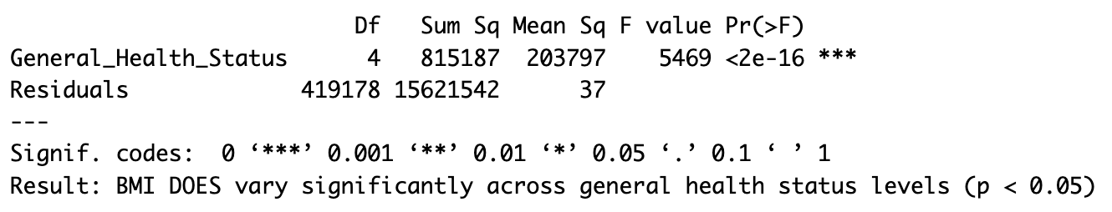
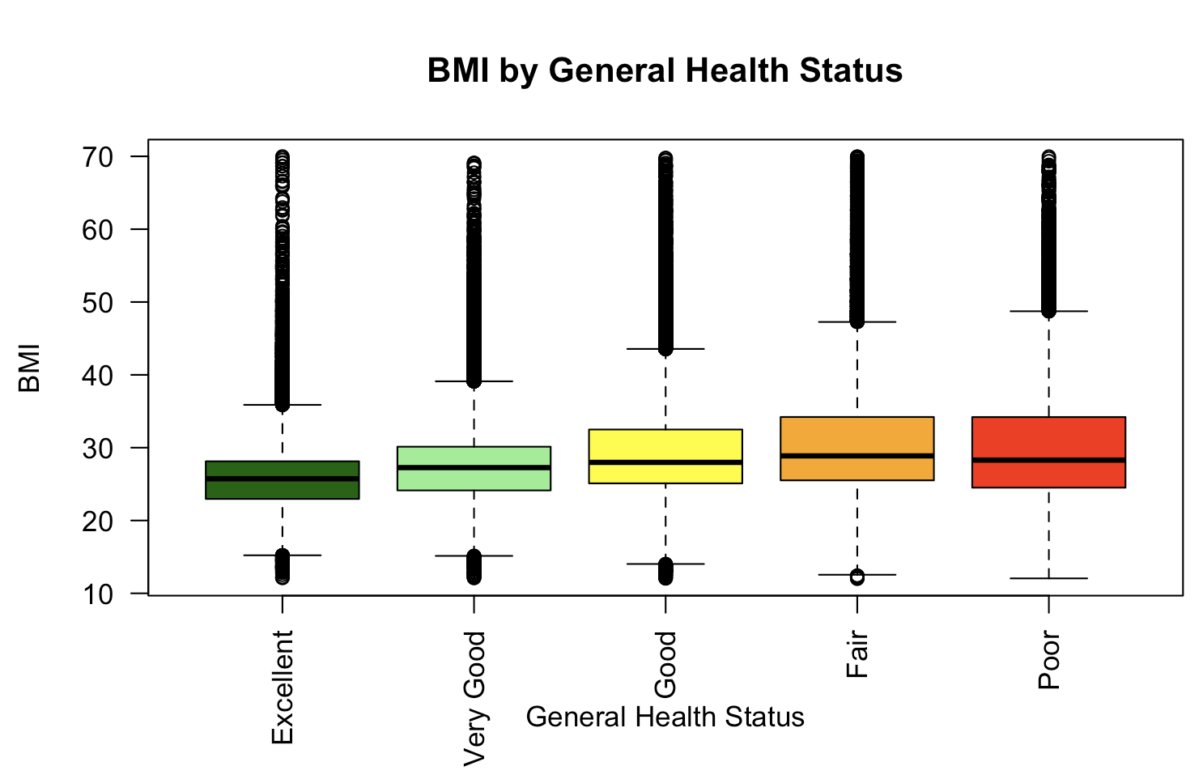
Question 3: Does BMI vary significantly across different general health status levels?

Slide 13
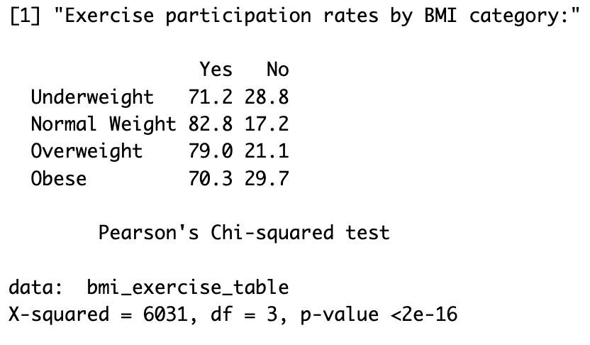
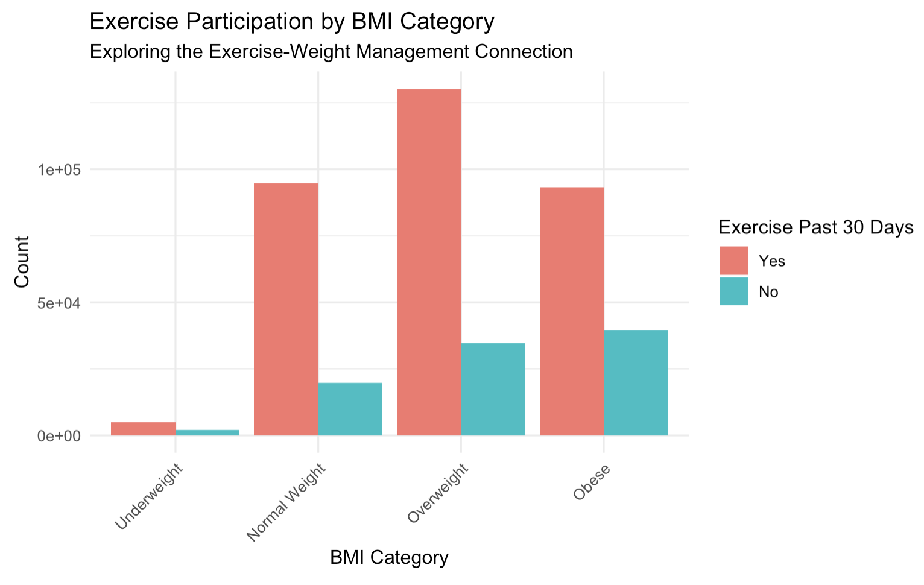
Question 4: Does exercise participation vary significantly across different BMI categories, suggesting a role in weight management?

Slide 14
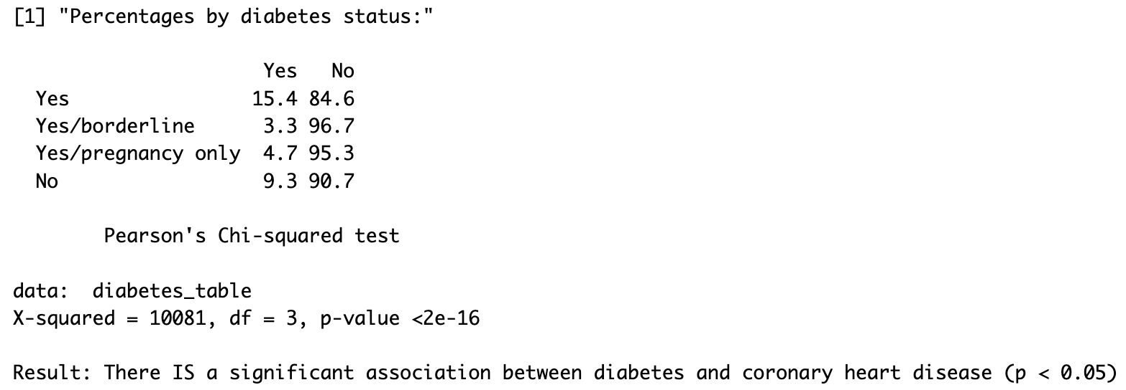
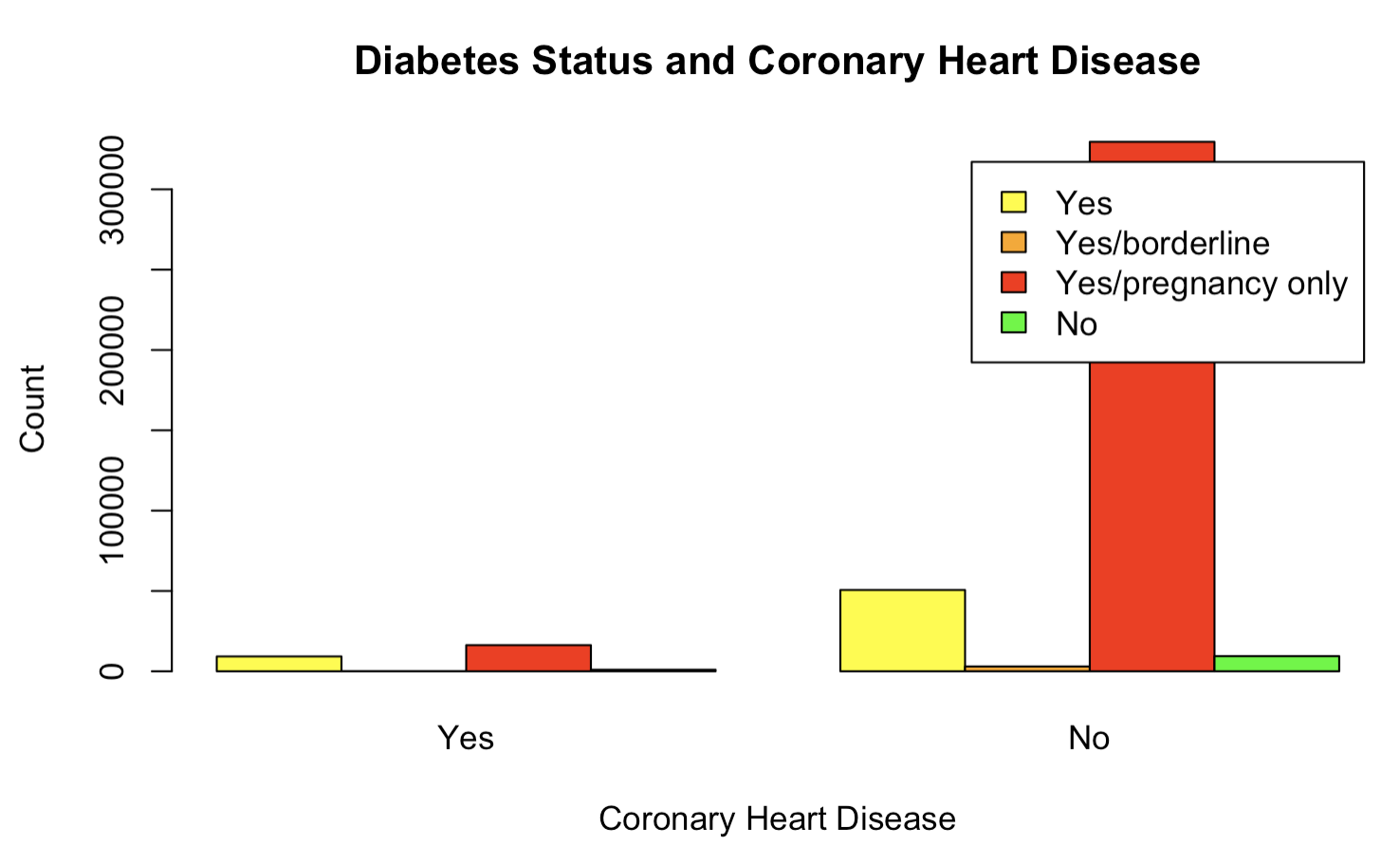
Question 5: Is diabetes status associated with coronary heart disease?

Slide 15
Conclusion
Key Findings:
- Strong correlations between CHD and factors like Age, BMI, Smoking, and Diabetes.
- Data insights align with World Bank and CDC data.
Future Work:
- Expand dataset and analyze additional lifestyle factors.

