Slide 1
Factors linked to the Diagnosis on Coronary Heart Disease
- DHANUSH MATHIVANAN
- HENG-JUI CHU
- NIKHILESH DHAVALE
- ADITYA KARANDE

Slide 2


Source links
Git Hub: 6101-mid-term-project
Dataset Link: Behavioral Risk Factor Survelliance System

Slide 3
Agenda
Proposal and objectives
Workflow process
Data Overview
SMART QUESTION
Conclusion
Analysis test
SUMMARY
MODEL
DEVELOPMENT
MODEL EVALUATION
WEB APP

Slide 4
Proposal and Objectives
This project investigates the relationship between lifestyle factors, health metrics, and the diagnosis of Coronary Heart Disease (CHD).
To analyse key CHD predictors using statistical tests and developed two models Random Forest and Decision Tree to evaluate CHD Risk.
The dataset was obtained from the CDC's Behavioral Risk Factor Surveillance System (BRFSS) 2024 annual data, which is publicly available at this link: Behavioral Risk Factor Survelliance System
The goal is to provide evidence-based insights that can support public health strategies to mitigate CHD risk factors.

Slide 5
Project workflow process diagram
RAW DATA IMPORT FROM US CDC WEBSITE
TRANSFORM DATA INTO READABLE CSV FORMAT
CLEAN & FILTER DATA FOR EDA
CHECK DATA INTEGRITY & NORMALITY DISTRIBUTION
GRAPHICAL ANALYSIS (HISTROGRAMS, QQPLOT, GGPLOT, Etc)
HYPOTHENISIS TESTING (T-TEST, Z-TEST, CHI-TEST, ANOVA)
SUMMARIZE RESULTS AND CONCLUDE MEDICAL FACTORS PREDICTION
FORMULATE NEW SMART QUESTION
ADVANCED EXPLORATORY DATA ANALYSIS
BUILD MACHINE LEARNING MODELS
EVALUATE & COMPARE MODEL PERFORMANCE
DEPLOY MODEL INTO WEB APP

Slide 6
Dataset overview
The BRFSS 2024 dataset includes 457,671 records. We analyze key CHD predictors—Age, Sex, Smoking, Diabetes, Exercise, General Health, and BMI. Our EDA includes cleaning, class balance checks, and statistical tests. These results guide the development of two predictive models: Random Forest and Decision Tree.
Raw Data Transformation Process:
IMPORT BRFSS dataset with 457K+ Adult health records.
Key CHD predictors analyzed: Age, Sex, Smoking, Diabetes, Exercise, General Health, BMI.
EDA included cleaning, class balance check, statistical tests.
Results used to build two models.
Evaluate Model Performance

Slide 7
SMART QUESTION
How do Age, Sex, Smoking_Status, Diabetes_Status, Exercise_Past_30_Days, and General_Health_Status affect the likelihood of having Coronary_Heart_Disease?
PURPOSE :
Identify which demographic and behavioral factors most strongly influence CHD
Compare the strength of relationships between predictors and CHD
Prepare reliable inputs for machine learning models
Support targeted public health interventions

Slide 8
RANDOM FOREST MODEL
Built using ranger on cleaned dataset with key predictors
Predictors: Age, Sex, Smoking Status, Diabetes Status, Exercise, General Health, BMI
70/30 stratified train–test split
Model configured with:
500 trees
Mtry = √p
Permutation importance
Min node size = 5
Probability outputs enabled

Slide 9
Performance:
Accuracy: ~0.77
AUC: ~0.84
Balanced sensitivity & specificity
Good calibration (OOB Brier Score = 0.162)
Key Insights:
Top predictors: Age, General Health, Diabetes Status
Random Forest provides higher predictive power vs Decision Tree
Well-suited for identifying high-risk CHD individuals

Slide 10
RAnDOM FOREST : ROC AND FEATURE IMPORTANCE
ROC Results:
ROC curve significantly above diagonal
Random Forest shows strong discrimination between CHD vs Non-CHD
AUC = 0.837
Variable Importance (Permutation):
Age
General Health Status
Diabetes Status
Sex
Smoking
BMI
Exercise_Past_30_Days
Interpretation:
Age dominates prediction
Health status & diabetes add meaningful predictive power
Lifestyle factors provide additional improvement but smaller impact

Slide 11
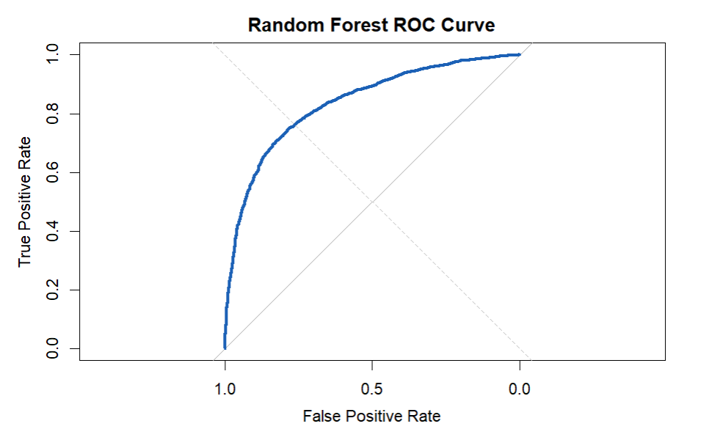

Slide 12
Decision TREE MODEL (CART)
Built using rpart with tuning
Predictors identical to Random Forest model
Model control parameters:
cp = 0.001
minsplit = 20
minbucket = 10
maxdepth = 10
Pruning:
Optimal CP selected based on minimum cross-validation error
Final pruned tree improves generalization and interpretability
Interpretation Highlights:
First split: Age
Second major split: General Health
Diabetes and BMI appear in deeper splits
Highly interpretable model for clinicians

Slide 13
Performance Metrics:
Accuracy: ~0.77
Sensitivity: ~0.79
Specificity: ~0.74
Precision: ~0.72
AUC: ~0.82
ROC Curve:
Strong separation between CHD vs Non-CHD
Slightly lower performance vs Random Forest but still robust
Takeaways:
Decision Tree is simpler, interpretable, and visually intuitive
Slightly lower predictive power than Random Forest
Useful for explaining CHD risk rules to non-technical audiences

Slide 14
Model comparison ee
Decision Tree VS Random Forest
Metric | Random Forest | Decision Tree | Comparison
Accuracy | 0.77 | 0.77 | Similar
AUC | 0.84 | 0.82 | RF better
Sensitivity | Slightly higher | Slightly lower | RF advantage
Specificity | Higher | Lower | RF advantage
Interpretability | Low | High | DT advantage

Slide 15
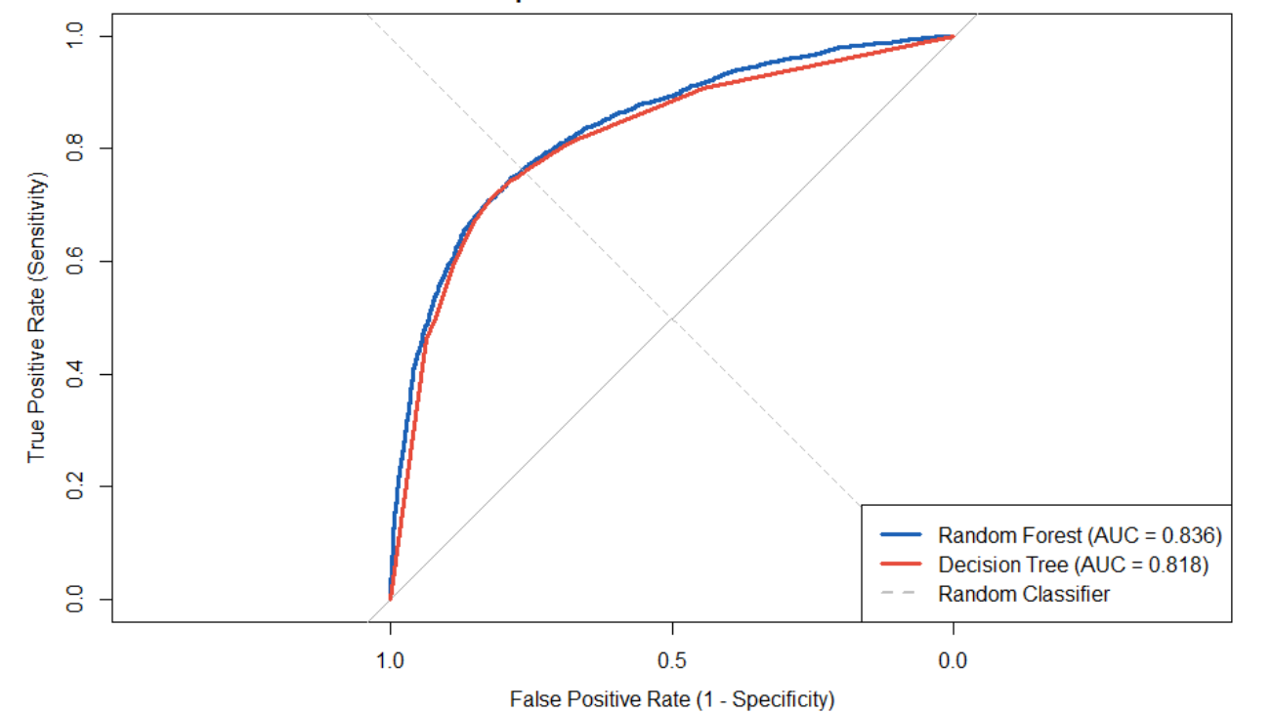
ROC ANALYSIS

Slide 16
summary
Age and CHD: CHD risk increases sharply with age, and statistical tests confirm a strong association. Age is the strongest predictor in both models.
Smoking and CHD: A very strong association exists between smoking status and CHD, with smokers significantly more likely to have the disease.
General Health and CHD: Individuals reporting fair or poor general health show substantially higher CHD rates, making general health one of the top predictors.
Exercise and CHD: Lack of exercise is significantly linked to higher CHD prevalence, underscoring the role of physical activity in cardiovascular health.
BMI and CHD: Individuals with CHD tend to have higher BMI values, as confirmed by statistical testing.
Diabetes and CHD: A strong association exists between diabetes and CHD, with diabetic individuals showing much higher disease prevalence.
Model Insights: Both Random Forest and Decision Tree models identify Age, General Health Status, and Diabetes Status as the most important predictors of CHD, with Random Forest achieving slightly better predictive performance (AUC ≈ 0.84).

Slide 17
Conclusion
• Key factors linked to CHD include Age, General Health, Diabetes, Smoking, and BMI.
• Statistical tests confirm each predictor’s strong association with CHD.
• Both models perform well, with Random Forest showing slightly higher accuracy and AUC.
• Age, General Health, and Diabetes consistently emerge as the strongest predictors.
• Findings highlight the value of early screening and lifestyle-focused interventions

Slide 18
LIMITATIONS
Uses a limited set of predictors from a much larger dataset
BRFSS is self-reported and cross-sectional (no causality)
Missing values removed, reducing sample size
No hyperparameter tuning or cross-validation
CHD treated as simple Yes/No, no severity measures

Slide 19
Web App: CHD Prediction Tool
• URL: WEB PAGE LINK
• User inputs health factors → model predicts CHD
• Built for awareness and quick risk estimation

Slide 20


