Slide 1

SCAMSHIELD US
Architecture & Pipeline Overview
Open-source agentic RAG for consumer fraud / identity-theft education on EC2 + S3.
Classify → Retrieve top-5 → Answer with Qwen
Notes:
Introduce the product, stack constraint, and the core online loop.
[Sources]
- ScamShield US repository architecture & S3 evaluation artifacts

Slide 2
PROBLEM & GOALS
02 / 11
What we are solving
Consumers need educational decision support for suspicious messages — not paid APIs.
Classify
Ground
Answer
Traditional, DistilBERT, and
Hybrid cascade score scam
risk.
Hybrid BM25 + FAISS
retrieves official guidance
(top_k=5).
Local Qwen2.5-1.5B answers
only from retrieved
evidence.
Generated art plate is used as visual direction; all meaningful copy and structure are editable PowerPoint objects.
Notes:
Emphasize educational scope and open-source constraint.
[Sources]
- ScamShield US repository architecture & S3 evaluation artifacts

Slide 3
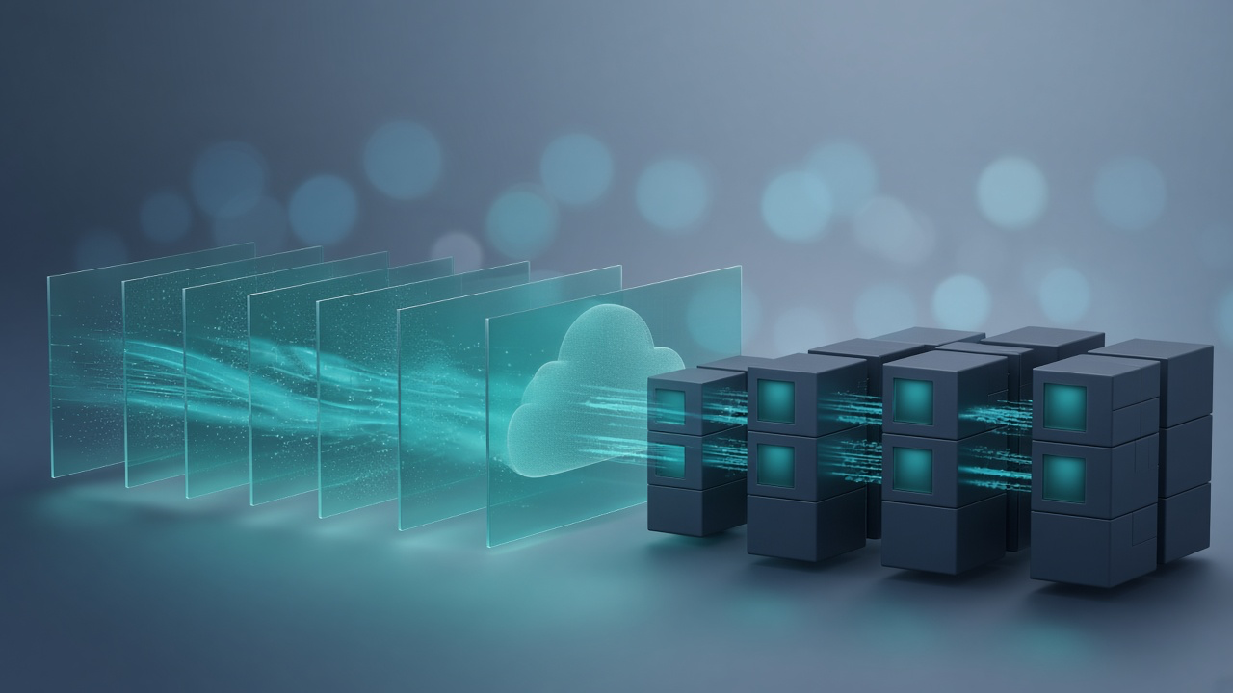
SYSTEM ARCHITECTURE
03 / 11
Angular UI → FastAPI → S3-backed models
EC2 runs code only. Durable data, indexes, and models live in S3 via boto3.
Frontend
API / Agents
Storage
Angular 19 on :4200 proxies
/api to the FastAPI service.
Deterministic investigate()
pipeline: detect → retrieve
→ answer → validate.
S3DataStore (boto3) +
ephemeral
/tmp/scamshield-s3-cache.
Generated art plate is used as visual direction; all meaningful copy and structure are editable PowerPoint objects.
Notes:
Draw the three-tier split clearly for graders.
[Sources]
- ScamShield US repository architecture & S3 evaluation artifacts

Slide 4
OFFLINE PIPELINE
04 / 11
How artifacts are built into S3
run_pipeline.sh writes knowledge, splits, models, index, metrics, and viz.
1–2 Seed & prepare
3–4 Train & index
5–6 Evaluate & viz
Knowledge JSON + UCI/Super
SMS → processed
train/val/test.
sklearn + DistilBERT models;
MiniLM FAISS + BM25 index.
Approach reports for the UI;
dashboard wordclouds/geo
overlay.
Generated art plate is used as visual direction; all meaningful copy and structure are editable PowerPoint objects.
Notes:
Mention uv sync setup before pipeline on a fresh EC2.
[Sources]
- ScamShield US repository architecture & S3 evaluation artifacts

Slide 5

ONLINE WORKFLOW
05 / 11
Investigation path for one message
Supervisor routes specialized steps without LangGraph.
Fraud detection
Retrieval
LLM + validate
Hybrid classifier returns
label + confidence.
Hybrid retriever returns
five grounded passages.
Qwen drafts an educational
answer; soft safety checks.
Generated art plate is used as visual direction; all meaningful copy and structure are editable PowerPoint objects.
Notes:
Walk through workflow.investigate step by step.
[Sources]
- ScamShield US repository architecture & S3 evaluation artifacts

Slide 6
CLASSIFIERS
06 / 11
Traditional → Advanced cascade
Hybrid keeps Traditional when confident; escalates weak cases to DistilBERT.
Traditional
Advanced
Hybrid margin
TF-IDF + linguistic features
→ LR / Linear SVM vote.
Fine-tuned DistilBERT
sequence classifier.
Validation chose margin 0.05
(~2% of test routed).
Generated art plate is used as visual direction; all meaningful copy and structure are editable PowerPoint objects.
Notes:
Contrast binary sources vs silver multi-class subtypes.
[Sources]
- ScamShield US repository architecture & S3 evaluation artifacts
- artifacts/metrics/approach_metrics.csv (held-out test split)

Slide 7
RAG DESIGN
07 / 11
Hybrid retrieval and grounded answers
MiniLM embeddings + BM25 fused; only top-5 chunks reach the LLM.
Knowledge
Index
Generation
24 URL-backed official docs
(FTC, CISA, SSA, IRS, …).
artifacts/indexes:
faiss.index + chunks.jsonl +
meta.
Qwen2.5-1.5B-Instruct,
answer-only over retrieved
context.
Generated art plate is used as visual direction; all meaningful copy and structure are editable PowerPoint objects.
Notes:
Stress top_k=5 filtering even when the KB is small.
[Sources]
- ScamShield US repository architecture & S3 evaluation artifacts

Slide 8
S3 LAYOUT
08 / 11
Durable store under the course prefix
GitHub holds code; S3 holds raw/processed/knowledge/models/indexes/metrics/viz.
data/
artifacts/
Access
raw CSVs, processed splits,
knowledge JSON, provenance.
models, indexes, metrics,
dashboard viz.
All reads/writes through
boto3 S3DataStore — no AWS
CLI.
Generated art plate is used as visual direction; all meaningful copy and structure are editable PowerPoint objects.
Notes:
Point to configs/settings.yaml s3_uri.
[Sources]
- ScamShield US repository architecture & S3 evaluation artifacts

Slide 9
TECH STACK
09 / 11
Open-source stack on EC2 + S3
uv sync installs the Python env from pyproject.toml / uv.lock.
App
ML
Ops
Angular + FastAPI + Uvicorn
+ pydantic-settings.
torch, transformers,
sentence-transformers,
faiss, sklearn, spaCy, Qwen.
uv, boto3, g5.xlarge GPU
EC2, course S3 prefix.
Generated art plate is used as visual direction; all meaningful copy and structure are editable PowerPoint objects.
Notes:
No Bedrock / Lambda / OpenSearch / SageMaker.
[Sources]
- ScamShield US repository architecture & S3 evaluation artifacts

Slide 10
EVALUATION
10 / 11
Held-out test comparison
Hybrid NLP leads on macro-F1 while keeping high accuracy.
0.640
0.983
1.9%
Hybrid macro-F1
Hybrid accuracy
Routed to DistilBERT
Best primary metric
≈ micro-F1
Margin 0.05
Test macro-F1 by approach
Traditional
0.626
Advanced
0.391
Hybrid
0.640
Generated art plate is used as visual direction; all meaningful copy and structure are editable PowerPoint objects.
Notes:
Primary metric is macro-F1 because rare subtypes matter.
[Sources]
- artifacts/metrics/approach_metrics.csv (held-out test split)

Slide 11
DEPLOY & SAFETY
11 / 11
Run on a new EC2, then educate — don’t decide
Clone → AWS creds → uv sync → API + UI. Educational use only.
Bootstrap
Serve
Safety
bash scripts/setup_venv.sh
then source
.venv/bin/activate
uvicorn backend.app.main:app
--host 0.0.0.0 --port 8000
Not legal advice; no sender
contact or account access.
Generated art plate is used as visual direction; all meaningful copy and structure are editable PowerPoint objects.
Notes:
Close with reproducibility and ethics.
[Sources]
- ScamShield US repository architecture & S3 evaluation artifacts

