Slide 1

GWU DATS 6450 · NLP FINAL PROJECT
Torque Diagnostics
System architecture for a technician RAG assistant over ABB drive manuals
From website PDF download → family folders → hybrid BM25+embedding retrieval → Qwen drafting → DeBERTa confidence gate → cited answer or domain-restricted withhold
Dhanush Mathivanan · Master’s Data Science
Madeline Bumpus · Master’s Data Science
Notes:
Open with the end-to-end promise: grounded answers from manuals only.
[Sources]
- docs/full-pipeline.md — Torque Diagnostics EC2 runbook
- github.com/DhanushGWU1995/torque-diagnostics

Slide 2

PROBLEM & DESIGN GOALS
02 / 15
A technician needs procedures the manuals actually state
Unsupported steps must be withheld. Citations must name document id and page.
Grounded answers
Hybrid retrieval
Reply only from indexed English ABB manuals; never invent a procedure.
Combine lexical BM25 with dense BGE vectors; fuse scaled scores.
Confidence gate
Operable on EC2
Copied sentence, DeBERTa, or domain-restricted withhold for off-topic / unsupported asks.
g5.xlarge GPU path; Streamlit UI; model weights reused from disk cache.
Torque Diagnostics · GWU DATS 6450 · Text RAG architecture
Notes:
Emphasize domain-restricted withhold as a safety property of the product.
[Sources]
- docs/milestone-1-data-and-questions.docx

Slide 3

END-TO-END ARCHITECTURE
03 / 15
One pipeline from ABB website PDFs to a gated technician reply
Offline index build on S3 · online question path on GPU EC2 — detail diagram on next slide
1. Ingest
2. Chunk
3. Index
4. Retrieve
5. Generate
6. Gate
Download list
→ S3 raw PDFs
by family
PyMuPDF text
→ passage
Parquet
Tokens · BM25
· BGE embeds
per family
Route folder
hybrid top 15
passages
Qwen draft
from passages
only
Copy / DeBERTa
/ domain refuse
+ cite pages
Storage: s3://dats-nlp/.../torque-diagnostics/ · Runtime: AWS g5.xlarge (A10G) + Streamlit tunnel
Models: BAAI/bge-base-en-v1.5 · Qwen/Qwen2.5-7B-Instruct · MoritzLaurer/DeBERTa-v3-base-mnli-fever-anli
Indexes: 139 equipment folders · ~28,665 text shards · ~831,185 passages
Torque Diagnostics · GWU DATS 6450 · Text RAG architecture
Notes:
This is the master map; next slide is the full detailed pipeline diagram.
[Sources]
- docs/full-pipeline.md — Torque Diagnostics EC2 runbook

Slide 4

FULL PIPELINE DIAGRAM
04 / 15
Complete end-to-end workflow — offline build and online answer path
Every major module from website download through hybrid retrieval, gated generation, and UI
lexical / sparse
Tokens
(BM25 words)
BM25
.pkl
OFFLINE
INDEX
BUILD
ABB site
URLs
Download
list CSV
Stream to
S3 raw/
Family
folders
PyMuPDF
chunk
Passage
Parquet
BGE embeds
(raw passage text)
dense / neural — not from Tokens
Coverage + 5 EDA (DuckDB) sits beside indexing. No separate TF-IDF index — BM25 is the lexical path; BGE is embedding, not tokenization.
Question
Folder
router
BM25
search
BGE
search
Score
fuse
Top 15
passages
ONLINE
QUESTION
PATH
↓ continues → Top-15 hybrid hits feed Load texts in the same rank order (generation context)
Load texts
(rank order)
Qwen2.5-7B
draft
Confidence
gate
copied /
DeBERTa /
domain refuse
Cite doc+
page
Streamlit
UI (+ top 10)
Hybrid = scaled BM25 + BGE cosine · Tokens only serve BM25 · k=15 to Qwen · UI shows top 10 · Gate cites or domain-restricted withhold
Torque Diagnostics · GWU DATS 6450 · Text RAG architecture
Notes:
Use this slide as the single diagram for the oral defense.
[Sources]
- docs/full-pipeline.md — Torque Diagnostics EC2 runbook
- github.com/DhanushGWU1995/torque-diagnostics

Slide 5

DATA INGESTION
05 / 15
Download every English PDF and arrange by equipment family
ABB_100GB_Download_List.csv → streamed upload; finished keys are skipped
Source list
S3 layout
28,666 English PDFs · ~101.8 GB
Four concurrent downloads
Failures logged for retry
_COMPLETE markers per raw folder
raw/<family>/<document-kind>/<document_id>.pdf
Named series → own folders (e.g. ACS880-11)
Catalogues / unmatched → library
139 folders total (library + 138 series)
ABB website URLs
upload_library_pdfs.py
s3://…/torque-diagnostics/raw/<family>/…
Torque Diagnostics · GWU DATS 6450 · Text RAG architecture
Notes:
Stress that PDFs are not kept locally; S3 is the lake.
[Sources]
- docs/full-pipeline.md — Torque Diagnostics EC2 runbook

Slide 6

PASSAGE CHUNKING
06 / 15
One Parquet shard per PDF — passages stay on the page
PyMuPDF text layer · pages over 3,500 characters are split · page number preserved
Input
raw/<family>/…/*.pdf
Output
chunks/asset_family=<family>/<document_id>.parquet
Unit
Passage text on a single page (split if long)
Scale done
28,665 shards · 831,185 passages
Resume
Intact Parquet footer → skip; remaining listed in chunk_remaining.txt
Torque Diagnostics · GWU DATS 6450 · Text RAG architecture
Notes:
Text-only index in this submission; tables/images deferred.
[Sources]
- docs/full-pipeline.md — Torque Diagnostics EC2 runbook

Slide 7
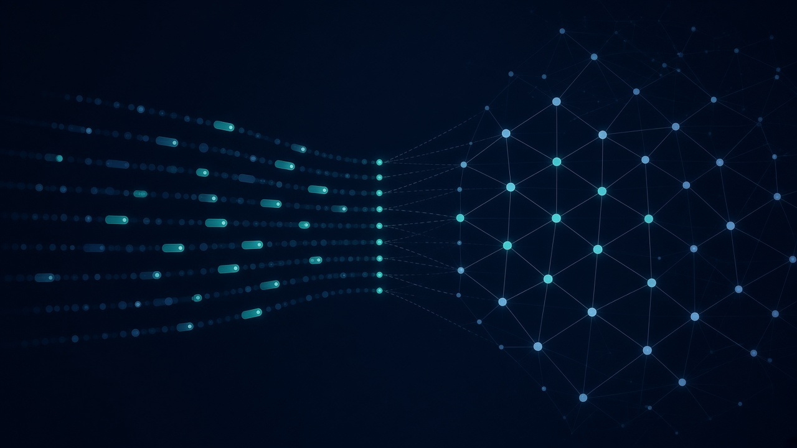
COVERAGE & EDA
07 / 15
Understand the corpus before indexing
DuckDB coverage counts · five EDA questions answered from passage Parquet
Coverage (DuckDB)
Q1 PDF spread by folders / kinds
Shards, passages, blanks
Tracing pages
Fault / part / procedure flags
Writes coverage.txt
Does not answer technician questions
Q2 Passage length & pages by family
Q3 Fault/part/procedure vs datasheet
Q4 Tracing share ACS880 / ACS860 / library
Q5 Document ids across families
Torque Diagnostics · GWU DATS 6450 · Text RAG architecture
Notes:
EDA charts live under the proposal Word doc.
[Sources]
- docs/milestone-1-data-and-questions.docx

Slide 8

LEXICAL INDEX
08 / 15
Tokenize each family, then build BM25
Exact equipment terms and fault codes rank strongly in BM25
Passage Parquet
(per family)
build_tokens.py
→ tokens/*.parquet
build_bm25.py
→ bm25/*.pkl
Tokenization
BM25
INDEX_FAMILY=all
One token file per equipment folder
library uses more workers
Finished files are skipped
rank_bm25 over folder tokens
Strong on part numbers & fault labels
Searched together with dense vectors
at question time
Torque Diagnostics · GWU DATS 6450 · Text RAG architecture
Notes:
BM25 alone misses paraphrase; embeddings alone miss rare codes — hence hybrid.
[Sources]
- docs/full-pipeline.md — Torque Diagnostics EC2 runbook

Slide 9

DENSE INDEX
09 / 15
BAAI/bge-base-en-v1.5 embeds every passage on GPU
One 768-d vector per passage · cosine search · weights cached under models/huggingface
Model
Artifacts
Why dense?
BAAI/bge-base-en-v1.5
Sentence-transformer
Normalized embeddings
Query prefix for questions
CUDA required on EC2
index/embeddings/
asset_family=<family>.parquet
Built after tokens/BM25
library is the long GPU job
skip if already stored
Paraphrase & wording shift
Complements BM25 codes
Same passages as lexical index
Fused at query time
Loaded once per process
Torque Diagnostics · GWU DATS 6450 · Text RAG architecture
Notes:
First embedding run downloads BGE once into the project cache.
[Sources]
- docs/full-pipeline.md — Torque Diagnostics EC2 runbook

Slide 10

HYBRID RETRIEVAL
10 / 15
Top 15 passages for generation · top 10 shown in the chat UI
Scale BM25 and cosine to a shared range, add scores, keep the highest fused hits
Technician question
Folder router
(manual_tokens rules)
Search that family (else library)
BM25 branch
Embedding branch
Lexical ranking over tokens
Keeps many candidates
Scores scaled to [0, 1] band
Encode question with BGE
Cosine vs passage matrix
Scores scaled, then added to BM25
Fuse → rank → keep k=15 for Qwen context · UI displays the top 10 of those hits with scores
Torque Diagnostics · GWU DATS 6450 · Text RAG architecture
Notes:
Clarify: generation uses 15; the Streamlit panel shows 10 for readability.
[Sources]
- docs/full-pipeline.md — Torque Diagnostics EC2 runbook

Slide 11

GENERATION
11 / 15
Qwen2.5-7B-Instruct drafts only from retrieved passages
Greedy decoding · no document ids in the draft · citations attached by the gate
1
Load top-15 passage texts in hybrid-rank order
2
Prompt: technician assistant; copy tools/steps as stated
3
Off-topic or unsupported → short domain-refusal draft
4
Qwen returns draft without naming document/page
5
Gate cites kept claims or releases domain withhold
Torque Diagnostics · GWU DATS 6450 · Text RAG architecture
Notes:
Writer is free to paraphrase; gate decides what is released.
[Sources]
- docs/full-pipeline.md — Torque Diagnostics EC2 runbook

Slide 12

CONFIDENCE GATE
12 / 15
Three outcomes: copied-sentence · deberta · withheld (domain refuse)
DeBERTa-v3 MNLI checks partial paraphrases; off-topic asks get a domain-restricted refusal
High confidence
Weak confidence
Domain / no support
≥4 novel words and one page sentence covers ≥60%
→ quote that sentence
OR exact / ≥50% word overlap line
Label: copied-sentence
Best manual line overlap 34–50%
→ load DeBERTa once
Entailment → keep & cite
Else drop claim
Label: deberta
Off-topic question, or all claims dropped
→ domain-restricted withhold
Scope: indexed ABB drive / motor manuals
Label: withheld
Streamlit only displays the gate text
Kept claims always get document_id + page_number. Withheld replies say knowledge is restricted to indexed ABB manuals.
Torque Diagnostics · GWU DATS 6450 · Text RAG architecture
Notes:
Demo unrelated-stock for domain refuse; flange-tools and ov-controller for the other labels.
[Sources]
- docs/full-pipeline.md — Torque Diagnostics EC2 runbook

Slide 13

EVALUATION
13 / 15
Score the pages the answer cites — not the whole retrieval list
reply/questions.jsonl · ANSWER=1 · precision / recall / F1 / MRR + confidence label
Sample id | Gold pages | What it exercises
flange-tools | 3AXD50000349838 p.17 | copied-sentence path
acs860-reset | p.68 + p.27 | multi-doc autoreset
acs860-ov-controller-protect | 3AXD50000034052 p.62 | DeBERTa / weak confidence
unrelated-stock | withhold | off-topic → domain refuse
Citation accuracy in the UI = precision (share of cited pages that match gold). MRR uses the rank of the first correct citation.
evaluate_answers.py writes evaluation_report.txt · Streamlit can score all samples and show a confidence matrix
Torque Diagnostics · GWU DATS 6450 · Text RAG architecture
Notes:
Mention that metrics grade citations, not free-form fluency.
[Sources]
- docs/full-pipeline.md — Torque Diagnostics EC2 runbook

Slide 14

UI & DEPLOYMENT
14 / 15
Streamlit on the GPU EC2 — not public Spaces or GitHub Pages
Models and private ABB indexes stay on the instance; laptop uses an SSH tunnel
Chat UI shows
Run commands
Model cache
Sample questions
Live stage progress
Answer + citations
Confidence / DeBERTa / domain withhold
Top 10 passages
Citation metrics
Batch confidence matrix
streamlit run ui/chat_app.py
--server.address 127.0.0.1
--server.port 8501
Stop: pkill -f streamlit…
Tunnel: ssh -L 8501:127.0.0.1:8501
Disk: models/huggingface
(no re-download)
GPU: cached while server up
Stop Streamlit → free VRAM
Restart → load from disk once
Torque Diagnostics · GWU DATS 6450 · Text RAG architecture
Notes:
Demo the tunnel URL if presenting live.
[Sources]
- github.com/DhanushGWU1995/torque-diagnostics

Slide 15
SCALE & CONTRIBUTIONS
15 / 15
A complete text-RAG stack for industrial manuals
Big-data NLP submission: lake → indexes → hybrid transformers → gated generation
Delivered
28,666
28,665
Full S3 text lake & indexes
Hybrid BM25 + BGE retrieval
Qwen + DeBERTa gate with domain-restricted withhold
Hand-checked evaluation set
Streamlit technician UI
Architecture documentation
Out of scope this run:
table / image corpus indexing
English PDFs
Passage shards
831,185
139
Passages
Equipment folders
Torque Diagnostics · GWU DATS 6450 · Text RAG architecture
Notes:
Close on groundedness + operable EC2 deployment.
[Sources]
- docs/full-pipeline.md — Torque Diagnostics EC2 runbook
- github.com/DhanushGWU1995/torque-diagnostics

