Slide 1
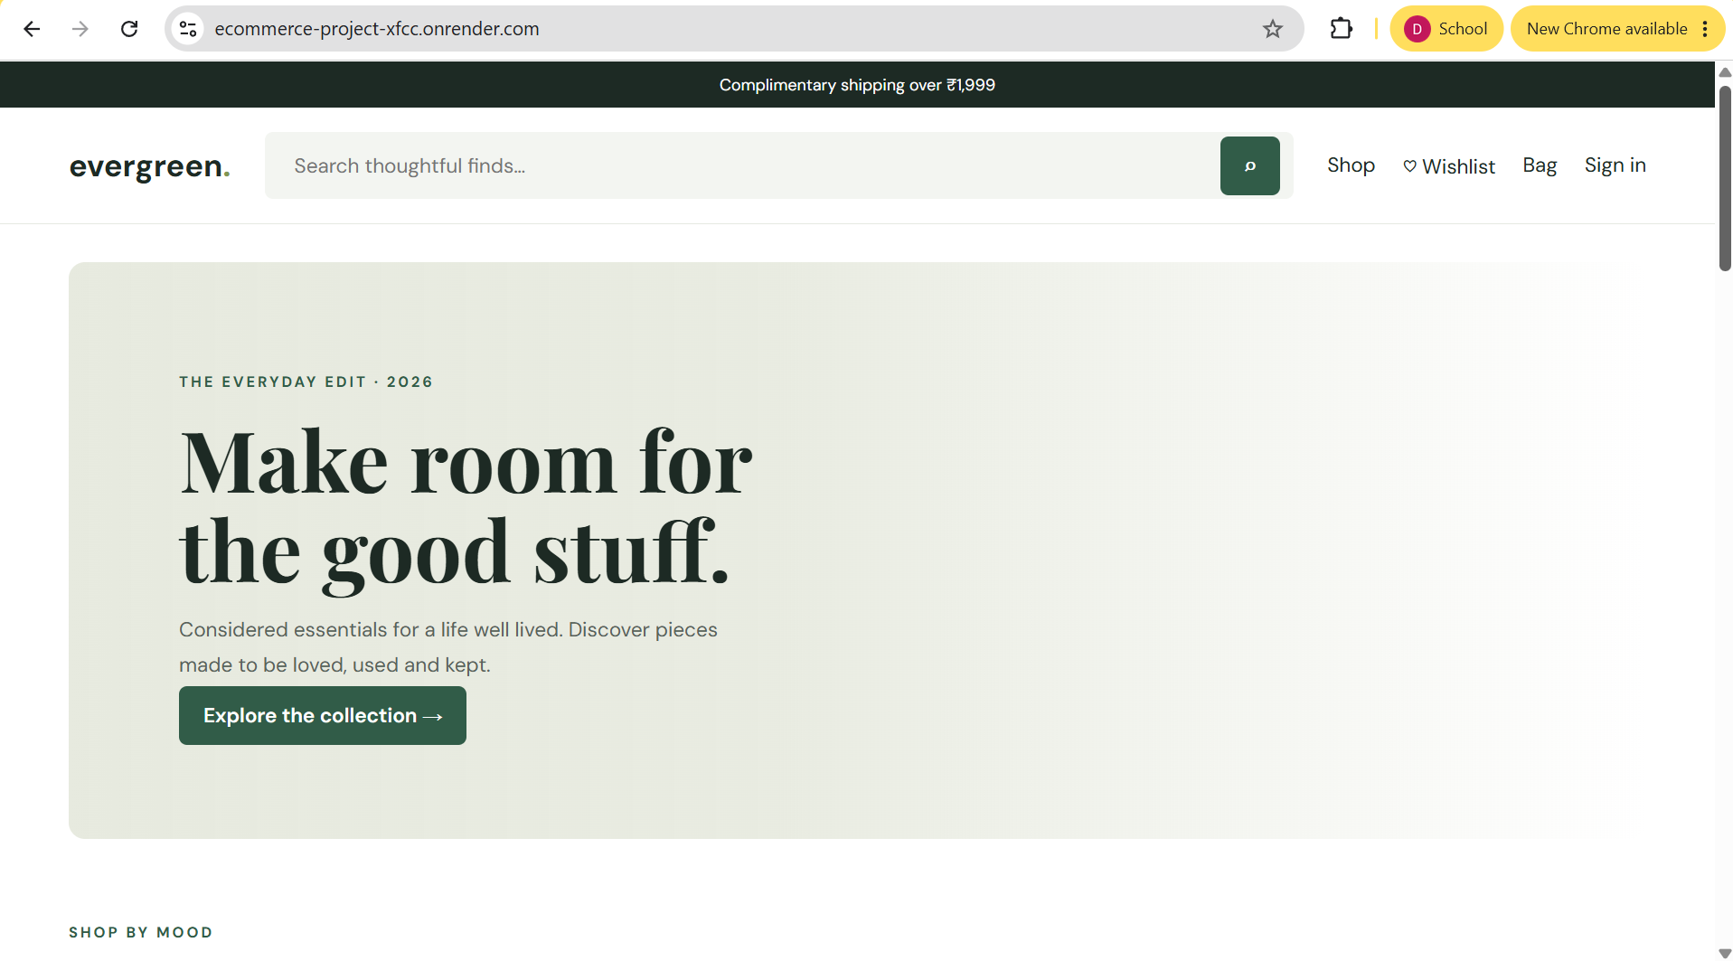
DEPARTMENT OF COMPUTER SCIENCE AND ENGINEERING
ECOMMERCE
MANAGEMENT SYSTEM
WEB PROGRAMMING COURSE PROJECT
Full-stack web application
DHANUSH KARTHIK K
HTML • CSS • JavaScript • Node.js • Express.js • JSON
240701112
III YEAR – COMPUTER SCIENCE & ENGINEERING
ECOMMERCE MANAGEMENT SYSTEM • WEB PROGRAMMING COURSE PROJECT
01

Slide 2
01 PROJECT OVERVIEW
Aim
To develop a responsive web-based Ecommerce Management System that provides a complete online shopping workflow — from browsing products and managing a wishlist/cart to checkout, simulated payment and order management.
The application combines a user-friendly frontend with a Node.js + Express backend and JSON-based data storage.
ECOMMERCE MANAGEMENT SYSTEM • WEB PROGRAMMING COURSE PROJECT
02

Slide 3
02 PROJECT OVERVIEW
Objectives
01
02
03
Online shopping
User accounts
Product discovery
Provide a simple interface to discover and purchase products.
Support registration, login and password recovery.
Search, category filtering, sorting and product details.
04
05
06
Shopping tools
Order workflow
Administration
Wishlist, cart, coupons and checkout.
Create orders and track their delivery status.
Provide an admin workspace for managing ecommerce data.
ECOMMERCE MANAGEMENT SYSTEM • WEB PROGRAMMING COURSE PROJECT
03

Slide 4
03 PROJECT SUMMARY
Abstract
Ecommerce Management System
Core flow
A web application designed to demonstrate the core concepts of web programming through a practical ecommerce workflow.
The frontend is implemented using HTML5, CSS3 and vanilla JavaScript. Node.js with Express.js provides the server-side API layer, while separate JSON files are used for application data.
The system supports authentication, product browsing, wishlist and cart management, checkout, simulated payment methods, coupons, order tracking and administrative operations.
1
Browse
Search and filter products
2
Select
Wishlist or add to cart
3
Checkout
Enter delivery & payment details
4
Order
Place and track the order
ECOMMERCE MANAGEMENT SYSTEM • WEB PROGRAMMING COURSE PROJECT
04

Slide 5
04 FUNCTIONAL SCOPE
Project Objectives
User Interface
Authentication
Build responsive pages, navigation, forms, product cards and clear call-to-actions.
Implement registration, login and direct password reset using the project’s simplified authentication flow.
Catalog
Shopping
Display products with search, category filters, sorting, ratings, discounts and details.
Manage wishlist, cart, coupons, delivery information and checkout.
Orders
Admin
Create orders and expose status progression from placement through delivery.
Provide management functions for products, categories, users, orders and dashboard insights.
ECOMMERCE MANAGEMENT SYSTEM • WEB PROGRAMMING COURSE PROJECT
05

Slide 6
05 PROBLEM STATEMENT
Problem Statement
• Online shopping workflows involve multiple disconnected interactions: discovery, selection, checkout and order management.
• Users need a single interface for search, filtering, wishlist, cart and order history.
• Authentication and user-specific data need a consistent application flow.
• The project should demonstrate client-side interaction with server-side APIs using web programming concepts.
• A lightweight data layer is required for a college project without depending on a full database server.
Proposed solution
A single responsive ecommerce platform connecting the complete customer journey with a Node.js / Express API and JSON data layer.
Focus: usability • modularity • REST APIs • practical web programming
ECOMMERCE MANAGEMENT SYSTEM • WEB PROGRAMMING COURSE PROJECT
06

Slide 7
06 FRONTEND IMPLEMENTATION
HTML & CSS Implementation
Semantic pages, responsive layouts, forms, product cards and reusable visual patterns
• HTML5 pages for home, authentication, products, wishlist, cart, checkout and account flows.
• CSS3 styling for typography, spacing, responsive layouts, buttons, cards and navigation.
• Consistent visual language using neutral surfaces and dark-green accent elements.
• Product grids adapt to different screen sizes while preserving clear content hierarchy.
• Forms and call-to-action buttons are designed for straightforward user interaction.
ECOMMERCE MANAGEMENT SYSTEM • WEB PROGRAMMING COURSE PROJECT
07

Slide 8
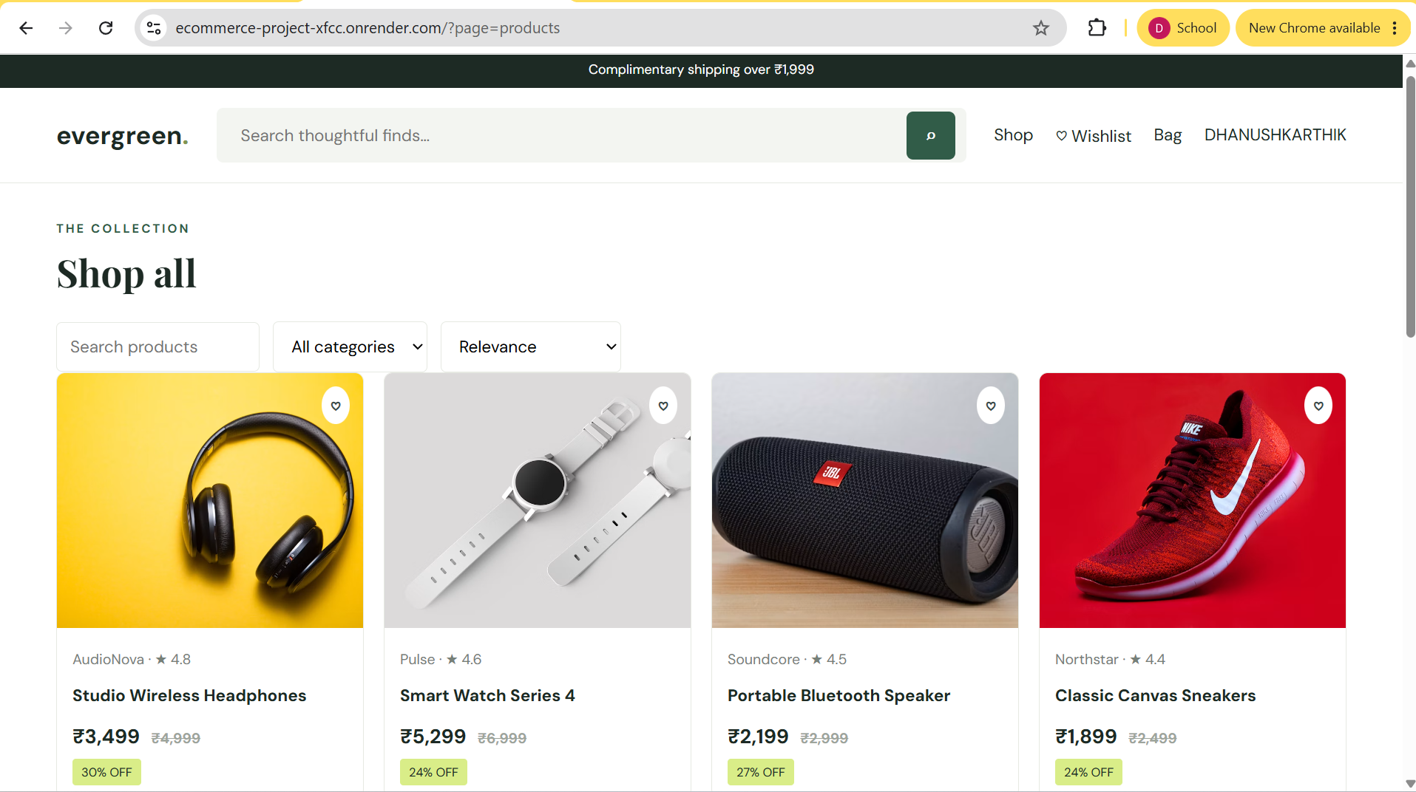
07 JAVASCRIPT & API
JavaScript – DOM, Events & API
Vanilla JavaScript connects user actions to REST endpoints and dynamic page updates
Key implementation areas
• DOM manipulation for rendering product and account data.
• Event listeners for forms, search, filters, wishlist and cart actions.
• Fetch API for asynchronous communication with the Express backend.
• localStorage used for the project’s client-side authentication/session flow.
• Dynamic feedback for success, validation and error states.
ECOMMERCE MANAGEMENT SYSTEM • WEB PROGRAMMING COURSE PROJECT
08

Slide 9
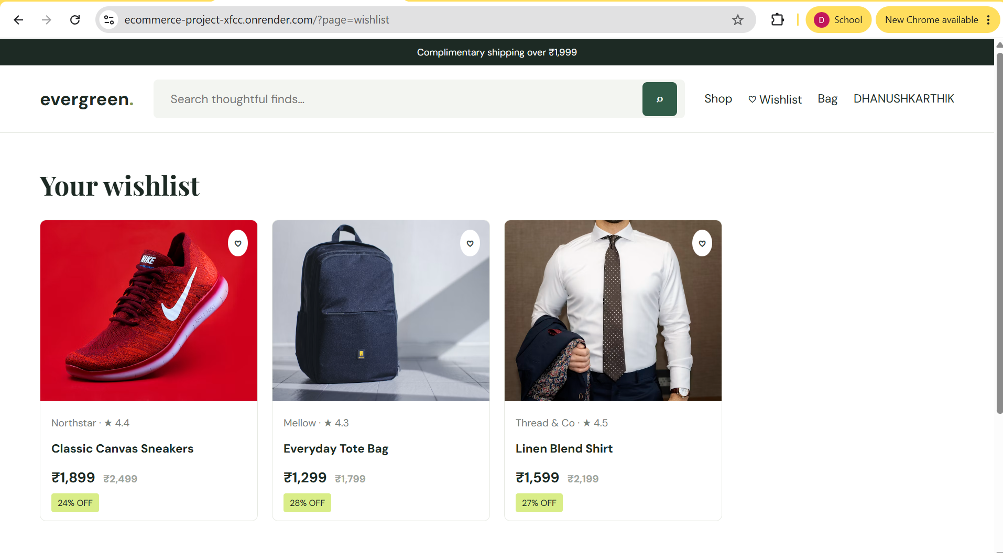
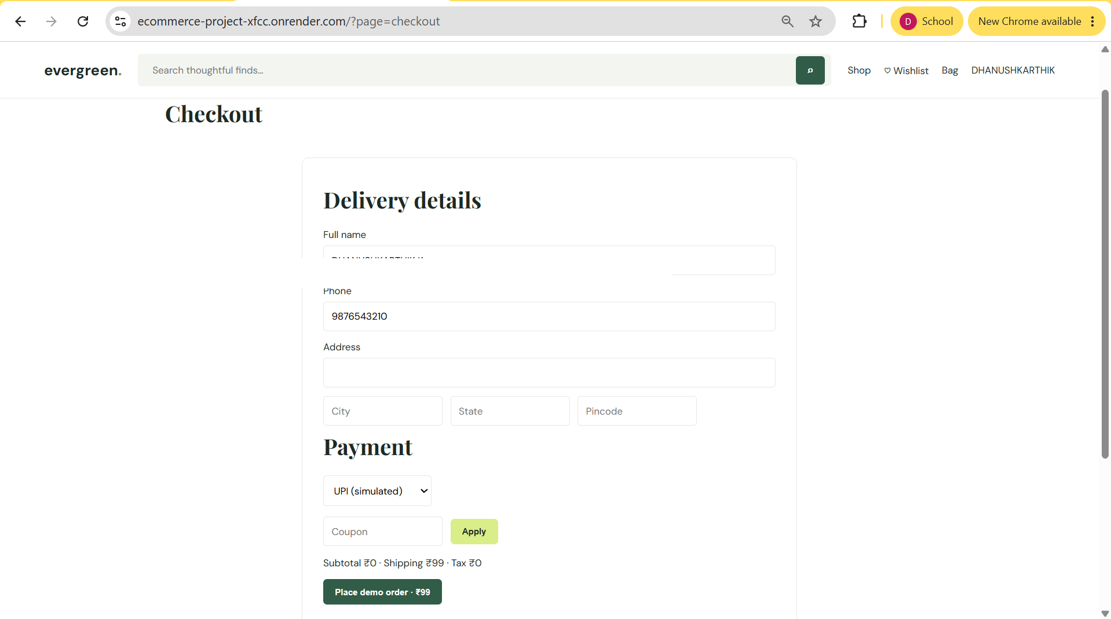
08 USER MODULES & INTERFACES
User Modules & Interfaces
Product Discovery
Wishlist
Checkout
Search, categories, sorting, ratings, discounts and wishlist controls.
Save products for later and review their prices
Delivery details, coupon application, simulated payment and demo order placement.
ECOMMERCE MANAGEMENT SYSTEM • WEB PROGRAMMING COURSE PROJECT
09

Slide 10
09 METHODOLOGY
Methodology
01
Presentation
02
Interaction
03
API Requests
HTML5 + CSS3
Responsive UI
Vanilla JS
DOM + Events
Fetch API
JSON payloads
04
Server Logic
05
Data Layer
06
Access Control
Node.js + Express.js
REST endpoints
Separate JSON files
CRUD-style operations
bcryptjs + localStorage
Project authentication flow
ECOMMERCE MANAGEMENT SYSTEM • WEB PROGRAMMING COURSE PROJECT
10

Slide 11
10 SYSTEM ARCHITECTURE
System Architecture
FRONTEND
HTML5 • CSS3 • Vanilla JavaScript
Home / Auth / Products / Wishlist / Cart / Checkout / Orders
API LAYER
Node.js • Express.js • REST APIs
Routes • Controllers • Validation • Error handling
DATA LAYER
JSON Database Files
users • products • categories • carts • wishlists • orders • reviews • coupons
SECURITY & STATE
bcryptjs • localStorage
Hashed passwords • simplified client session flow
ECOMMERCE MANAGEMENT SYSTEM • WEB PROGRAMMING COURSE PROJECT
11

Slide 12
11 TECHNOLOGY STACK
Technologies Used
HTML5
Semantic page structure and forms
CSS3
Responsive layout and visual styling
Vanilla JavaScript
DOM events, UI logic and Fetch API
Node.js
Server-side JavaScript runtime
Express.js
REST API and routing layer
JSON Database
Separate JSON files for project data
bcryptjs
Password hashing
Git & GitHub
Version control and source management
Payment is simulated for demonstration; no real payment gateway is integrated.
ECOMMERCE MANAGEMENT SYSTEM • WEB PROGRAMMING COURSE PROJECT
12

Slide 13
THANK YOU
ECOMMERCE MANAGEMENT SYSTEM
WEB PROGRAMMING COURSE PROJECT
DHANUSH KARTHIK K • 240701112
III YEAR – COMPUTER SCIENCE & ENGINEERING
ECOMMERCE MANAGEMENT SYSTEM • WEB PROGRAMMING COURSE PROJECT
13

