Slide 1
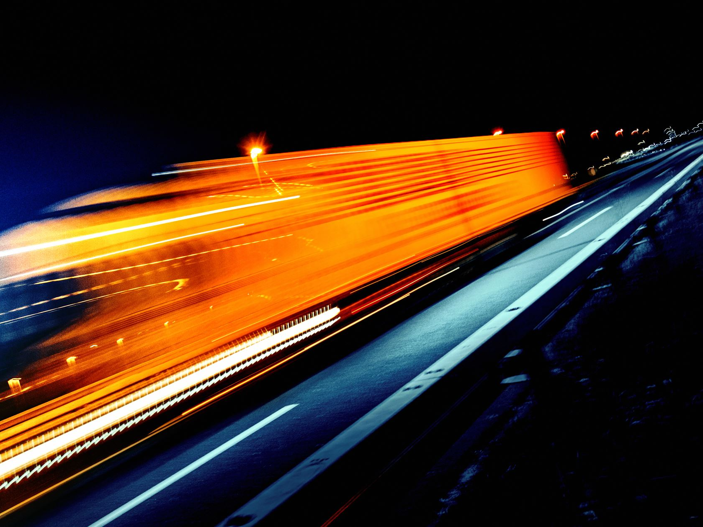
Line & Sign Detection Challenge for Autonomous Driving Group #2

Slide 2
LANE DETECTION
Boundaries are detected for non curved roads
Should be applicable in all weather conditions irrespective of shadow

Slide 3
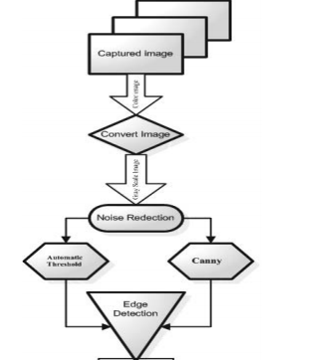
Overview of Algorithm

Slide 4
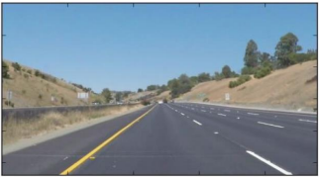
Image Capturing
Camera placed in front of vehicle
Capture color image

Slide 5
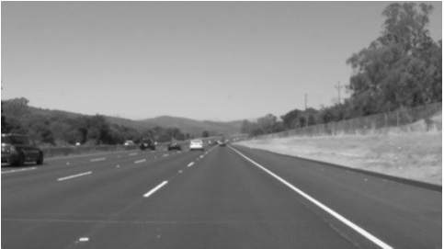
Conversion to gray scale
Captured image is converted to gray scale
Reduce the processing time

Slide 6
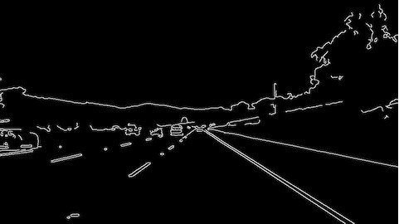
Noise Reduction
Boundary will be more distinguishable
Algorithm to reduce noise
Irrelevant images should be removed

Slide 7
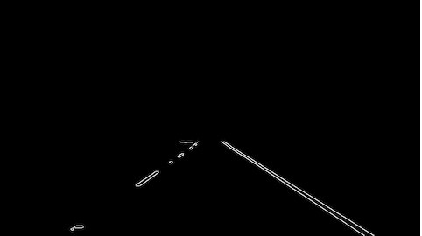
Determination of edges
Canny filter can determine the boundaries
Edged image is sent to line detector to produce left and right boundary

Slide 8
CANNY FILTER
Multi- stage Edge Detector
It is Based on the gradient magnitude of a smoothed image: local maxima of the gradient magnitude that are high are identified as edges.
Able to detect maximum number of edges.
Gives good results for detection of horizontal and vertical edges and also detect the circular edges and edges at the corner.
Better Performance and Less time.

Slide 9
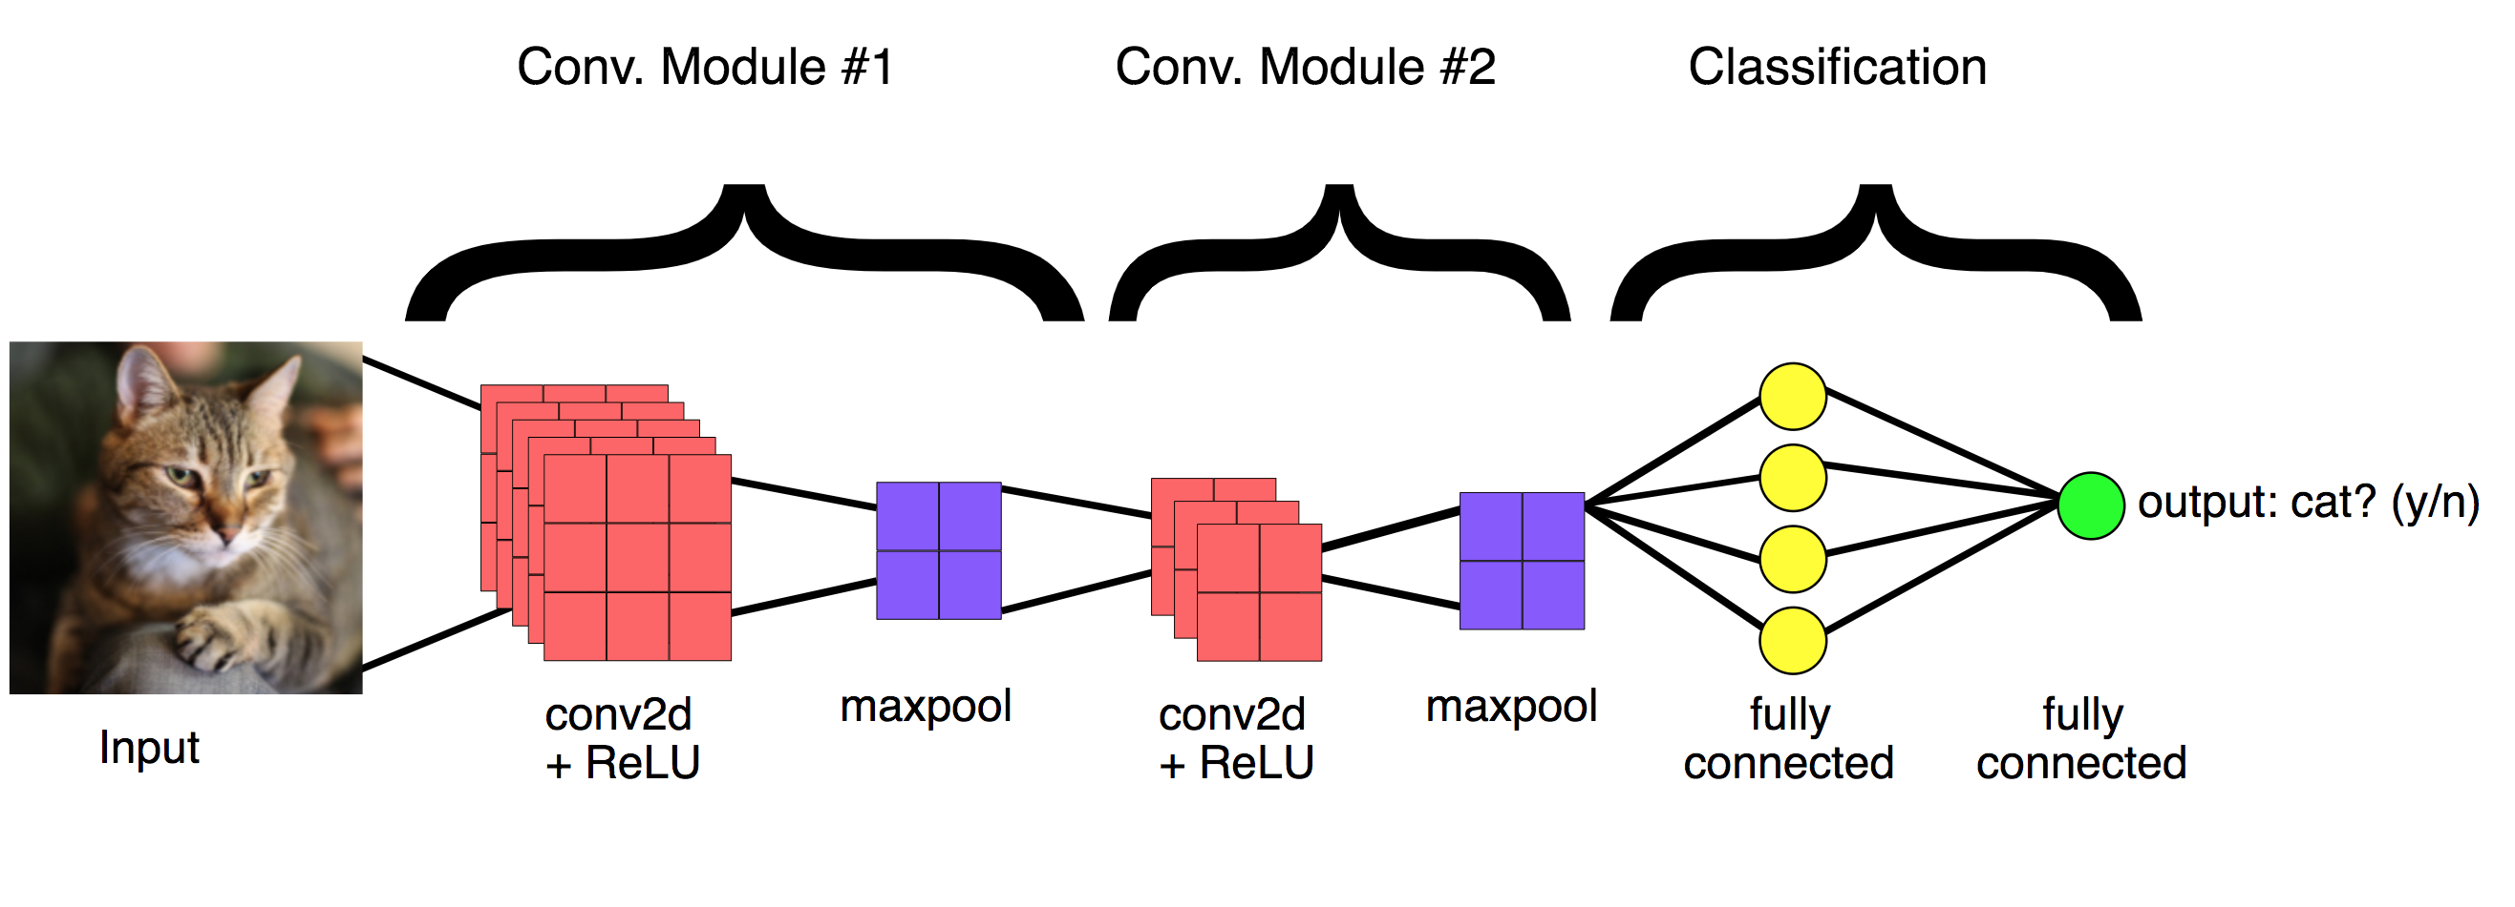
SIGN DETECTION using cnn

Slide 10
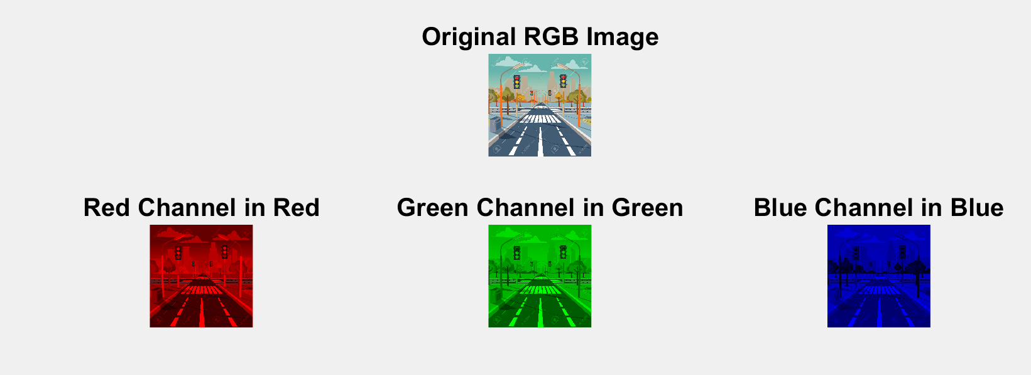
RGB CHANNELS

Slide 11
Convolution layer

Slide 12
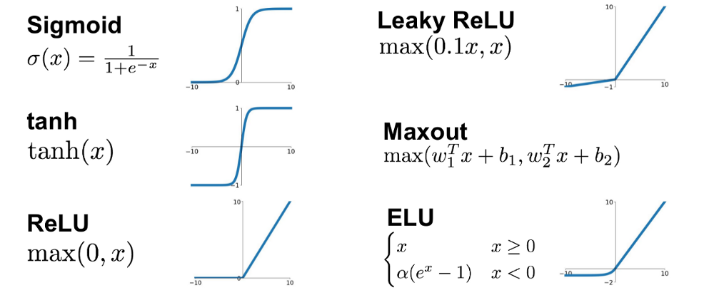
ACTIVATION LAYER

Slide 13
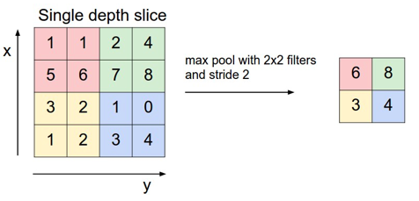
MAX POOLING

Slide 14
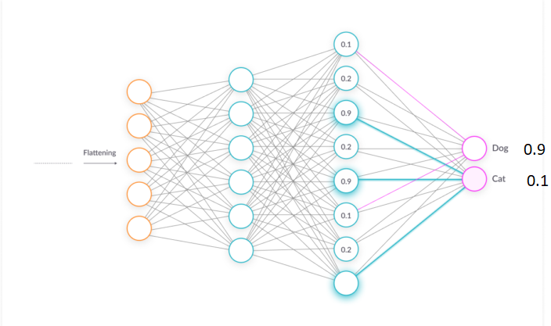
FULLY CONNECTED LAYER

Slide 15
THANK YOU

