Slide 1
PROJECT A60 · MODULE 55-708252
AI4Mobility
A multimodal assistive platform for parents supporting children with mobility difficulties. This deck covers the data: how it was constructed, cleaned, described and split.
PRESENTED BY
Sheffield Hallam University — MSc
AI Research and Development Project
Team Deepminds · Supervisor: Alejandro
Krushna Sai Teja Adhala
Data engineering and pipeline lead
A60 AI4Mobility · Krushna Sai Teja Adhala · Team Deepminds
1
Notes:
Introduce yourself and the project title, then set the boundary of this deck straight away: it is about the data layer, not the models or the interface. Say the headline honestly in the first minute — the dataset is synthetic and seeded, so everything downstream describes the generator rather than real children. Promise that the pipeline is written so a real recording can be dropped in without changing anything else.

Slide 2
AGENDA
What this deck covers
Four sections, ending with the numbers the pipeline makes possible.
1
The dataset
What it is, why it is synthetic, and what that does and does not license us to claim.
2
Cleaning
Four rules, 153 frames removed, and the deliberate decision to impute nothing.
3
Features
A four-stage pipeline and 45 features in three families.
4
Split, scaling and results
Subject-level split, a scaler fitted on training data only, and the model comparison.
5
Limitations and next steps
What the data layer cannot support, and what would fix it.
A60 AI4Mobility · Krushna Sai Teja Adhala · Team Deepminds
2
Notes:
Walk through the four sections in ten seconds each so the audience knows where the honesty statement sits. Point out that limitations are a named section rather than an afterthought at the end. Mention that every number in this deck comes from a seeded run that can be reproduced exactly.

Slide 3
THE TEAM
Team Deepminds — four roles, one platform
Four members, four defined responsibilities. This deck presents the data engineering work.
Krushna Sai Teja Adhala
THIS DECK
Ailuri Rupa Sri
Data engineering and pipeline lead
Model development and evaluation lead
Peer contribution split: 28%
Peer contribution split: 26%
Nandi Reddy Shashidhar Reddy
Dhanush Sanjay
Pose estimation and visualisation lead
Research and documentation lead
Peer contribution split: 24%
Peer contribution split: 22%
A60 AI4Mobility · Krushna Sai Teja Adhala · Team Deepminds
3
Notes:
Name each member and their responsibility briefly, then say which parts of the work you owned. The peer contribution split shown here is the one agreed for the individual reports. Make clear that the four workstreams share one dataset definition, which is why the split and cleaning rules had to be settled early.

Slide 4
01
The dataset
1,358 raw frames from a seeded generator, six exercise classes, and an honest account of what that means.
A60 AI4Mobility · Krushna Sai Teja Adhala · Team Deepminds
4
Notes:
Signal a change of gear: this section is the part of the project most likely to be challenged in a viva, so it is placed first. Tell the audience you would rather explain the synthetic data yourself than have it discovered. Preview the three numbers that follow: raw frames, removed frames, usable frames.

Slide 5
HONEST STATEMENT
The dataset is synthetic
It is not recorded video of children and it is not a public dataset. Every number describes the generator.
What this licenses us to claim
What it does not license
The pipeline runs end to end and is reproducible under random_state=42.
The models separate six classes that were constructed to differ as the real exercises differ.
The evaluation protocol is sound and would transfer unchanged to real data.
The confusion structure behaves as designed, which is evidence the pipeline measures what we intended.
No claim about accuracy on real children performing real physiotherapy.
No clinical claim of any kind.
No claim that the platform improves adherence or technique.
No comparison against published results on recorded datasets.
A60 AI4Mobility · Krushna Sai Teja Adhala · Team Deepminds
5
Notes:
Say this line without hedging: the dataset is synthetic and seeded, so accuracy figures are properties of the generator. Then give the audience the useful half — the pipeline, the split discipline and the evaluation protocol are real work that transfers to real data unchanged. Close by saying that swapping in a recorded dataset means replacing one function, build_raw_frames, and nothing else.

Slide 6
JUSTIFICATION
Why synthetic, and what is honest about it
1
Recording children needs approval we do not have
Ethical approval, parental consent and safeguarding arrangements were out of reach for a taught project of this length.
2
No public dataset covers these six classes
No paediatric physiotherapy pose dataset with our exercise classes was available to download.
3
The generator is seeded
random_state=42, so every figure and every metric in the report reproduces exactly.
4
Class configurations come from the NHS descriptions
Joint positions are derived from the published exercise text, so the classes differ in the ways the real exercises differ.
5
Degradations are injected on purpose
Occlusion dropout, per-subject body proportions and measurement jitter, because a clean generator gives implausible accuracy.
A60 AI4Mobility · Krushna Sai Teja Adhala · Team Deepminds
6
Notes:
Give the two reasons for the decision first, so it reads as a considered choice rather than a shortcut. Then explain the three things that keep it honest: seeding, NHS-derived class geometry, and deliberate degradation. Note that annotation label noise of six per cent was added within confusable families for the same reason.

Slide 7
AT A GLANCE
The dataset in four numbers
1,358
153
1,205
45
Raw frames
Removed in cleaning
Usable frames
Features
Before any cleaning
11.3% of the raw set
Carried into feature building
Across three families plus quality
Six classes: calf_control, cat_cow, childs_pose, core_hip_stability, lower_limb, thread_the_needle.
Requested frames per class range from 300 (lower_limb) down to 150 (calf_control).
Annotation label noise of 6% was injected within confusable families.
A60 AI4Mobility · Krushna Sai Teja Adhala · Team Deepminds
7
Notes:
Read the four numbers slowly; they are the spine of the whole data section. Point out that 11.3 per cent removal is high enough to be worth explaining and that the next slides do exactly that. Mention that the class counts are deliberately uneven because real recording practice is uneven.

Slide 8
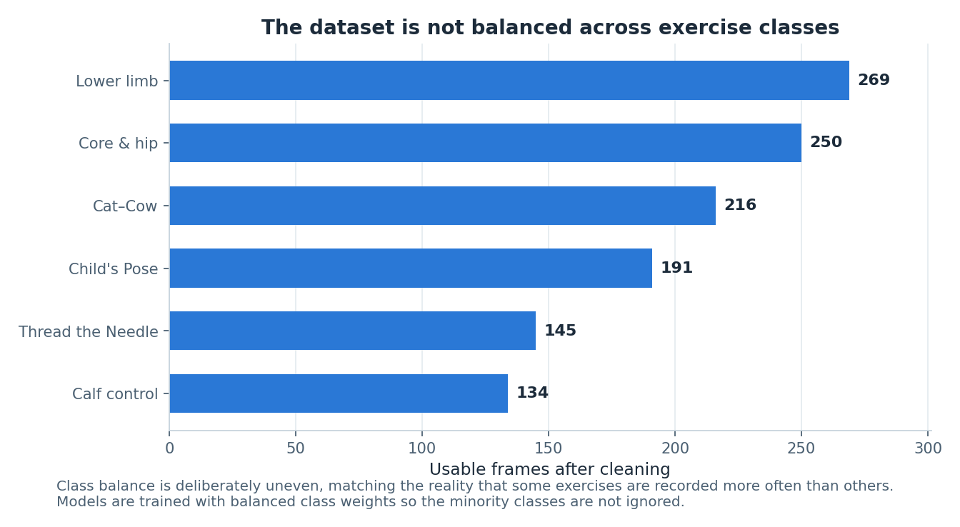
FIGURE 2
Six classes, deliberately unbalanced
Why not balance them
Requested counts: lower_limb 300, core_hip_stability 275, cat_cow 240, childs_pose 210, thread_the_needle 165, calf_control 150.
Some exercises really are recorded more often than others, so an even set would be the unrealistic choice.
Imbalance is handled in the model rather than in the data, using class_weight="balanced".
Macro F1 is reported alongside accuracy so small classes cannot be hidden by large ones.
Figure 2 — usable frames per class after cleaning.
A60 AI4Mobility · Krushna Sai Teja Adhala · Team Deepminds
8
Notes:
Explain that the imbalance is a design decision, not an accident of generation. Say where it is compensated: balanced class weights in the Random Forest and macro F1 in the reporting, both of which stop the largest class carrying the score. Note that calf_control ends up with the smallest test support, 14 frames, which is worth remembering when reading its per-class scores.

Slide 9
02
Cleaning, and what we refused to do
Four rules, 153 frames removed, and no imputation anywhere in the pipeline.
A60 AI4Mobility · Krushna Sai Teja Adhala · Team Deepminds
9
Notes:
Introduce cleaning as the place where quiet mistakes are usually made. Say that the interesting decision in this section is a negative one — nothing is filled in. Promise the reasoning, not just the counts.

Slide 10
CLEANING
Four rules, applied in order
Each rule is auditable and each removal is counted and reported.
Rule | What it removes | Frames removed
Exact duplicates | Identical rows, as when a recording is processed twice | 18
Missing a critical joint | Any frame missing hip, neck, either shoulder or either knee | 130
Detector confidence below 0.55 | Frames the landmark detector was not confident about | 5
Coordinates outside the frame | Landmarks outside the permitted bounds | 0
Total | 11.3% of 1,358 raw frames | 153
Order matters: duplicates are removed first, so a duplicated bad frame is not counted twice.
WHY THE ZERO IS REPORTED
The out-of-frame rule removed nothing. It is still listed, because a check that finds no problems is evidence the data is well-formed, not a reason to hide the check.
A60 AI4Mobility · Krushna Sai Teja Adhala · Team Deepminds
10
Notes:
Take the rules in order and explain that ordering changes the counts, so it is fixed and documented. The dominant cause is a missing critical joint at 130 frames, which is occlusion rather than a coding fault. Point at the zero row and say a passing check is still worth publishing.

Slide 11
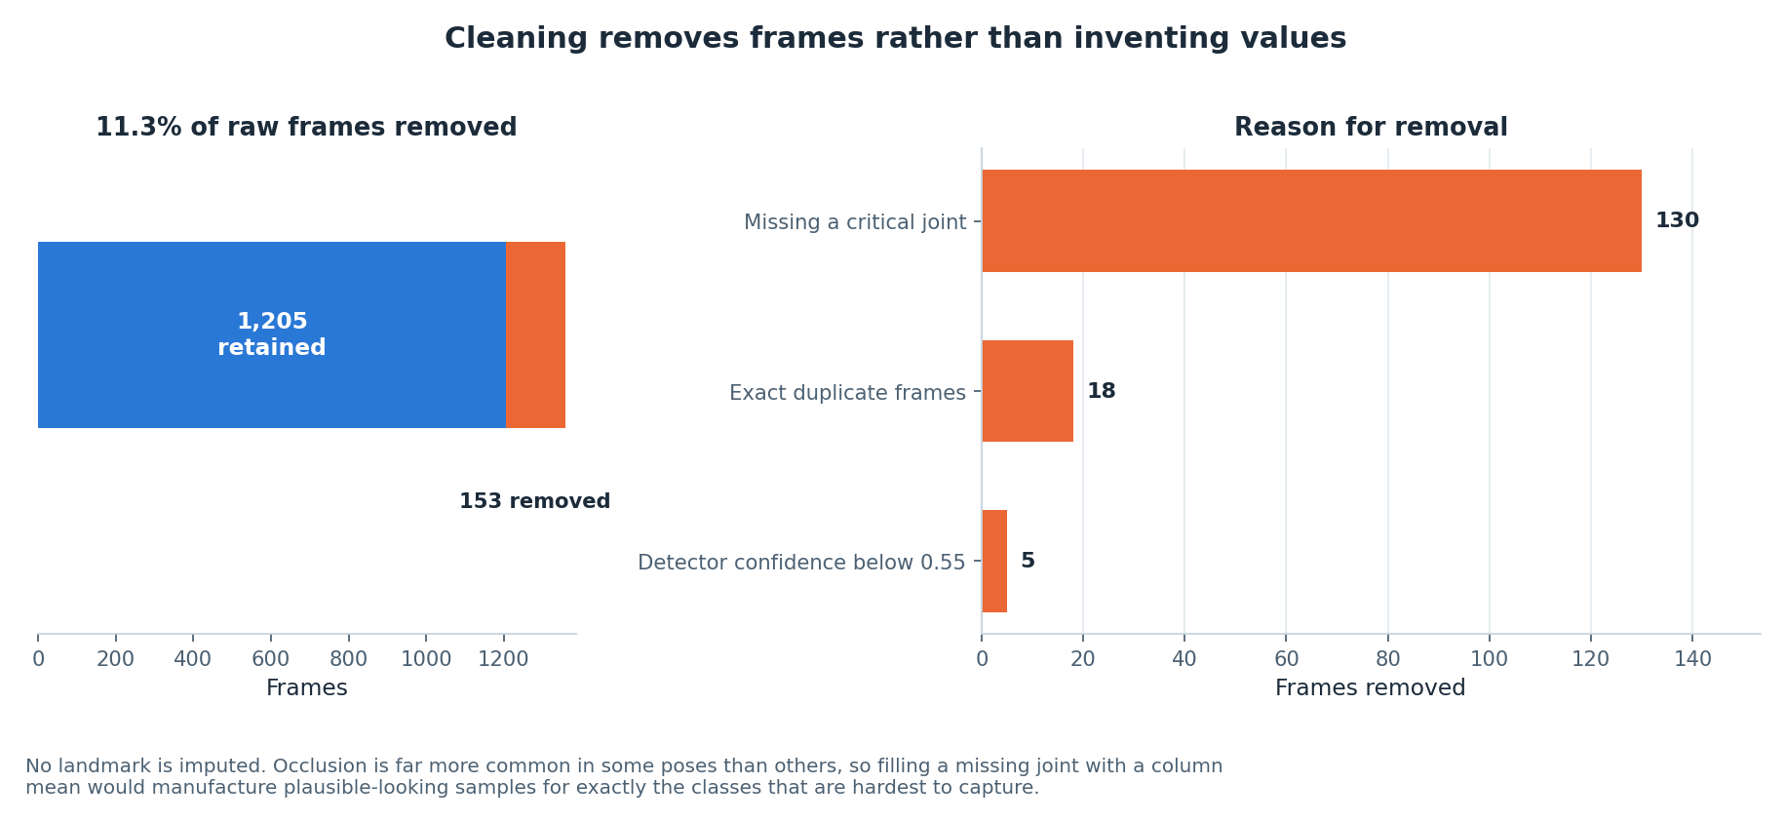
FIGURE 3
What was removed, and why
Figure 3 — 11.3% of raw frames removed, broken down by reason.
A60 AI4Mobility · Krushna Sai Teja Adhala · Team Deepminds
11
Notes:
Use the figure to show that removal is dominated by one cause rather than spread evenly, which is what you would expect from occlusion. Say that the 1,205 surviving frames are the only ones that reach feature building. Add that publishing the reason for every removal is what makes the eleven per cent defensible rather than alarming.

Slide 12
A DELIBERATE OMISSION
No landmark is imputed
Mean-filling would have been easy, faster and quietly wrong.
The reasoning
What we do instead
Landmarks go missing through occlusion, not at random.
Occlusion is pose-dependent: wrists and elbows disappear far more often in the quadruped poses.
A column mean would therefore manufacture samples for exactly the hardest classes.
Those invented samples would look plausible and would raise the reported score.
Frames missing a critical joint are removed, and the removal is counted.
Feature columns more than 35% empty are dropped rather than filled.
Remaining rows with any missing value are dropped, so no value is ever invented.
Detector confidence is kept as a feature, so frame quality stays visible to the model.
A60 AI4Mobility · Krushna Sai Teja Adhala · Team Deepminds
12
Notes:
This is the slide to linger on, because it is the clearest example of a decision made against our own interest. Explain that imputing would have raised accuracy while removing the model's ability to fail honestly on the hardest poses. Note that keeping detector confidence as a feature means the model can learn that a poor frame is a poor frame.

Slide 13
ARCHITECTURE
The pipeline runs in four stages
Each stage has one responsibility and hands a tabular artefact to the next.
1
Generate
build_raw_frames produces one row per frame from the seeded class-conditional generator. Replace this one function to swap in real data.
2
Clean
clean_frames applies the four rules and returns the surviving frames plus the removal counts.
3
Engineer features
build_feature_table produces 45 features in three families from 13 landmarks.
4
Split and scale
Subject-level train/test split, then a StandardScaler fitted on the training partition only.
THE POINT OF THE SEAM
Only the first stage knows the data is synthetic. Everything after it reads a plain landmark table, so a recorded dataset can be substituted without touching cleaning, features, splitting or modelling.
A60 AI4Mobility · Krushna Sai Teja Adhala · Team Deepminds
13
Notes:
Describe each stage in a sentence and stress that the boundaries are real function boundaries, not a diagram drawn after the fact. The generate stage is the only one that would change if we obtained real recordings. That property is what makes the honest account of synthetic data more than an apology.

Slide 14
FEATURE ENGINEERING
45 features in three families, plus a quality signal
Each family is included for a stated reason, not because it was available.
Family | Count | Why it is included
Normalised coordinates | 26 | Hip-centred and divided by torso length, so the model learns the pose rather than where the child stood or how tall they are
Joint angles | 9 | Invariant to translation, scale and body proportion — what an exercise classifier should key on
Inter-joint distances | 9 | Separations that distinguish classes, such as wrist-to-ankle for Child's Pose against Thread the Needle
Detector quality | 1 | Detector confidence, retained so frame quality stays visible instead of being silently averaged away
Frame-level features only. No temporal windowing, because the dataset is built as independent frames rather than continuous sequences.
WHERE THE 26 COMES FROM
Thirteen tracked landmarks, each with an x and a y, translated to a hip-centred origin and divided by torso length. Angles are returned as missing rather than zero when a segment is degenerate, so no invented value enters the table.
A60 AI4Mobility · Krushna Sai Teja Adhala · Team Deepminds
14
Notes:
Take each family and give the one-line justification rather than listing column names. Emphasise that normalisation is what stops the model keying on position in the frame or on the height of the subject. Flag the absence of temporal features here, because it returns as the strongest next step later in the deck.

Slide 15
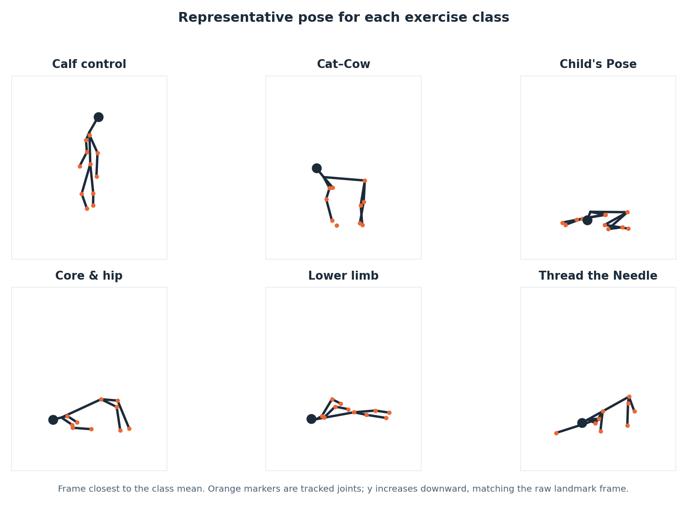
FIGURE 1
Thirteen landmarks, one representative frame per class
What the figure shows
The pipeline tracks 13 landmarks: head, neck, shoulders, elbows, wrists, hip, knees and ankles.
The representative frame is the one closest to the class mean, not the first frame — an unrepresentative frame makes a convincing and wrong figure.
The four quadruped-derived classes look alike here, which is why the confusion structure later is not a surprise.
y increases downward, matching the raw landmark frame.
Figure 1 — the frame closest to each class mean, drawn with the shared skeleton connection list.
A60 AI4Mobility · Krushna Sai Teja Adhala · Team Deepminds
15
Notes:
Explain the choice of representative frame, because picking the first frame would have produced a prettier and less truthful figure. Draw attention to how similar the quadruped-derived classes look, and say that this visual similarity is the same thing the confusion matrix later measures. Mention that the drawing uses the same connection list as the web platform, so both halves of the project describe one skeleton.

Slide 16
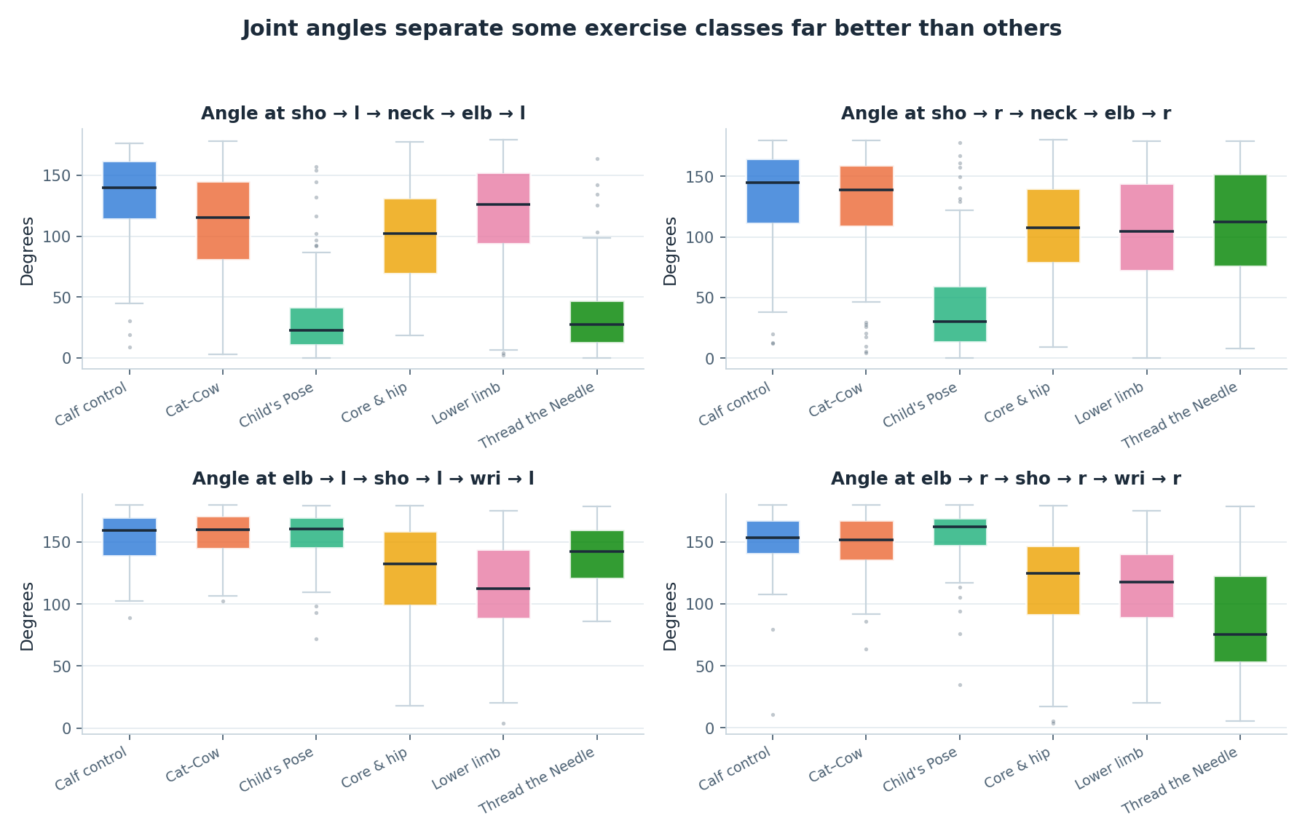
FIGURE 4
Joint angles carry class structure
Reading this honestly
Nine angles are computed at anatomically meaningful vertices, such as hip–knee–ankle.
Angles are returned as missing rather than zero when a segment is degenerate, so no meaningless value enters the table.
Classes separate on some angles and overlap on others, which is the expected picture.
Overlap between quadruped-derived classes is visible here and consistent with the later confusion analysis.
DO NOT OVERSTATE THIS
Angles help, but they do not dominate. Feature importance puts normalised positions at 77% and distances at 14%.
Figure 4 — joint-angle distributions by class, from the nine angle features.
A60 AI4Mobility · Krushna Sai Teja Adhala · Team Deepminds
16
Notes:
Use this figure to show that the angle family behaves sensibly, with separation on some joints and overlap on others. Point out the deliberate choice to return a missing value rather than zero when an angle cannot be computed, since a zero would be read by the model as a real measurement. Then pre-empt the obvious overstatement: the importance analysis shows positions carry far more weight than angles.

Slide 17
03
Splitting, scaling and results
The two decisions that decide whether a reported score means anything at all.
A60 AI4Mobility · Krushna Sai Teja Adhala · Team Deepminds
17
Notes:
Frame this section as the difference between a number and a trustworthy number. Say that both decisions here are about preventing information leaking from test to training. These are the parts of the work that transfer unchanged to a real dataset.

Slide 18
LEAKAGE CONTROL
Split by subject, scale on training only
577 training frames and 195 test frames, partitioned by subject rather than by frame.
The subject-level split
The scaler
Frames are generated in short takes of up to 15, sharing one subject's body proportions.
Whole subjects go to training or to test — never both.
A random frame-level split would put near-duplicate frames on both sides.
That silently inflates the test score, and nothing in the output would signal it.
StandardScaler is fitted on the training partition only.
The fitted scaler is then applied to the test partition.
Fitting before splitting leaks test means and variances into training.
The leak is small, undetectable in the metrics, and would make every later comparison unsound.
THE HONEST VERSION
A frame-level split would have produced a higher number. It would also have been a measurement of memorisation rather than generalisation.
A60 AI4Mobility · Krushna Sai Teja Adhala · Team Deepminds
18
Notes:
Explain that frames within a take are highly correlated because they share body proportions and a movement phase. A frame-level split therefore tests the model on frames that are near-copies of ones it trained on. Make the same point about the scaler: fitting before the split is a leak that never announces itself, so it has to be prevented by discipline rather than caught by a metric.

Slide 19
RESULTS
What this pipeline supports
Three model families, identical data and identical splits. Measured on synthetic data.
Model | Test accuracy | Test macro F1 | CV macro F1 (5-fold, train only) | Train accuracy | Generalisation gap
Random Forest | 0.928 | 0.935 | 0.955 ± 0.017 | 0.965 | +0.037
Gradient Boosting | 0.923 | 0.931 | 0.939 ± 0.016 | 1.000 | +0.077
Neural Network (MLP) | 0.923 | 0.932 | 0.939 ± 0.019 | 1.000 | +0.077
Cross-validation is five-fold on the training partition only. The test set was scored once, after all model selection was complete.
READING THE TABLE
Random Forest wins narrowly on macro F1 and decisively on the generalisation gap: +0.037 against +0.077 for both alternatives. The gap is a pipeline property as much as a model property.
A60 AI4Mobility · Krushna Sai Teja Adhala · Team Deepminds
19
Notes:
Give the headline first: the three models sit within half a point of each other on test accuracy, so the interesting column is the gap. Explain that the two models reaching 1.000 training accuracy are memorising the training partition, which the subject-level split makes visible. Finish by repeating that these figures are measured on synthetic data.

Slide 20
LIMITATIONS
What the data layer cannot support
The data is synthetic
No claim about real children follows from any figure in this deck.
Frame-level only
There are no temporal features, so movement quality over time is not modelled at all.
Small test partition
195 frames, and calf_control has a test support of only 14 — per-class figures for it are fragile.
Subjects are synthetic takes
They stand in for people; they do not carry real between-person variation.
No clinical review of the class definitions
The six classes come from published exercise text, not from a physiotherapist's judgement.
A60 AI4Mobility · Krushna Sai Teja Adhala · Team Deepminds
20
Notes:
Deliver these as facts rather than apologies, and do not soften the first one. The small test support for calf_control is worth naming because it scores a perfect 1.00 F1 and that deserves a caveat. Say plainly that no physiotherapist has reviewed the class definitions.

Slide 21
NEXT STEPS
What would move the data layer forward
In priority order, and each one is achievable rather than aspirational.
1
Record a small consented dataset
Even 20 participants, with ethical approval and safeguarding in place, would let every number be re-derived from reality.
2
Add temporal features over a sliding window
Velocity and phase across frames, then re-run the same comparison on the same splits.
3
Keep the split discipline unchanged
A real dataset makes subject-level splitting more important, not less, since takes become recording sessions.
4
Report cleaning counts for real data too
The removal table becomes a data-quality instrument once frames come from a camera rather than a generator.
A60 AI4Mobility · Krushna Sai Teja Adhala · Team Deepminds
21
Notes:
Present the recorded dataset as the single change that would upgrade every other claim in the project. Explain that temporal features are the second priority because the remaining confusions are exactly the ones a movement-over-time model should resolve. Close by saying the pipeline is already built to accept both changes without restructuring.

Slide 22
IN CLOSING
A pipeline built so the data can be replaced
Honest about the source
Disciplined in the middle
Trustworthy at the end
1,358 synthetic frames, seeded and reproducible, described as a generator rather than as evidence about children.
153 frames removed with reasons published, nothing imputed, 45 features in three justified families.
Subject-level split, scaler fitted on training only, test set scored once — 0.928 accuracy with a +0.037 gap.
The most useful thing this deck can leave behind is a method that survives contact with real data.
Krushna Sai Teja Adhala · Data engineering and pipeline lead
Project A60 · Module 55-708252 · Sheffield Hallam University · Team Deepminds
A60 AI4Mobility · Krushna Sai Teja Adhala · Team Deepminds
22
Notes:
Close on the three-part summary and repeat the synthetic caveat one final time so it is the last thing the audience hears about the data. Offer to walk through the cleaning table or the split code in questions. Thank the supervisor for the direct question about honest reporting, which shaped how this section is written.

