Slide 1

Team 12 : Web – Browser and a Search Engine
Statement:
Create an integrated web browser and search engine that uses multiple data structures to
index, query, and navigate web pages.
Build a BST for word frequencies.
Process search queries using priority queues for relevance ranking.
Crawl and build a graph of hyperlinks, support connectivity and path queries.
TEAM-12 :
PES2UG24CS154 - Dhanush S S
PES2UG24CS166 - G S Dheekshith
PES2UG24CS173 - G Yekambar Eshwar
Intro:
We split our project into 3 files:
browser.h header file having all the function declarations and structure;
Then our browser.c having all our function definitions;
Finally the main.c file for testing our code with a menu driven program;

Slide 2
Data Structures Used in The Code:
Data Structure | Used In | Why?
Stack (forwardStack & backwardStack) | Navigating between pages; | LIFO behavior perfectly models browser navigation.
BST (Binary Search Tree) | Storing & searching words from page titles; | Efficient lookup; supports frequency counting per word.
Priority Queue (Max-Heap) | Query ranking | Returns highest relevance word first.
Hash Table (Linear Probing) | Cache storage | Quick lookup for repeated URL visits.
Graph (Adjacency Matrix) | Storing links between pages | Easy to compute out-degree based PageRank.
Page, Browser, BSTNode, PQNode | To improve readability and acting as a Master Structure to Store a certain State | Organized storage, improves code clarity.

Slide 3
Abstract Data Type (ADT)
Data Structure | Stack | BST | Priority Queue | Hash Table
Operations: | push(x): Adds item at the top. Algorithm: top++, place element at data[top] pop(): Removes and returns top element. Algorithm: return data[top--] isEmpty(): Checks if top == -1. | insert(word): Inserts word into tree. Algorithm: Compare, recurse left/right, create node if NULL. search(word): Finds word's node. Algorithm: Standard BST search (compare + recurse). inorder traversal: Prints words in sorted order. | push(word, relevance): Inserts node into heap. Algorithm: Insert at end, heapify-up. pop(): Removes highest relevance node. Algorithm: Replace root with last item, heapify-down. peek(): Shows most relevant node. | insert(url): Adds URL using linear probing. Algorithm: Hash(URL), probe until empty slot. find(url): Searches URL. Algorithm: Hash(URL), probe until match/empty.
Data: | A collection of elements, Top pointer | Word, Frequency, Left, right children | Node with (word, relevance) ,Size | Array of buckets ,Used flag

Slide 4
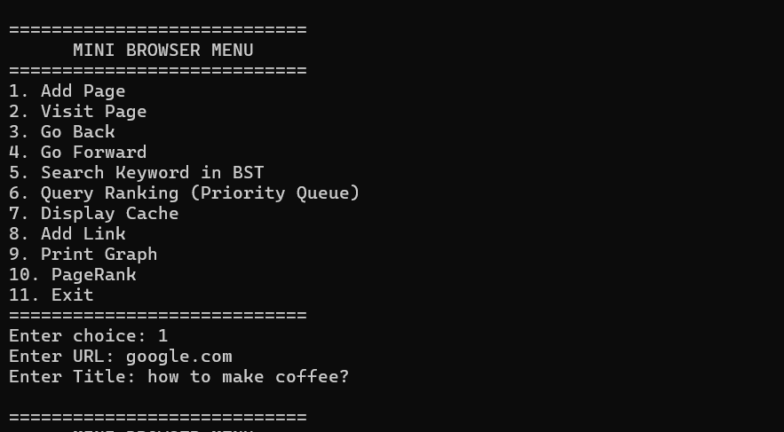
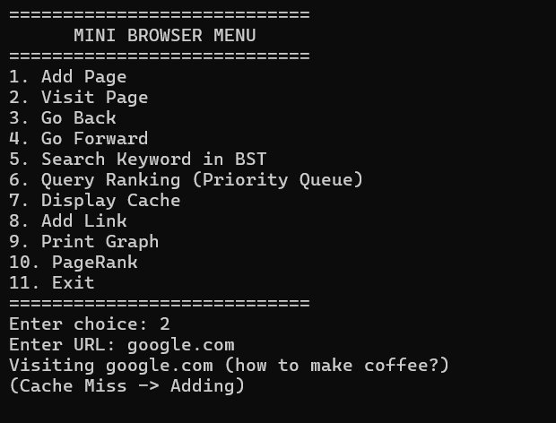
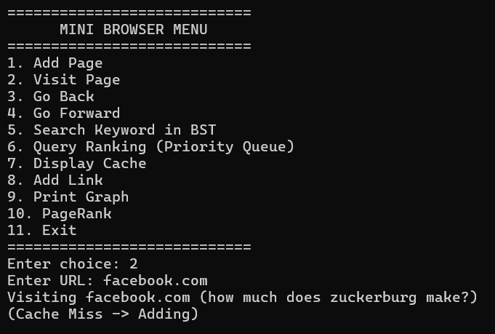
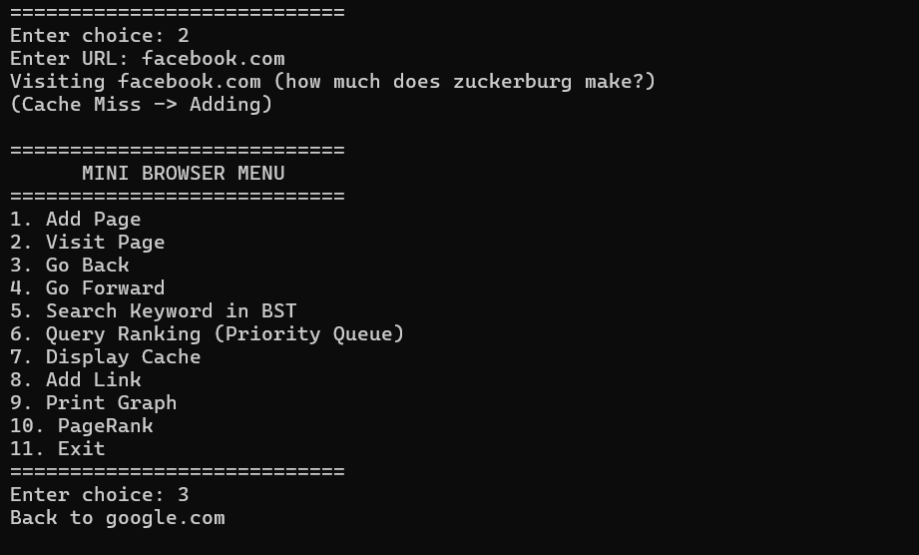
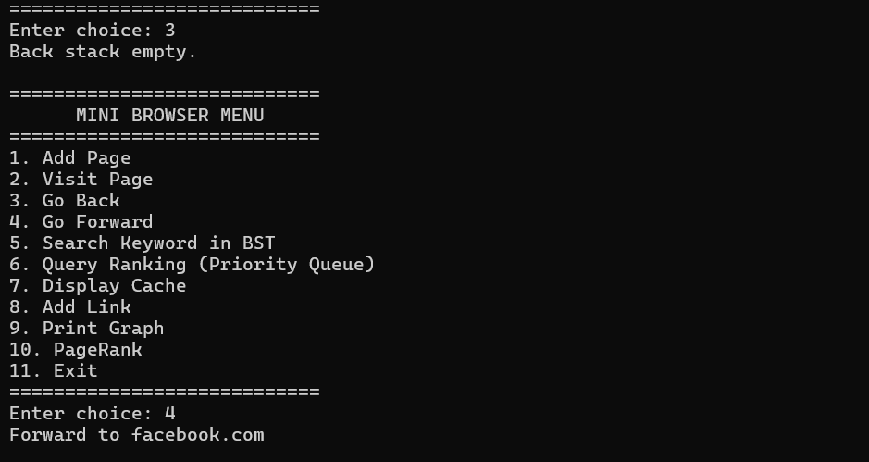
Output SSC: 1) adding and navigating

Slide 5
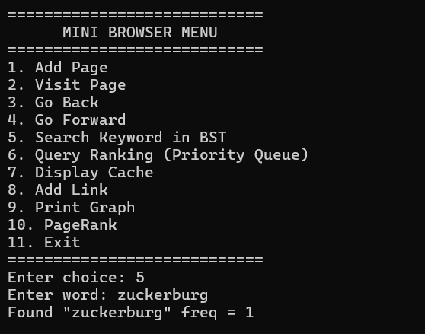
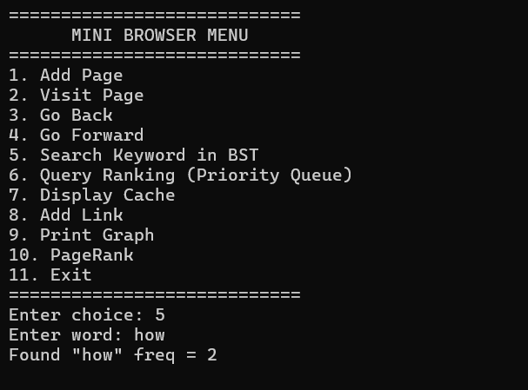
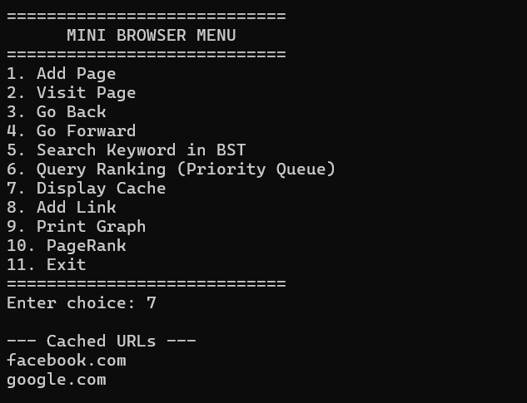
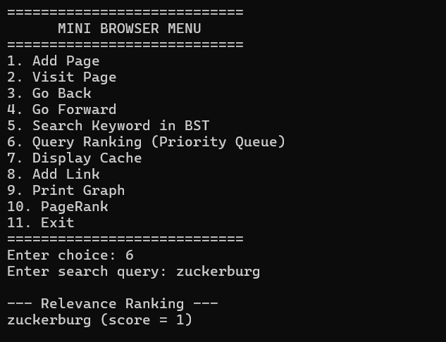
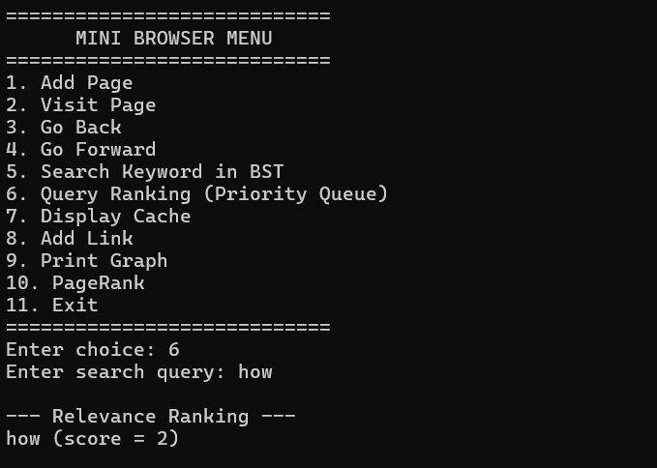
Output SSC: 2)Searching, Ranking and display Cache

Slide 6
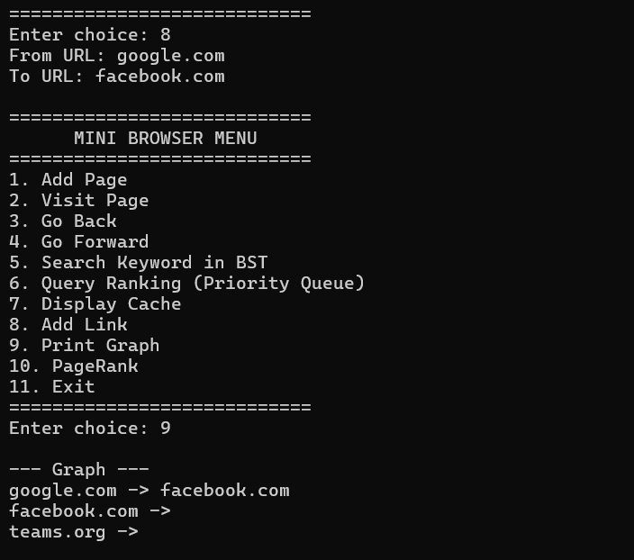
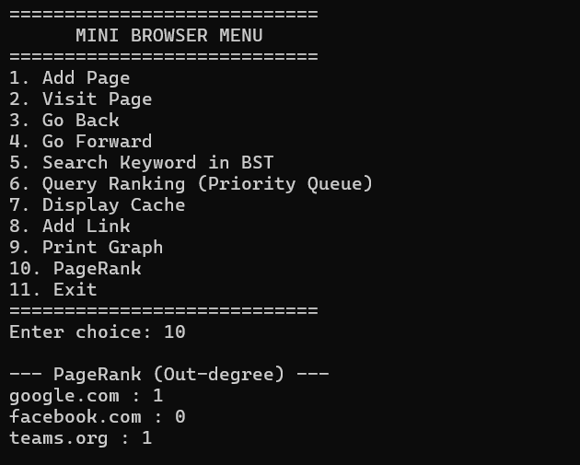
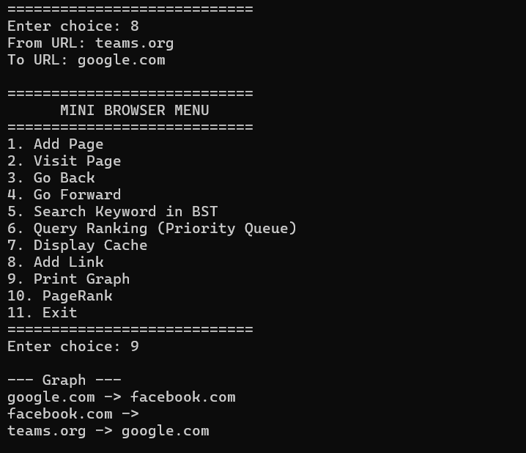
Output SSC: 3)Linking and Page Ranking

Slide 7
Conclusion:
Our Code is Menu Driven and adds pages with a URL and a title; uses stacks to navigate forward or backward;
We Use Trees and Hash Tables for Efficient Searching of words and easy access respectively; Ranks using their frequency as a parameter via heaps;
Also, We Use Adjacency Matrix form of Graph to form Connection between Pages and then print them and also rank them in order of their out-degree;
Work Split:
Dhanush Sai Suprapadha – PES2UG24CS154: worked on the stacks and their ADT, and add/visit page;
G S Dheekshith – PES2UG24CS166: worked on max heap and ranking logic via graphs;
G Yekambar Eshwar Rao – PES2UG24CS173: worked on BST and hash-tables;
--Thank You--

