Slide 1
Passenger Registration Management System
Dhanush D

Slide 2
CONTENT
Abstract
Technology
Necessity of Passenger registration management system (PRMS)
Passenger registration System
MVC Folder Structure
API Folder Structure
MVC Solution
API Solution
Dapper Connection
SQL server and database
Output
Conclusion

Slide 3
ABSTRACT
The Passenger Registration System is a comprehensive web-based application designed to provide a seamless and efficient platform for managing passenger data, and enhance the passenger management process within the transportation industry. This system is structured to offer a effective management that in which the transportation organization can maintain the details effectively and the management robust functionalities catering to various aspects of passenger registration, data management, and system security.

Slide 4
Technology
.NET CORE
MVC
API
SQL SERVER
DAPPER

Slide 5
Necessity of PRMS
Question:
Challenges to build a extensive Passenger Registration Management System using web API controllers and database connectivity. The management system should include user authentication, Passenger record management, and proper CRUD (Create, Read, Update, Delete) operations.The application involves creating a login functionality, loading a dashboard, and implementing a user-friendly passenger registration form.

Slide 6
Passenger Registration Management System
The Application is designed with a user interface customized
to be user-friendly and efficient for administrative and HR-related tasks within the transportation domain.
It includes Admin login and enables the admin users to create new account .
It contains Passenger Dashboard which responsible for the operations such as Create, Read,Update and Delete.

Slide 7
Passenger Registration Management System
The Create and Update operations are established in the same view page.
The dashboard operations such as Read and Delete is done using the modal popup.
The application includes MVC for the user interface, API for three-tier architecture, and Dapper for SQL database connections.

Slide 8
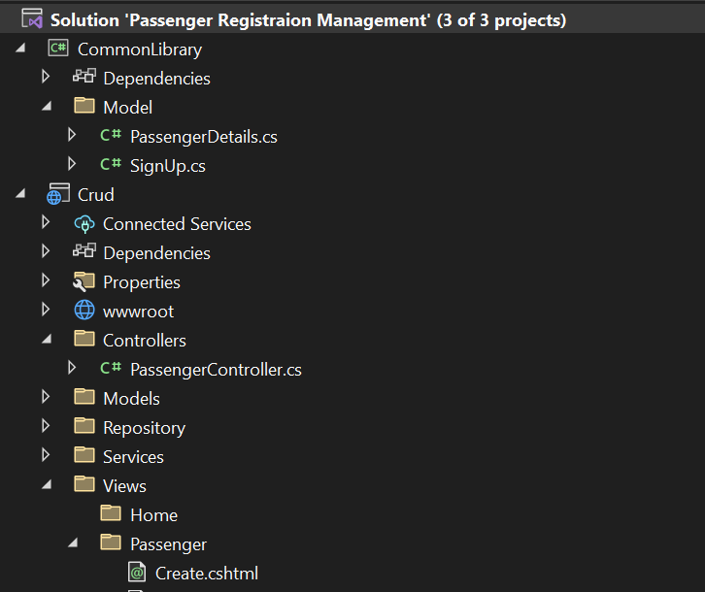
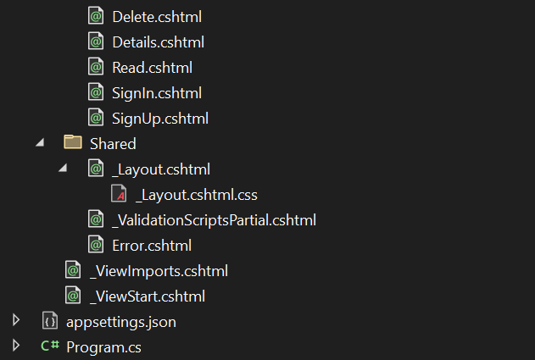
MVC Folder Structure
Connections
Dapper Connection
Dependency Injection

Slide 9
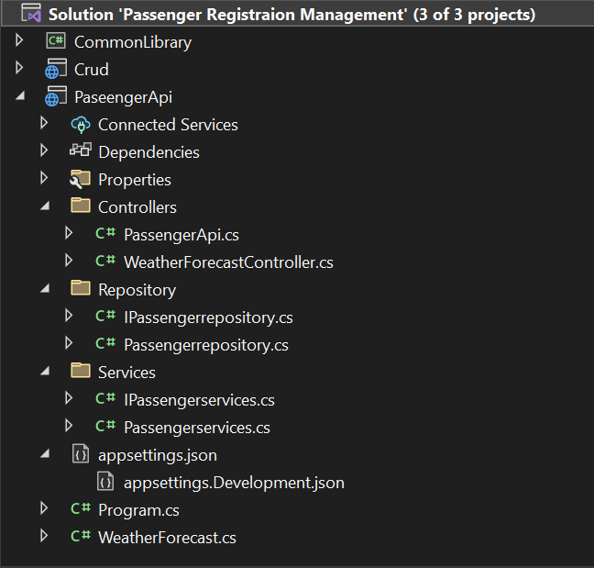
API Folder Structure
Three-tier-architecture
Controller(action methods)
Business Layer (service)
Resource(Repository)

Slide 10
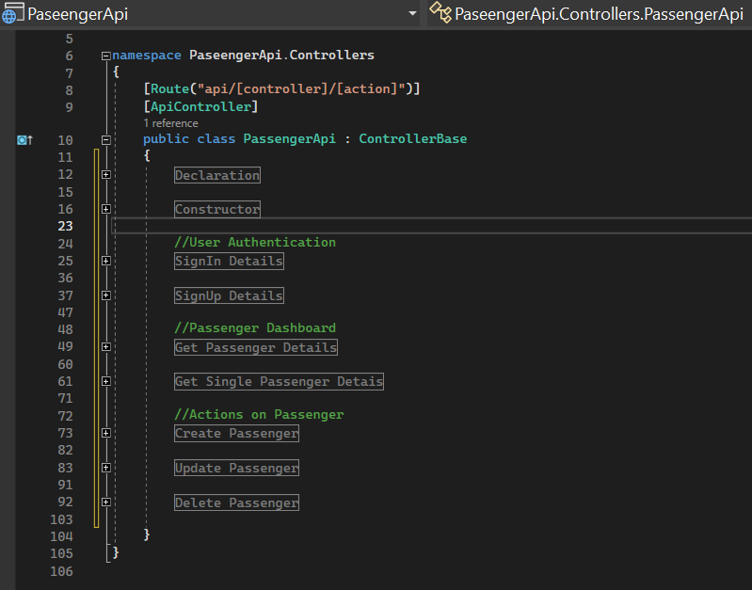
API Solution
API Which stands for application programming interface
API call is done by the server
The data is carried out in API in the flow of
Controller to Service
Service to Repository
This is done to fetch the data from the database

Slide 11
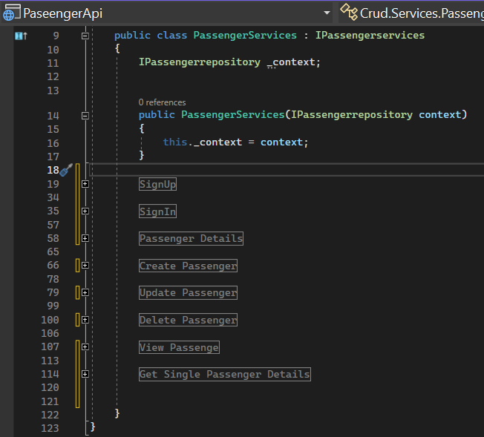
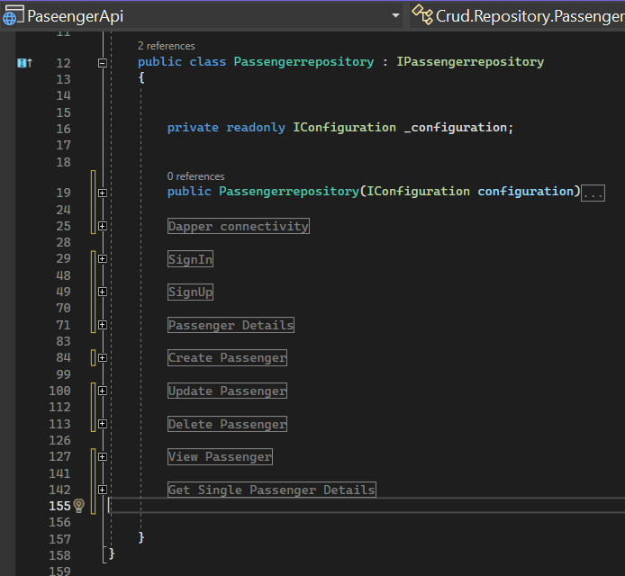
API Service
API Repository

Slide 12
API Service
Service-side injects the repository.
Service refers to the class responsible for handling the business logic and functionalities
After completing logic methods it passes the response for the respective operation for further process in the solution.

Slide 13
API Repository
A Repository-side injects the Dapper connection
Repository is used for Fetching data from database and delivering it to the requesting application. This might include retrieving passenger information or any other relevant data.
The repository is only gateway to access the database.
After completing database action it will pass the relevant data to the next operation.

Slide 14
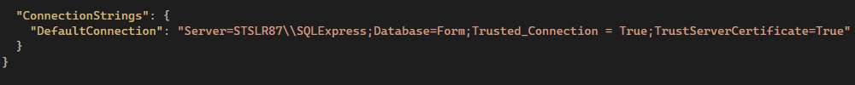
Dapper Connection
The Connection String is placed in the app setting folder in the API solution
The Dapper connection is to used to fetch the data from our database.

Slide 15
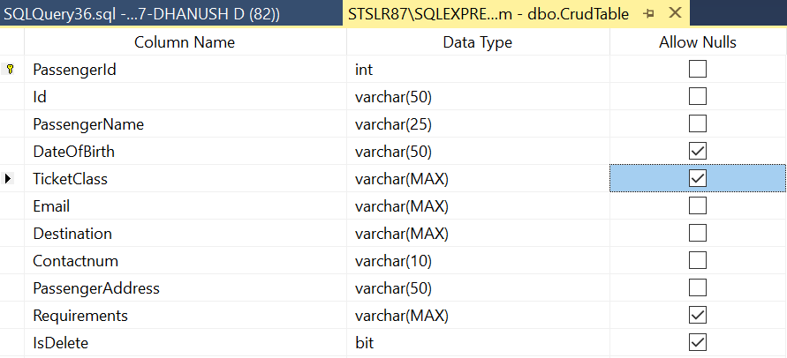
SQL Server & Database
Local Server is used in this application.
The data from SQL server can be retrieved by using SQL queries in the solution

Slide 16
OUTPUT

Slide 17
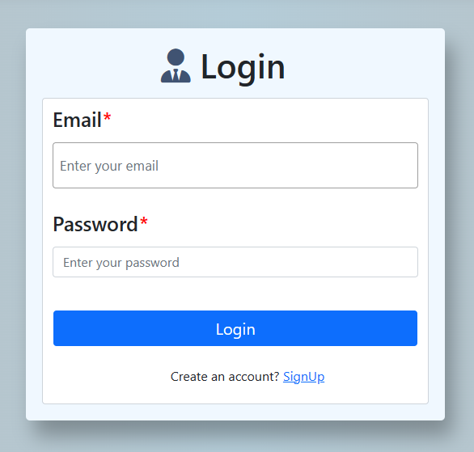
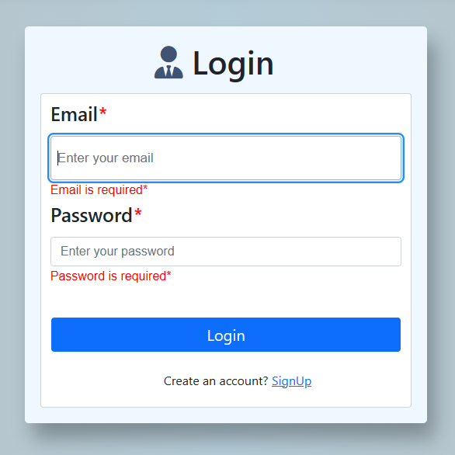
Login Form
Login Form
(With Validation*)

Slide 18
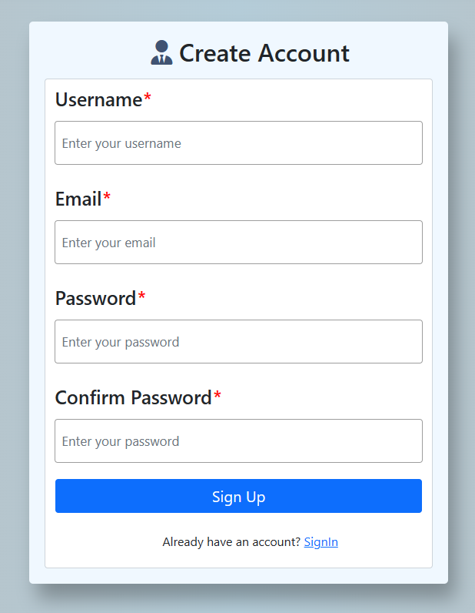
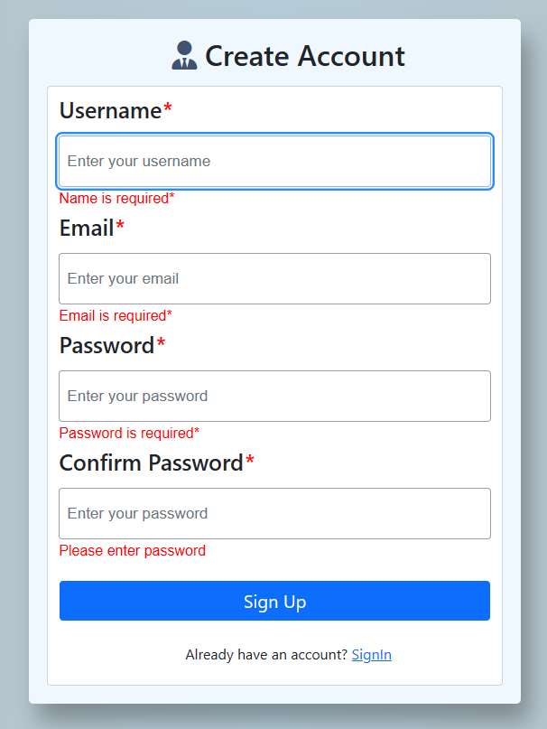
SignUp Form
SignUp Form
(With Validation*)

Slide 19
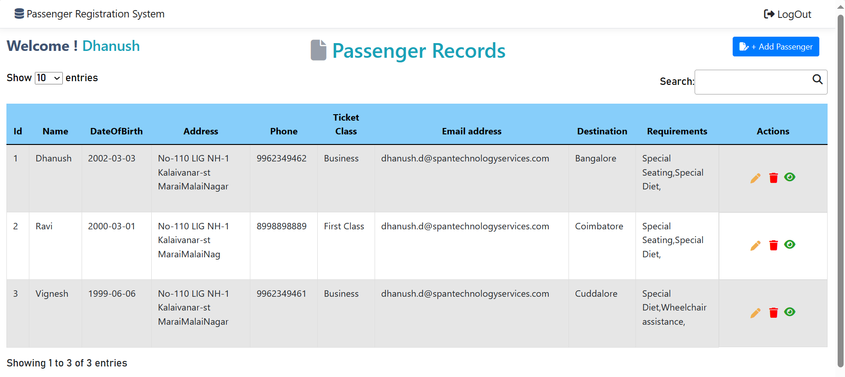
Passenger Dashboard

Slide 20
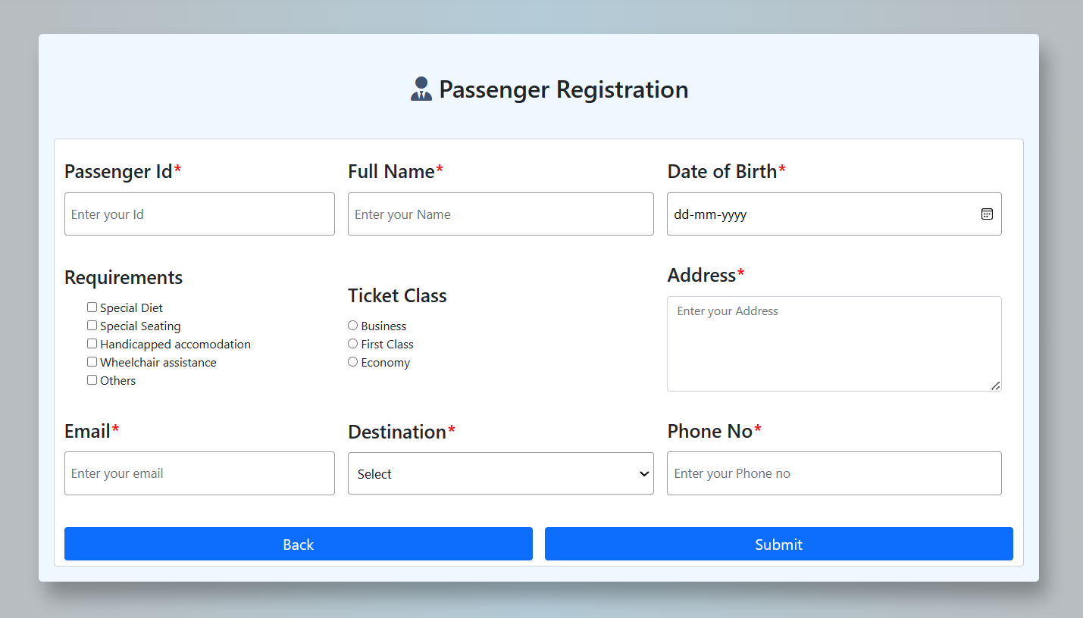
Passenger Registration
Form

Slide 21
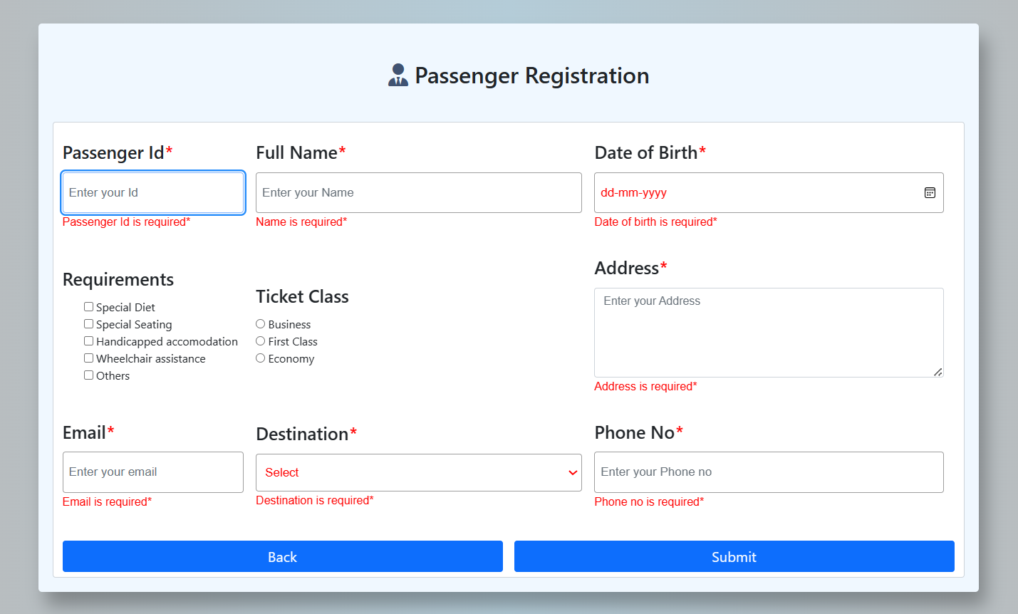
Passenger Registration
Form
(With Validation*)

Slide 22
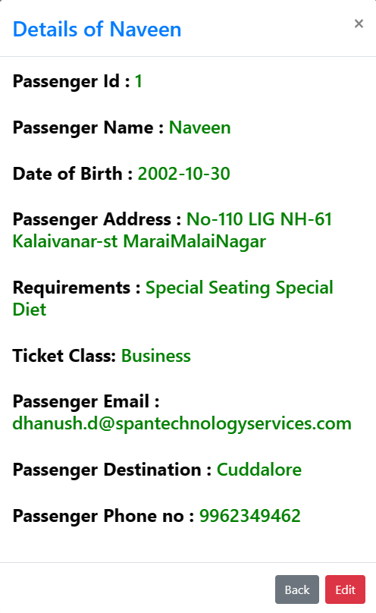
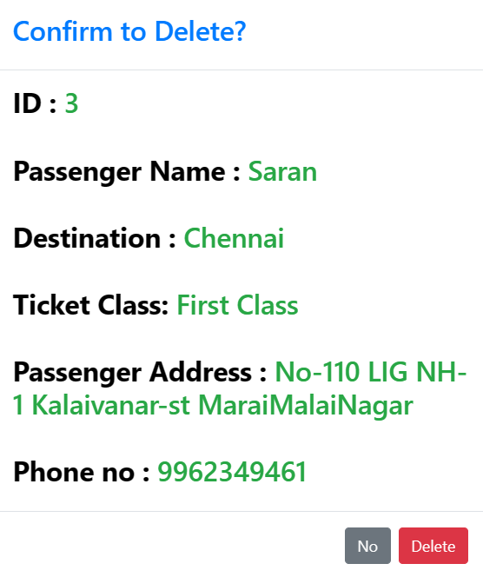
Read PopUp
Delete PopUp

Slide 23
CONCLUSION
The Passenger Registration Management System is a application developed in MVC and API solution that addresses the challenges associated with CRUD operations,it is useful in Transportation organization if the application is implemented.
Reference
Google Chrome,YouTube,Bootstrap

Slide 24
THANK YOU

