Slide 1

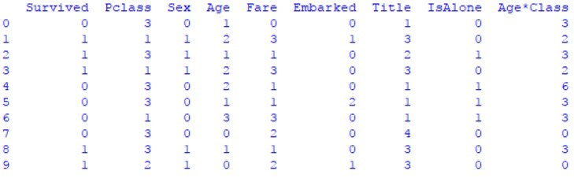
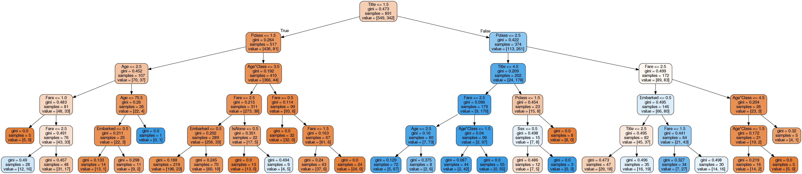
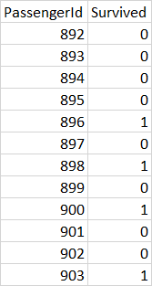
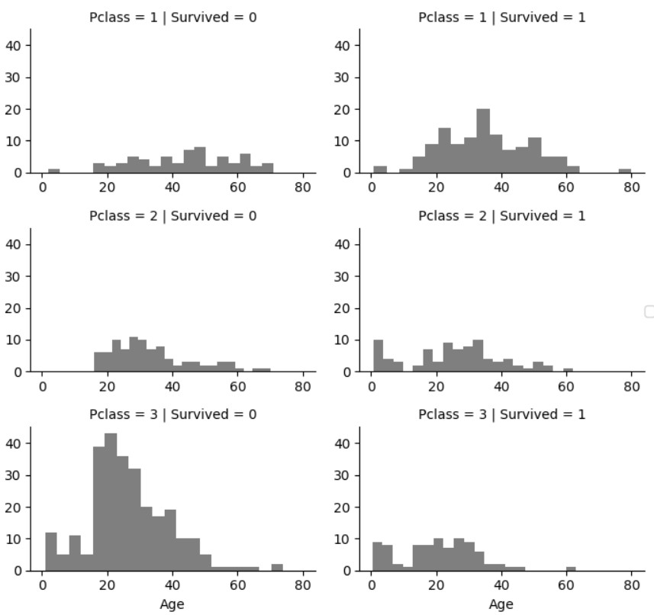
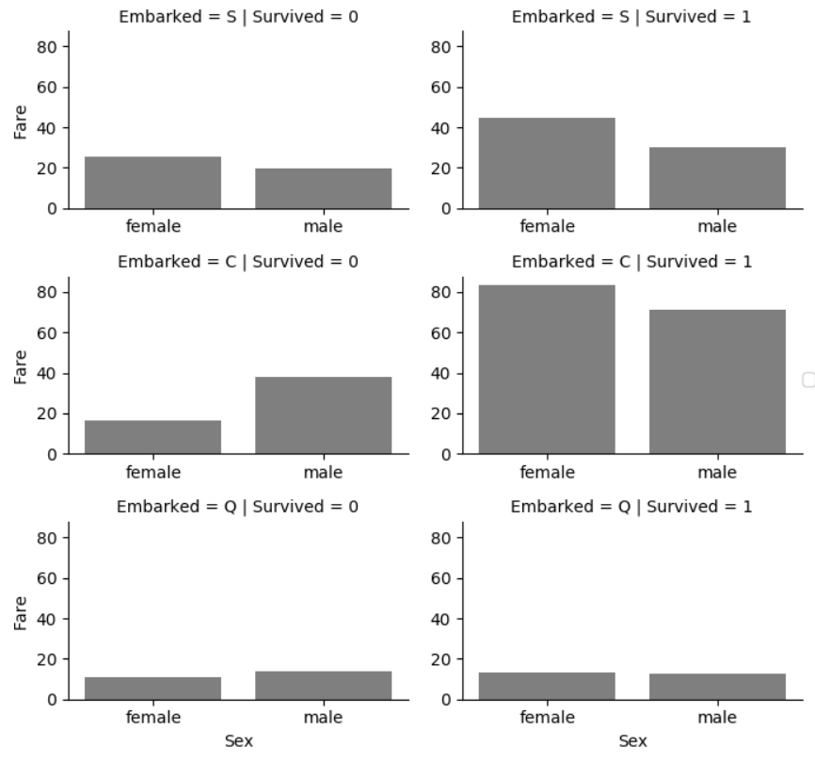
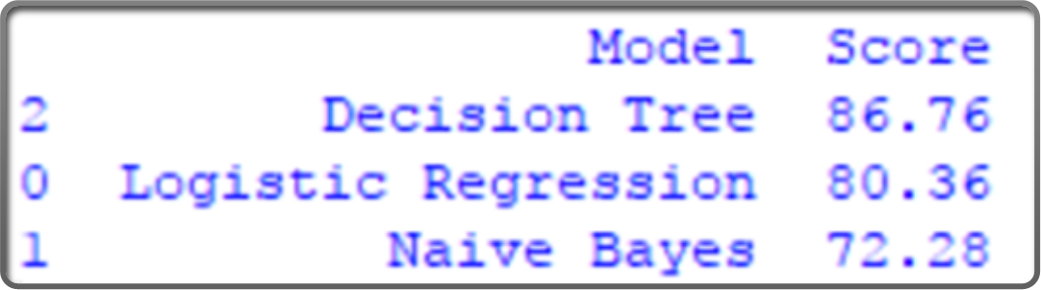
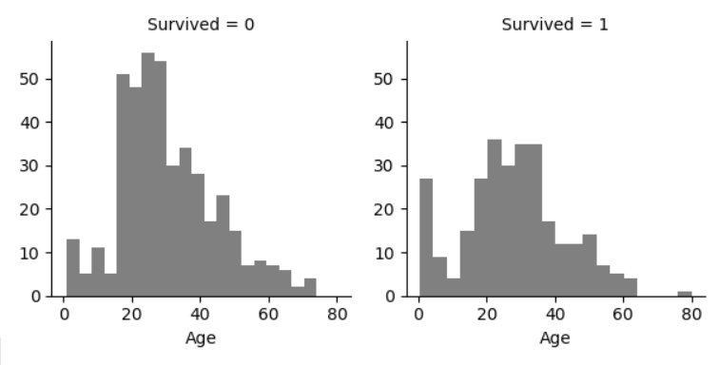
Titanic: Machine Learning from disaster
Dhanush M Chandrashekar, V S Kishan Kandirelli, Ravi Thubati
Under the Guidance of Prof. Jeongkyu Lee
Department of Computer Science
University of Bridgeport, Bridgeport, CT
Abstract
Some features such as Cabin, Ticket information, was dropped them as there was no contribution from them towards our survived feature.
All the categorical value were converted in to ordinal values or numerical equivalence, i.e., feature scaling.
Training dataset after feature scaling
In this project, we are trying to predict the survivability of the passengers who met with the tragedy of TITANIC, using the machine learning methods and algorithms.
Having a training dataset of 891 tuples with features like gender, age ,fare and embarkment, our aim is to predict the survivors of a test datasets which consists 418 tuples with unseen data. With a tuning and preprocessing of data we are comparing the machine learning algorithm like Decision Tree analysis, Naïve Bayes and Logistic Regression.
Introduction
One of the most historically infamous irretrievable loss happen on April 15, 1912 was the Titanic colliding with the iceberg. This collision during the voyage sank the ship killing 1502 out of 2224 passengers and crew. This incidence was wicked to the world and shocking to the international community.
Now the goal was to better the overall safety regulations for the ships. As working on the analysis of the number of deaths it was analyzed that one of the reasons was the insufficiency of lifeboats for the passengers and the crew. Considering some elements some groups of people were more likely to survive, such as women, children and the upper class.
In this, we are trying to analyze the Kaggle dataset and see on what category of people would have survived in the tragedy, applying the tools of machine learning. we are using machine learning methods like Naive Bayes, Logistic Regression, Decision tree, and using different combinations of features we are trying to predict if the passenger survived or not.
Result and Evaluation
As a way to start we choose naïve bayes. For this we considered features, gender, age, passenger class and fare. Both gender and passenger class took on discrete values, gender with male and females, and passenger class with 1st, 2nd and 3rd class. Then condition probability was taken for all the features.
For logistic regression we began with examine one variable at a time, and then many at a time. We only show the distribution of the response survived and the relationship between survived and other potential predictor variables. The above visualizations helped.
As for decision tree, we selected an attribute based on minimum descriptions length, age, PClass and Embarked and then applied a splitting criteria rule for the attribute, Gini index based on the ground truths. The rule we kept to stop the tree from splitting was to compare the accuracy between parent node and the leaf node, if the accuracy is more then we will split again but if the error rate is more between the parent and lead node then we will stop the tree and make that subtree as leaf with ground truths.
Visualization and Observations
Decision Tree
The Training dataset consists information about 891 passengers, including a feature that mentions if they survived or not. For each passenger, we were given his/her passenger class, name, sex, age, number of siblings/spouses aboard, number of parents/children aboard, ticket number, fare, cabin embarked, and port of embarkation and the same for test dataset 418 passengers. Also the dataset obtained had several fields like fare, age, embarkment empty or missing, and so to fill in those values we used medians of the remaining data of the same feature.
Features like fare, age can range a large number of values, hence we grouped fares, ages, and embarked features and converted them to numerical equivalents.
Decision Tree predicts more accurately about 86.76 which is more than logistic regression and naïve bayes.
Sample Output
Fig.1
Fig.2
Accuracy
Observations made on the comparing the categorical data with class label:
Our data set had three, categorical features, Age, PClass and Embarked.
Fig.1 reads about the PClass feature, showing passengers of PClass 3 were most who dint survive and PClass1 was most survived.
Fig.2 Female passengers from the any port of embarkation survived the most.
Fig.3 Most age group present was 15-40. Passengers below 5 and above 55 had higher survivability.
Conclusion
Of all the three methods which we implemented on the dataset, naïve bayes gives the least accuracy of 72.28%, where as logistic regression has a moderate accuracy of 80.36%.
Decision tress showed better accuracy with predicting 86.76%. This is probably because there was one feature that was strongly correlated with whether a passenger survives.
Fig.3
CPSC 552 – Data Mining

