Slide 1
Line Following Robot
Without using Arduino

Slide 2
Group Members
R.M.U.I.Rathnayake – KADSE23.1F-067
W.M.N.M.Wasala – KADSE23.1F-066
A.M.Dhanushanandan – KADSE23.1F-020
G.V.D.Jayaweera – KADSE23.1F-016
P.J.Palange – KADSE23.1F-021

Slide 3
Introduction
Project Steps
1st Step
Features of our product - Udari Rathnayake
2nd Step
Explaining Components – Nadun Wasala
3rd Step
Explaining Circuit – A.M.Dhanushanandan
4th Step
Limitation & Recommendation – Vihanga Jayaweera
5th Step
Conclution & End – Pasindu Palange

Slide 4
Features of the Products
Simple Logical Functions
Circuit without using Arduino
Robot movements are automatic

Slide 5
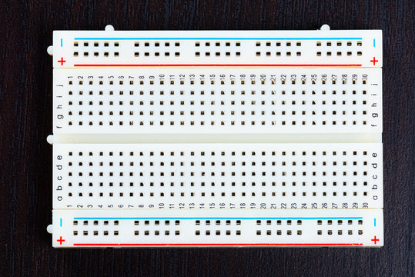
Circuit Components
1.Bread Board
Connect all the components and store as a single components to make simple circuit in one view.

Slide 6
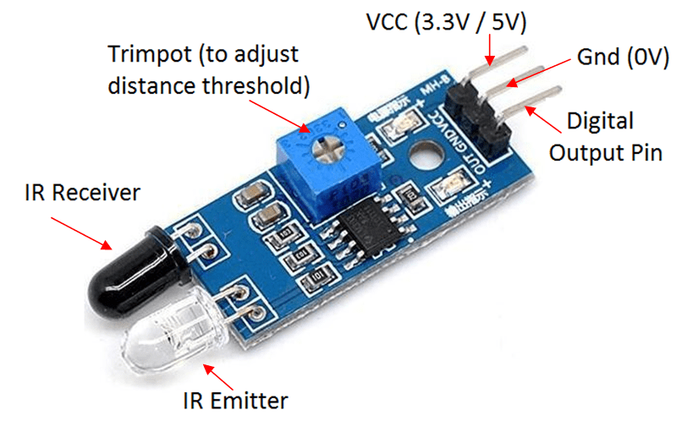
2.IR Sensor Module
These sensors are essential for detecting the line on the ground. Typically, you'll use two IR sensors positioned on the front of the car, one on the left and one on the right.

Slide 7
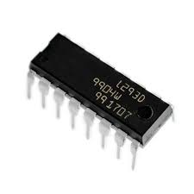
3.LM293D IC
L293D is a motor driver IC. It’s used to drive the motors. It can change the speed of the motors based on the current supplied to the motors. It can control the direction of the motors based on the input. It can also start or stop the motors. It’s a 16 Pin IC.

Slide 8
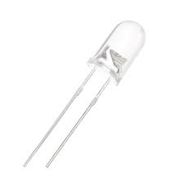
4.LED
LED light indicate the circuit is in function or not. Many variety of colors are available in the market. It get 3.2V max input voltage.

Slide 9
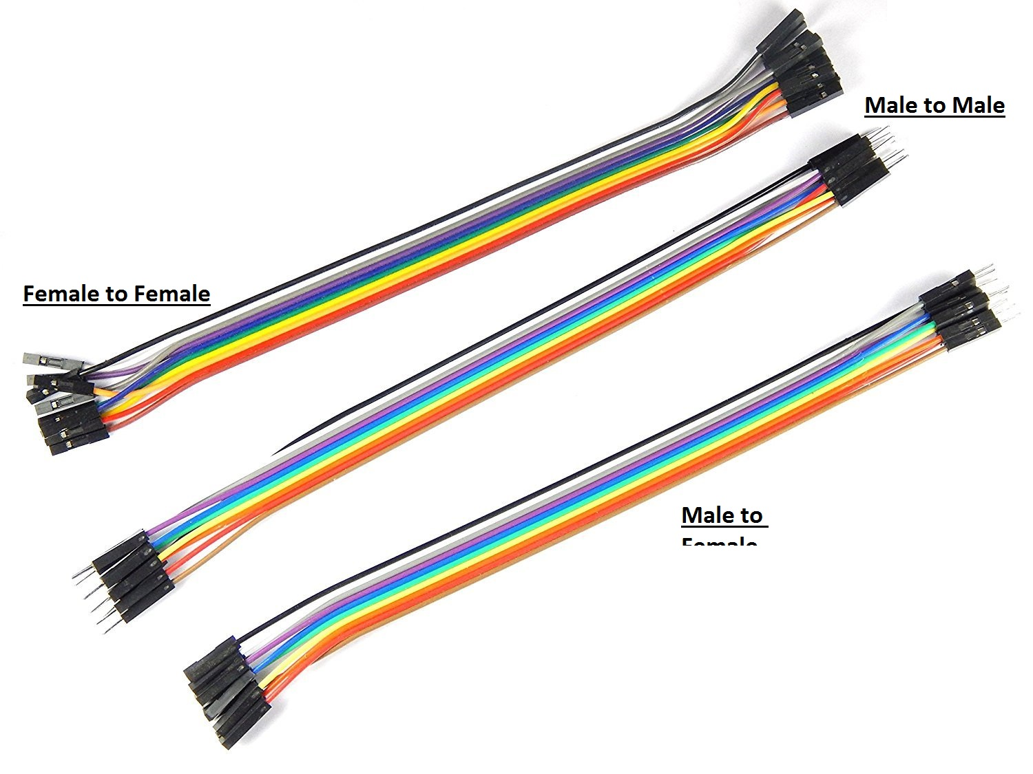
5.Jumpa Wires
Jumpa wires used to connect the components with other components connections. There are 3 type of jumpa wires,
1.Male to Male
2.Male to Female
3.Female to Female

Slide 10
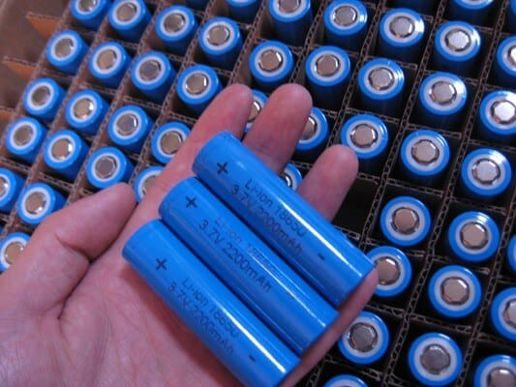
6.Rechargable Batteries
Battery gives the power supply for the circuits components to boot up. Its give the backup power for the circuit. Rechargeable and non rechargeable batteries are available in the market. Battery power choose with its size.

Slide 11
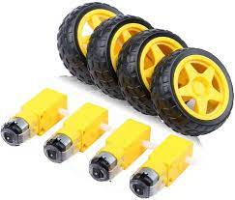
7.Bo Motors and Wheels
It’s a DC motor commonly used in various applications such as robotics, automation, and hobby projects. Its help to move the car by following predefine path.

Slide 12
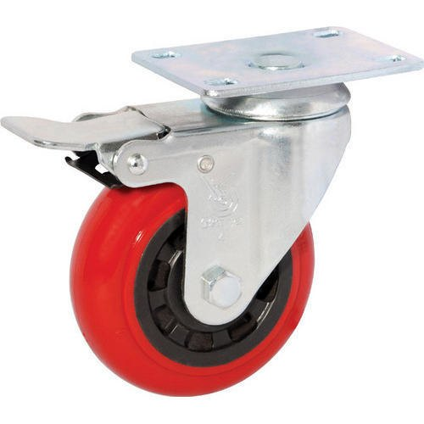
8.Caster Wheel
Used to turn the car freely to any direction. The directions choose by IR module output.

Slide 13
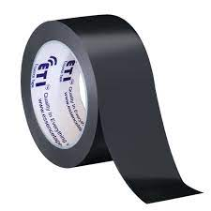
9.Black Tape
Use to create a predefine path for the automated moving car.

Slide 14
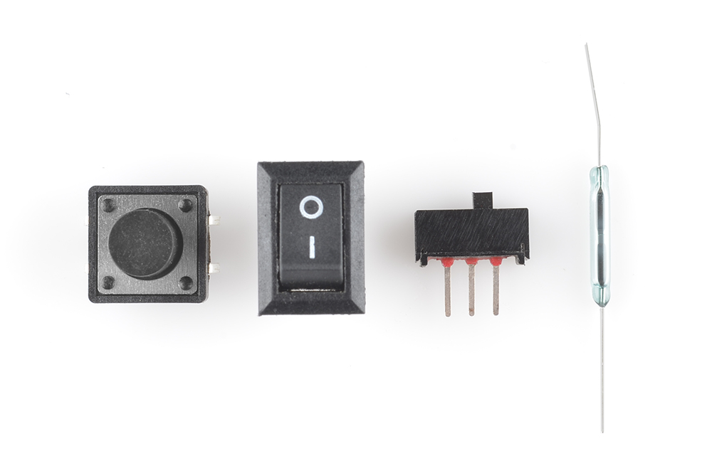
10.Caster wheels
Switches use to controls the voltage flow in the circuit. There are many variety switches for an example,
1.push button switch
2.On/Off switch
3.Clap switch etc..

Slide 15
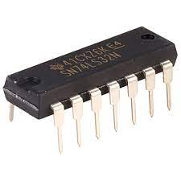
11.OR Gate IC
Its an OR gate IC when output is 00 the LED is OFF didn’t glow when the Output is 01/10/11 LED is Glow.

Slide 16
Our Circuit
The L293D IC is a popular motor driver IC for an alternative to control motors without using an Arduino. The DC motors commonly used to control the movement of car. DC motors get data from IR sensors and control the motors. It’s a feedback control circuit it continuously monitor the line and provide the signal to the circuit.IR sensor is the base of this car because car is follow the black line using IR sensor output. IR module detect predefine black line and give the output data to LM358 IC. IR transmitter emits the IR-Rays to the ground. Black color absorb the IR-Rays other colors reflect the IR-Rays it helps to determine the position of the line. When IR detect object colors except black the output is high when detect black then output is low. This is the input to the LM293D IC to drive the motor or not. The motor rotation can be changed by changing the pins of the IC. We can run the car using the each IR module output is High and we can take cars turning paths using only drive one motor [only one sensor will be given the high voltage] at a time.

Slide 17
IR module is choose the car’s moving path with detection and output will choose the
motors function for an example,
If the IR detect each side different colors then car will move forward, if the one side of the IR module detect the black line the output voltage is low so motor will be stooped but another motor will be in function the car will be automatically turn other side.
This process will be continue until the each IR module detect the black line at same time. When the
each IR modules detect the black line then output is low voltage so the motors will be stopped.
Basic LM293D IC pin connections to the component,
Positive(VCC) PINS = 1//16//7//8//9//10//IR module positive edge
Negative(GND) PINS = 4//5//12//13//IR module negative edge
IR MODULE PINS = 2nd pin for one IR module // 15th pin for another IR module
MOTORS PINS = 3/6th pins for one motor // 14/11th pins for another motor

Slide 18
Limitation & Recommendation
Limitations | Recommendations
We didn’t use Arduino | If we used the Arduino , we could improve the circuit more
The bot can't make 90 degrees turns | If we can use the 8 channel IR sensor Panel, Robot can get any turns and bends very smoothly
Limited range IR sensors | We can use Ultrasonic sensors To avoid the obstacles

Slide 19
THANK YOU FOR YOUR TIME..

