Slide 1
IMPACT OF STUDY HABITS AND SOCIAL MEDIA USAGE ON STUDENT PERFORMANCE IN ONLINE EDUCATION…

Slide 2
INTRODUCTION
Online education is increasingly prominent.
Investigating key factors influencing student performance
Study habits
Social media usage
Sleep patterns
Online interaction

Slide 3
FACTORS AND THEIR IMPACT
Study Time: Positive impact on performance (but weak correlation).
Sleep Time: Minimal effect on performance.
Social Media: Negative impact on performance.
Online Interaction: Significant positive impact on performance.

Slide 4
OBJECTIVES
Assess the impact of study time on student performance.
Evaluate the effect of social media on performance.
Investigate the role of online interaction on performance.
Analyze the influence of sleep time on performance.

Slide 5
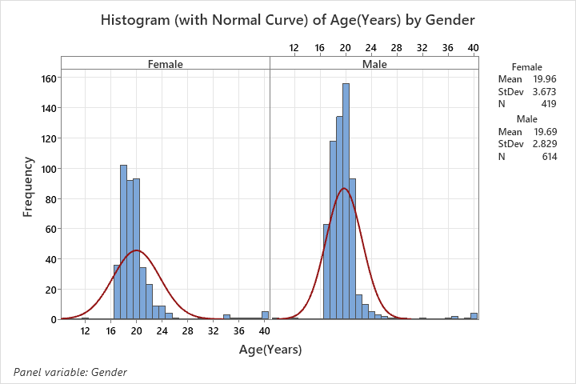
DATASET DESCRIPTION
Dataset obtained from Kaggle.com

Slide 6
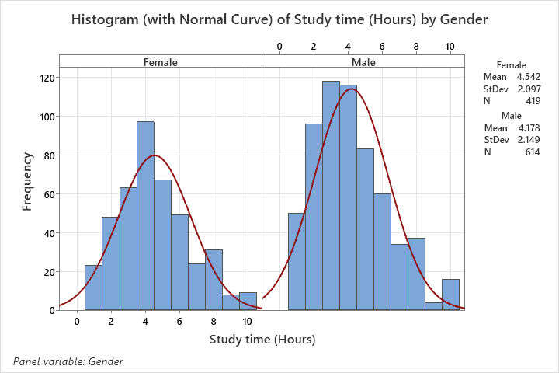

Slide 7
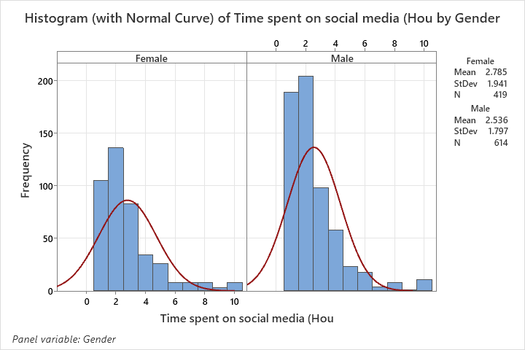

Slide 8
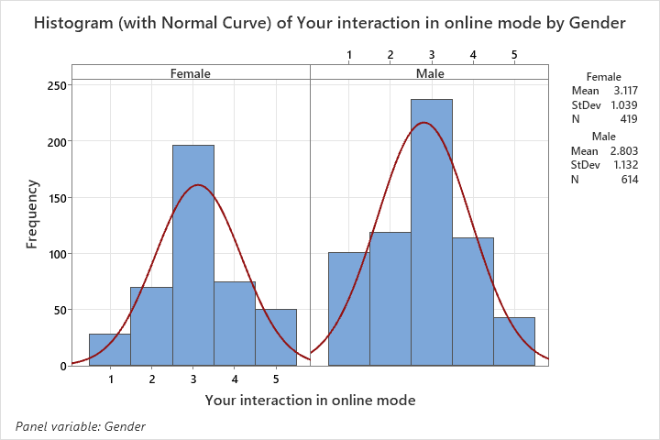

Slide 9
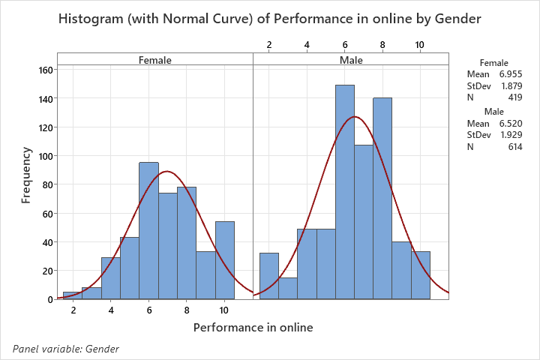

Slide 10
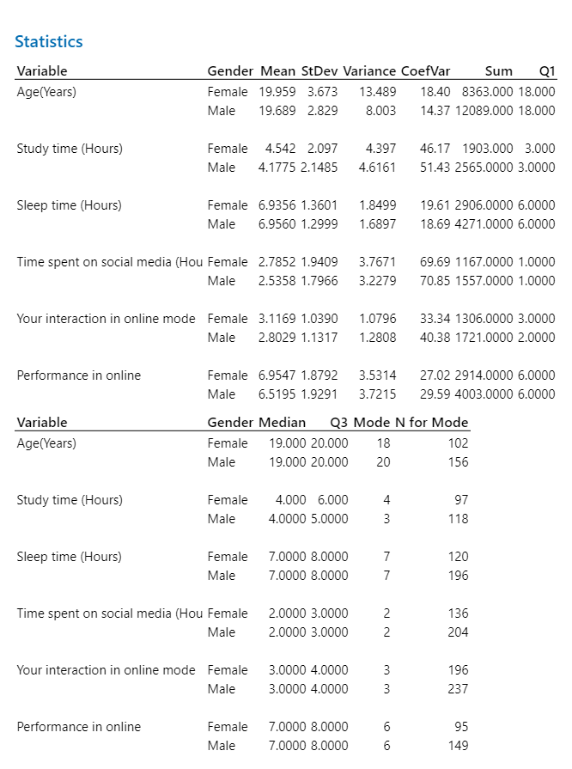
DESCRIPTIVE STATISTICS

Slide 11
CORRELATION ANALYSIS
Study Time vs Performance: Weak positive correlation (0.134).
Sleep Time vs Performance: Very weak positive correlation (0.065).
Social Media vs Performance: Weak negative correlation (-0.087).
Online Interaction vs Performance: Moderate to strong positive correlation (0.558).

Slide 12
REGRESSION ANALYSIS
Study Time: Positive relationship, slope = 0.1493.
Sleep Time: Positive but minimal relationship, slope = 0.448.
Social Media Usage: Negative effect, slope = -0.0838.
Online Interaction: Strong positive relationship, slope = 0.3210.

Slide 13
RESULTS AND DISCUSSION
Study time has a minimal impact on performance.
Sleep time's impact on performance is insignificant.
Social media has a small negative effect on performance.
Online interaction is a key factor influencing better performance.

Slide 14
CONCLUSIONS AND RECOMMENDATIONS
Conclusions: Interaction in online classes is the strongest determinant of performance, while study time, sleep, and social media use have minimal effects.
Recommendations:
Focus on improving study quality.
Enhance interactive elements in online learning.
Promote effective time management among students.

Slide 15
THANK YOU!

