Slide 1
Online Food Ordering System
Roll no | Name
CB.EN.U4CSE18415 | Dhanush C
CB.EN.U4CSE18439 | Mithun Rosinth V V
Section: E Faculty in Charge: Dr.G.Jeya Kumar

Slide 2
Introduction
The purpose of this project is to provide an easily accessible interface wherein the customer can view and place the order easily.

Slide 3
Overview
Introduction
Abstract
Logical Database Design ER Diagram
Entities
Attributes
Relationships
ER to Relational Schema Mapping
User Interface Screens
References

Slide 4

Abstract
The customer can register initially with minimum details and will be allowed to check the menu items before ordering them, adding them to cart and submit the order. The system records the details in the database so that it will be easy to retrieve later. The users of the system also include employee/admin who will handle info related to product addition and assigning vehicle for placed orders.

Slide 5
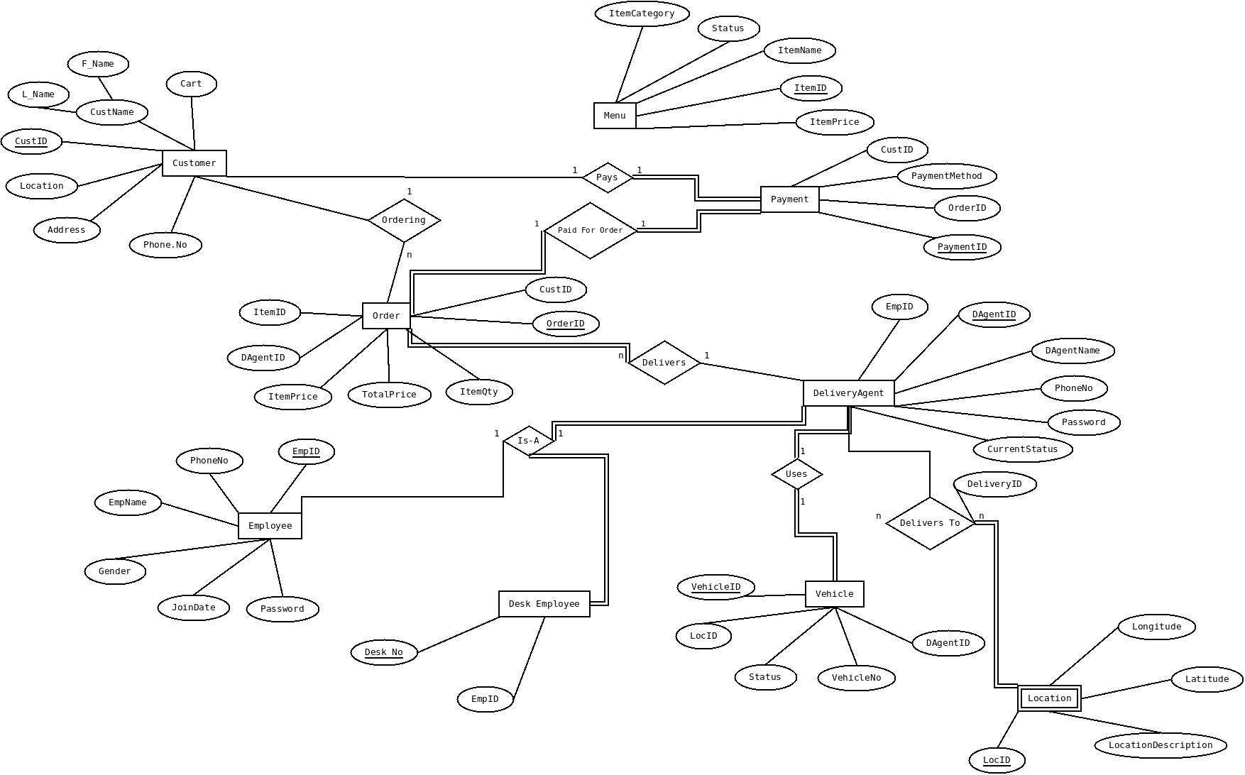
ER diagram

Slide 6
ER diagram -Entities
Customer
Order
Employee
Vehicle
Menu
Payment
DeliveryAgent
DeskEmployee
Location

Slide 7
ER diagram -Attributes
Customer(CustID,F_Name,L_Name,Address,Cart,Location,Phone.no)
Order(OrderID,DAgentID,ItemPrice,TotalPrice,ItemQty,CustID,ItemID)
Employee(EmpID,EmpName,PhoneNo,Gender,JoinDate,Password)
Vehicle(VehicleID,LocID,Status,VehicleNo,DAgentID)
Menu(ItemID, ItemName,ItemPrice,Status,ItemCategory)
Payment(CustID,PaymentMethod,OrderID,PaymentID)
DeliveryAgent(EmpID,DAgentID,AgentName,PhoneNo,Password,CurrentStatus)
DeskEmployee(EmpID,Desk.no)
Location(LocID,Longitude,Latitude,LocationDescription)

Slide 8
ER diagram -Relationships
Ordering - Customer,Order
Pays - Customer,Payment
Paid for Order - Payment,Order
Delivers - Order,DeliveryAgent
Is-A - Employee,DeliveryAgent,DeskEmployee
Uses - Vehicle,DelveryAgent
DeliversTo - DeliveryAgent,Location

Slide 9
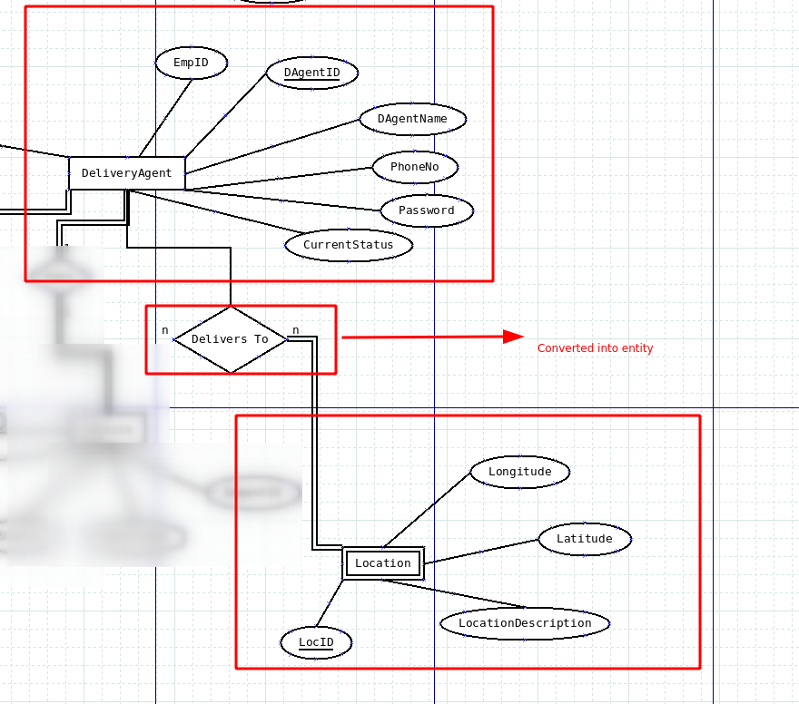
ER to Relational Schema Mapping
Delivery Table(DeliveryID,DAgentID,LocID)

Slide 10
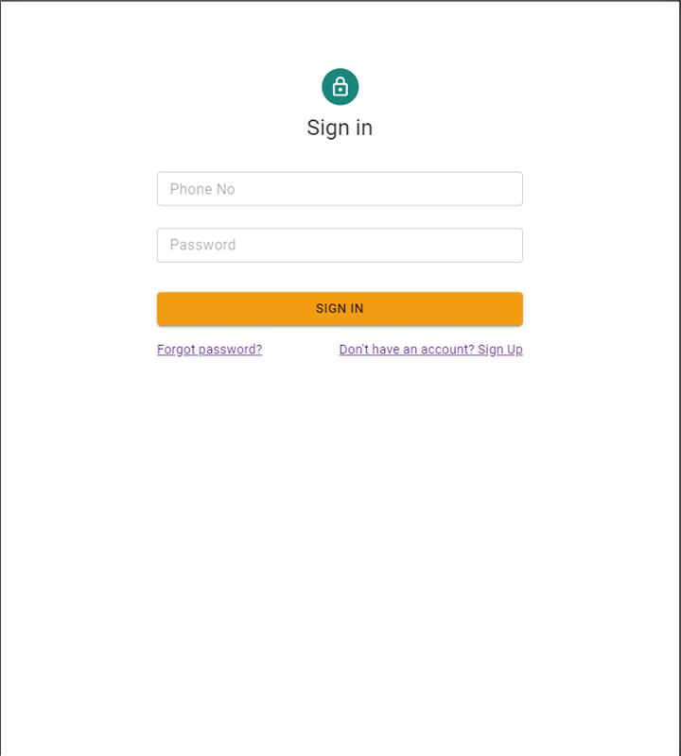
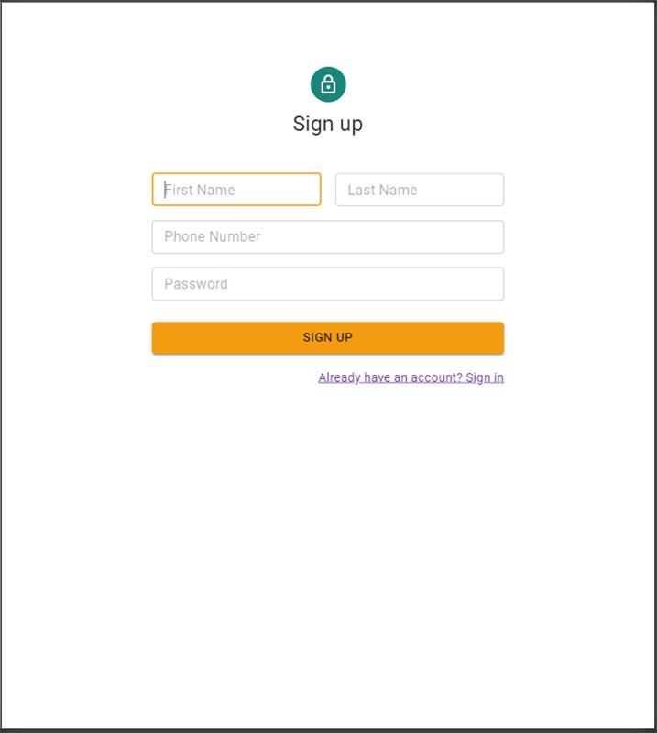
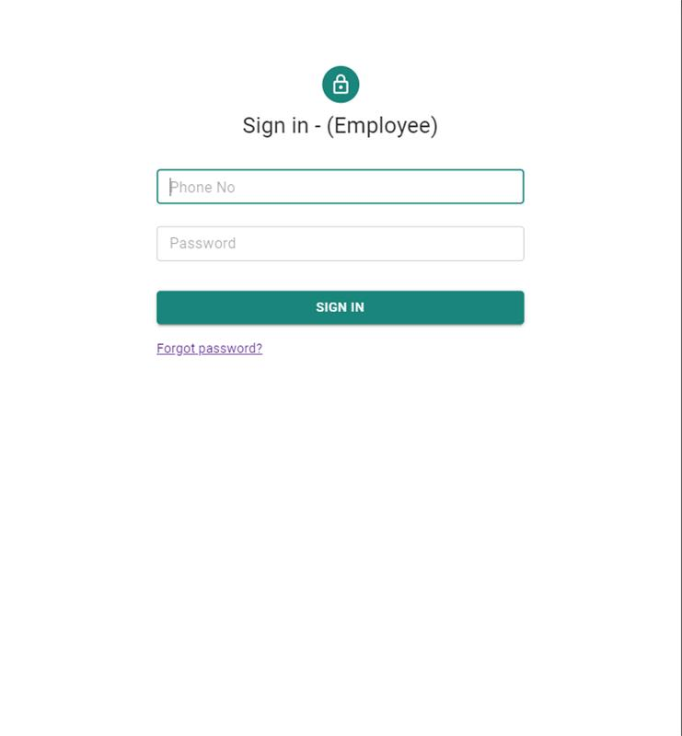
User Interface Screens

Slide 11
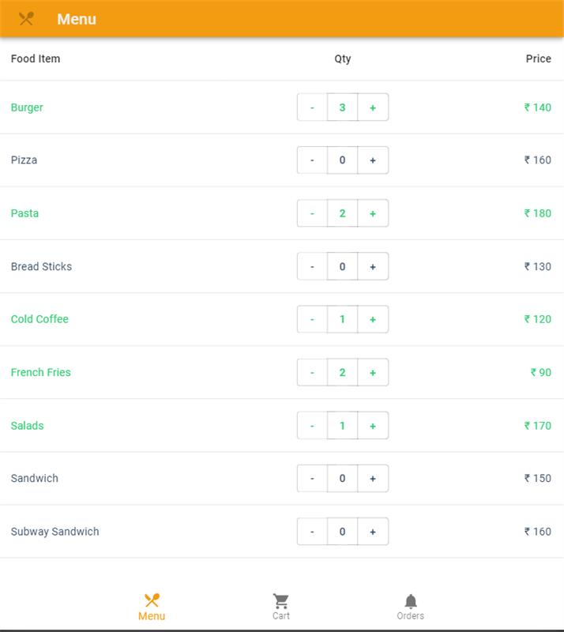
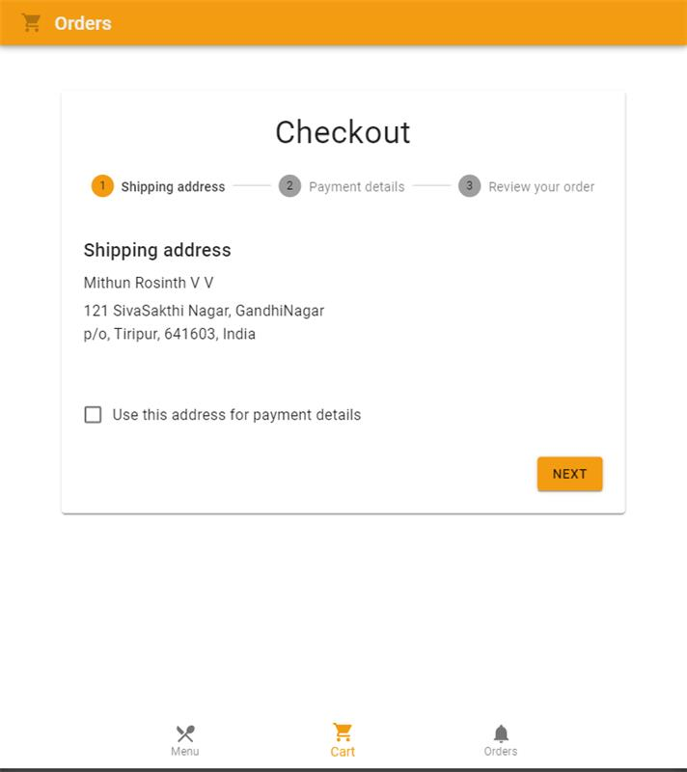
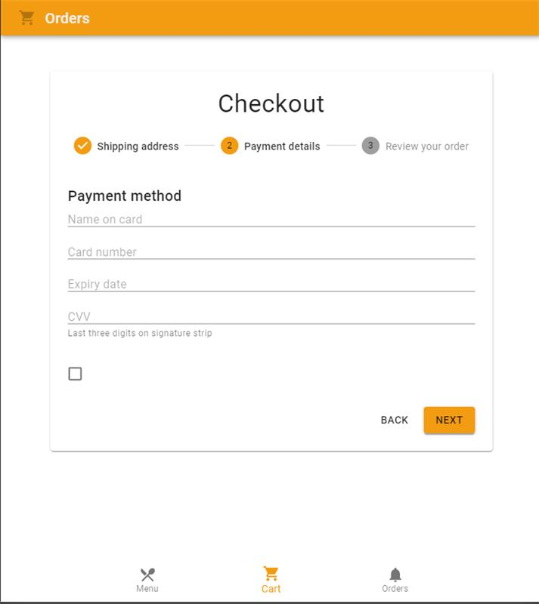
User Interface Screens

Slide 12
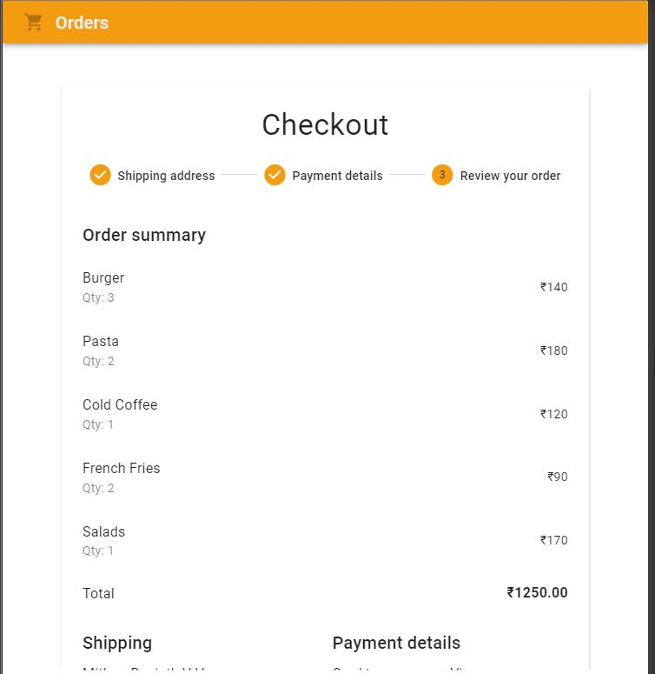
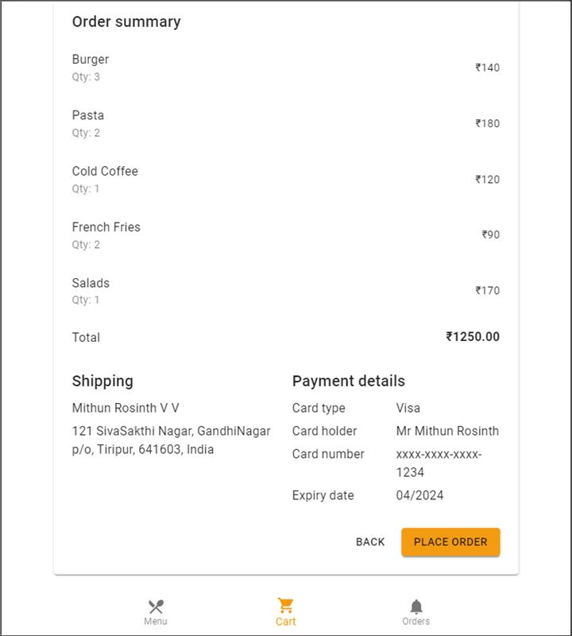
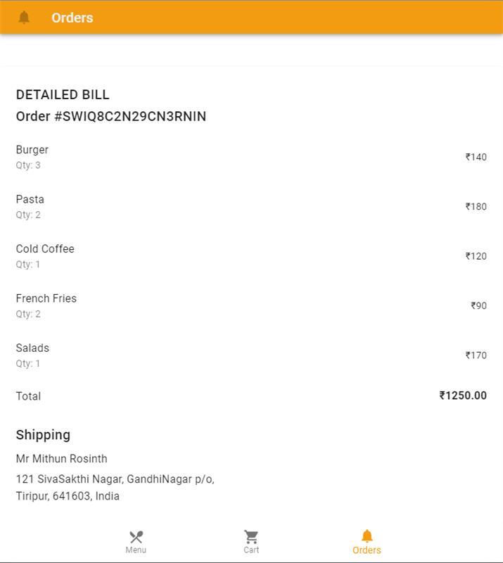
User Interface Screens

Slide 13
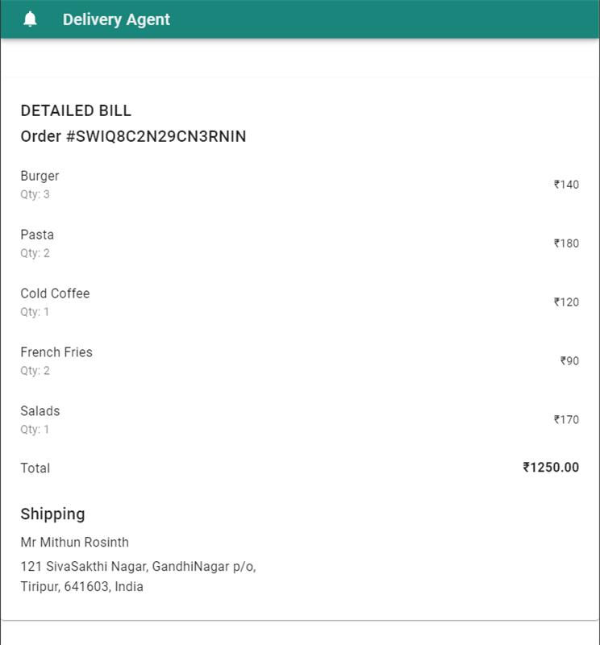
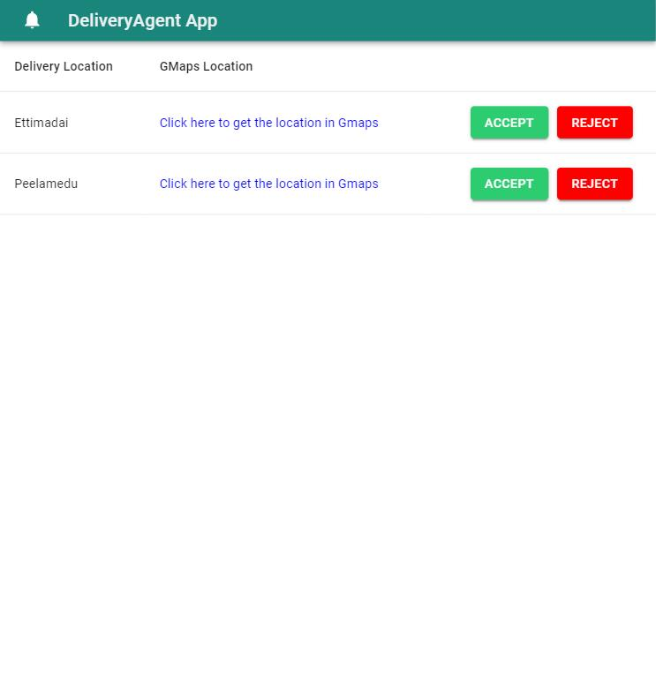
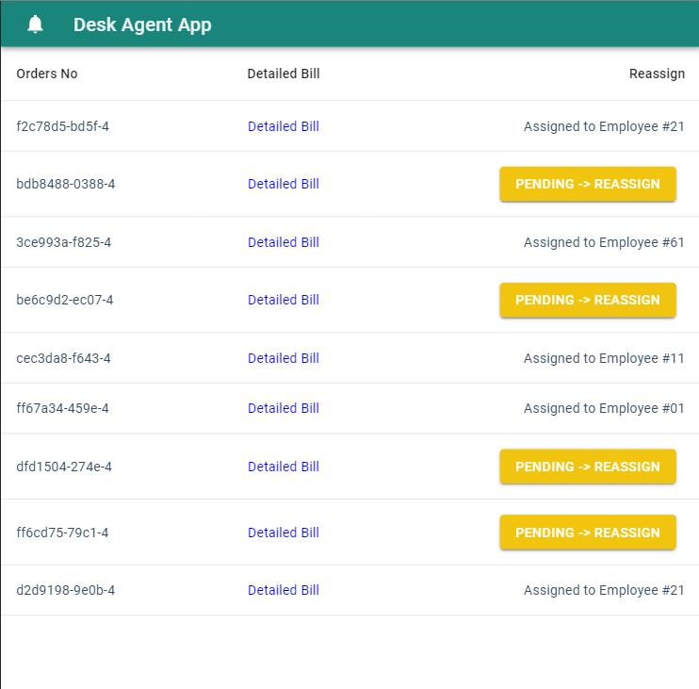
User Interface Screens

Slide 14
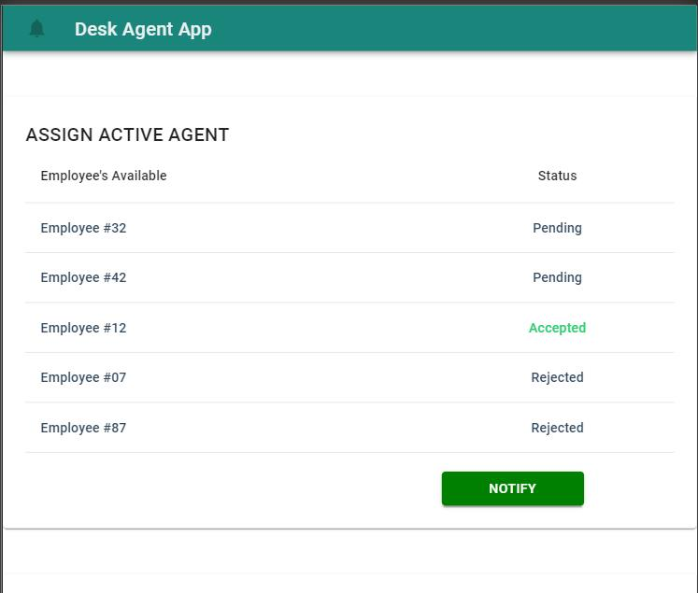
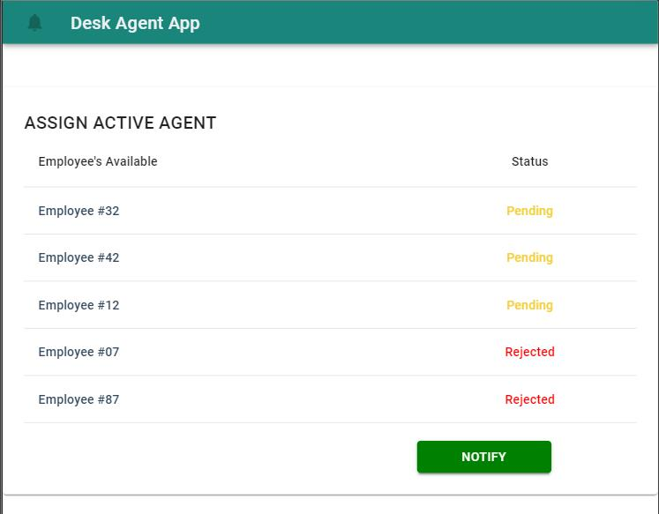
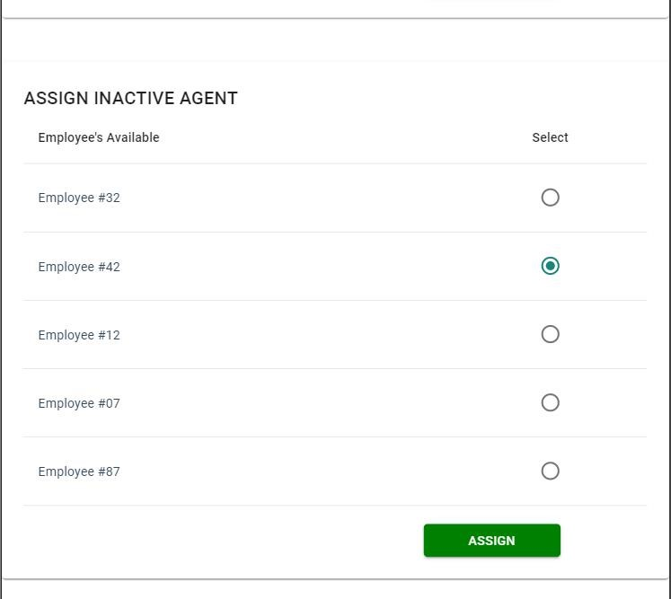
User Interface Screens

Slide 15
References
https://material-ui.com/

Slide 16
Thankyou
Questions

