Slide 1
Online Food Ordering System
Rollno | Name
CB.EN.U4CSE18415 | C.Dhanush
CB.EN.U4CSE18439 | V.V.Mithun Rosinth
Section: E Faculty in Charge: Dr.G.JeyaKumar

Slide 2
Overview
Normalization
Creation of Tables
User Interface Screens
References

Slide 3
Normalization
1NF:
Removing Multivalued attributes:
*The cart attribute in the Customer entity is multivalued as it contains the contents of the customer's cart
*We add Cart as a separate entity with CartID and CustID as Primary key
Specialization:
*The Employee entity can be specialized by splitting it into two types of employees and having unique attributes to each
*Here we split the Entities into DeskEmployee and DeliveryAgent

Slide 4
Normalization
2NF:
Partial Dependencies:
EmpID -> DAgentName,Phone,Password
CustID -> ItemID, ItemQty
Removing Extraneous Attributes:
*The attributes DAgentId, DAgentName, Password, Phone are just copies of the EmpID, EmpName, Phone,Password in the Employee table
*The Primary key DAgentID is dependent on EmpID
*So we remove all these attributes out of the table and just have EmpID and CurrentStatus in the table
Replacing DAgentID with EmpID:
*As the attribute DAgentID is removed from the schema we have to replace it's occurrences with EmpID

Slide 5
Normalization
3NF:
Transitive Dependencies:
ItemID -> ItemQty => This applies in two Entities -> Order and Cart
EmpID -> CurrentStatus => We removed the attributes and added them to new entity
OrderID -> LocID,EmpID => DeliveryID Becomes an Extraneous attribute here (Transitivity Rule)
Changes:
*The Primary key of Cart is now both CustID and ItemID
*New Entity named Status is added to satisfy the EmpID -> CurrentStatus dependency
*OrderID is made the Primary Key of the Delivery entity
*To satisfy the ItemID -> ItemQty in the Order entity we add a new entity named OrderItems and Add ItemID,OrderID,ItemQty,ItemPrice to the entity and make ItemID and OrderID the primary key
* Since TotalPrice can be derived from ItemQty and ItemPrice It is also removed

Slide 6
Normalization
Dependencies not satisfying BCNF:
OrderID -> PaymentID => in Payment entity
Changes:
*We added PaymentID as an attribute to the Order entity and removed OrderID and CustID from Payment entity
*Since the Dependencies satisfied by the status table is already satisfied by the DeliveryAgent entity, we remove the Status entity
*All the Dependencies are preserved and even after removing the Extraneous attributes the schema and dependencies are intact

Slide 7
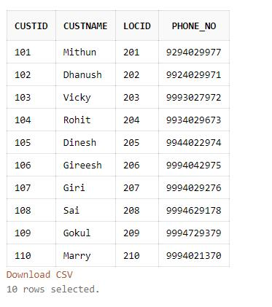
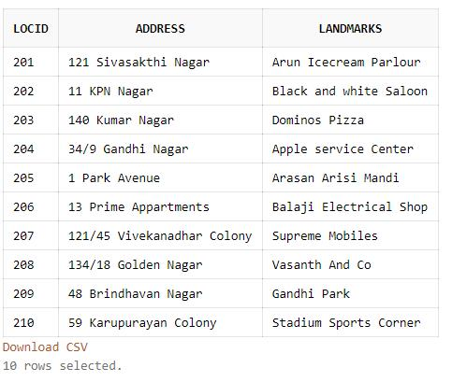
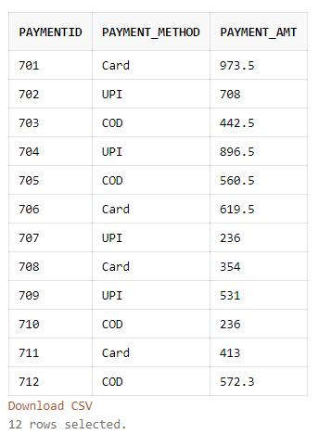
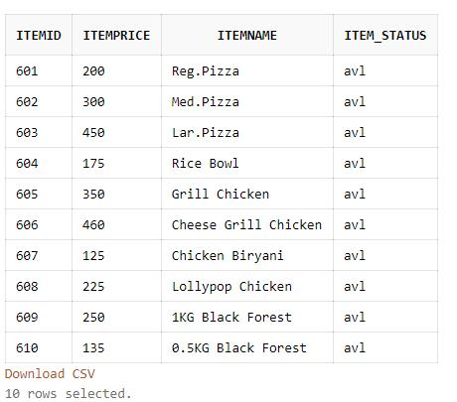
Creation of Tables

Slide 8
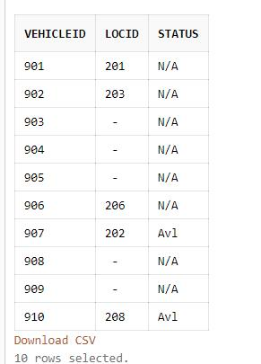
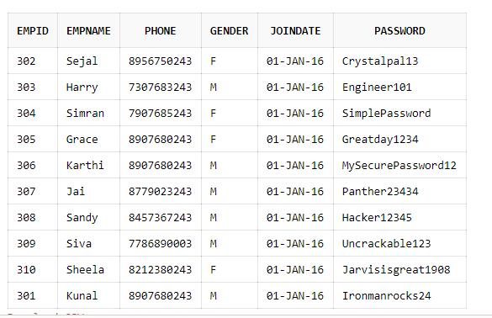
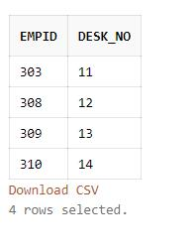

Slide 9
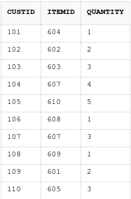
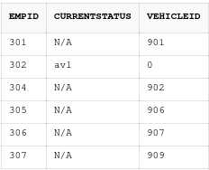
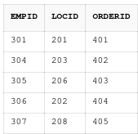

Slide 10
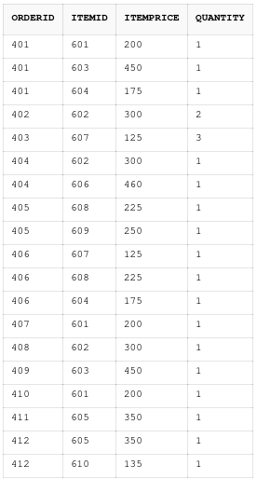
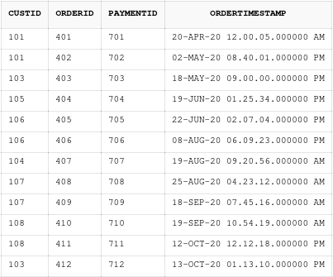

Slide 11
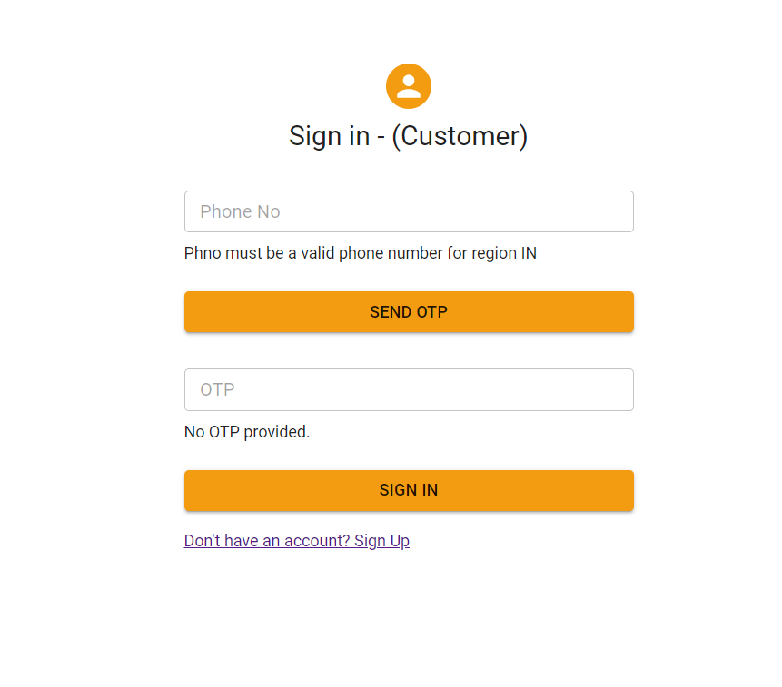
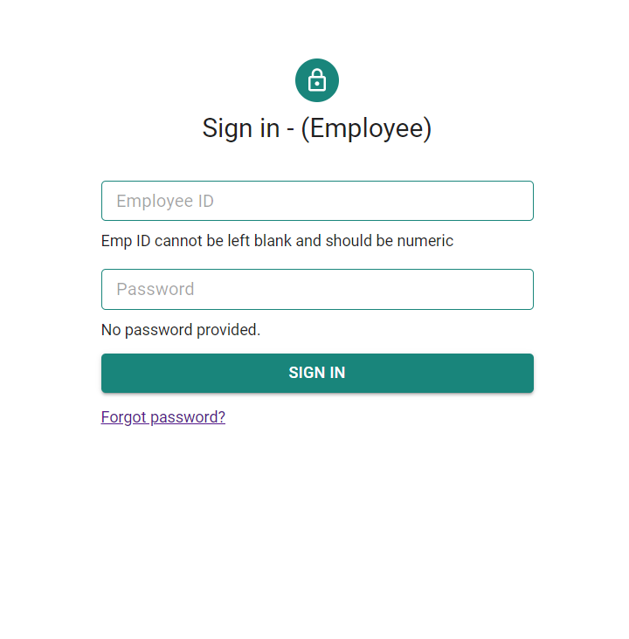
User Interface Screens

Slide 12
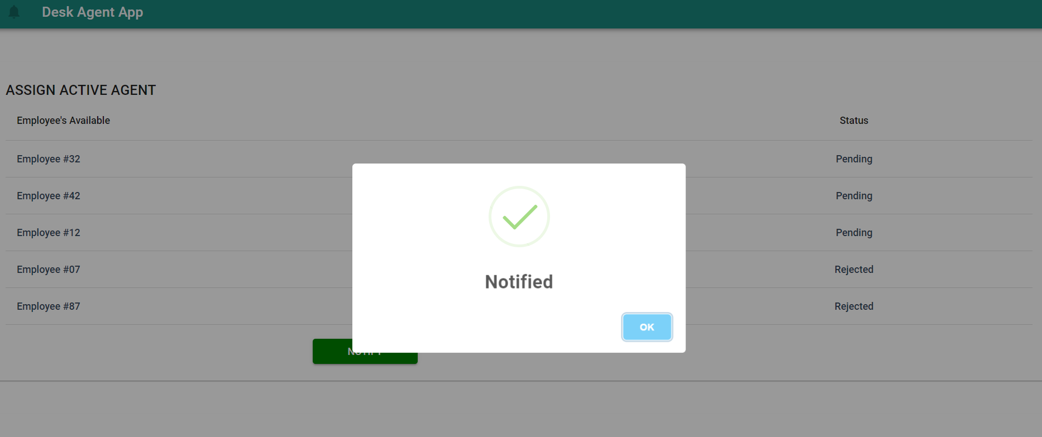
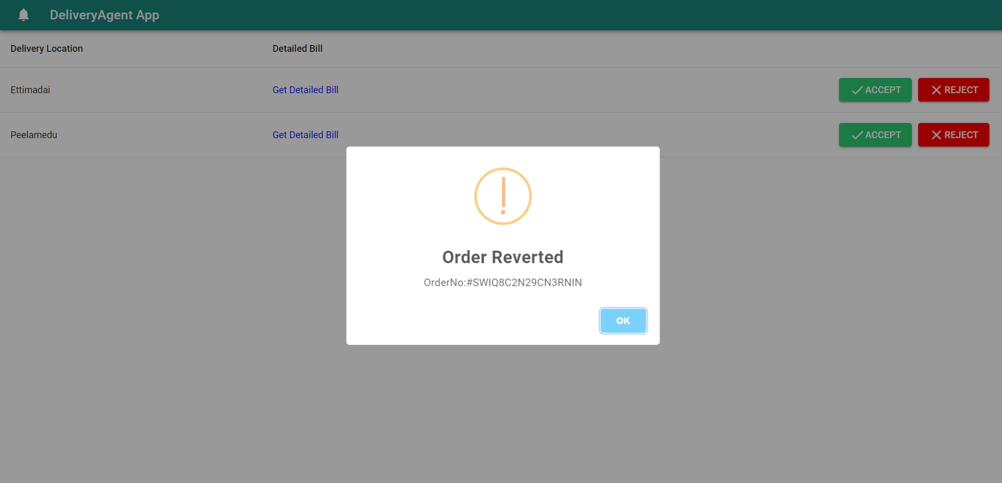
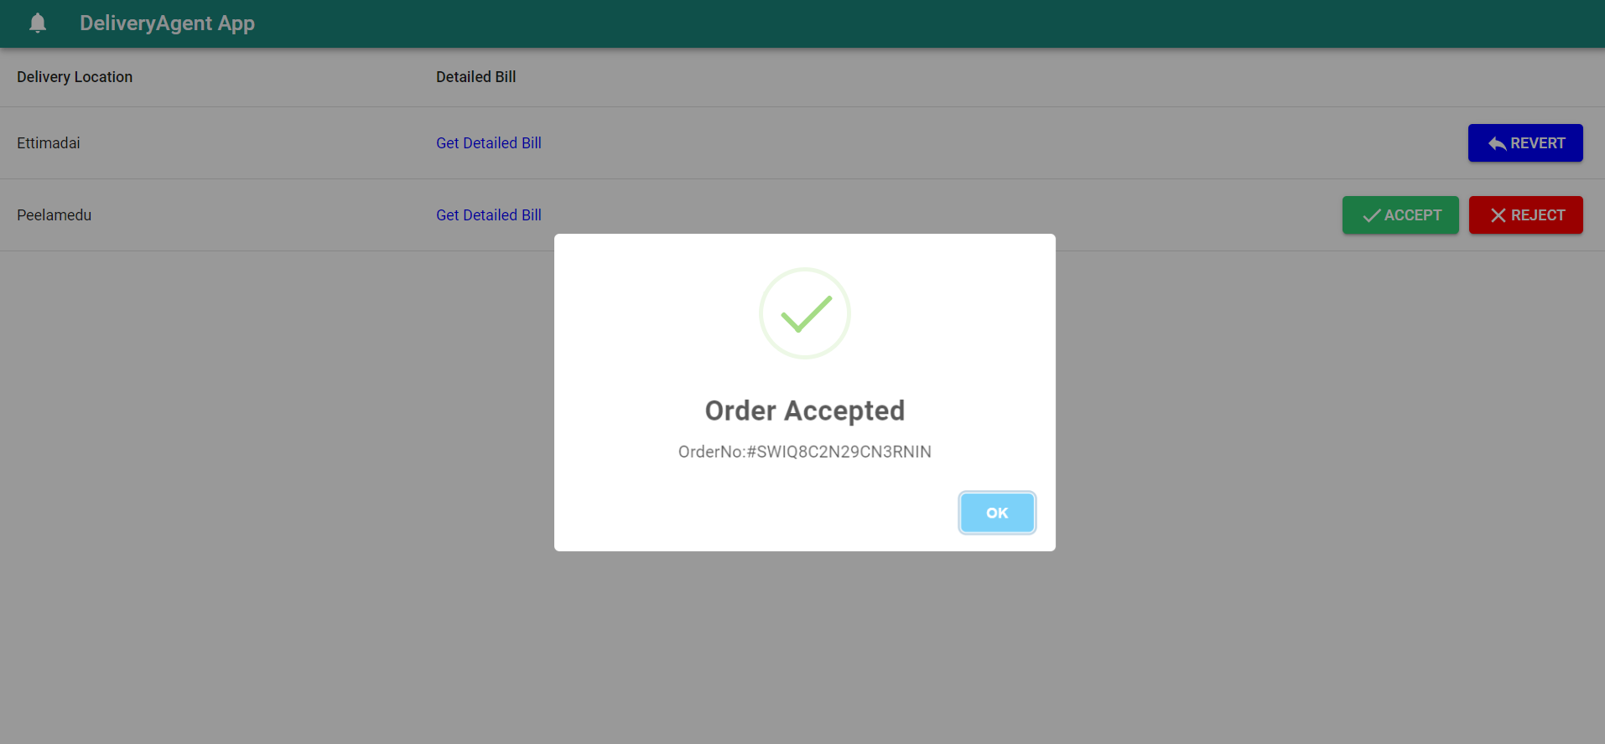
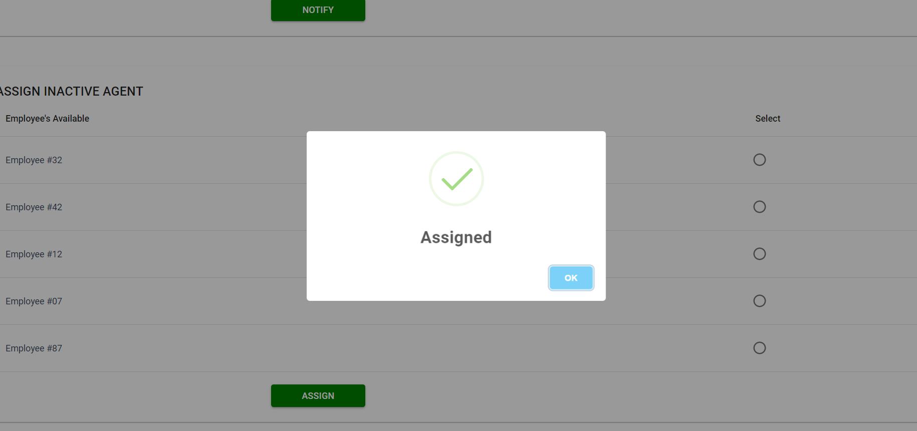

Slide 13
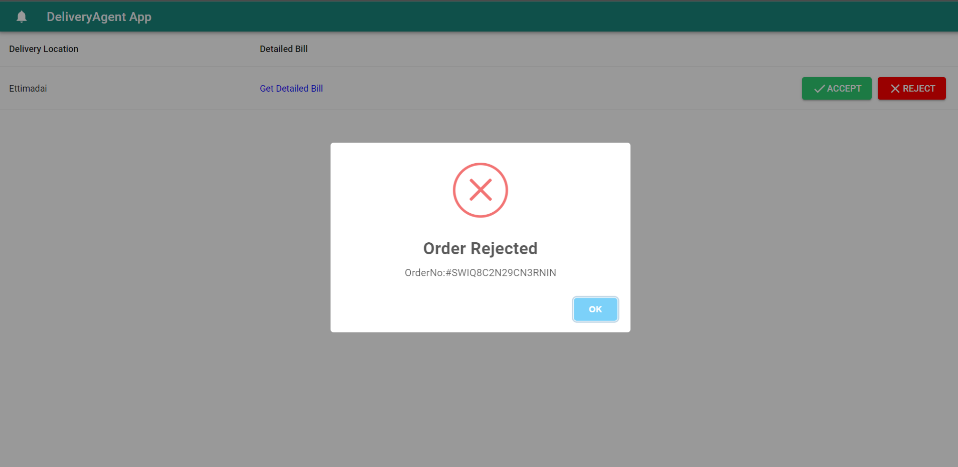
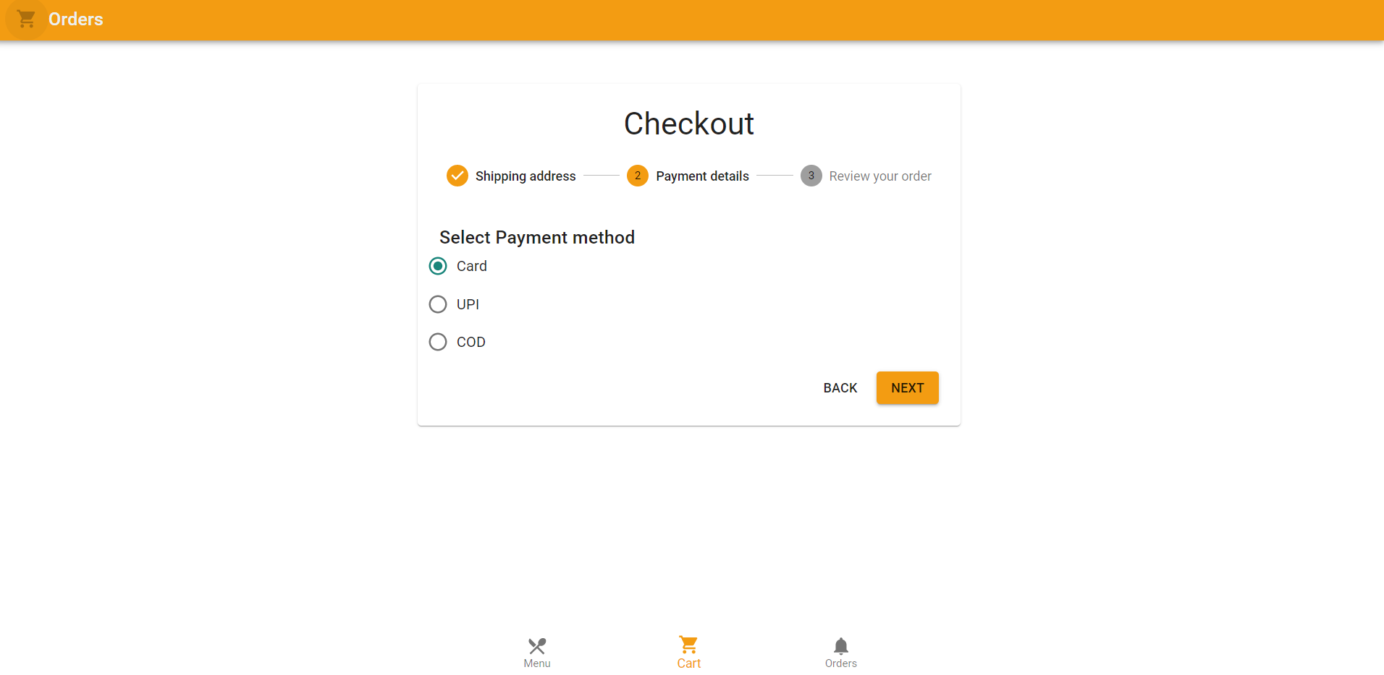

Slide 14
Thankyou
Questions

