Slide 1


Project Report On GPS Toll based System simulation using Python
TRAINEE ; DHANUSH
MENTOR ; PRIYADHARSHINI

Slide 2
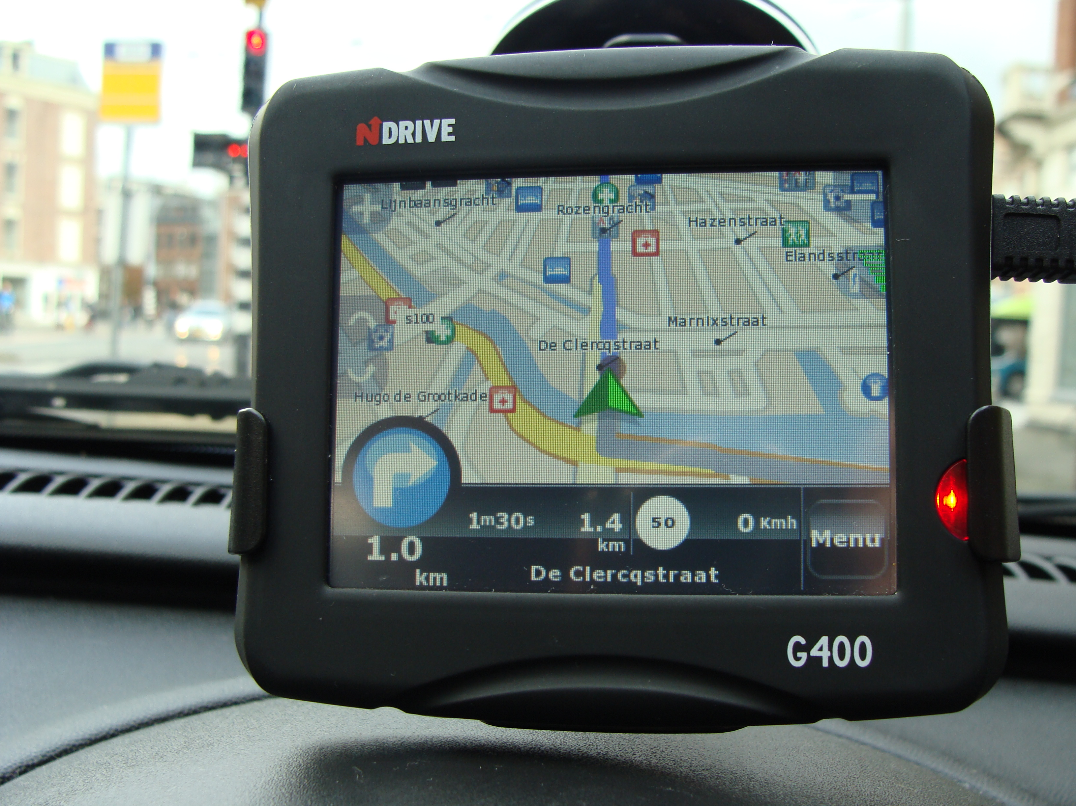
Problem Statement
• Create a simulation that models a modern toll collection system based on GPS data.
• Simulate vehicle movements using a framework like SimPy.
• Define toll zones with GPS coordinates.
• Calculate distances traveled within toll zones.
• Compute toll charges based on distance or zone crossings.
• Simulate payment deductions from user accounts.
• Challenges: Accuracy, performance, and integration

Slide 3
Unique Idea Brief (Solution)
Dynamic Routing and Toll Calculation Simulation for GPS-Based Navigation Systems using Python
Map Representation: Utilize a graph-based representation where nodes represent intersections or locations, and edges represent roads with associated travel times and toll costs.
Real-Time Traffic Simulation: Integrate real-time traffic data to simulate varying travel times on different routes.
Dynamic Toll Calculation:Incorporate toll calculation based on selected routes. Toll costs can vary based on factors like distance, time of day, and traffic congestion.

Slide 4
Features Offered
Geospatial Data Handling: Utilize GeoPandas for managing toll station locations and vehicle routes, and Shapely for geometric operations.
Simulation Frameworks: Employ SimPy for simulating vehicle movements and toll transactions.
Web Development: Choose Flask or Django for building a web interface to manage user registration, toll payments, and real-time tracking.
Data Management: Use SQLAlchemy or Django ORM for interacting with databases to store vehicle data, toll transactions, and user information.
Visualization and Reporting: Visualize vehicle routes and toll stations using Folium, and generate reports using Matplotlib for analyzing toll revenue and system performance.
Python’s versatility in handling geospatial data, simulations, web development, data management, and visualization makes it suitable for simulating complex systems like GPS toll-based systems effectively.

Slide 5





Architecture Diagram
COMMUNICATION
Billing
Backend system
GPRS/UMTS
t
ETC VPN
GPS Sattellite
Mobile Device
GPS Receiver
Camera
ENFORCEMENT
OBU

Slide 6
Technologies used
Streamlit :
Streamlit is the primary framework used for building interactive web applications with Python.
Shapely :
Shapely is a Python package for manipulation and analysis of geometric objects in the Cartesian plane.
Folium :
Folium is a Python library used for visualizing geospatial data with interactive maps.
Geopandas :
Geopandas extends the pandas library to include spatial operations and data structures for geospatial data.
Pandas :
Pandas is a powerful data analysis and manipulation tool, commonly used for tabular data.
NumPy :
NumPy is a fundamental package for numerical computing in Python, providing support for large, multi-dimensional arrays and matrices.

Slide 7
Conclusion
The dynamic toll pricing and zone management system presented in the project provides a comprehensive solution for calculating toll charges based on real-time factors and optimizing traffic flow.
It uses Streamlit for user interaction and Folium for map visualization, offering an intuitive interface for users to plan their journeys and understand the associated costs effectively.
Future enhancements could include real-time data integration for congestion updates and more advanced route optimization algorithms

