Slide 1
NETVISTA 3D: ARQ PROTOCOL EVALUATION
Comparative Investigation of Go-Back-N and Selective Repeat ARQ under Frame Losses
__________________________________________________________________
Student ID: 25CS024 | Subject: ITUC201 Fundamentals of Computer Networks
Assigned Topic: Go-Back-N & Selective Repeat under losses | Assessment: Individual (20 Marks)
Implementation: Python 3.12 Discrete-Event Engine (Priority Queue) | Academic Year: 2026–27

Slide 2
ITUC201: FUNDAMENTALS OF COMPUTER NETWORKS | STUDENT ID: 25CS024
Project Objectives & Core Research Question
PRIMARY RESEARCH QUESTION
"How do retransmission counts change with window size and loss pattern?"
• Does Go-Back-N's discard policy severely penalize channel efficiency as window size expands?
• Can Selective Repeat's out-of-order buffering maintain constant retransmission overhead?
• What happens when multiple frames (4 and 7) are lost in close proximity?
TECHNICAL DELIVERABLES & GOALS
1. Event-Driven Simulator (Python 3):
- Pure priority queue (heapq) discrete-event architecture.
- Zero arbitrary loops or polling; explicit simulation timestamps.
2. Controlled Experimental Framework:
- Window sizes W = 3 vs W = 5.
- Deterministic loss at frames 4 and 7 (first attempt only).
- Identical transmission and propagation latencies.
3. Verification & Visualizations:
- Space-time ladder diagrams for every experiment.
- Automated CSV metrics, comparative graphs, and Streamlit dashboard.
4. University Syllabus Grounding:
- Solved ITUC201 examination numerical on link efficiency.

Slide 3
ITUC201: FUNDAMENTALS OF COMPUTER NETWORKS | STUDENT ID: 25CS024
Reliable Data Transmission & Sliding Window Concept
1. Stop-and-Wait ARQ
• Efficiency: η = 1 / (1 + 2a), where a = Tp / Tt.
• Transmitter waits for ACK after every single frame.
• If propagation delay (Tp) is high, link remains idle > 90% of the time.
• Unacceptable for modern high-bandwidth high-latency links.
2. Pipelining & Sliding Window
• Allows up to W frames to be in flight simultaneously.
• Link Saturation Condition: W ≥ 1 + 2a.
• Achieves up to 100% link utilization under zero errors.
• Requires sequence number management and recovery policies under frame loss.
3. Loss Recovery Protocols
• Go-Back-N (GBN):
- Receiver window Wr = 1.
- Discards out-of-order frames.
- Retransmits all in-flight frames.
• Selective Repeat (SR):
- Receiver window Wr = Ws.
- Buffers out-of-order frames.
- Retransmits solely the lost frame.

Slide 4
ITUC201: FUNDAMENTALS OF COMPUTER NETWORKS | STUDENT ID: 25CS024
Go-Back-N (GBN) Protocol Principles
SENDER BEHAVIOR (GBN)
• Sender Window:
- Window size Ws. Window range: [send_base, send_base + Ws - 1].
- next_seq_num points to next unsent frame.
• Single Logical Timer:
- Timer is set for the oldest unacknowledged frame (send_base).
- Timer restarts whenever an ACK advances send_base.
- Timer stops only when all sent frames are acknowledged.
• Retransmission on Timeout:
- If timeout fires for send_base, sender 'Goes Back N'.
- Retransmits ALL outstanding frames currently in flight:
from send_base up to next_seq_num - 1.
- Undamaged frames already sent are wastefully retransmitted!
RECEIVER BEHAVIOR (GBN)
• Receiver Window Size Wr = 1:
- Receiver only accepts the exact expected frame: rcv_base.
- Has ZERO buffer capacity for out-of-order packets.
• In-Order Frame Receipt:
- Accepts frame, passes it to Application Layer.
- Advances rcv_base = rcv_base + 1.
- Sends Cumulative ACK(rcv_base - 1).
• Out-of-Order Frame Receipt:
- If frame sequence number ≠ rcv_base, frame is DISCARDED.
- Re-transmits duplicate cumulative ACK for the last in-order frame.
• Sequence Number Requirement:
- Minimum sequence numbers: Ws ≤ 2^m - 1 (m bits required).

Slide 5
ITUC201: FUNDAMENTALS OF COMPUTER NETWORKS | STUDENT ID: 25CS024
Selective Repeat (SR) Protocol Principles
SENDER BEHAVIOR (SR)
• Window Size Ws:
- Permits up to Ws frames in flight.
• Per-Frame Independent Timers:
- Every transmitted frame has its OWN dedicated timer.
- When ACK(k) arrives, timer for frame k is cancelled.
• Selective Retransmission:
- When timer for frame k expires, ONLY frame k is retransmitted.
- Unaffected frames in flight or buffered are NOT retransmitted.
• Window Advancement:
- Window base advances forward ONLY when the oldest frame at send_base is acknowledged.
RECEIVER BEHAVIOR (SR)
• Receiver Window Size Wr = Ws:
- Can receive out-of-order packets within [rcv_base, rcv_base + Wr - 1].
• Receiver Buffering:
- Accepts out-of-order frames and stores them in buffer memory.
- Returns an Individual / Selective ACK(k) acknowledging solely frame k.
• In-Order Application Delivery:
- When missing frame rcv_base arrives, receiver delivers contiguous buffered frames to application.
- Window base rcv_base slides past all delivered frames.
• Window Constraint (Crucial Rule):
- Ws + Wr ≤ 2^m ⟹ Ws ≤ 2^(m - 1) (Half of sequence number space).

Slide 6
ITUC201: FUNDAMENTALS OF COMPUTER NETWORKS | STUDENT ID: 25CS024
Protocol Architectural Matrix: GBN vs Selective Repeat
Protocol Feature | Go-Back-N (GBN) | Selective Repeat (SR)
Receiver Window (Wr) | 1 (Strict in-order) | Equal to Ws (Out-of-order permitted)
Receiver Buffering | None (Discards out-of-order frames) | Buffers all valid frames within window
Acknowledgment Scheme | Cumulative (ACK n confirms ≤ n) | Individual / Selective (ACK n confirms only n)
Timer Management | Single timer for oldest unACKed frame | Dedicated independent timer per frame
Retransmission Action | Retransmits all outstanding in-flight frames | Retransmits only the specific lost frame
Bandwidth Efficiency | Lower under loss (wasteful retransmissions) | High (strictly minimal retransmissions)
Sequence Sizing Rule | Ws ≤ 2^m - 1 | Ws + Wr ≤ 2^m ⟹ Ws ≤ 2^(m - 1)

Slide 7
ITUC201: FUNDAMENTALS OF COMPUTER NETWORKS | STUDENT ID: 25CS024
Event-Driven Discrete-Event Simulator Architecture
EVENT-DRIVEN ENGINE (heapq)
• Priority Queue Scheduling:
- Uses Python's heapq priority queue.
- Simulation clock jumps directly to earliest scheduled event.
- Eliminates polling loops, sleep delays, and race conditions.
• Event Structure:
- (time, event_id, event_type, frame_id, payload)
- event_id acts as strict tie-breaker for simultaneous events.
• State Machine Integrity:
- Full tracking of in-flight frames, ACK status, buffer slots.
- Sequence validation ensures obsolete timer events are safely ignored.
SIMULATION EVENT LIFECYCLE
1. FRAME_TX:
- Pushes frame onto channel; schedules FRAME_ARRIVAL.
- If Attempt 1 and frame in {4, 7}, injects loss (no arrival scheduled).
2. FRAME_ARRIVAL:
- GBN: Check if in-order; accept or discard; schedule ACK.
- SR: Buffer frame; schedule individual ACK; slide rcv_base.
3. ACK_ARRIVAL:
- Slide send_base forward; manage timers; send new frames.
4. TIMEOUT:
- GBN: Go-Back-N (retransmit all in-flight frames).
- SR: Selective Retransmission (retransmit single frame).

Slide 8
ITUC201: FUNDAMENTALS OF COMPUTER NETWORKS | STUDENT ID: 25CS024
Experimental Setup & Controlled Assumptions
Parameter | Configured Value | Simulation Significance & Notes
Total Unique Data Frames | 10 Frames (0 to 9) | Default assessment payload size; verifies ordered delivery
Frame Transmission Time (Tt) | 1.0 Time Unit (TU) | Time required by transmitter to place full frame onto the wire
Propagation Delay (Tp) | 1.5 Time Units (TU) | One-way signal transit delay across the physical link
ACK Transmission Delay | 0.2 TU (Tx) + 1.5 TU (Prop) | Round-Trip Time RTT ≈ 1.0 + 1.5 + 0.2 + 1.5 = 4.2 TU
Retransmission Timeout (RTO) | 6.0 Time Units (TU) | Configured above RTT (4.2 TU) to prevent spurious timeouts

Slide 9
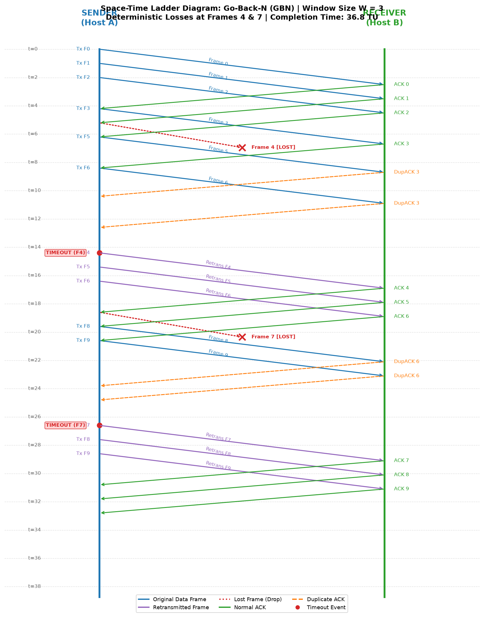
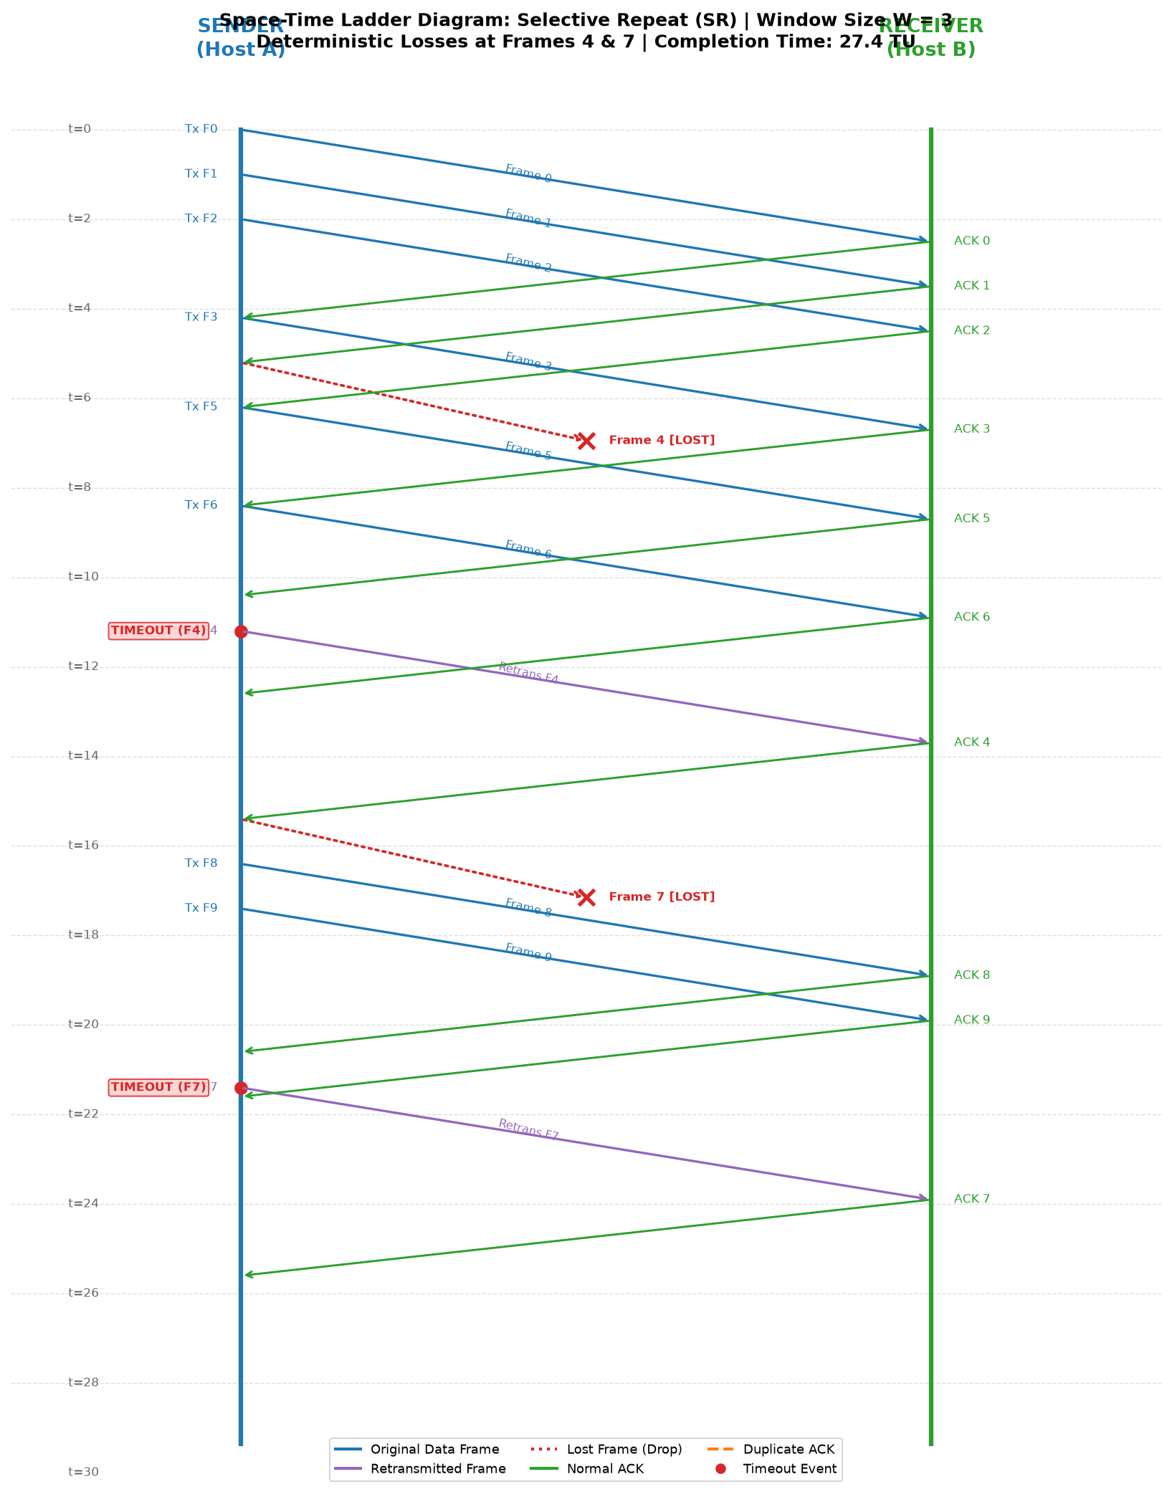
ITUC201: FUNDAMENTALS OF COMPUTER NETWORKS | STUDENT ID: 25CS024
Deterministic Loss Injection at Frames 4 and 7
LOSS TRACE ANALYSIS
• Frame 4 First Attempt:
- Dropped by channel (Red X).
- GBN: Receiver discards 5, 6; sends DupACKs.
- SR: Receiver buffers 5, 6; sends selective ACKs.
• Frame 7 First Attempt:
- Dropped by channel (Red X).
- In GBN W=3: Separate timeout occurs.
- In GBN W=5: Repaired in the same retransmission window!
• Retransmission Rule:
- Attempt 2 always delivered successfully.

Slide 10
ITUC201: FUNDAMENTALS OF COMPUTER NETWORKS | STUDENT ID: 25CS024
Experimental Results: Window Size W = 3
Performance Metric | Go-Back-N (W=3) | Selective Repeat (W=3) | Performance Difference
Retransmissions | 6 frames | 2 frames | SR saves 4 data-frame retransmissions (-66.7%)
Total Transmissions | 16 frames | 12 frames | SR consumes 25% less link bandwidth
Timeout Count | 2 timeouts | 2 timeouts | Equal timeouts (Loss of 4, Loss of 7)
Completion Time | 36.8 TU | 27.4 TU | SR is 25.5% faster in total transfer time
ANALYSIS FOR WINDOW SIZE 3
• In GBN (W=3), frames 4, 5, 6 were sent in window 1. Loss of 4 caused frames 5 and 6 to be discarded at the receiver. Upon timeout at t=13.5 TU, GBN retransmitted all 3 frames [4, 5, 6]. Later, frame 7 was lost; timeout triggered retransmission of frames [7, 8, 9]. Total = 3 + 3 = 6 retransmissions.
• In SR (W=3), frames 5 and 6 were buffered. Only frame 4 was retransmitted upon timeout. Later, only frame 7 was retransmitted. Total retransmissions = 1 + 1 = 2 frames.

Slide 11
ITUC201: FUNDAMENTALS OF COMPUTER NETWORKS | STUDENT ID: 25CS024
Experimental Results: Window Size W = 5
Performance Metric | Go-Back-N (W=5) | Selective Repeat (W=5) | Performance Difference
Retransmissions | 5 frames | 2 frames | SR saves 3 data-frame retransmissions (-60.0%)
Total Transmissions | 15 frames | 12 frames | SR consumes 20% less link bandwidth
Timeout Count | 1 timeout | 2 timeouts | GBN experienced only 1 timeout (repaired both!)
Completion Time | 23.4 TU | 19.0 TU | SR is 18.8% faster; both much faster than W=3
KEY DISCOVERY: THE WINDOW CONSOLIDATION EFFECT IN GBN (W=5)
• At W = 5, frames 4, 5, 6, 7, 8 were all transmitted in one continuous pipeline burst.
• Frame 4 was dropped, and Frame 7 was also dropped on its first attempt during this burst.
• When timeout expired on Frame 4, GBN retransmitted the entire window: [4, 5, 6, 7, 8] (5 frames).
• Because Frame 7 was retransmitted in this burst (Attempt 2), it arrived safely! This repaired Frame 7 simultaneously without ever triggering a second timeout. Thus, GBN experienced only 1 timeout and 5 retransmissions!

Slide 12
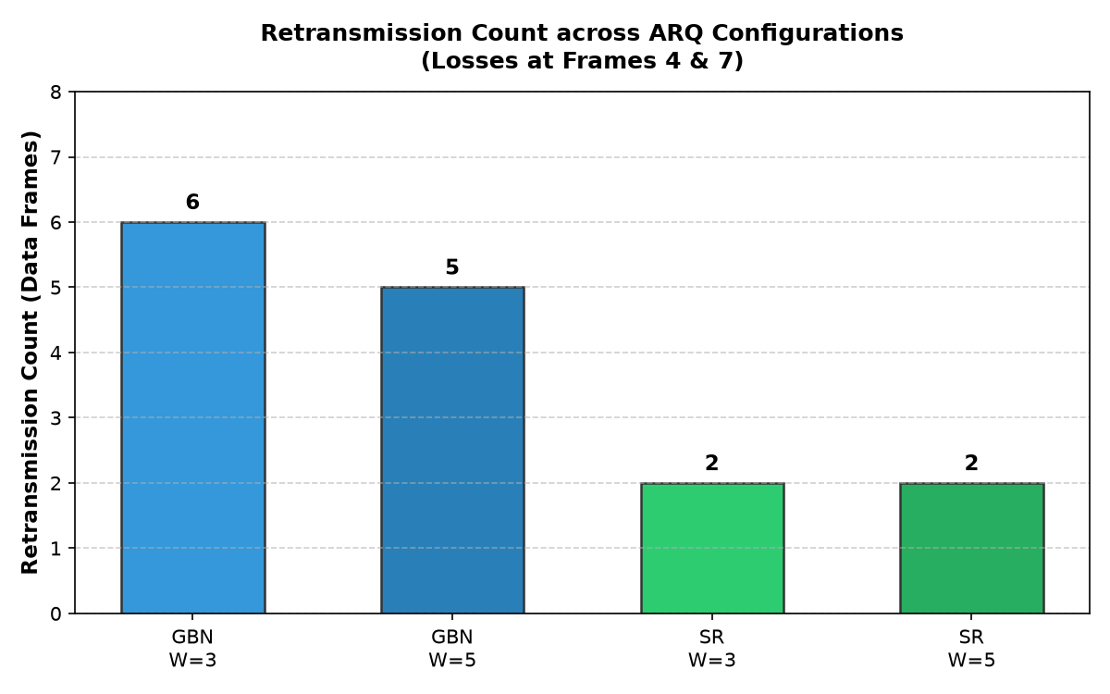
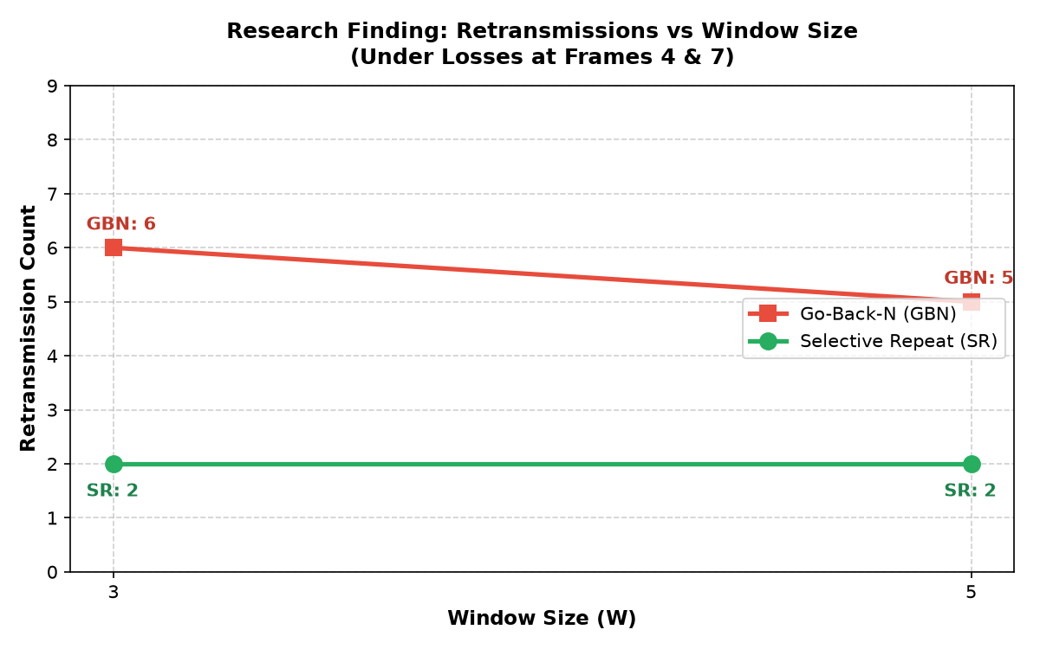
ITUC201: FUNDAMENTALS OF COMPUTER NETWORKS | STUDENT ID: 25CS024
Visual Comparison & Scientific Interpretation
RESEARCH QUESTION FINDING SUMMARY
1. Selective Repeat is strictly invariant to window size: 2 retransmissions across both W=3 and W=5.
2. Pipelining benefits both protocols: W=5 reduced completion time by 36.4% in GBN and 30.7% in SR.
3. Receiver buffering is the decisive differentiator in bandwidth preservation under packet loss.

Slide 13
ITUC201: FUNDAMENTALS OF COMPUTER NETWORKS | STUDENT ID: 25CS024
Solved University Examination Numerical (ITUC201 Standard)
PROBLEM STATEMENT & STEP-BY-STEP SOLUTION
Problem: 100 km terrestrial link, 10 Mbps bandwidth, propagation velocity v = 2 × 10^8 m/s, Frame size = 1000 bytes (8000 bits).
1. Latency Calculations:
- Transmission Delay: Tt = 8000 bits / (10 × 10^6 bps) = 0.8 ms
- Propagation Delay: Tp = 100 × 10^3 m / (2 × 10^8 m/s) = 0.5 ms
- Link Parameter a: a = Tp / Tt = 0.5 ms / 0.8 ms = 0.625
2. Stop-and-Wait ARQ Efficiency:
- η = 1 / (1 + 2a) = 1 / (1 + 2(0.625)) = 1 / 2.25 = 44.44%
- Achievable Throughput = 0.4444 × 10 Mbps = 4.44 Mbps
3. Optimal Sliding Window Size for 100% Saturation:
- W_opt ≥ 1 + 2a = 1 + 1.25 = 2.25 ⟹ W_opt = ⌈2.25⌉ = 3 frames
4. Minimum Sequence Number Bits (m):
- Go-Back-N: Ws ≤ 2^m - 1 ⟹ 3 ≤ 2^m - 1 ⟹ 2^m ≥ 4 ⟹ m ≥ 2 bits
- Selective Repeat: 2 Ws ≤ 2^m ⟹ 6 ≤ 2^m ⟹ 2^m ≥ 6 ⟹ m ≥ 3 bits

Slide 14
ITUC201: FUNDAMENTALS OF COMPUTER NETWORKS | STUDENT ID: 25CS024
Conclusion, References & Execution Guide
RESEARCH CONCLUSIONS
• Selective Repeat Superiority under Loss:
Confining retransmission strictly to damaged frames minimizes channel contention and retransmission counts.
• Window Sizing Trade-offs:
Larger windows improve throughput via pipelining, reducing total completion time across all configurations.
• Implementation Complexity:
SR requires complex receiver sorting and per-frame timer management, whereas GBN achieves simpler operation at the cost of bandwidth.
EXECUTION COMMANDS & REFERENCES
• Run Core Simulator (CLI):
python arq_simulator.py
• Run Interactive Dashboard:
python -m streamlit run app.py
• Key Academic References:
1. Kurose & Ross, Computer Networking: A Top-Down Approach (8th ed., Pearson).
2. Behrouz A. Forouzan, Data Communications and Networking (5th ed., McGraw-Hill).
3. Tanenbaum & Wetherall, Computer Networks (5th ed., Pearson).

