Slide 1
Data Science Academy
Capstone Project

Slide 2
Introduction
The Capstone project for ML Course by Dialog Data Academy consists in building a classification model that capable to predict whether a customer will subscribe a term deposit or not given customer relationship data. The classification goal is to predict if the customers will subscribe a term deposit (target variable y).
This will helpful for bank marketing team to easily identify potential customers in existing database.

Slide 3
Dataset
Data origin: UCI Machine Learning Repository
Total records:
16 independent variables
8 are numeric features and 7 are categorical features.
Two classes are “yes” denoting that the customer subscribed to a term deposit, and “no” denoting that the customer did not subscribe.
No missing fields

Slide 4
ML Workflow used in the project
Data Acquisition
Model Tuning
Data Transformation
Exploratory Analytics
Data Resampling
Model Training
Model Evaluation
Model Deployment
Data Preprocessing
Pipeline Steps
Overall ML workflow is desgined to obtain best model with parameters to classify the customer base.

Slide 5
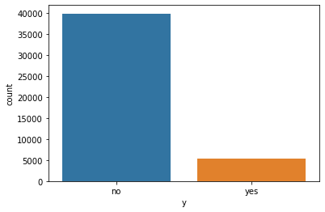
Exploratory Analytics (Imbalanced classification )
Highly imbalanced classification is identified in the dataset.
Less records on people subscribed to term deposit.
Up-sampling and Down-sampling techniques used to handle imbalance data.
4000 total records equaly considered by majority class and minority class.

Slide 6
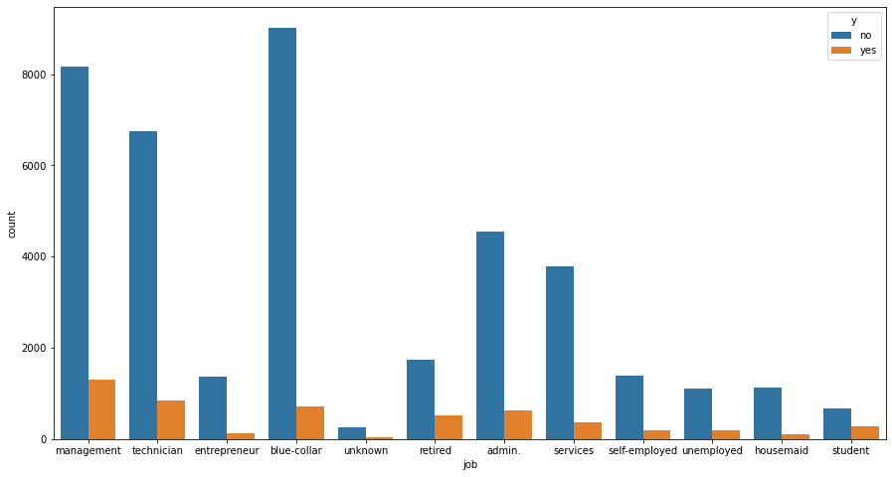
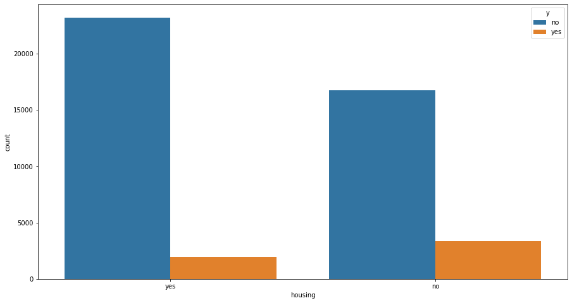
Exploratory Analytics (Feature Selection)
This is categorical type variable which shows that type of job doing by employee. Management and technicians have the highest rate of subscribing a term deposit, while most of blue collar and management employees are not subscribing.
This attribute shows that whether employee has personal loan or not? This graph shows that more number of customers has no any personal loan and they showed more tendency to subscribe to a long-term deposit.

Slide 7
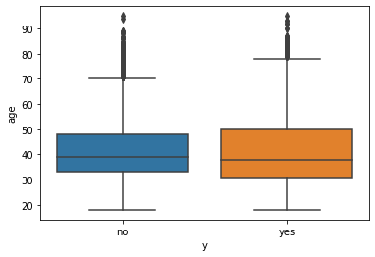
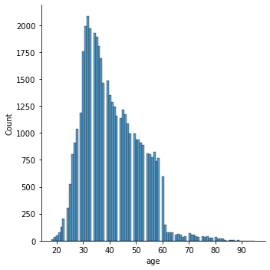
Exploratory Analytics (Age)
Median age of around 38–40 for both subscribed or unsubscribed.
Distribution of the age count shows positive skewness in the dataset. Therefore, this feature need to process through transformation.

Slide 8
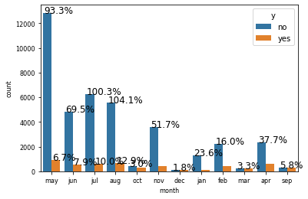
Exploratory Analytics (Month)
Above 50% of the customers on any given month refuse to subscribe to a term deposit, and 1.8–10% of customers agrees to subscribe.

Slide 9
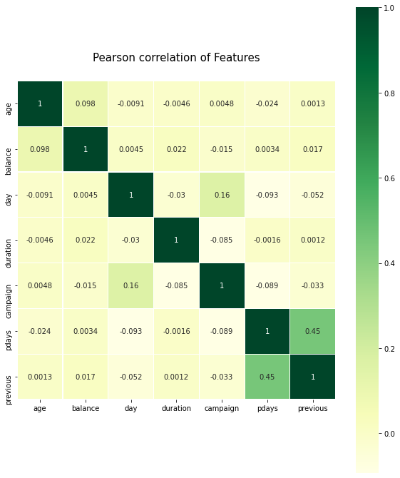
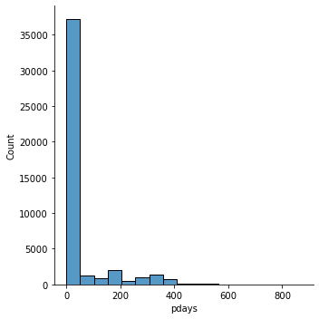
Exploratory Analytics (Pdays and Previous)
This denotes the number of days that passed by after the client was last contacted from a previous campaign.
Only correlation visible is between pday and previous. Therefore only ‘pday’ will take into the model.

Slide 10
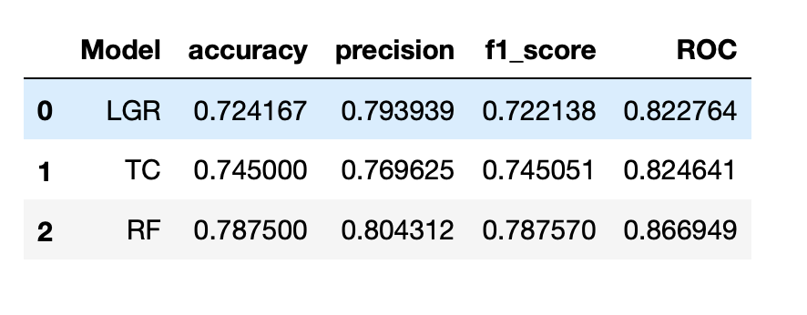
Combined Algorithm Comparison
Diffent models tested prior to feature engineering to identify most sutiable model. Random Forest Classifer was achieved the highest Precision and the ROC which are the higly relevant metrics in this analysis.

Slide 11
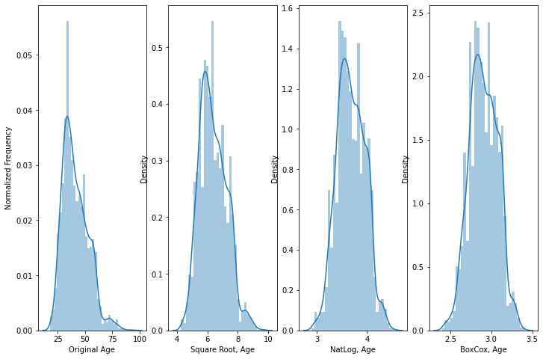
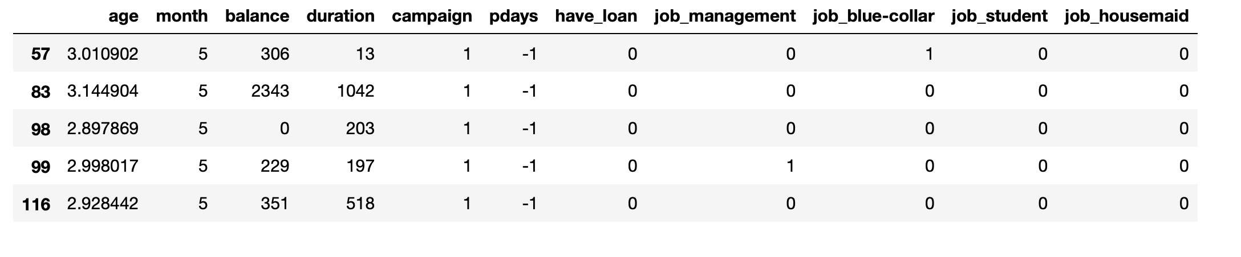
Feature Transformation and Engineering
box-cox reduced the skew very very significantly (to very close to 0) and use the box-cox values in to the model.
This the final dataset insert in to the model for the classification. One-Hot Encoding for ‘loan’ feature and feature transformation done for the ‘job’ feature.
Month converted in to numeric value.

Slide 12
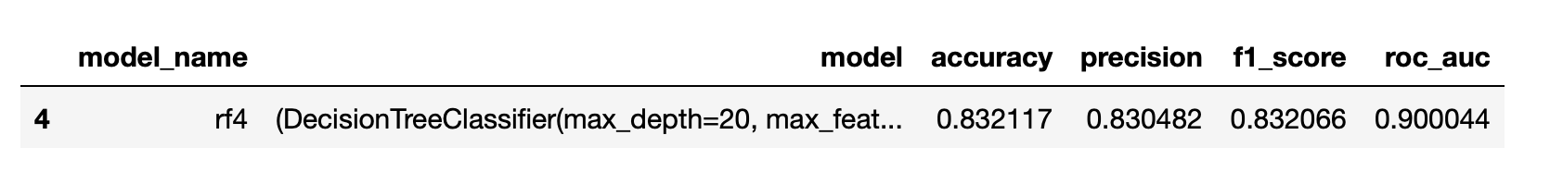
Model Evaluation (with HyperParameter Tunning)
Grid search recommendation for best parameters to tune the model
Radom Forest Classifier on the dataset with hyper parameter tunning is achieved precision by 0.830 and ROC by 0.900

Slide 13
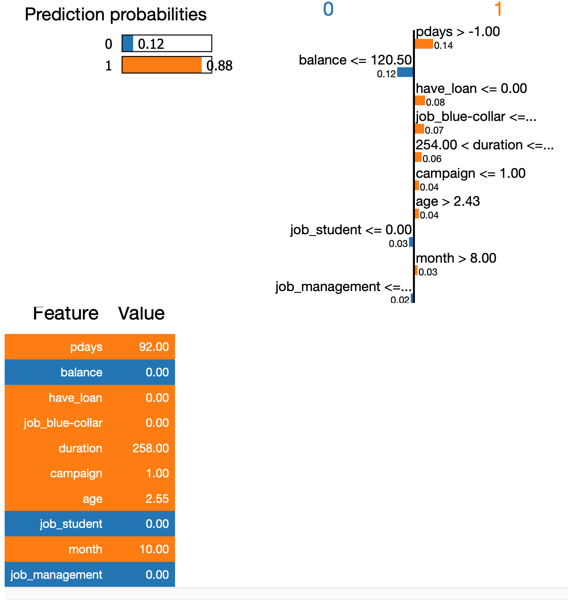
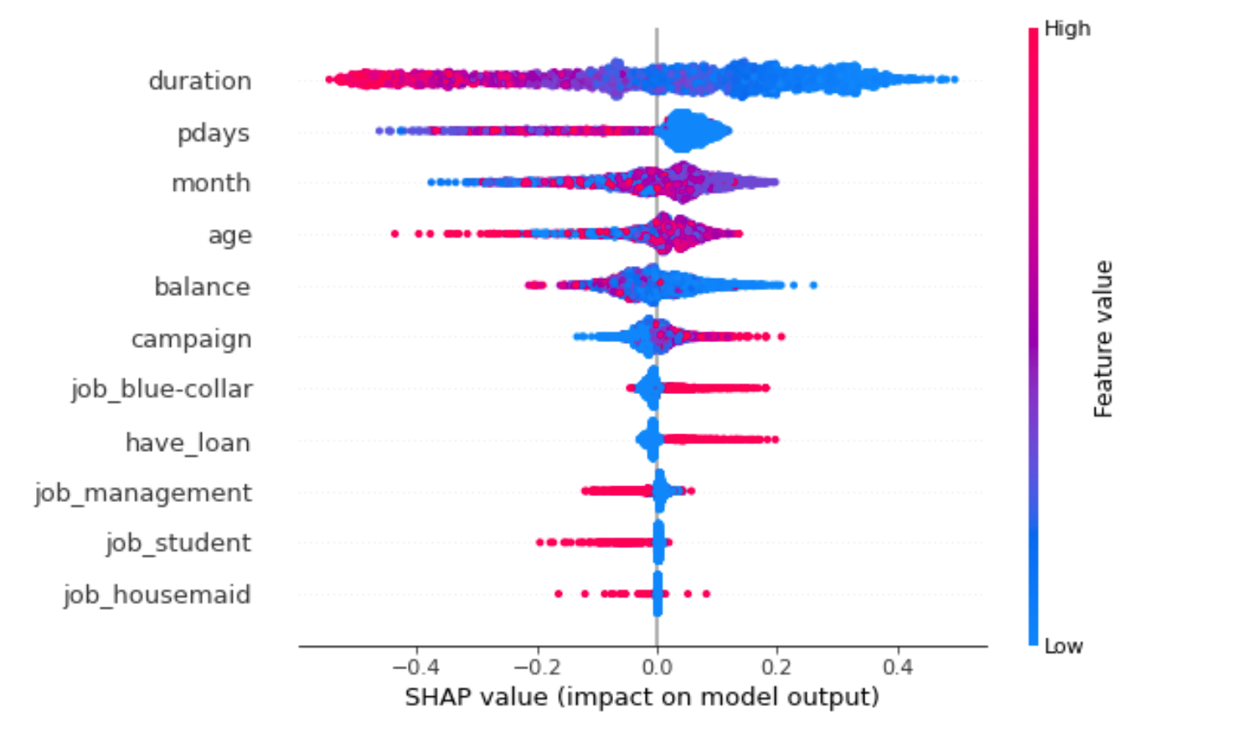
Model Explanation
Tested sample classified by model as a potential customer, duration, pdays, balance and month features are more influential for the predicted class.

Slide 14
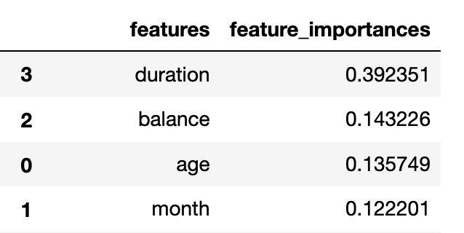
Conclusion
Up-sampling and Down-sampling techniques used to handle highly imbalance data taken to the project.
After basic data pre-processing, some of categorical data encoded into One hot encoding method and converted to numeric values.
After implementing all the models, we saw that the model that gave the best performance was Random Forest with GridSearchCV and the test ROC was 0.900
The top 4 key features that helped in the prediction of the class variable were:

