Slide 1
AI POLLINATION STUDENT COMPETITION 2026
CAMPUS CRUISE
AI-Powered School Transport Optimisation
Technical Challenge 2 — Travel Organizer
Dhanush Kalapati
Samyaka
Sathwika
Cardiff University
Notes:
TIME: 0:00-0:20 (20 s)
SAY:
We're Dhanush, Samyaka and Sathwika from Cardiff University. This is Campus Cruise: it decides which schools should share a bus to an event, so getting pupils there costs less.
KEY MESSAGE: Campus Cruise plans shared school buses to an event.
TRANSITION: So why is this a problem in the first place?

Slide 2
The problem: every school books its own bus
60
1,244
60
68.0%
schools going to one event
attendees, 3 to 42 per school
buses if every school books its own
of those seats filled
Why planning by hand is hard
Rules every plan must keep
Schools differ in size and location
Buses come in 15, 35 and 50 seats, each priced differently
Too many ways to group 60 schools to check by hand
A school's group is never split: one adult supervises it
No bus carries more people than it has seats
Every attendee gets a seat
Notes:
TIME: 0:20-0:55 (35 s)
SAY:
Sixty schools are sending 1,244 people to the same stadium. If every school books its own bus, that's 60 buses, and only 68.0% of the seats are filled. Sharing is obviously cheaper, but schools differ in size and location, buses come in three sizes, and there are far too many groupings to check by hand. And each school's group must stay together on one bus, because one adult supervises it.
KEY MESSAGE: Booking separately wastes seats and money; sharing is too complex to plan by hand.
TRANSITION: So here's how Campus Cruise plans it automatically.

Slide 3
Campus Cruise: from data to a checked plan
1
2
3
4
5
6
Load
Choose
Optimise
Validate
Show
Export
›
›
›
›
›
Schools, attendance, locations, bus prices; checked on load
Cost model: fixed price, per mile or per driving hour
OR-Tools groups schools onto buses and orders pickups
Separate code re-checks every rule and recomputes costs
Dashboard, route map, compare and scenario views
Plan CSV, report, audit report, metrics CSV
A plan that fails validation is never shown or exported. When attendance changes, the fixed-price model re-plans automatically, starting from the previous plan.
Notes:
TIME: 0:55-1:25 (30 s)
SAY:
Campus Cruise works in six steps. Load and check the data. Pick how buses are priced. OR-Tools decides which schools share each bus and the pickup order. Then separate code re-checks every rule and recalculates every cost, and a plan that fails is never shown. Finally, the results go to a dashboard and map, and can be downloaded.
KEY MESSAGE: Every plan is optimised, then independently checked, before anyone sees it.
TRANSITION: Let me show what's inside the optimise step.

Slide 4
Algorithms: three cost models, one set of hard rules
Cost model | Method (OR-Tools) | Result
Fixed price per bus | CP-SAT constraint solver: exact bin packing | Proven optimal
Price × straight-line miles | Vehicle routing: cheapest-arc start + guided local search | Best found in time limit
Price × road driving hours | Same routing search on OSRM road times | Best found in time limit
What kind of AI, where
Constraint optimisation
CP-SAT: decides the plan
Heuristic search
Routing: best plan found, never called optimal
Hard rules in every model
Generative AI
No school split between buses
No bus over capacity; only the supplied 15/35/50 sizes and prices
Every attendee allocated; independent validator re-checks all of it
GPT-4.1 mini assistant: proposes only, you approve
Machine learning (experimental)
Ridge model approximating OSRM times when offline
Notes:
TIME: 1:25-2:10 (45 s)
SAY:
The challenge prices buses three ways. With a fixed price per bus, location doesn't matter, so it's a packing problem: OR-Tools' CP-SAT solver finds the cheapest plan and proves nothing cheaper exists. When price depends on miles or driving time, pickup order matters, so we use vehicle-routing search. It finds very good plans, but we never call them optimal. The rules are hard in every model: no school split, no bus over capacity. To be precise: this is optimisation, not a trained model. Generative AI is a separate assistant, and the machine-learning model is experimental.
KEY MESSAGE: Exact optimisation where it can be proven; honest 'best found' labels where it cannot.
TRANSITION: So what does that achieve on the real data?

Slide 5
Results: 43.7% lower cost, proven optimal
1,455
cost units saved (fixed price per bus)
3,330 → 1,875
Proven cheapest possible
60 → 25
buses · seats filled 68.0% → 99.5%
Saving: fixed 43.7% · per mile 28.6% · per hour 17.7%. Routing results are the best found in 300 s, not proven minimums. Results on the challenge data only: not yet measured at a real event.
Cost per attendee 2.68 → 1.51
Notes:
TIME: 2:10-2:45 (35 s)
SAY:
With a fixed price per bus, the plan costs 1,875 instead of 3,330: 43.7% less, with 25 buses instead of 60. That is provably the cheapest. The other two models save 28.6% and 17.7%; those are the best plans found in five minutes. Each model has its own prices, so I only compare within a model, and these are cost units, not pounds.
KEY MESSAGE: 43.7% cheaper and 35 fewer buses, proven optimal for fixed pricing.
TRANSITION: Let me show you the app producing this.

Slide 6
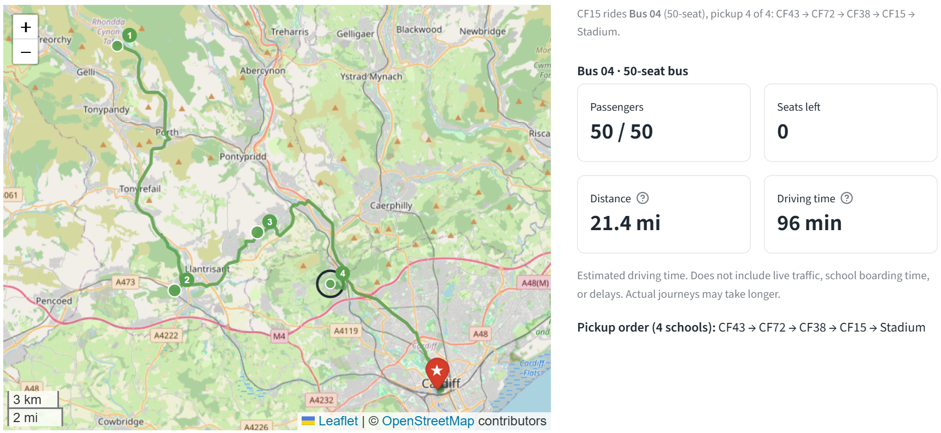
Live demo: one bus, its schools and its road route
1
Bus 04, 50 seats
Collects 4 schools in order
2
50 / 50 passengers
0 seats left: a full bus
3
Road path from OSRM
Drawn for display; costs use the model's own measure
4
96 min estimated
Distance card shows straight-line miles
Real screenshot: Campus Cruise Routes tab, fixed-price plan, 26 Oct 2026
Estimated times exclude live traffic, school boarding time and delays. Real journeys may take longer.
Notes:
TIME: 2:45-4:05 (80 s, live)
SAY:
[Switch to the app at http://localhost:8501]
1. (15 s) Sidebar: Fixed price per bus, Run optimiser. Point at 'Proven optimal', 25 buses, 1,875 vs 3,330.
2. (25 s) Routes tab: Find a school, CF15. Turn on Road paths. 'This is Bus 04: it picks up four schools and is completely full, 50 of 50. The green line is the real road route from OSRM.' Point at the estimated driving time and read the note under it: it excludes live traffic and boarding time, so real journeys may take longer.
3. (25 s) Adjust plan: set CF15 to 25 and SA18 to 20. 'The fixed model re-plans by itself in about 20 seconds.' Open Compare: the cost change and which schools moved.
4. (15 s) Scenarios tab: +10% attendance, Run scenario. 'Scenarios are tested separately; the plan only changes if I tick the box and adopt it.'
If the demo fails: say 'Let me show the screenshot', stay on this slide, and talk through points 1-4.
KEY MESSAGE: It's a working app: real map, real routes, honest estimates.
TRANSITION: Organisers can also just type what they want. That's the assistant.

Slide 7
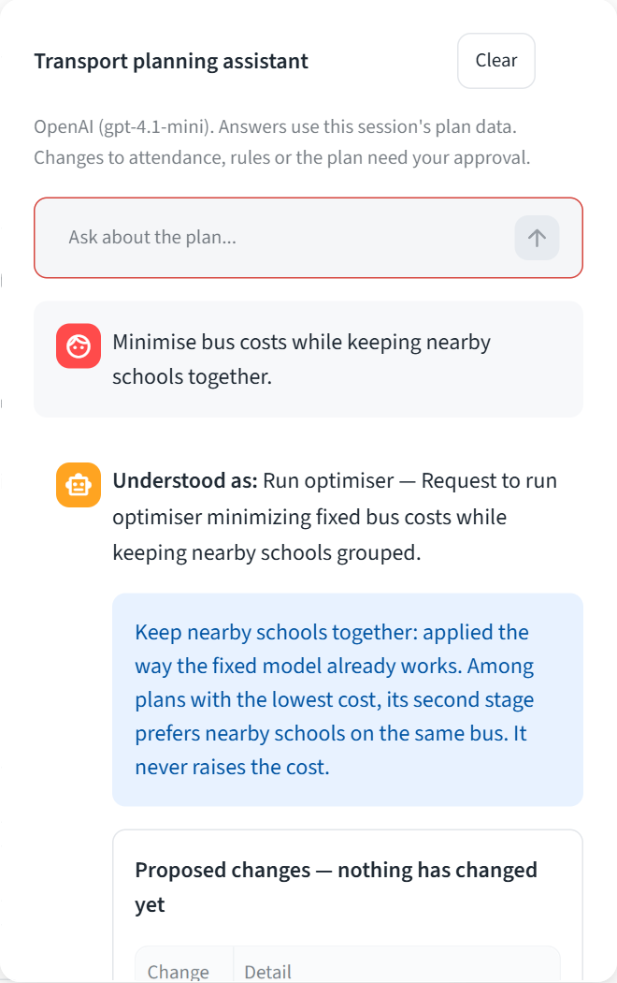
AI planning assistant: it proposes, you approve
1
You type a request
"Minimise bus costs while keeping nearby schools together."
2
GPT-4.1 mini proposes
Structured JSON only: no tools, cannot change anything
3
Code checks the proposal
Every school, number and rule against the data
4
You approve or reject
Proposed changes: nothing has changed yet
5
Optimiser + validator run
The same OR-Tools models and checks as every plan
"Nearby" is a cost tie-break in the fixed model, not a hard rule.
Real screenshot, 26 Oct 2026
Notes:
TIME: 4:05-4:40 (35 s)
SAY:
Organisers can also just type: 'Minimise bus costs while keeping nearby schools together.' GPT-4.1 mini turns that into a proposal, but it can't change anything. Code checks it against the data and shows it: nothing has changed yet. Only when I approve does the optimiser run. And it's honest: 'nearby' isn't a hard rule, it's how the fixed model breaks ties, and it says so.
KEY MESSAGE: Generative AI makes the tool easy to use, but people and the optimiser stay in control.
TRANSITION: So who actually benefits from this?

Slide 8
Sector impact: who benefits and what we can measure
Event organisers & SMEs
Schools & teachers
−35
buses to book and coordinate
a checked plan in seconds
lower, fair cost shares
Pupils
Welsh coach operators
99.5%
seats filled (was 68.0%)
lower cost to attend
a clear booking list
Event venues
Audiences
−38.8%
bus-miles: 1,289.4 → 789.4
fewer coaches to park
less coach traffic on event day
Fixed-price plan on challenge data. Bus-miles are straight-line, first pickup to stadium, summed over buses; baseline = one bus per school. No fuel or emissions claim.
Next: a pilot. One Welsh event organiser or coach operator, same inputs, current plan vs Campus Cruise. Measure cost, buses, seat use, mileage, planning time and user feedback, with school-level data only.
Notes:
TIME: 4:40-5:15 (35 s)
SAY:
Who gains? Organisers get a checked plan in seconds. Schools and pupils pay less to attend. Coach operators get a clear booking list, and venues have fewer coaches to park. On the challenge data that's 35 fewer buses, 99.5% of seats filled, and about 39% fewer bus-miles, straight-line, with no emissions claim. It hasn't run at a real event yet, so the next step is a pilot with one Welsh organiser, measuring cost, buses, mileage and planning time.
KEY MESSAGE: Measurable savings on the data, and a clear plan to prove them in the real world.
TRANSITION: Just as important is how it's built responsibly.

Slide 9
Responsible AI, aligned with Welsh strategy
Transparency
Privacy
National Events Strategy for Wales 2022–2030
Every plan labelled proven optimal or best found; estimates marked
School-level head counts only, no pupil names; assistant never sees coordinates
"A balanced portfolio will consider age, region, ethnicity, religion, cost to attend…"
→ lower cost to attend for school groups
Success measure: "Percentage of events encouraging or offering active and sustainable transport options"
→ shared coaches, fewer bus-miles
Security
Accountability
API keys never shown or logged; LLM has no tools, returns checked JSON
Organiser approves every AI change; audit report of every run
Safety & fairness
Honest limits
Hard rules re-checked by independent code; cost shared per attendee
No traffic or boarding time; not yet tested at a real event
The strategy builds on the Well-being of Future Generations (Wales) Act 2015. No endorsement implied.
Human oversight: decision support, not an autonomous system.
Source: gov.wales/national-events-strategy-wales-2022-2030-html (checked 26 Oct 2026)
Notes:
TIME: 5:15-5:50 (35 s)
SAY:
Campus Cruise is decision support, not an autonomous system. Every plan says whether it's proven or just the best found. It uses school-level head counts only, no names. The organiser approves every AI change, and independent code re-checks every rule. It fits the National Events Strategy for Wales, which asks events to consider cost to attend and measures sustainable transport options. Shared coaches help with both. We don't claim any endorsement.
KEY MESSAGE: Responsible by design, and pointed at goals Wales has already set.
TRANSITION: To wrap up.

Slide 10
Fewer buses, lower cost, plans people can trust
Problem
Result
Contribution
Next step
Schools booking alone waste seats and money
43.7% cheaper, 60 → 25 buses, proven optimal
Exact + routing optimisation, independent validation, a guarded AI assistant
Pilot with a Welsh organiser and collect stakeholder feedback
Thank you. Questions?
Generative AI disclosure. Claude (Anthropic, via Claude Code) helped write and test the code and draft the documentation, speaker script and this presentation. ChatGPT (OpenAI) was also used as a writing and planning aid. Dhanush reviewed, ran and tested all output. Separately, the app's optional assistant calls OpenAI GPT-4.1 mini at run time as a product feature.
Notes:
TIME: 5:50-6:10 (20 s)
SAY:
Campus Cruise finds which schools should share a bus: 43.7% cheaper on the challenge data, 25 buses instead of 60, proven optimal and independently checked. Next, I'd like to pilot it with a Welsh event organiser. My AI-use disclosure is on the slide. Thank you, I'm happy to take questions.
KEY MESSAGE: Campus Cruise: fewer buses, lower cost, and plans organisers can trust.
TRANSITION: (Questions.)

