Slide 1
Music Recommendation System using Long Short-Term Memory (LSTM)
CSE-6363-003-Machine Learning
Team 6
Arvind Raman 1002050501
Dhanush Raj 1002073155
Prajakta More 1001924287

Slide 2
AGENDA
Introduction​
Music recommendation system using LSTM
Implementation
Results
References

Slide 3
Introduction
Music Recommendation System using LSTM
A music recommendation system using deep learning is an intelligent software application that utilizes deep learning techniques to suggest music tracks or playlists to users based on their preferences, listening history, and other relevant data.
These systems aim to provide personalized music recommendations to enhance the user's music discovery experience.

Slide 4
Music Recommendation System using Deep Learning
Deep learning-powered music recommendation systems involve the application of deep neural networks to assess and interpret the emotional and tonal aspects conveyed in music data.
This specialized field within the realm of music technology centers on comprehending the feelings and vibes conveyed through musical compositions.

Slide 5
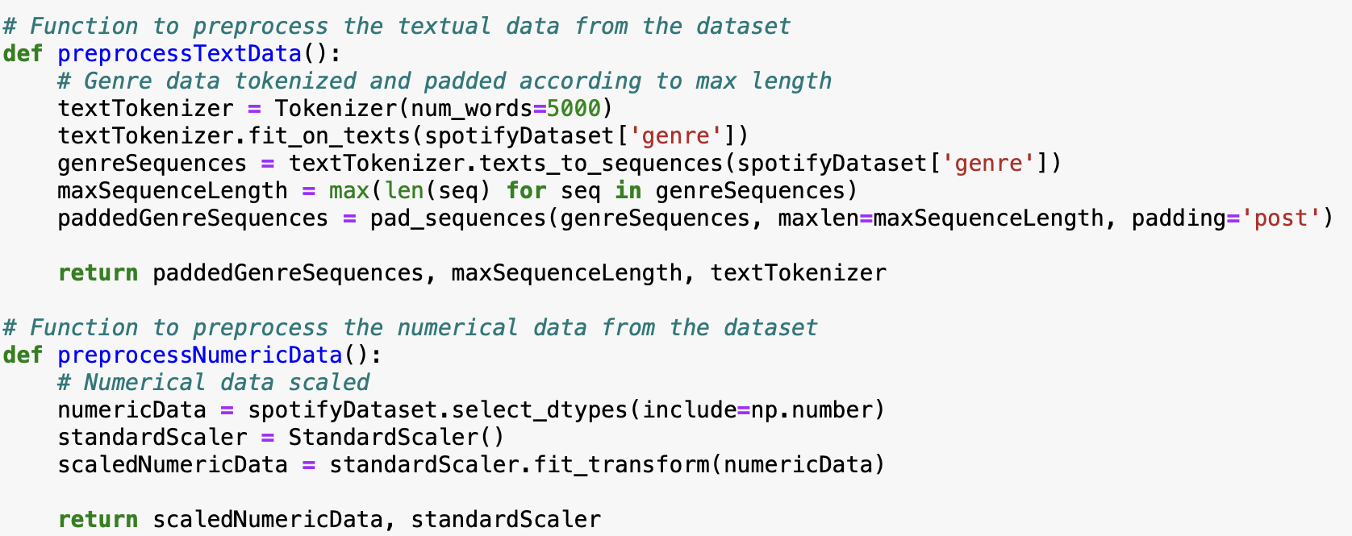
Data Preprocessing
Padding and Tokenization

Slide 6
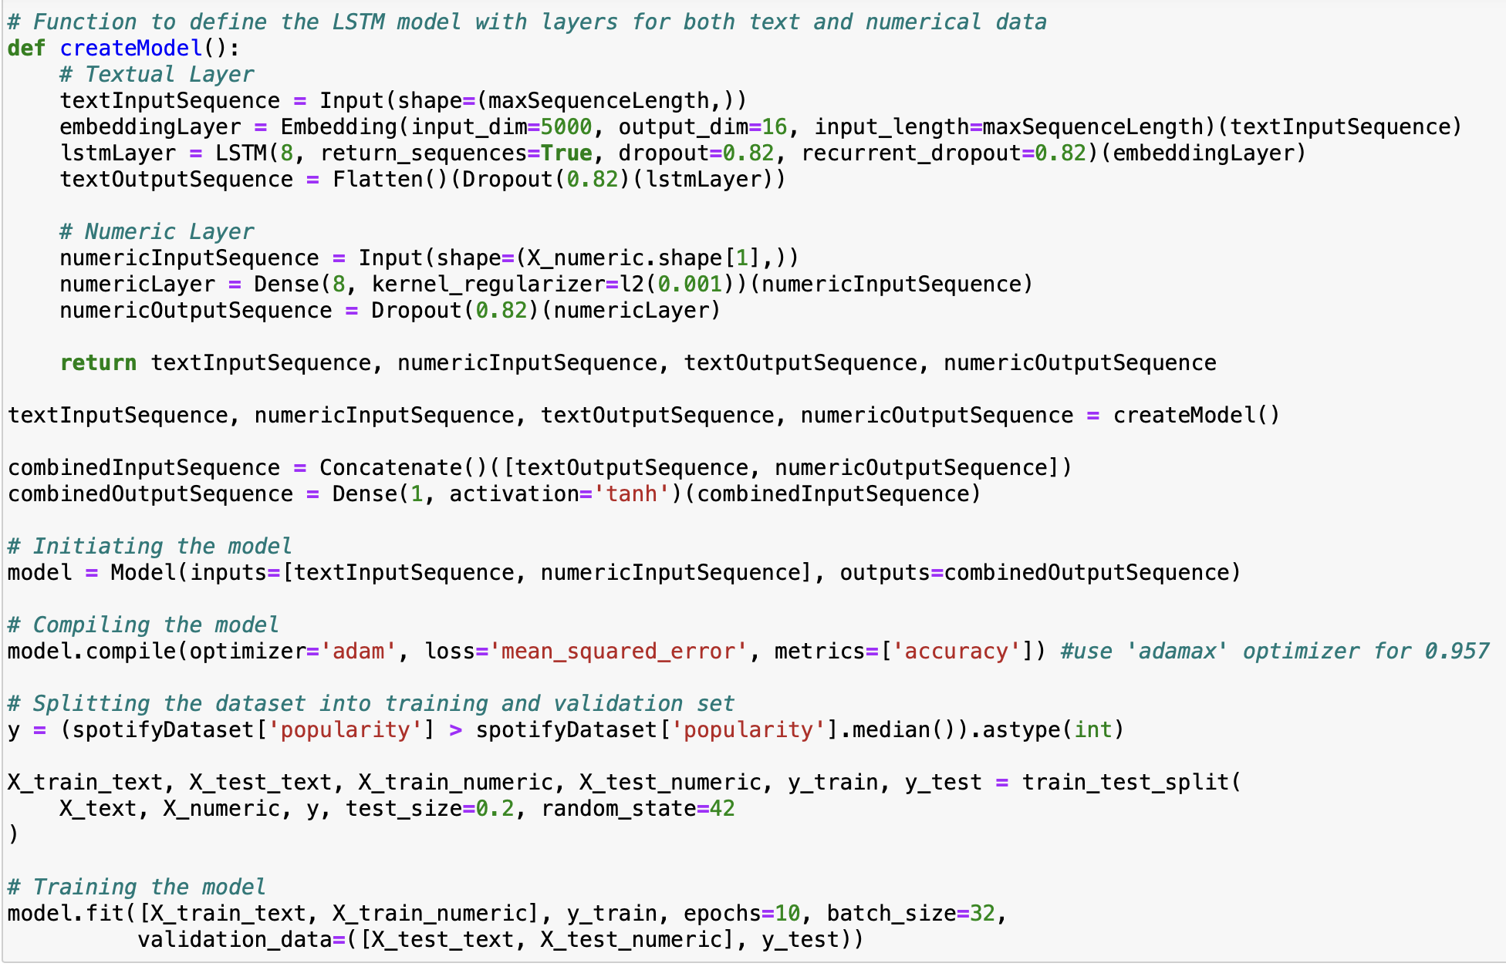
Implementing the model

Slide 7
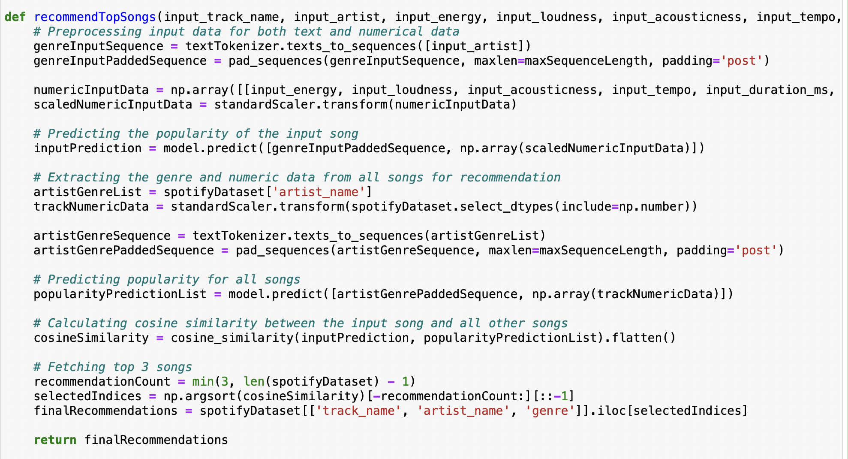
Recommending a Song

Slide 8
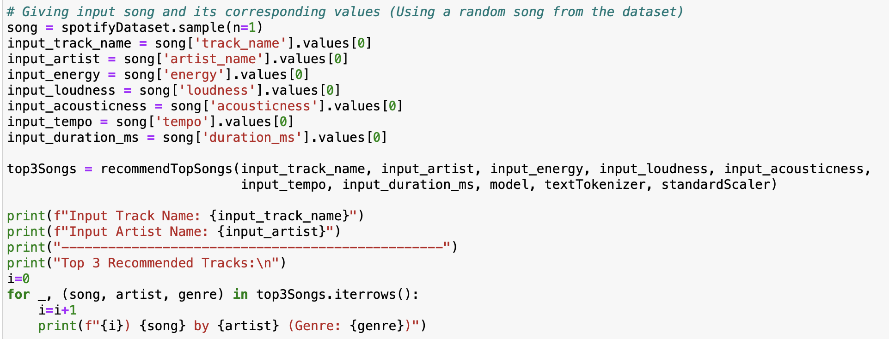
Recommending a Song

Slide 9
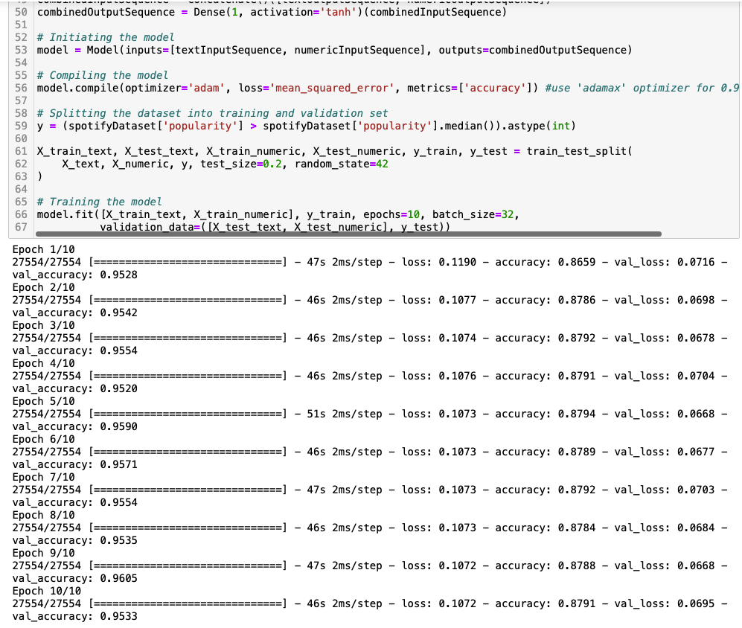
RESults

Slide 10
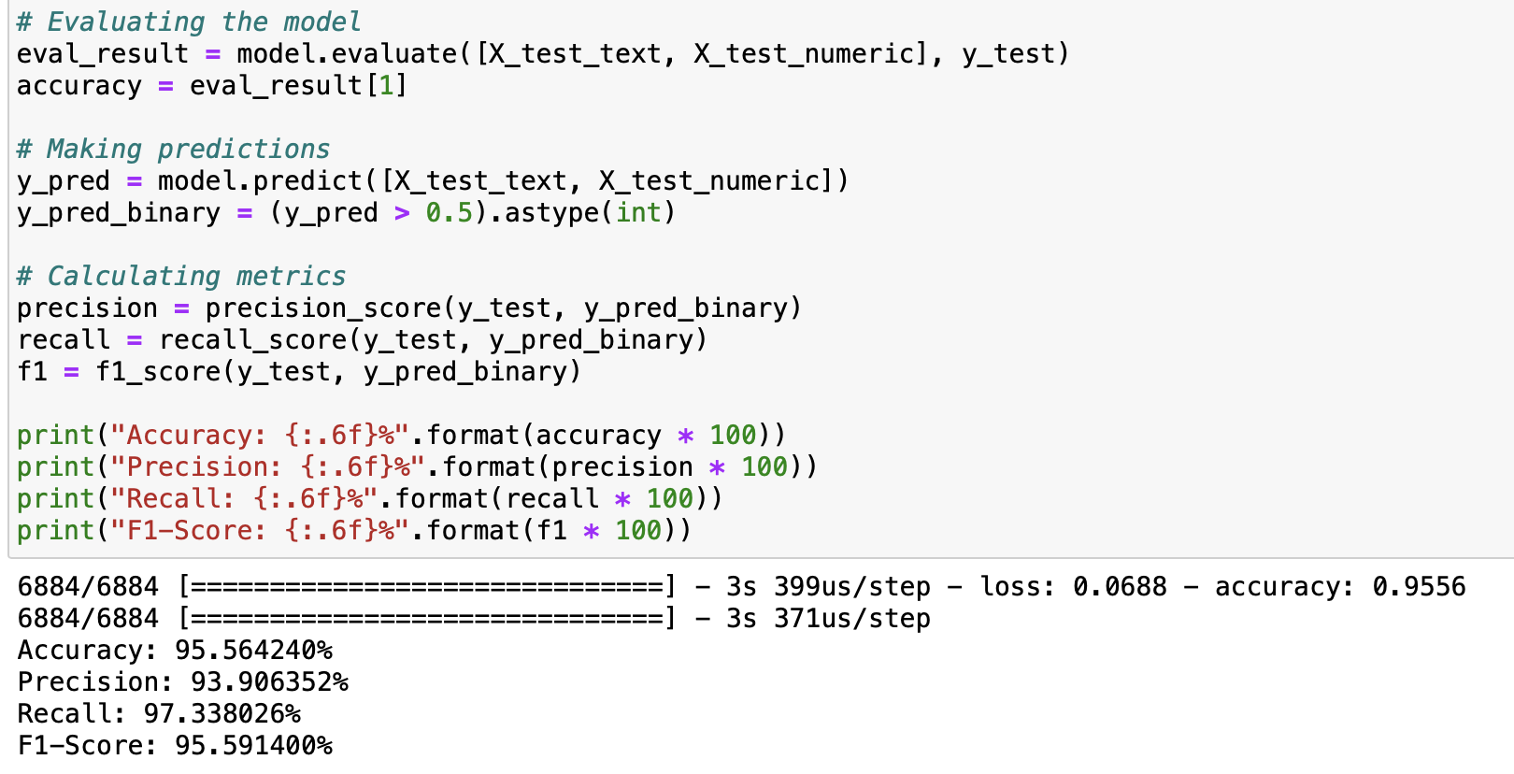
Results

Slide 11
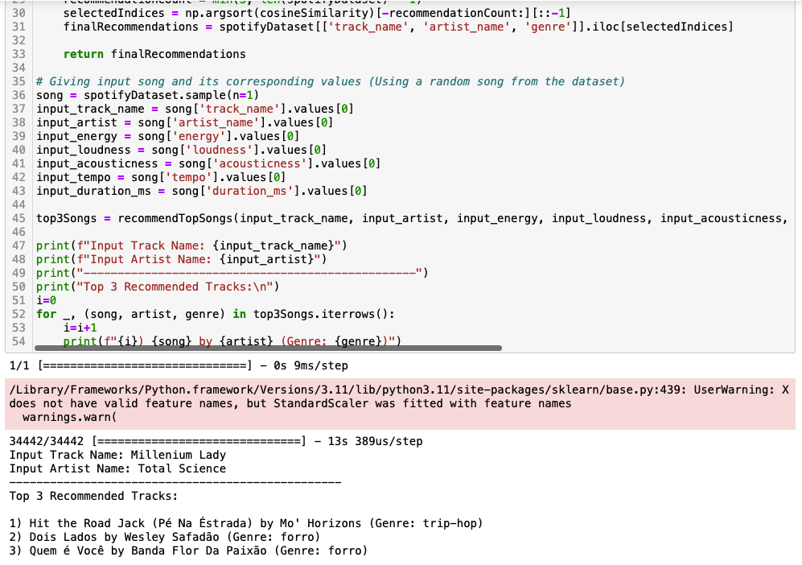
Results

Slide 12
Music Recommendation System using Deep Learning
One of the reference paper [1] we referred is using deep learning in a way that combines a hybrid of CFR and CBR as input to build a recommendation scheme by instantaneous prediction.
The other reference paper [2] we referred uses CNN
Paper [4] uses RNN to predict what song to play next
Paper [5] uses long short-term memory (LSTM) neural networks to collect long and short-term favorites from an individual's listening history and then give the results.
All of the above papers were showing to have an accuracy between 85% to 94%, whereas using our approach we are getting the accuracy as 95.4%.

Slide 13
References
[1] M. G. Galety, R. Thiagarajan, R. Sangeetha, L. K. B. Vignesh, S. Arun and R. Krishnamoorthy, "Personalized Music Recommendation model based on Machine Learning," 2022 8th International Conference on Smart Structures and Systems (ICSSS), Chennai, India, 2022, pp. 1-6, doi: 10.1109/ICSSS54381.2022.9782288.
https://ieeexplore.ieee.org/document/9782288
[2] J. S. Joel, B. Ernest Thompson, S. R. Thomas, T. Revanth Kumar, S. Prince and D. Bini, "Emotion based Music Recommendation System using Deep Learning Model," 2023 International Conference on Inventive Computation Technologies (ICICT), Lalitpur, Nepal, 2023, pp. 227-232, doi: 10.1109/ICICT57646.2023.10134389
https://ieeexplore.ieee.org/document/10134389
[3] S. Joshi, T. Jain and N. Nair, "Emotion Based Music Recommendation System Using LSTM - CNN Architecture," 2021 12th International Conference on Computing Communication and Networking Technologies (ICCCNT), Kharagpur, India, 2021, pp. 01-06, doi: 10.1109/ICCCNT51525.2021.9579813
https://ieeexplore.ieee.org/document/9579813
[4] M. Jiang, Z. Yang and C. Zhao, "What to play next? A RNN-based music recommendation system," 2017 51st Asilomar Conference on Signals, Systems, and Computers, Pacific Grove, CA, USA, 2017, pp. 356-358, doi: 10.1109/ACSSC.2017.8335200.
https://ieeexplore.ieee.org/document/8335200
[5] J. Singh, M. Sajid, C. S. Yadav, S. S. Singh and M. Saini, "A Novel Deep Neural-based Music Recommendation Method considering User and Song Data," 2022 6th International Conference on Trends in Electronics and Informatics (ICOEI), Tirunelveli, India, 2022, pp. 1-7, doi: 10.1109/ICOEI53556.2022.9776660.
https://ieeexplore.ieee.org/abstract/document/9776660

Slide 14
THANK YOU
Arvind Raman 1002050501
Dhanush Raj 1002073155
Prajakta More 1001924287

