Slide 1
Naan Mudhalvan Scheme TNSDC – Machine Learning to Generative AI
Heart Disease Prediction with Machine Learning
DHANUSH E
2021503708

Slide 2
Introduction
Heart disease is a leading global cause of mortality, underscoring the importance of effective risk assessment.
In this project, we leverage machine learning to develop a predictive model for heart disease risk.
By analyzing patient data, we aim to identify patterns and relationships crucial for accurate risk assessment.

Slide 3
Problem Statement
Heart disease is a significant health concern worldwide, contributing to a considerable number of fatalities.
Early detection and accurate prediction of heart disease risk can greatly improve patient outcomes and reduce mortality rates.
This project aims to develop a machine learning model capable of predicting the likelihood of heart disease based on various patient attributes and clinical indicators.

Slide 4
Objective
To develop a predictive model using logistic regression to assess the risk of heart disease.
Evaluate the model&#39;s performance using standard classification metrics such as accuracy, precision, recall, and F1-score.
Investigate the effectiveness of the model in both training and testing scenarios to ensure its generalization ability.
Provide insights into the key factors contributing to heart disease risk based on feature importance analysis.
Enhance awareness and understanding of heart disease risk factors through data-driven analysis and interpretation.

Slide 5
Goal and Scope
Goal:
To develop a reliable predictive model to accurately assess heart disease risk using medical data. This enables early interventions, appropriate treatments, and preventive measures for high-risk individuals.
Scope:
The project involves data collection, preprocessing, exploratory data analysis, model training, evaluation, and potential clinical deployment. Our focus is on developing a predictive model using logistic regression and understanding heart disease risk factors.

Slide 6
Key metrics
The key metrics used to evaluate the performance of the predictive model include accuracy, precision, recall, F1-score, and confusion matrix analysis.
These metrics help assess the model's ability to correctly classify individuals with and without heart disease and identify any potential trade-offs between different evaluation criteria.

Slide 7
Overview
Data Collection and Preparation:
We collect medical records and patient data, ensuring compliance with privacy regulations. Preprocessing involves handling missing values, encoding categorical variables, and scaling numerical features.
Exploratory Data Analysis (EDA):
It involves visualizing data distributions, identifying correlations between features and the target variable, and gaining insights into potential relationships and patterns within the dataset. EDA helps inform feature selection and model development decisions.

Slide 8
Overview
Model Selection and Training:
We employ logistic regression, ideal for binary classification tasks. The model is trained on preprocessed data with tuned hyper parameters. Cross-validation ensures model robustness.
Results and Deployment:
Logistic regression's performance is assessed using standard metrics on training and testing sets. If criteria are met, deployment in clinical settings enables real-time risk assessment and decision support.

Slide 9
WHO ARE THE END USERS?
The end users of this predictive model include healthcare professionals, clinicians, and medical practitioners involved in cardiovascular disease management.
Additionally, patients may benefit indirectly from the model's use through improved risk assessment and personalized healthcare interventions.

Slide 10
MY SOLUTION AND ITS VALUE PROPOSITION
My solution offers a data-driven approach to predicting heart disease risk, providing healthcare professionals with a reliable tool for early detection and personalized intervention.
By leveraging machine learning techniques, the model enhances preventive healthcare strategies and contributes to improved patient outcomes.

Slide 11
THE WOW IN MY SOLUTION
The "wow" factor in my solution lies in its ability to accurately predict heart disease risk using readily available patient data.
By leveraging advanced analytics, the model offers insights into key factors contributing to heart disease risk and empowers healthcare professionals to make informed decisions for better patient care.

Slide 12
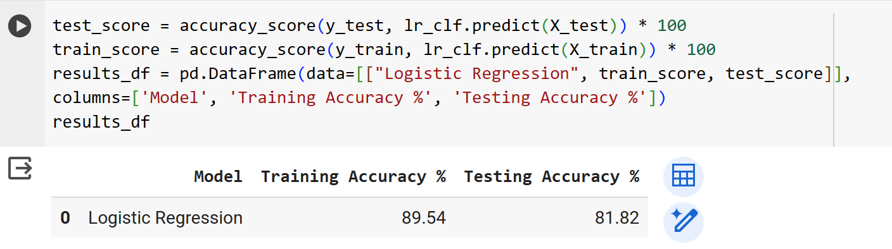
Modeling - Logistic Regression
Logistic regression serves as the cornerstone of my predictive model, offering simplicity, interpretability, and scalability.
Its ability to handle binary classification tasks makes it well-suited for predicting the presence or absence of heart disease based on patient attributes and clinical indicators.

Slide 13
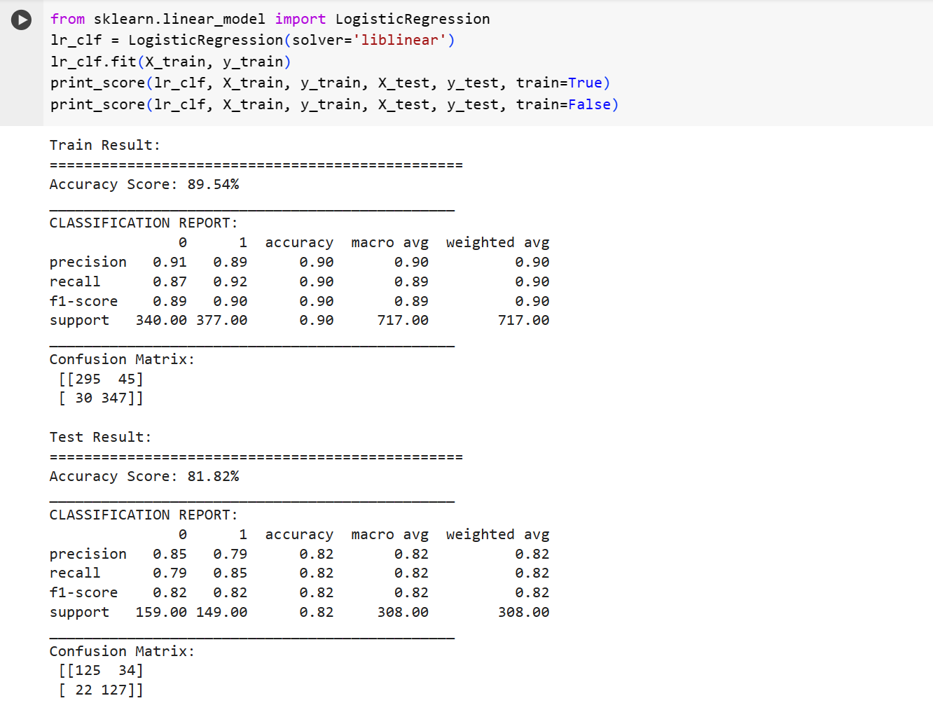
Result

Slide 14
Result
The logistic regression model demonstrates strong performance, achieving high accuracy, precision, recall, and F1-score on both training and testing datasets.
This indicates the model's effectiveness in accurately classifying individuals with and without heart disease, thus fulfilling the project objectives.

Slide 15
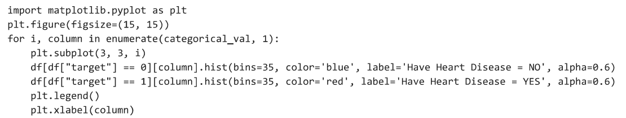
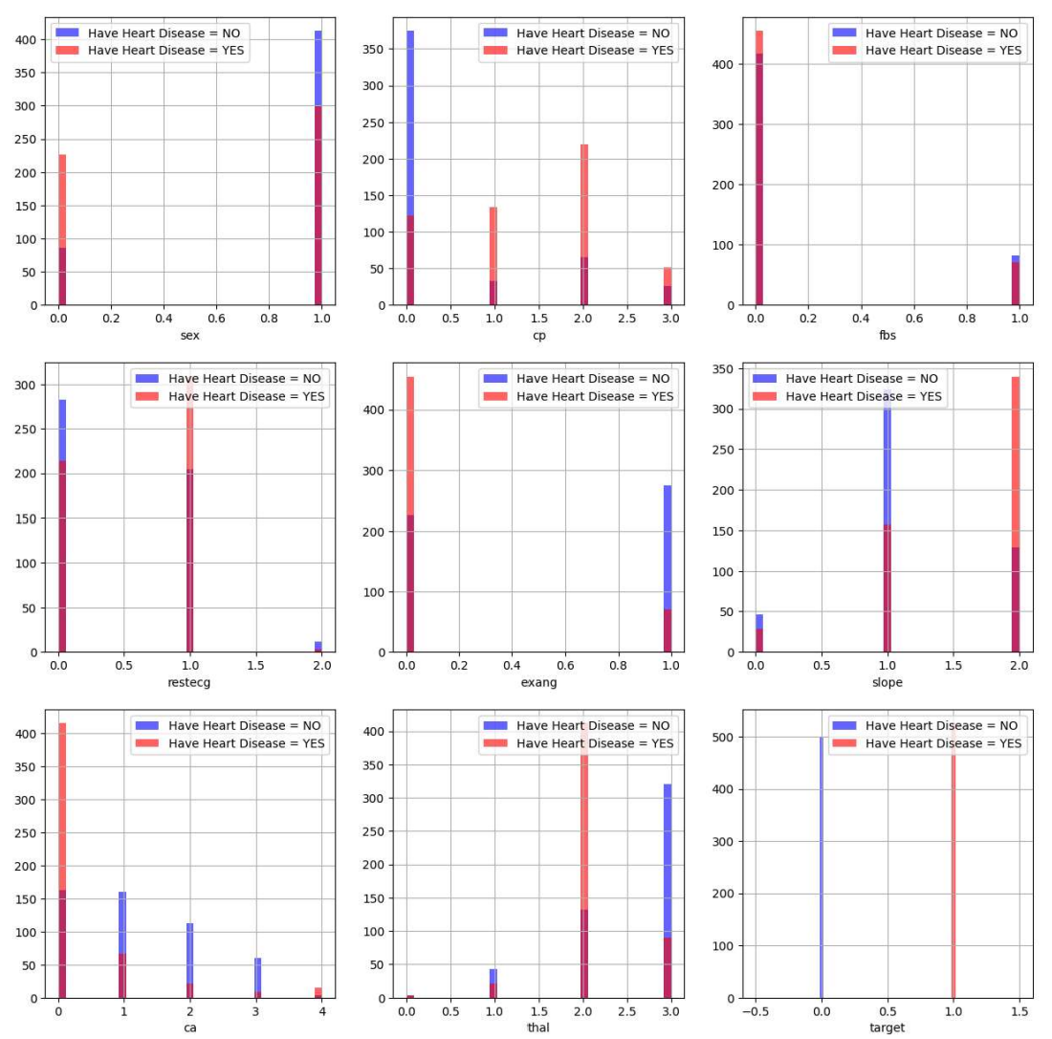
Graphs

Slide 16
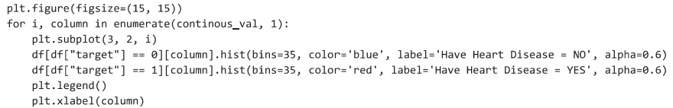
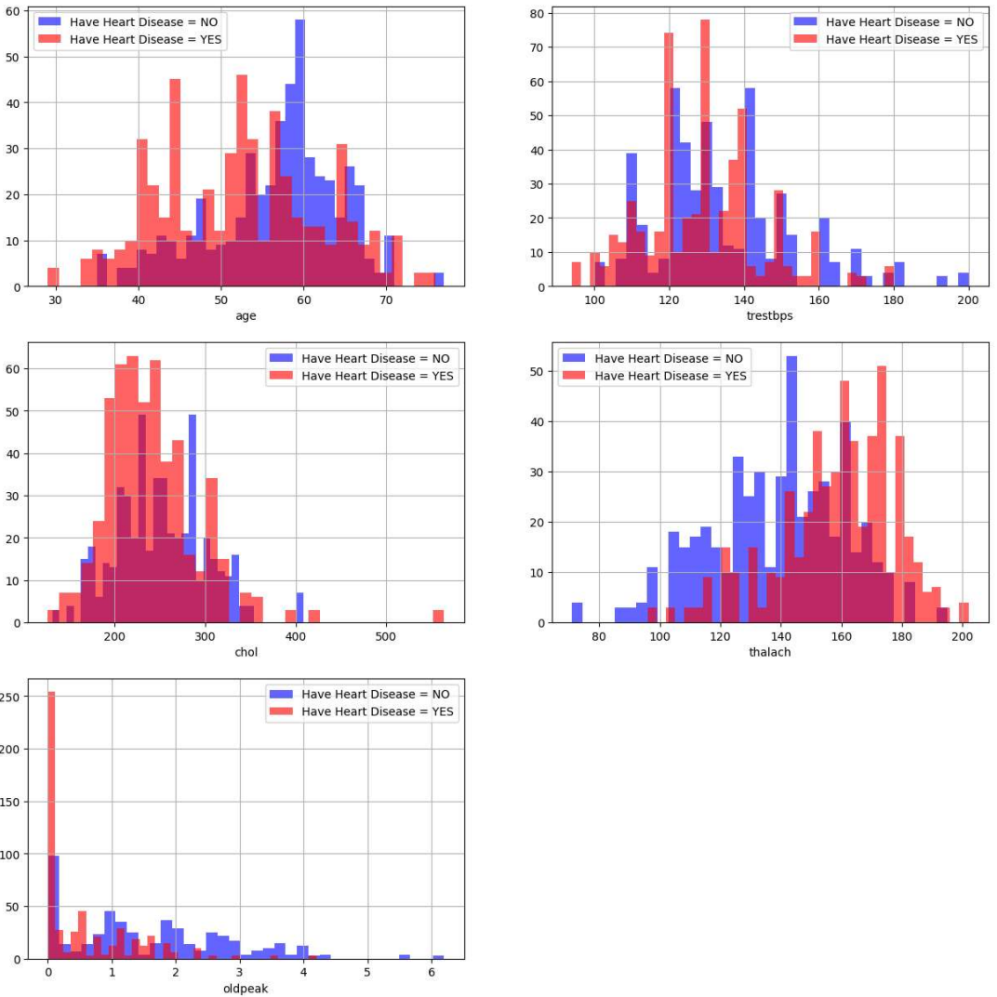
Graphs

Slide 17
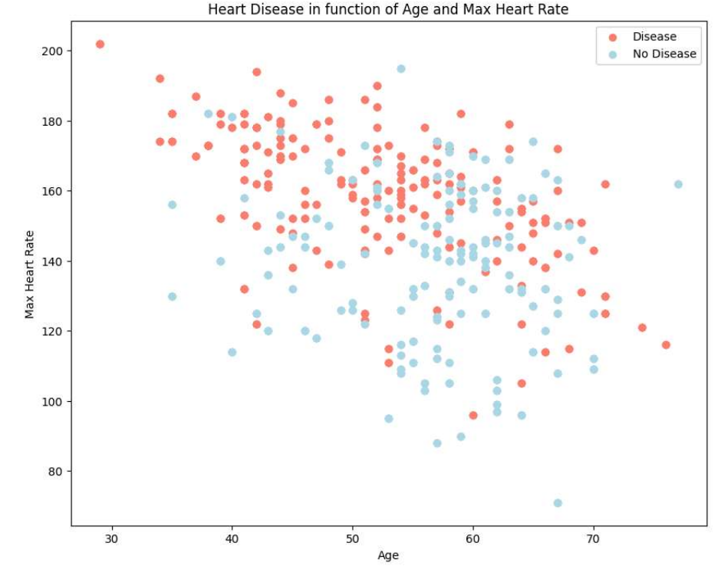
Graphs

Slide 18
Conclusion and Future Work
Conclusion:
In conclusion, the developed predictive model demonstrates promising performance in assessing the risk of heart disease based on patient data.
Future Work:
Future work may involve refining the model architecture, incorporating additional features, and conducting prospective validation studies to further validate its efficacy in clinical practice.

Slide 19
Thank You!!

