Slide 1

Credit Card Fraud Detection System
This presentation will delve into the critical domain of credit card fraud detection, exploring the techniques and methodologies used to identify and mitigate fraudulent transactions, exploring the journey of detecting credit card fraud, covering data preparation, model training, evaluation, and insights for future improvements
By : Dhanush Tadisetti
To: M.MUVENDIRAN.
(Infosys SpringBoard Mentor)

Slide 2
Introduction
What is Credit Card Fraud?
Types of Fraud
Credit card fraud refers to the unauthorized use of a credit card to make purchases or withdraw cash without the cardholder's consent. It's a significant problem that costs billions of dollars each year.
Credit card fraud can take many forms, including stolen cards, counterfeit cards, identity theft, and unauthorized online transactions.

Slide 3

Importance of Credit Card Fraud Detection
1
Financial Losses
2
Damaged Reputation
Fraudulent transactions result in significant financial losses for both individuals and financial institutions.
Fraud can damage the reputation of businesses and financial institutions, leading to loss of trust and customer confidence.
3
Increased Costs
Banks and businesses incur significant costs associated with investigating and resolving fraudulent claims.

Slide 4
Data Preprocessing using Python on Credit Card Dataset
Handling Missing Values
Data Acquisition
Missing values are addressed through techniques like
imputation or deletion, ensuring data integrity.
The first step involves acquiring a comprehensive dataset of credit card transactions. This dataset should include both legitimate and fraudulent transactions.
Class Imbalance
Data Cleaning
We used techniques like oversampling and undersampling to balance the number of fraudulent and legitimate transactions in our dataset. This ensured that our model could effectively learn to identify fraud without being biased toward the majority class.
Data cleaning is essential to remove noise and inconsistencies from the dataset. This includes handling missing values, removing duplicates, and correcting errors.

Slide 5
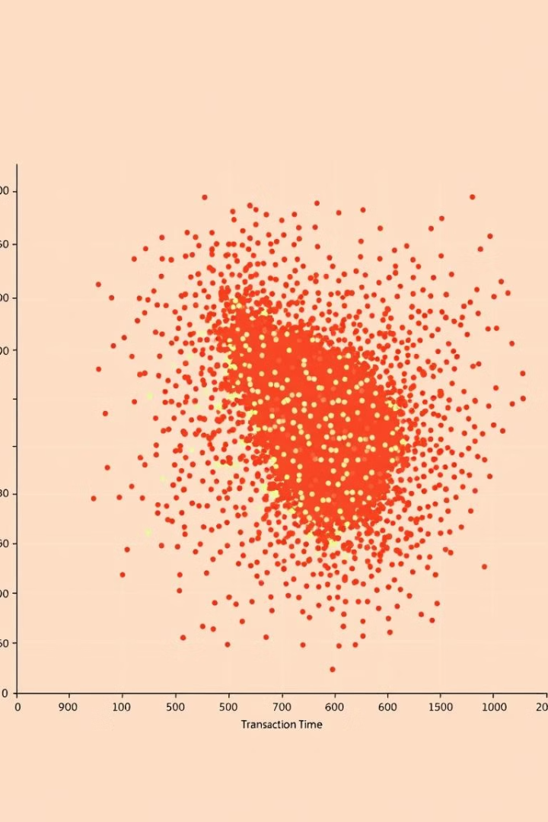


Exploratory Data Analysis
Feature Engineering
Data Visualization
This process involves extracting meaningful features from the raw data to improve model performance.
Data visualization tools are used to gain insights into the characteristics of fraudulent transactions and explore potential relationships between features.

Slide 6
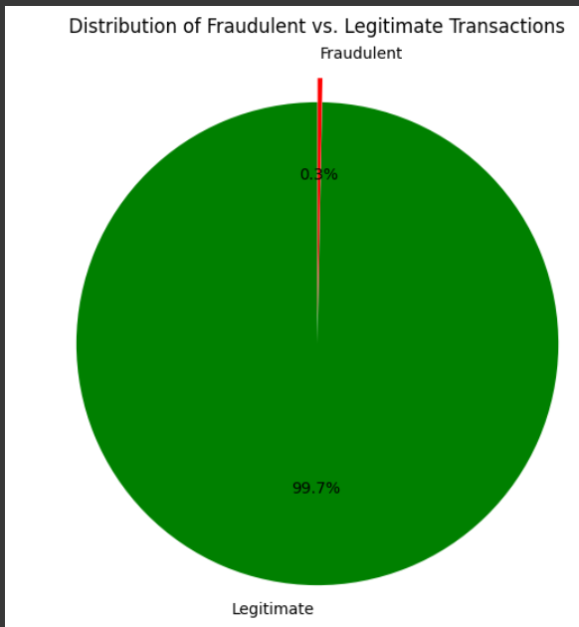
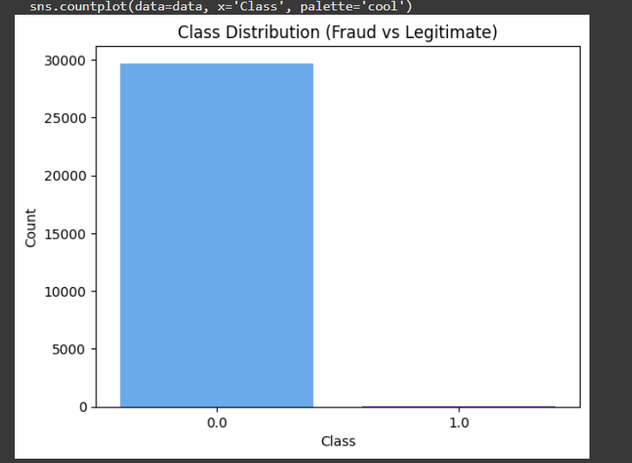
DATA EXPLORATION
Dataset Overview:
Total transactions: 29,704
Fraudulent transactions: 108
Techniques Used:
Identifying null values and handling missing data.
Exploratory Data Analysis (EDA) for insights:
Class distribution.
Correlation matrix.
Outlier detection.

Slide 7
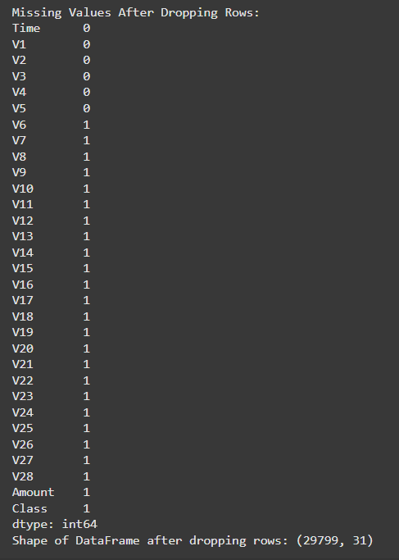
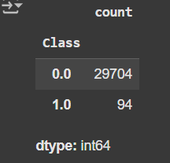
Data Pre-processing
Steps Taken:
Identified and handled null values.
Balanced class distribution using SMOTE (Synthetic Minority Oversampling Technique).
Result: Resampled class distribution: 23,763 for each class.

Slide 8
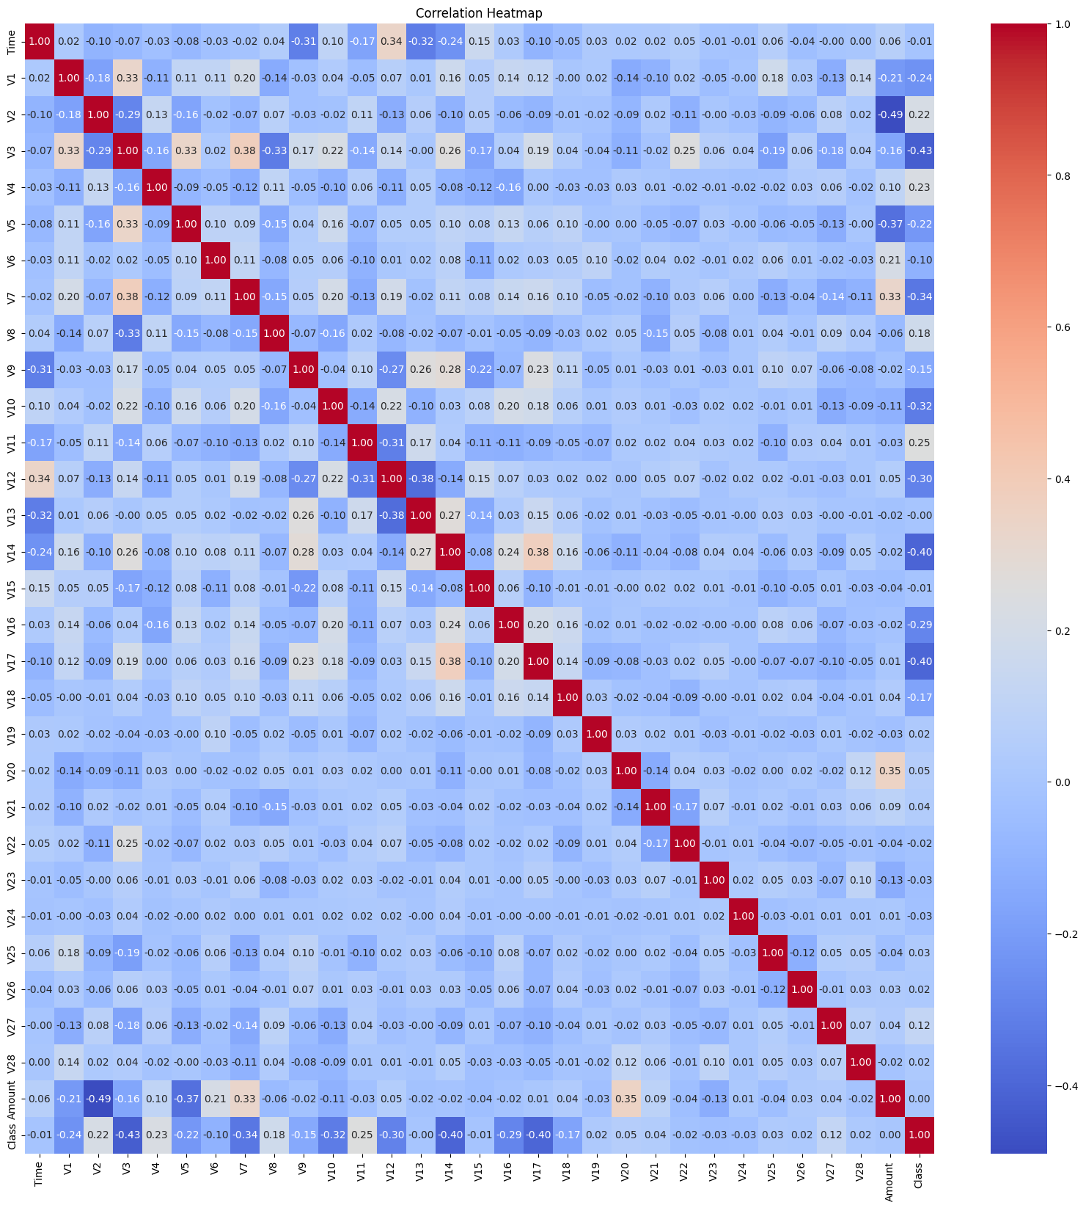
Feature Selection
Correlation Heatmap:
Used to analyze correlations between features
and the target variable.
Helped identify features most related to
fraudulent transactions.
Co-Relation Map calculates the correlations between numerical features in a dataset, visualizes those correlations using a
Heatmap with annotations and a color scheme,and then displays
the resulting plot.
This type of visualization is very useful for quickly identifying
strong relationships between different features in a dataset.

Slide 9



Machine Learning Models for Fraud Detection
1
Supervised Learning
2
Classification Algorithms
3
Fraud Detection Models

Slide 10
Model Selection
XGBoost, CatBoost, Random Forest, Decision Tree, SVM, Logistic Regression, LightGBM
XGBoost
CatBoost
Random Forest
Gradient boosting algorithm known for its accuracy and efficiency.
Another powerful boosting algorithm that handles categorical features well.
Ensemble method that combines multiple decision trees to improve accuracy.
Decision Tree
SVM
Logistic Regression
Simple, interpretable model that splits data into branches based on features.
Powerful algorithm for finding the optimal hyperplane to separate data into classes.
Statistical model used for binary classification, often used as a baseline.
LightGBM
Gradient boosting algorithm known for its speed and efficiency, especially with large datasets.

Slide 11
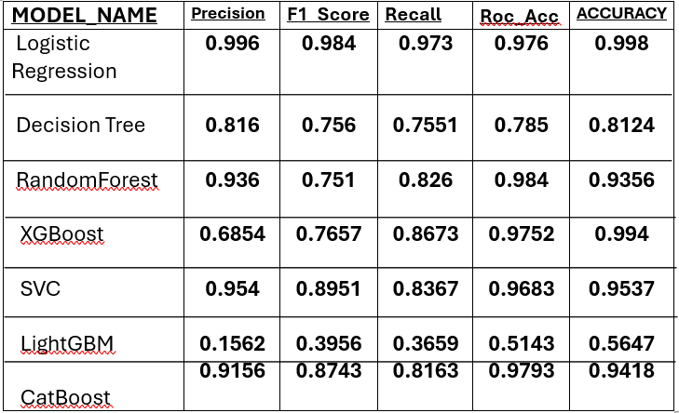
Comparing Model Performance
95%
94%
Accuracy
Precision
Proportion of correctly classified transactions.
Proportion of correctly identified fraudulent transactions out of all predicted fraud cases.
86%
78%
Recall
F1-Score
Proportion of correctly identified fraudulent transactions out of all actual fraud cases.
Harmonic mean of precision and recall, providing a balanced metric.

Slide 12
Conclusion and Future Considerations
Real-time Monitoring
1
Implementing real-time monitoring systems to detect and block fraudulent transactions immediately.
Advanced Analytics
2
Utilizing advanced analytics techniques to identify subtle patterns and anomalies in transaction data.
Collaboration with Law Enforcement
3
Working closely with law enforcement agencies to share information and coordinate efforts to combat fraud.

Slide 13

THANK YOU

