Slide 1
Superstore Sales Analysis
Data Storytelling & Business Insights
Dhanush V Rai
B.E. Computer Science (Data Science)

Slide 2
Objective
To analyze sales performance, profitability, and customer behavior and generate actionable business insights.

Slide 3
Business Problem
Strong sales but inconsistent profitability. Focus on discounts, regions, categories, and losses.

Slide 4
Analysis Performed
Data Cleaning, EDA, SQL Analysis, Power BI Dashboard, Customer Segmentation

Slide 5
Key Metrics
Total Sales: ₹2.29M
Total Profit: ₹286K
Total Orders: 5009
Profit Margin: ~12%

Slide 6
Key Insights
Technology highest sales
West highest profit
Q4 peak sales
Discounts reduce profit

Slide 7
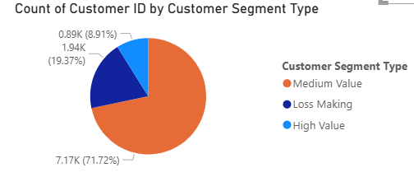
Customer Segmentation
High Value | Medium Value | Loss Making
Majority of customers fall under medium-value segment.
A portion of customers are loss-making, impacting profitability.
Focus should be on high-value customers to improve business performance.

Slide 8
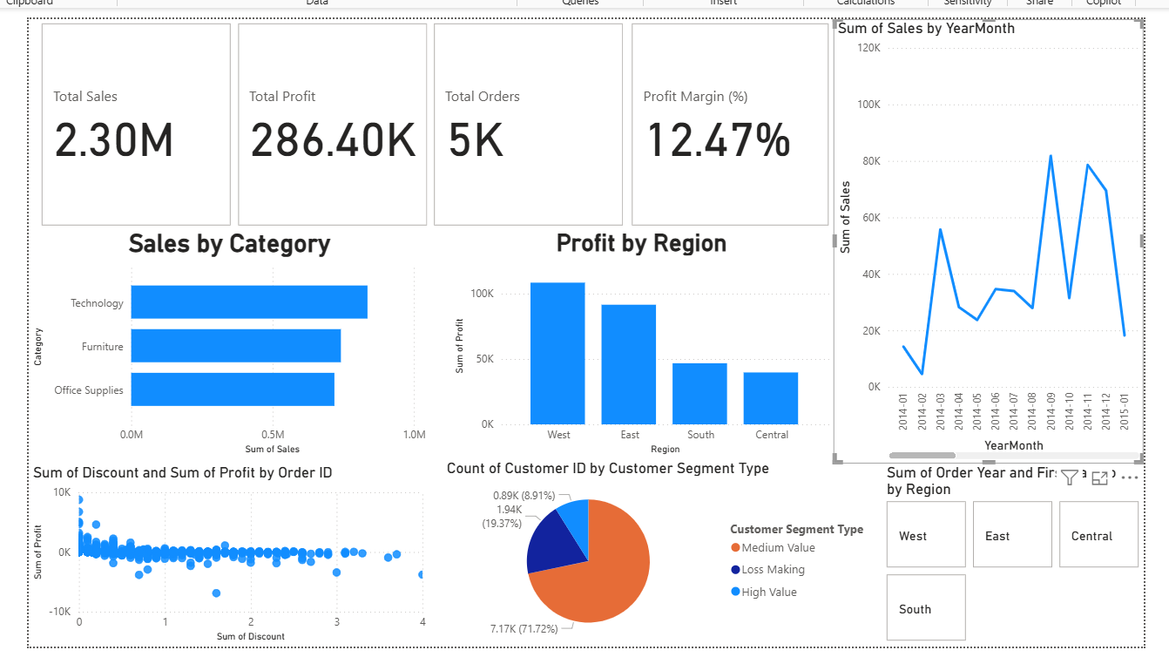
Interactive Dashboard
Power BI dashboard with KPIs and filters

Slide 9
Hypothesis Testing
H0: No impact
H1: Impact
p-value < 0.05 → Significant

Slide 10
Conclusion & Actions
Reduce discounts
Focus high-value customers
Improve pricing

