Slide 1



KONGU ENGINEERING COLLEGE
DEPARTMENT OF MCA
PERUNDURAI
TITLE: ONLINE FOOD ORDERING SYSTEM
TEAM NO:14
GUIDED BY: Dr. Chitra[ASSISTANT PROFESSOR]
Team Members:
Dhanushya V (24MCR017)
Karthik Santhosh S(24MCR050)
Kiruthiga M(24MCR057)

Slide 2

OVERVIEW OF THE PROJECT
1
The online food pre-ordering system(FoodQ) for our college food court is designed to streamline the dining experience for students, faculty, and staff.
This system, developed using React Native for the frontend and Firebase as the database, allows users to pre-order their meals, view nutritional information for each dish, and make secure online payments, significantly reducing wait times.
Users can also add favorite items to their profile for quick access in the future.
The system enhances the overall dining experience by combining convenience, health-conscious options, and operational efficiency.
The system makes dining easier and better while keeping up with the changing needs of the campus community.
24.12.2024
TEAM NO:14

Slide 3
DISADVANTAGES OF EXISTING SYSTEM
.
2
Long Wait Times: High demand during peak hours leads to extended waiting periods for meals.
Lack of Nutritional Information: Absence of nutritional details makes it difficult for users to make informed and healthy choices.
Limited Menu Visibility: Poorly displayed or inaccessible menus prevent customers from knowing all available food options.
Food Inconvenience for Meal Planning: Difficulty in pre-ordering or customizing meals disrupts effective meal planning and healthy eating.
24.12.2024
TEAM NO:14

Slide 4
ADVANTAGES OF PROPOSING SYSTEM
3
Reduced Waiting Times: Pre-ordering enables users to avoid long lines and receive their meals faster.
Customization: Users can personalize their food and beverage orders to suit individual tastes and dietary requirements.
Time Flexibility for Students: The system allows students to place orders at their convenience, accommodating their busy schedules.
Enhanced User Satisfaction: Streamlined operations and a user-friendly interface create a seamless and enjoyable dining experience.
Location-Based Services: Restricting the system to users within the college campus ensures prompt order processing and optimized resource management.
24.12.2024
TEAM NO:14

Slide 5
MODULE DESCRIPTION
4
Register
The Register Module allows new users (students or admins) to create an account by providing essential details such as name, email, password, and user role. After successful registration, users can log in to access the app’s features.
Menu Module
The Menu Module presents a wide range of food items with detailed nutritional information, enabling users to make healthier and informed decisions. It includes customization features, such as the ability to modify ice and sugar levels to suit individual preferences. Users can effortlessly add items to their cart with a simple and intuitive interface.
24.12.2024
TEAM NO:14

Slide 6
Cart Module
The Cart Module manages the items users select while ordering. Users can view the contents of their cart, adjust quantities, remove items, and proceed to checkout. It is integrated with the payment system to process the final order once the user decides to place it.
Profile Module
The Profile Module lets users manage their account details, including personal information. Students can update their preferences, while admins can edit their credentials and view system-related activity.
Favourites Module
The Favourites Module allows users to save their preferred food items for quicker access in the future. They can mark items as favourites from the menu, providing them with a personalized selection for easy reordering.
5
24.12.2024
TEAM NO:14

Slide 7
6
Bill Module
Accessible only to users on campus via location tracking, it shows order details, including cost, taxes, and discounts, and supports secure online payments for a smooth experience.
Payment Module
A QR code is generated with the total amount, enabling secure and contactless payments via preferred apps. This process includes all costs and discounts, ensuring fast and hassle-free transactions.
Admin Module
Administrators can manage the FoodQ app menu by adding, updating, or deleting items with details like price and nutritional information, keeping the menu accurate and user-friendly.
24.12.2024
TEAM NO:14

Slide 8
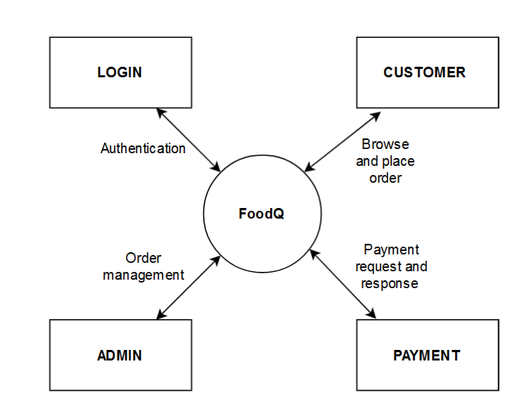
DATA FLOW DIAGRAM
7
DFD LEVEL – 0(LOGIN)

Slide 9
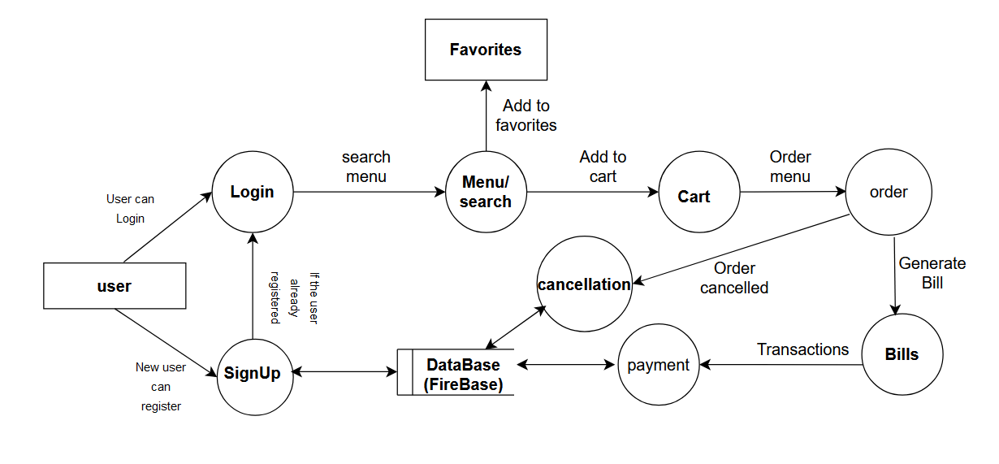
8
DFD LEVEL – 1(USER)
24.12.2024
TEAM NO:14

Slide 10
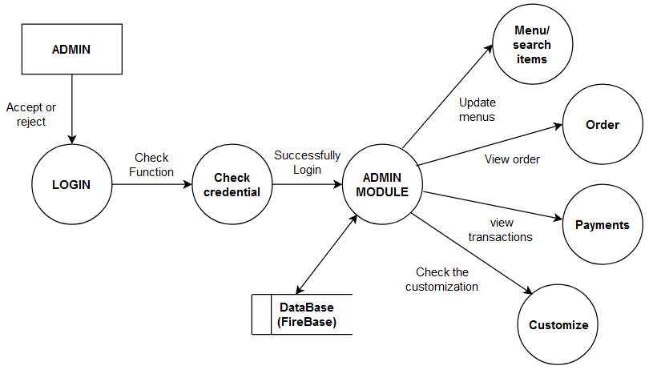
9
DFD LEVEL – 2(ADMIN)

Slide 11
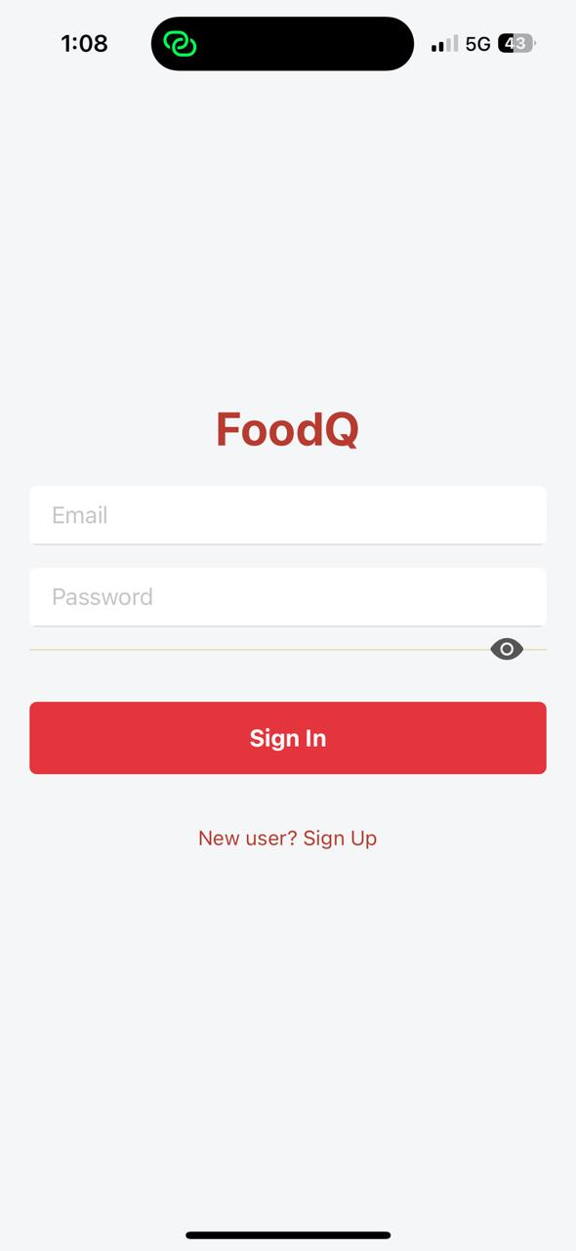
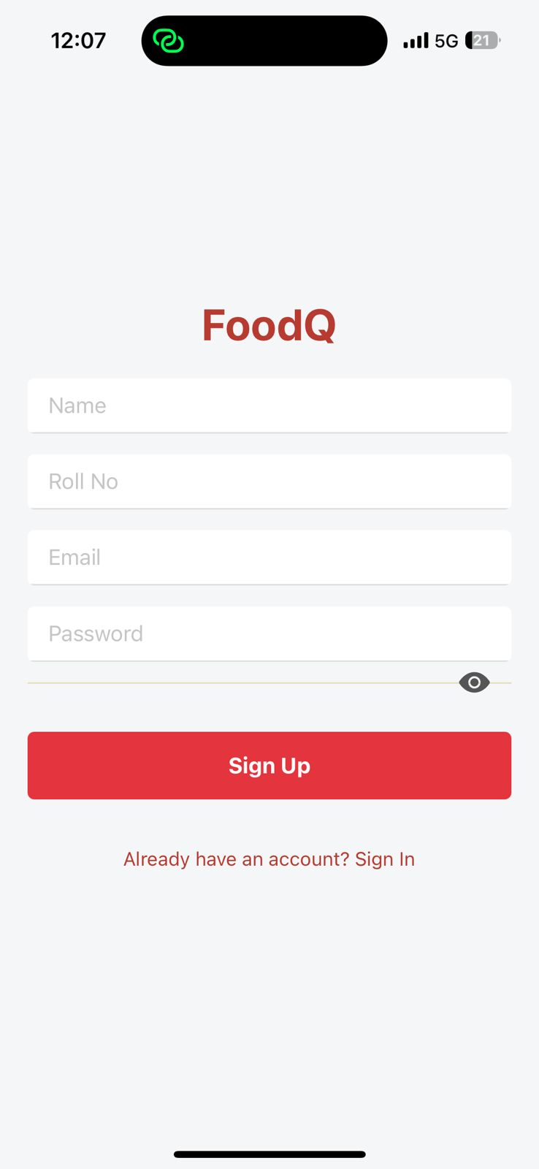
FORM DESIGN
10

Slide 12
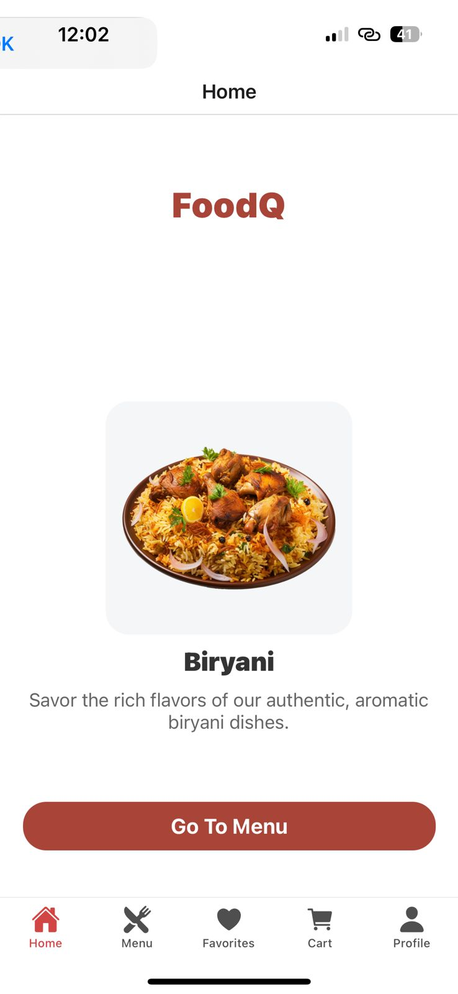
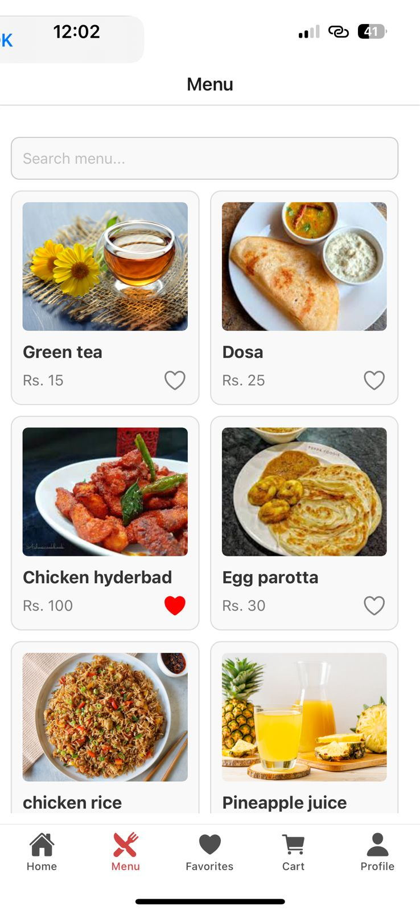
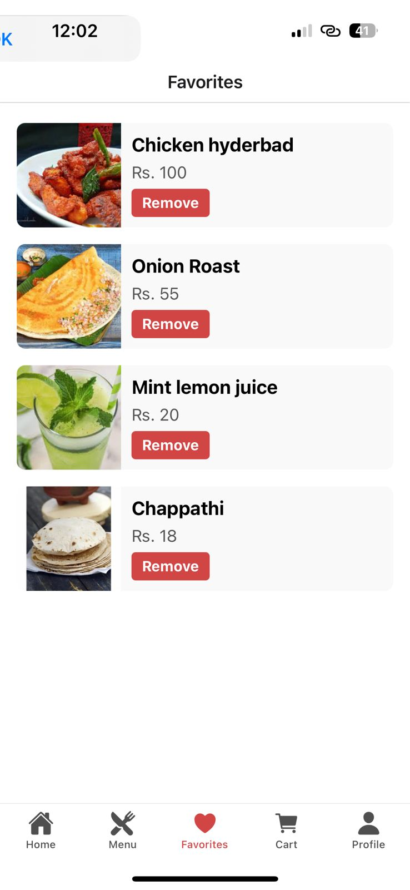
11

Slide 13
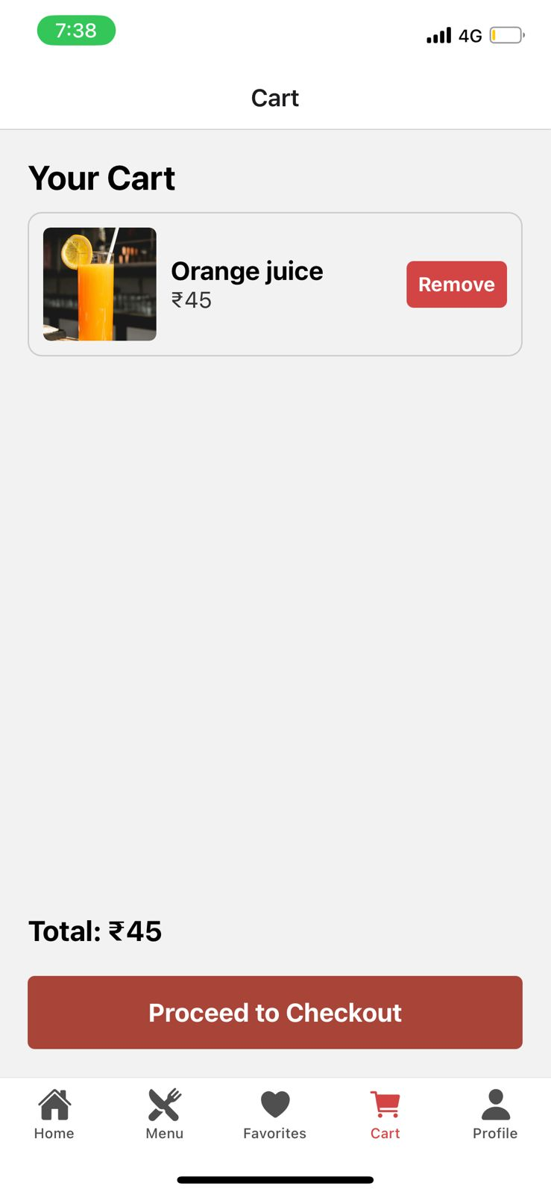
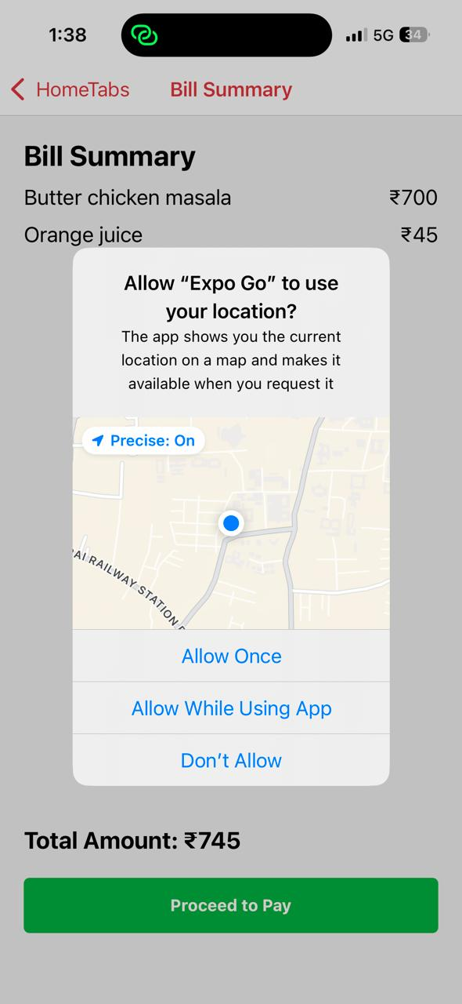
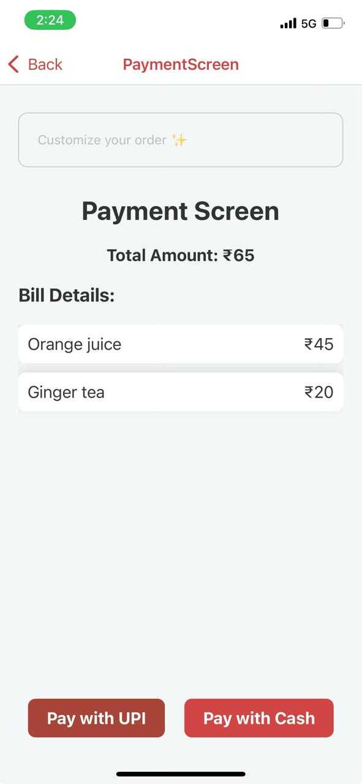
12

Slide 14
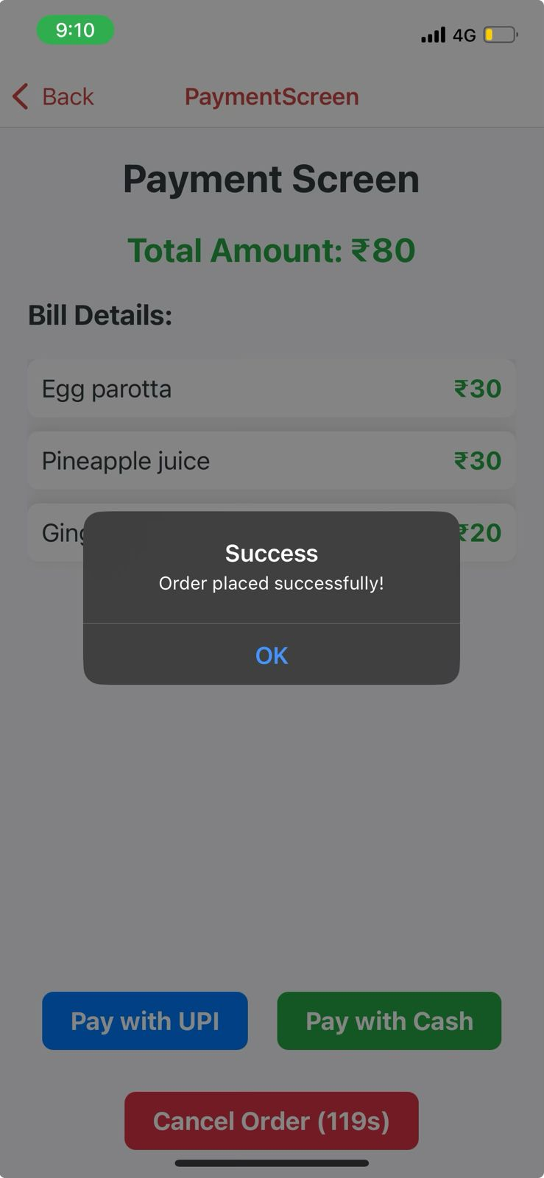
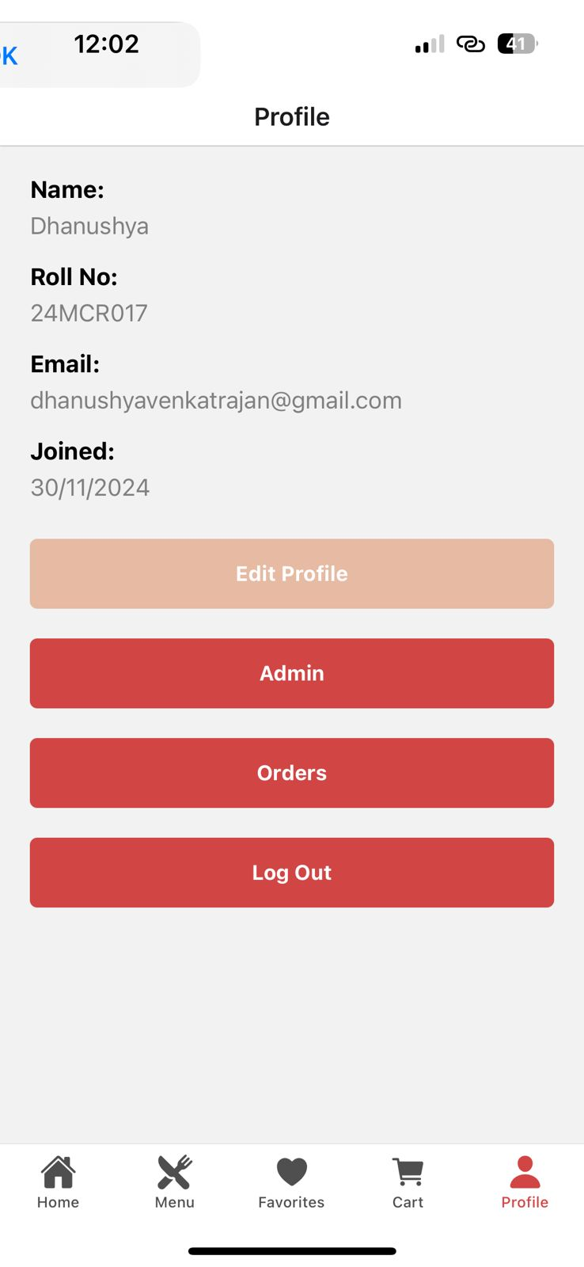
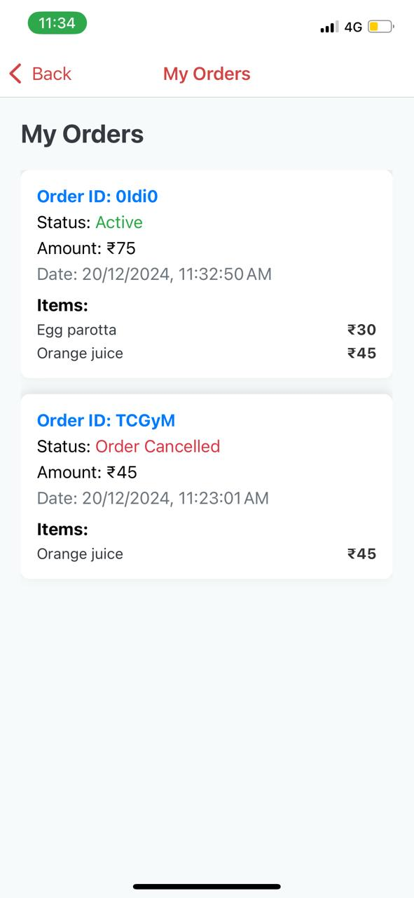
13

Slide 15
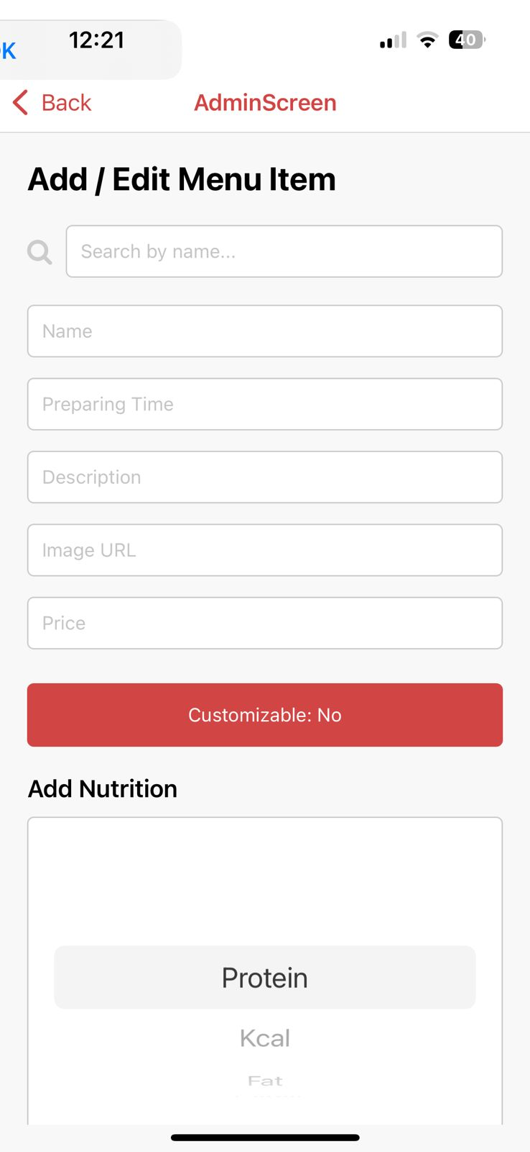
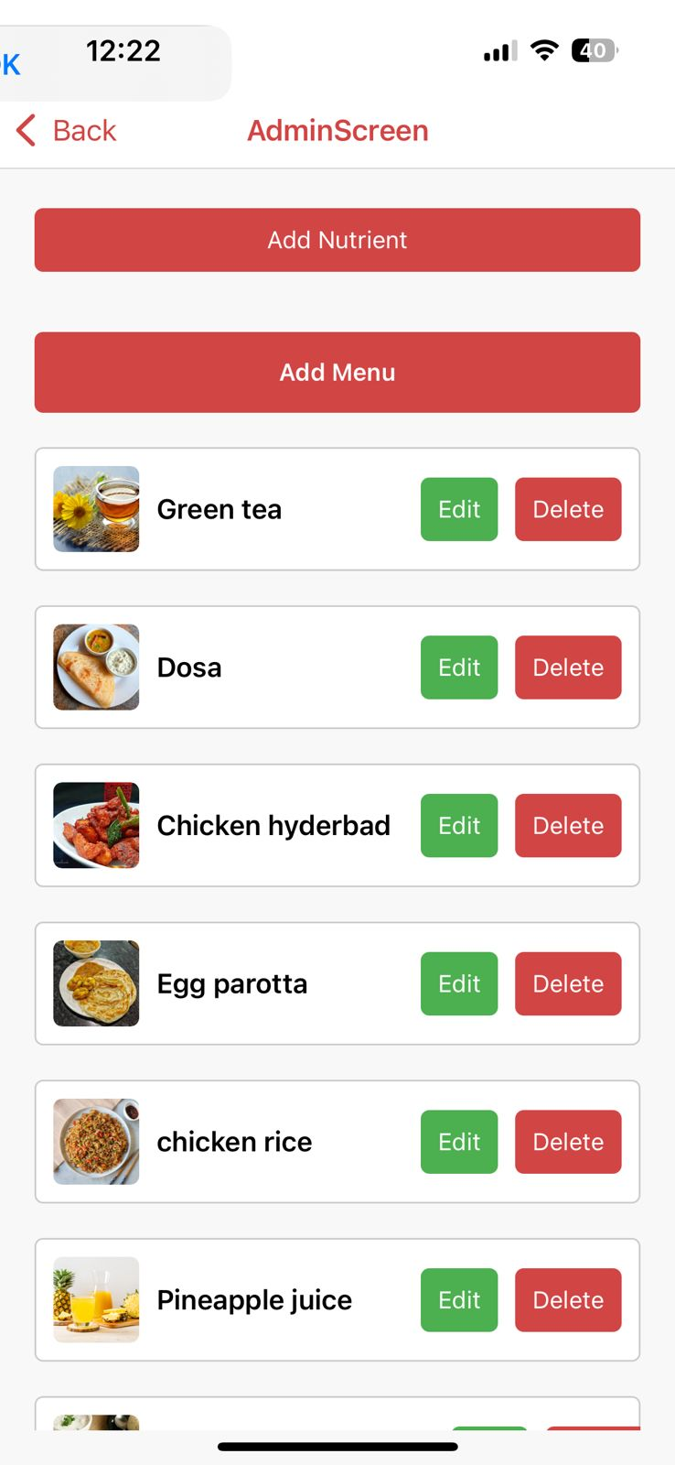
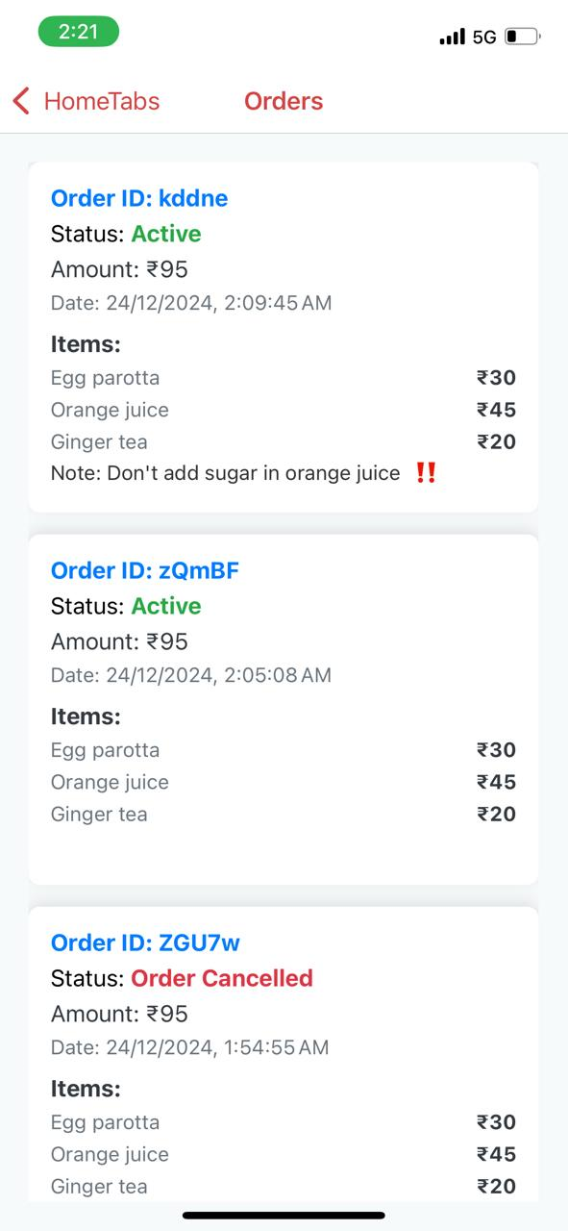
14

Slide 16
CONCLUSION
15
The "FoodQ" system simplifies and enhances the dining experience for students, faculty, and staff. By enabling meal pre-orders, providing nutritional details, and offering secure payment options, it reduces wait times and promotes convenience.
With features like personalized favorites and a focus on health-conscious choices, FoodQ adapts to the changing needs of the campus community, making dining more efficient and enjoyable.

Slide 17
THANK YOU !!

