Slide 1
Automated Insight Report
Generated 2025-12-03 07:35 UTC

Slide 2
Model KPIs
Accuracy: 0.661
Precision: 0.782
Recall: 0.466
Roc_Auc: 0.740

Slide 3
Narrative Insights
Overall approval conversion rate is 51.1% with model precision 78.2%
and recall 46.6%. 30-34 audiences respond best, followed by M users.
Campaign 1178 is outperforming at 62.1%, while campaign 936 trails at
37.1%. Reinvest into the winning creative mix and pressure-test
underperforming campaigns with fresh copy and tighter targeting.

Slide 4
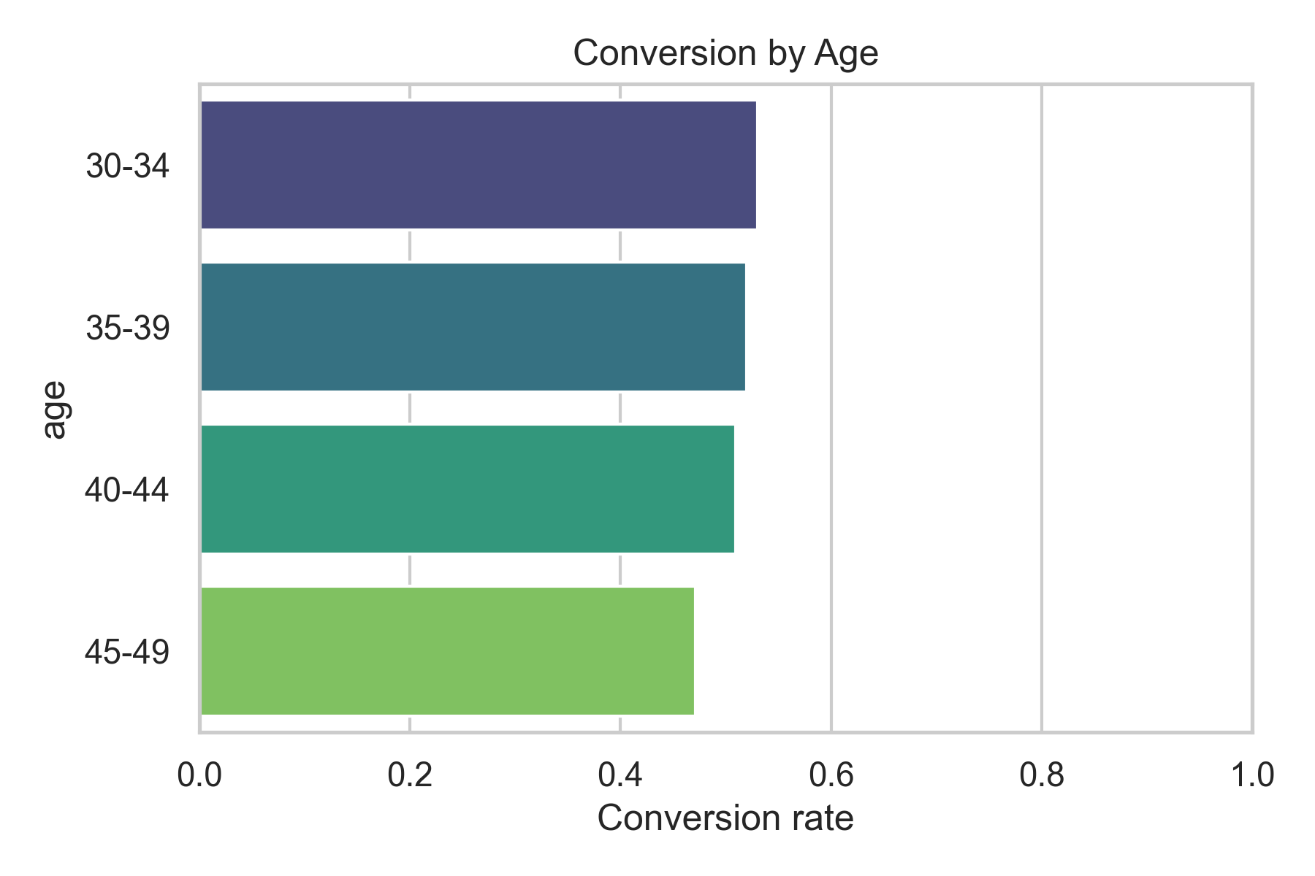
Conversion by Age

Slide 5
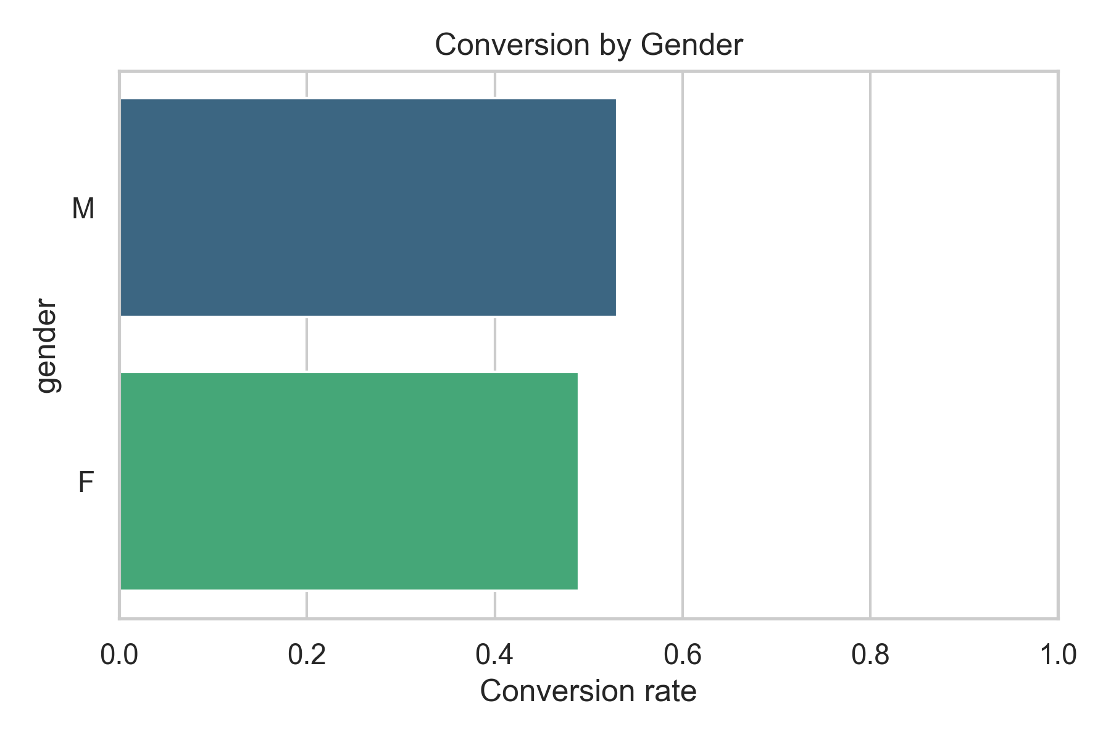
Conversion by Gender

Slide 6
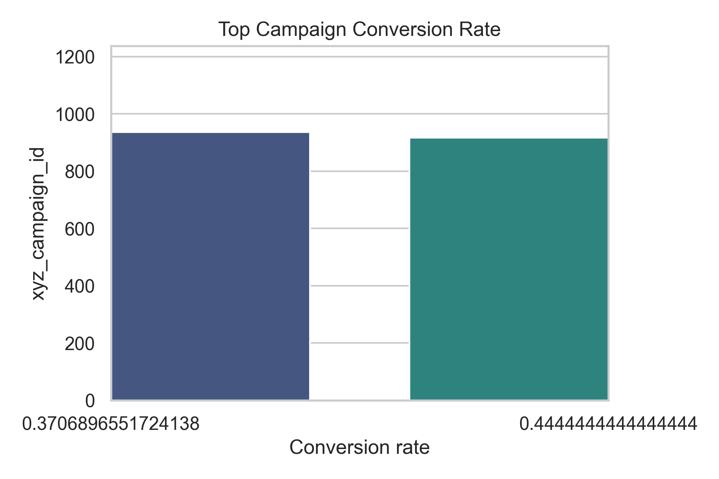
Top Campaigns

Slide 7
Cohort Summary
Overall Rate
By Age
  30-34: 53.1%
  35-39: 52.0%
  40-44: 51.0%
  45-49: 47.1%
By Gender
  M: 53.0%
  F: 49.0%
Top Campaigns
  1178: 62.1%
  916: 44.4%
  936: 37.1%
Efficient Campaigns
  916: 16.0%
  936: 5.9%
  1178: 0.7%

