Slide 1

Employee Data Analysis using Excel
STUDENT NAME : DHANUSRI C
REGISTER NO. : 312208472
DEPARTMENT : B.Com(General)
COLLEGE : Chellammal women's college
1
Notes:
1

Slide 2

PROJECT TITLE
Employee Performance Analysis using Excel
2

Slide 3



AGENDA
Project Overview
End Users
Problem Statement
Our Solution and Proposition
Dataset Description
Modelling Approach
Results and Discussion
Conclusion
3/21/2024 Annual Review
3

Slide 4

PROBLEM STATEMENT
This presentation aims to analyze existing employee
performance data to uncover actionable insights
,develop targeted strategies for performance
enhancement and support data driven decision
making to foster a more efficient and motivated
workforce
4

Slide 5

PROJECT OVERVIEW
The employee performance data analysis project
evaluates metrics like productivity, quality of
work, and attendance to identify trends and areas
for improvement. By analyzing this data, the
project aims to uncover strengths and weaknesses,
offering actionable insights and recommendations
to enhance overall performance and align with organisational goals.
5

Slide 6


WHO ARE THE END USERS?
-HR MANAGER
-Team Leaders
- Department Heads
- Senior Executives
- Performance Analysts
- Training and Development Teams
- Employee Relations Specialists
- Data Analysts etc
6

Slide 7
OUR SOLUTION AND ITS VALUE PROPOSITION
➢ Filtering: Enhanced data accuracy by isolating relevant subsets, which improved focus on specific performance metrics and streamlined analysis.
➢ Slicer: Enabled interactive data exploration by providing dynamic filtering options, allowing users to easily segment and analyze data across different dimensions.
➢ Pivot Table: Summarized large datasets effectively by aggregating and reorganizing data, facilitating in-depth analysis and insight into key performance indicators.
➢ Graph: Visualized data trends and patterns through charts, making complex information more accessible and actionable for stakeholders.
7

Slide 8
Dataset Description
Employee dataset - Kaggle
Total Features - 26
Features Used - 9
Employee ID - Numerical
Name - Text
Gender - Male & Female
Employee type - Full time,Part time, Contract
Employee status - Active
Employee Rating - Numerical
Business Unit - Department

Slide 9
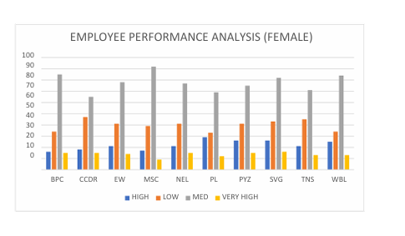
THE "WOW" IN OUR SOLUTION
About more than 100
Female employees in all
the departments have fully
met the performance
expectations and about
15-20 of employees in
each department have
exceeded the
Expectation.
9

Slide 10
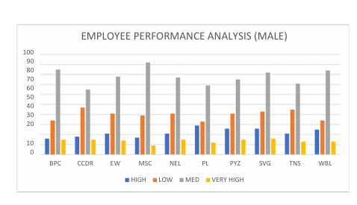
THE "WOW" IN OUR SOLUTION
Male employees have
achieved the similar results
and have also given
exceeding performance
in various sectors
accordingly
9

Slide 11
MODELLING
Data sources & cleaning:
Data sources provide the raw information needed for analysis, but this data often contains errors or inconsistencies.so cleaned the data collected from Kaggle to ensure there are no errors and the data is reliable for analysis.
Key Metrics and Dimensions:
Defined dimensions like departments and job roles for detailed analysis. Ensured metrics align with organizational performance goals.
Pivot Table:
Created pivot tables to summarize and analyze large data sets.
Organized data by dimensions like employee performance level and employee groups.
Visualizations:
Developed charts and graphs to illustrate performance trends.
Used bar charts for departmental comparisons
10

Slide 12
MODELLING
Insights and Conclusions:
Analyzed visualizations to identify performance patterns and
anomalies.
Delved into trends to uncover factors influencing employee -
performance.
Reporting and Presentation :
Designed visual aids to effectively communicate insights and recommendations.
Presented key findings and actionable steps for strategic decision-making
10

Slide 13
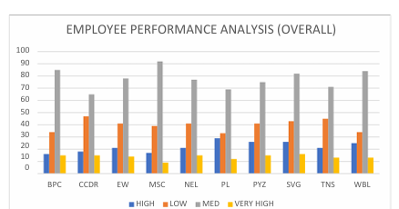
RESULTS
11

Slide 14
conclusion
WITH THE PERFORMANCE BEING SHOWN THAT MORE THAN OR EQUAL TO 100 EMPLOYEES IN BOTH MALE AND FEMALE(EACH DEPARTMENT ) HAVE FULLY MET THE PERFORMANCE
EXPECTATION AND LESS THAN OR EQUAL TO 20 EMPLOYEES IN EACH DEPARTMENT BEING EXCEEDING THE EXPECTAION THE REST ARE TAKEN AS ''PIP'' AND ''NEEDS IMPROVEMENT''
PIP < 15 IN EACH DEPARTMENT
NEEDS IMPROVEMENT < 25 IN EACH DEPARTMENT
THESE NUMBER OF EMPLOYEES MIGHT NEED EXTRA MOTIVATION / TRAINING /
PRACTICE ON EFFICIENT PERFORMANCE .

