Slide 1
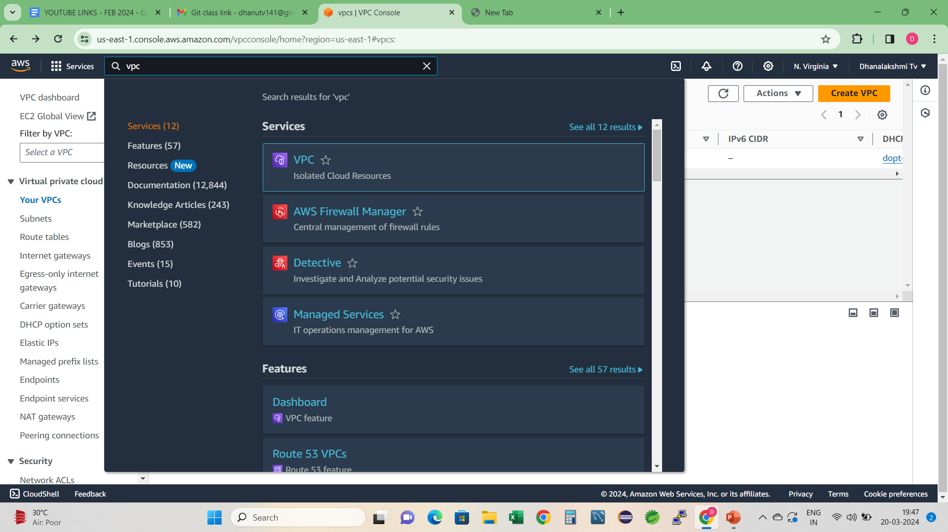
How to create AWS vpc with public and private subnets 1.open VPC in aws console, just search vpc

Slide 2
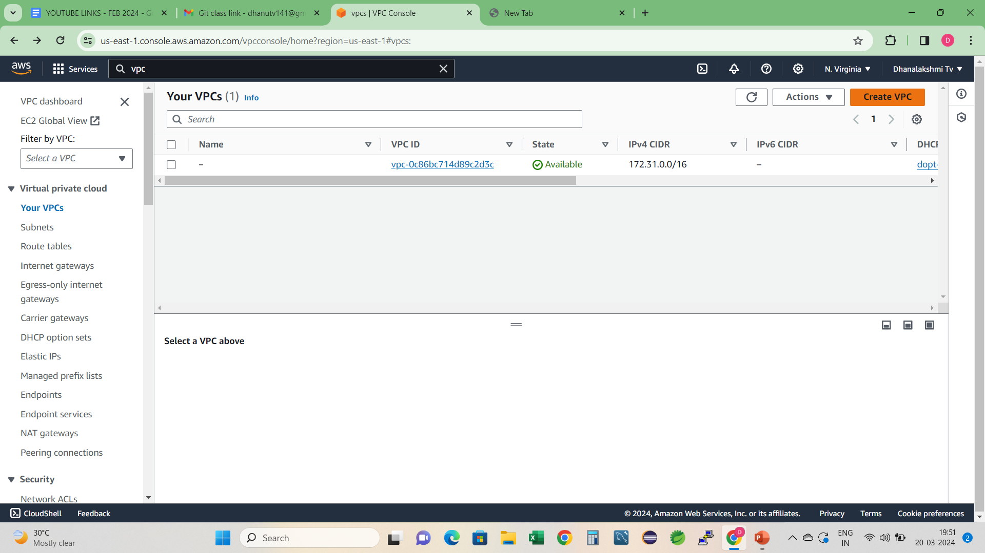

Click on create vpc

Slide 3
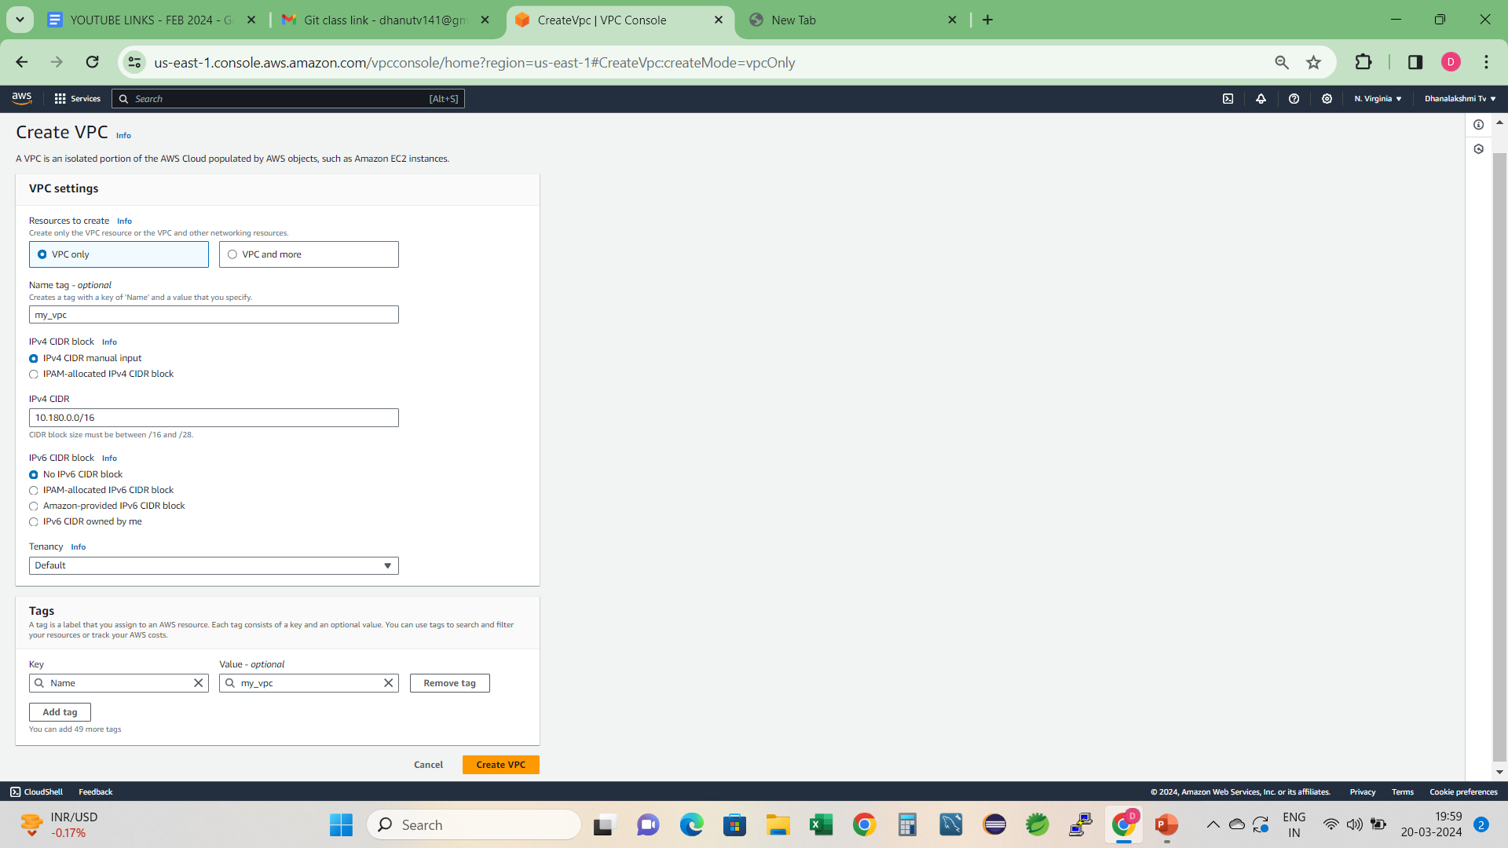
Vpc setting with 2 option will open , currently create vpc only, provide name, ipv4 details and then click on create vpc

Slide 4
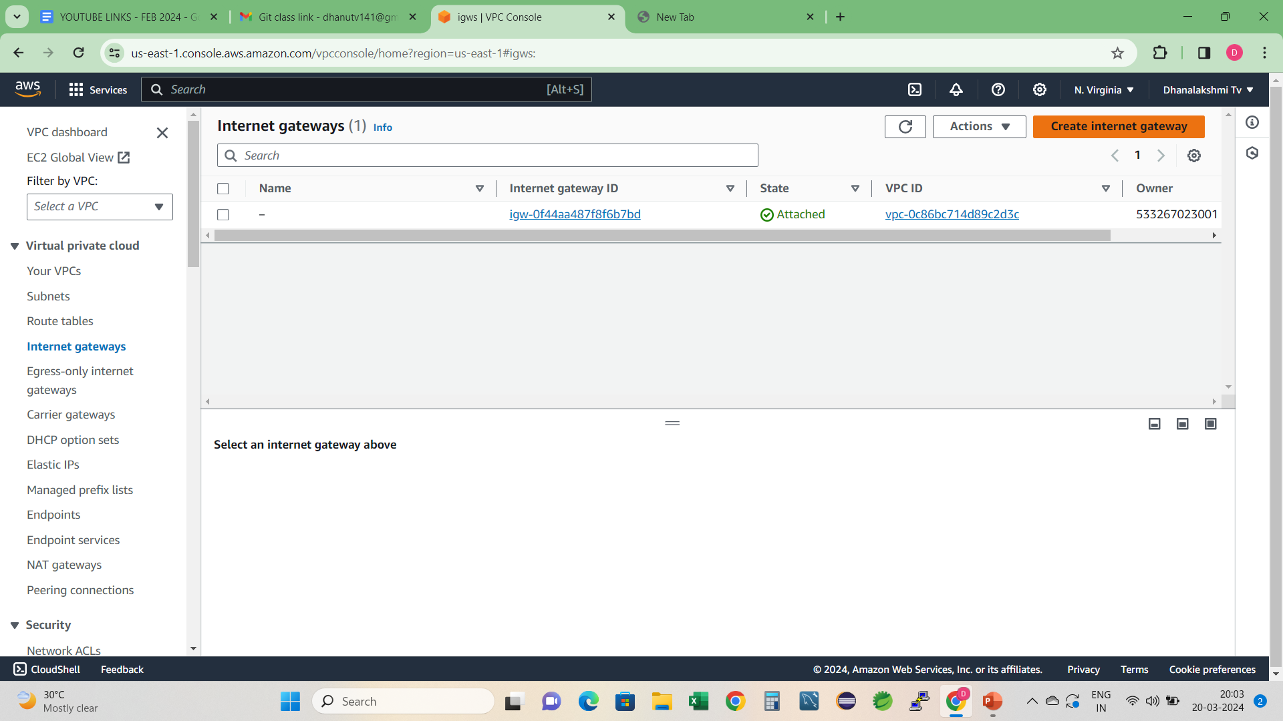
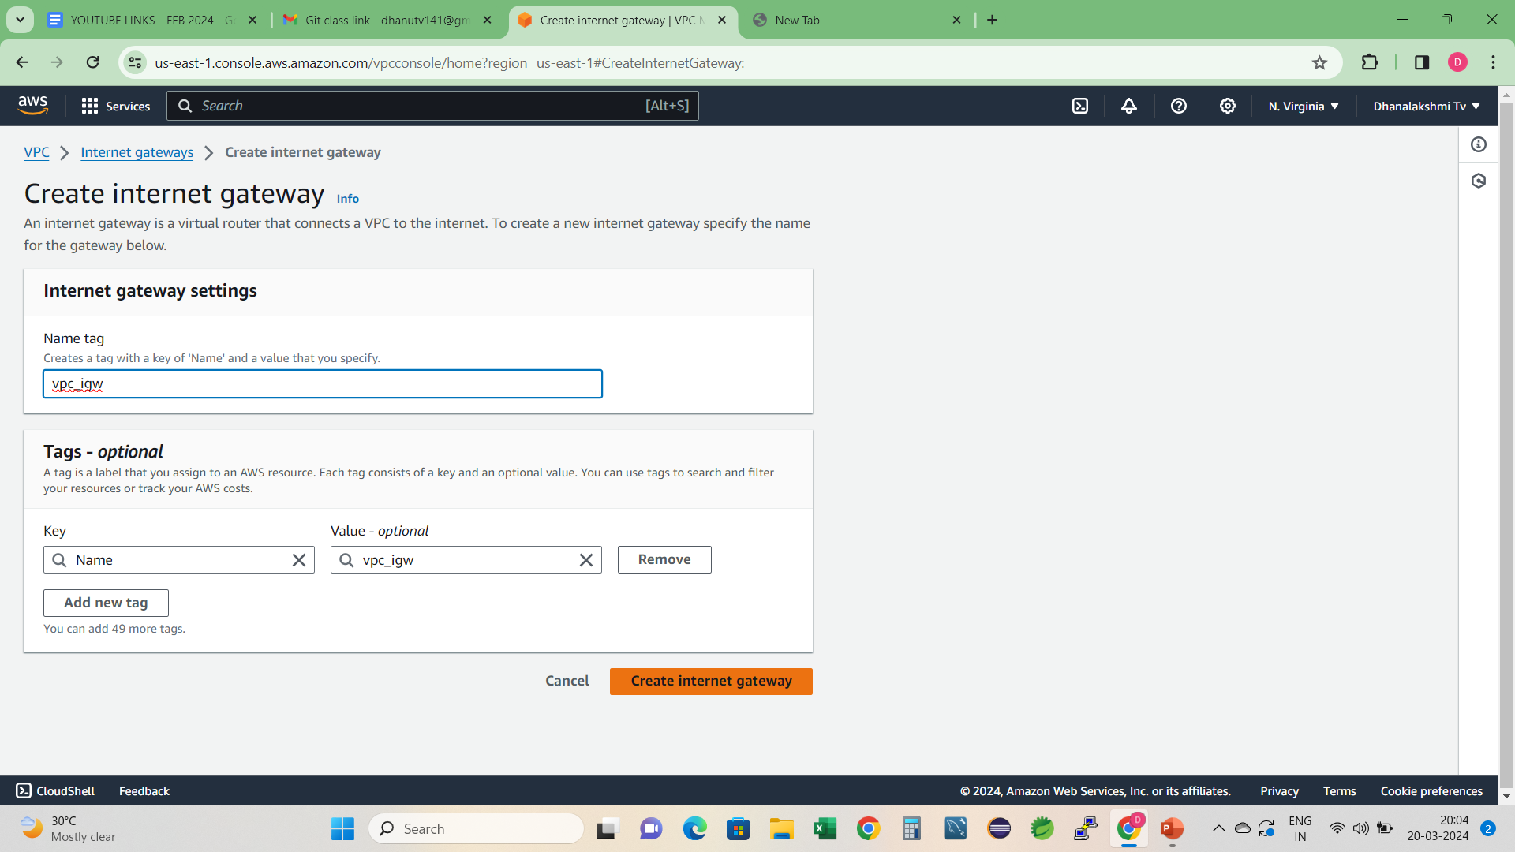
2.Create internet gateway attached with created vpc

Slide 5
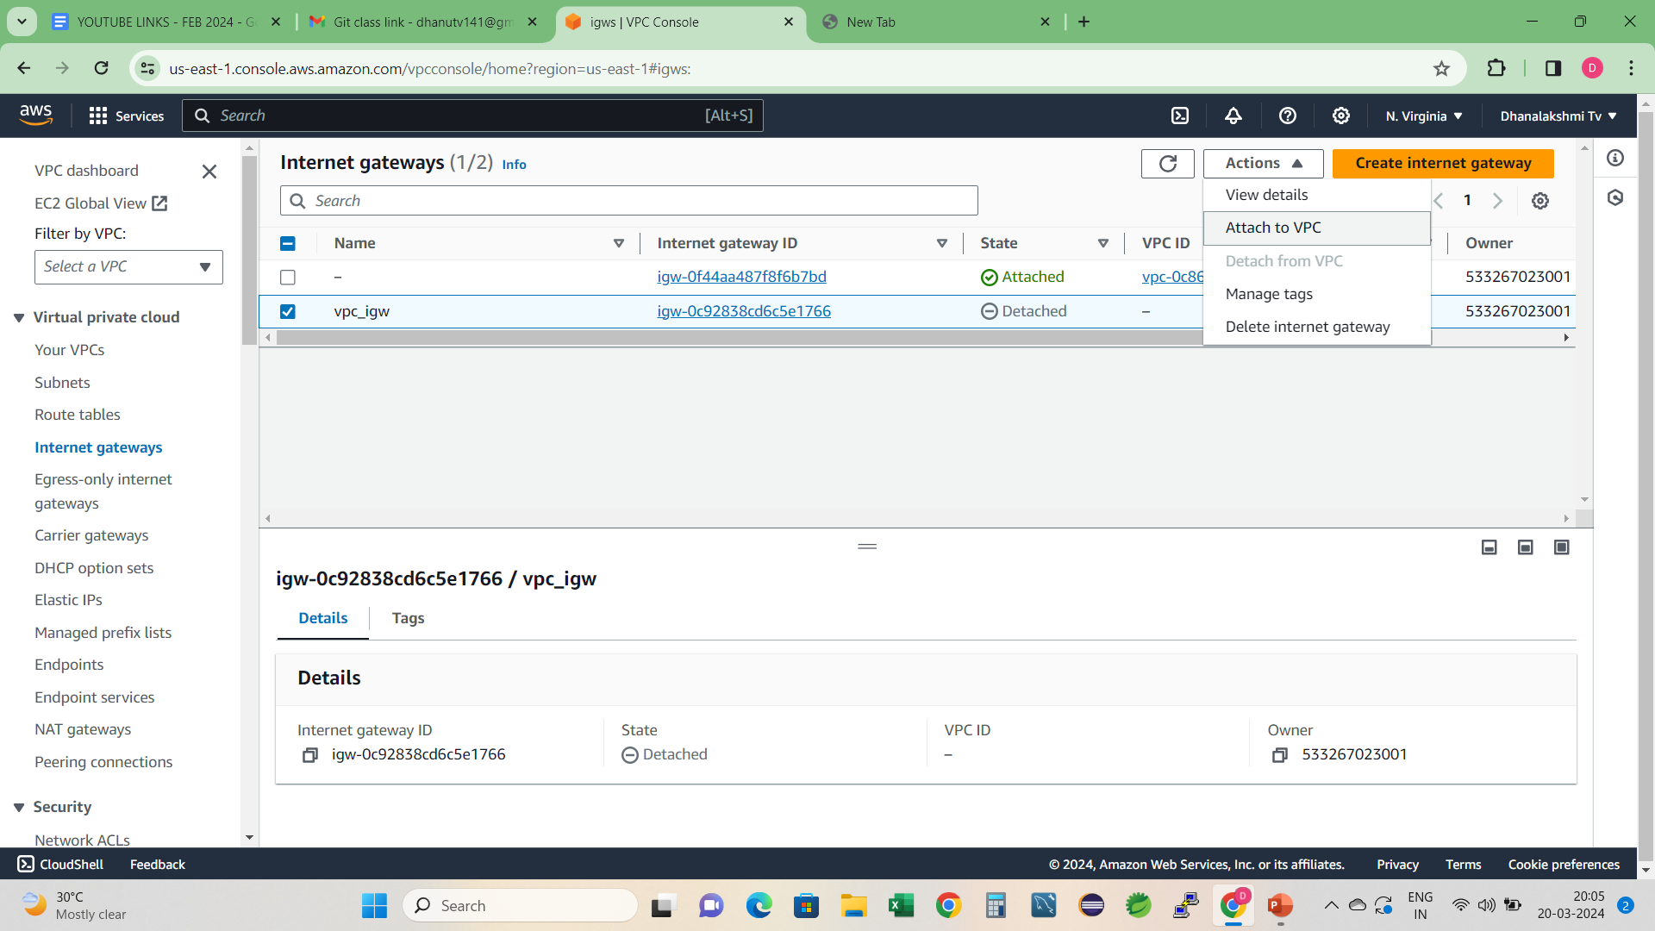
Attach internet gateway with vpc

Slide 6
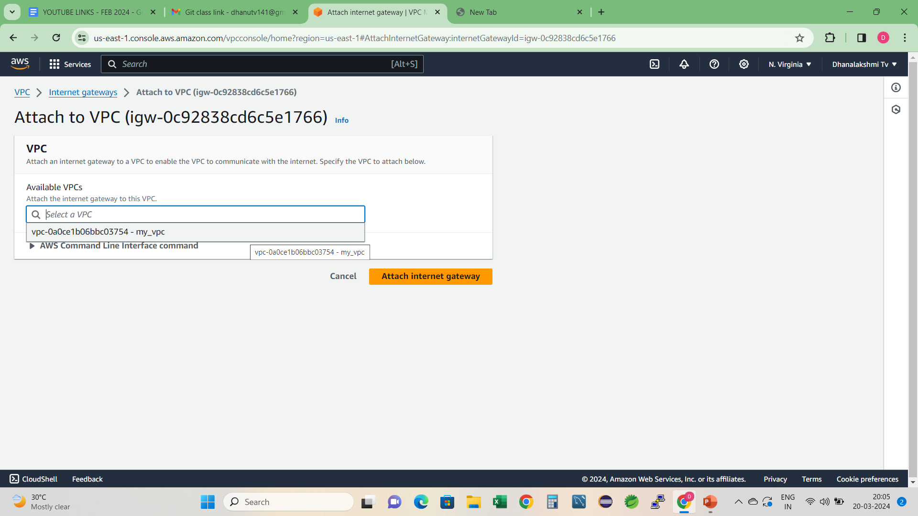

Slide 7
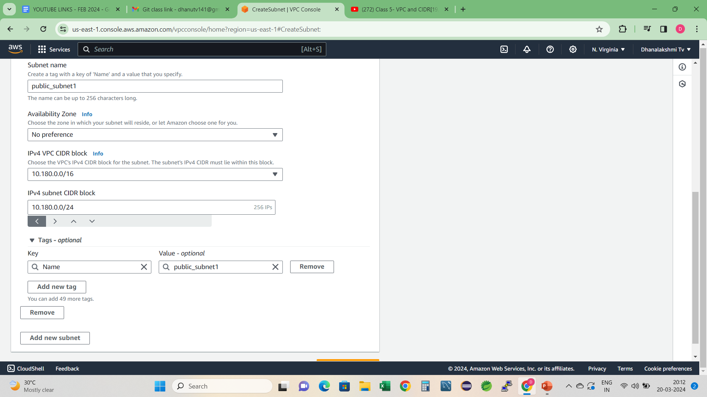
create 4 subnets in this vpc (2 public and 2 private subnets)

Slide 8
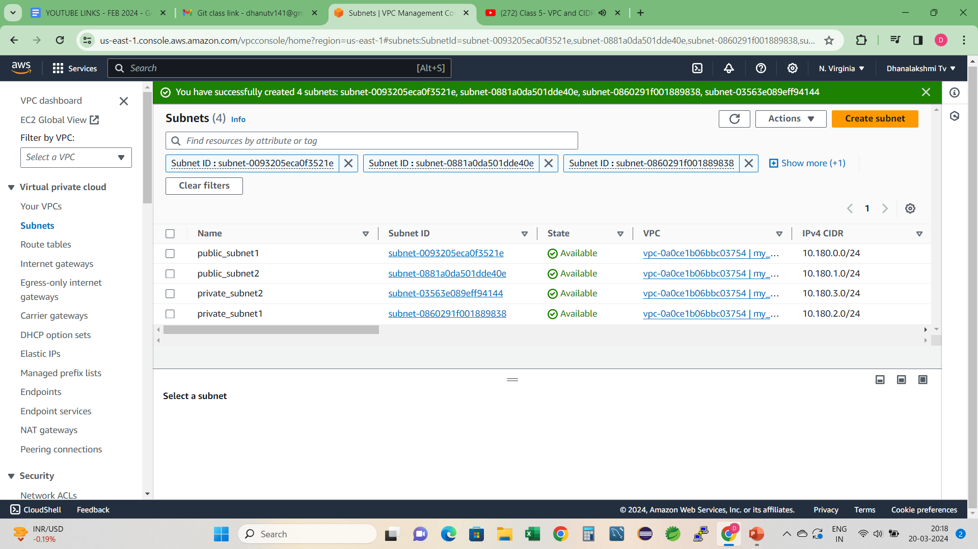

Slide 9
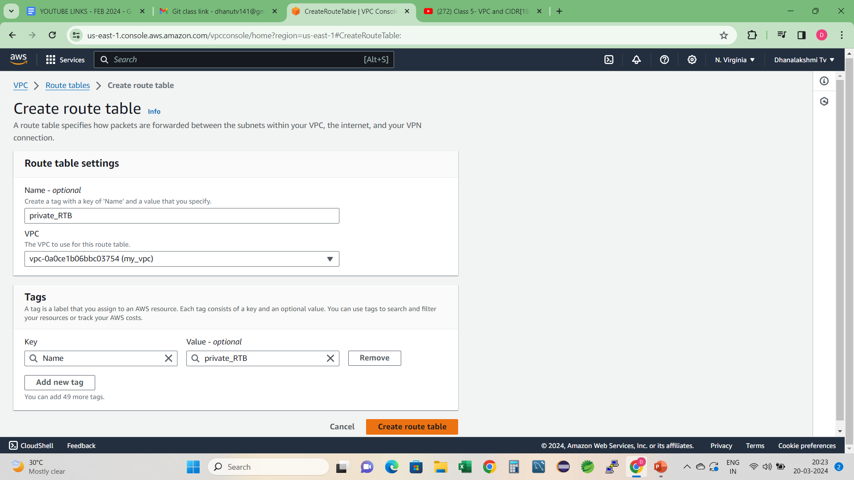
Create 2 route tables to connect private and public subnets with IGW

Slide 10
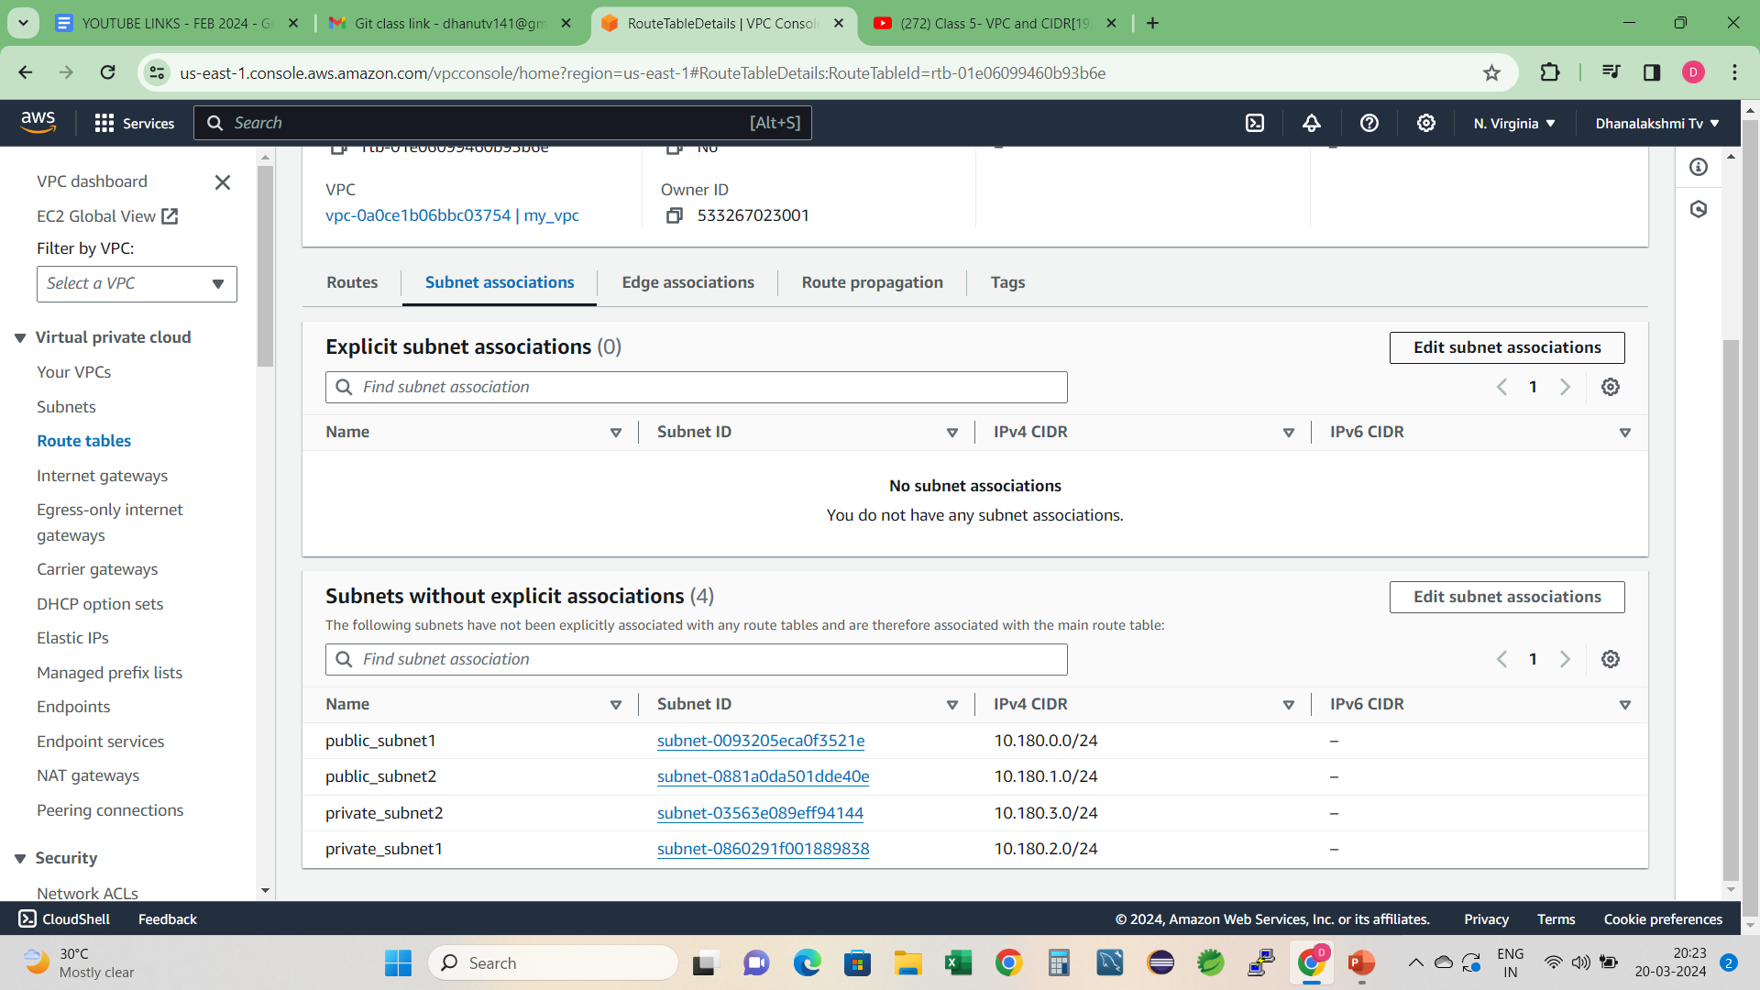
Attach subnets with RTB

Slide 11
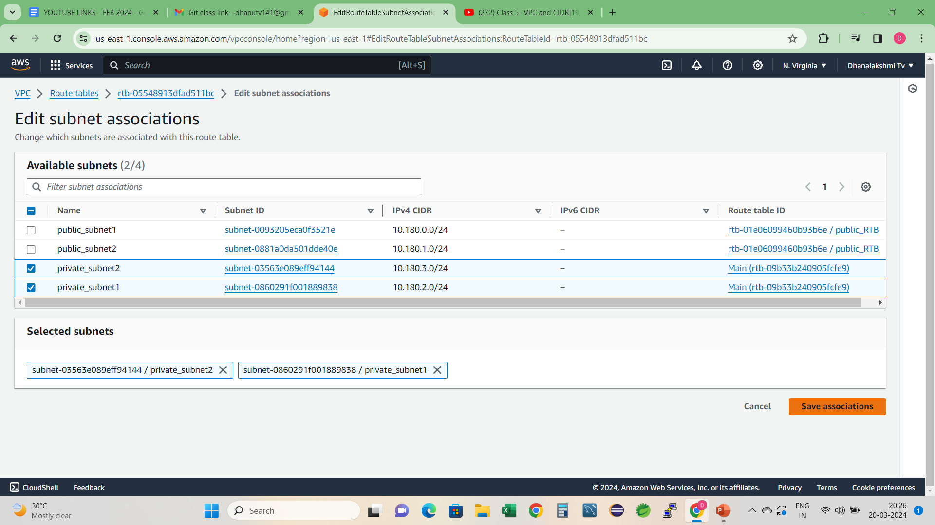

Slide 12
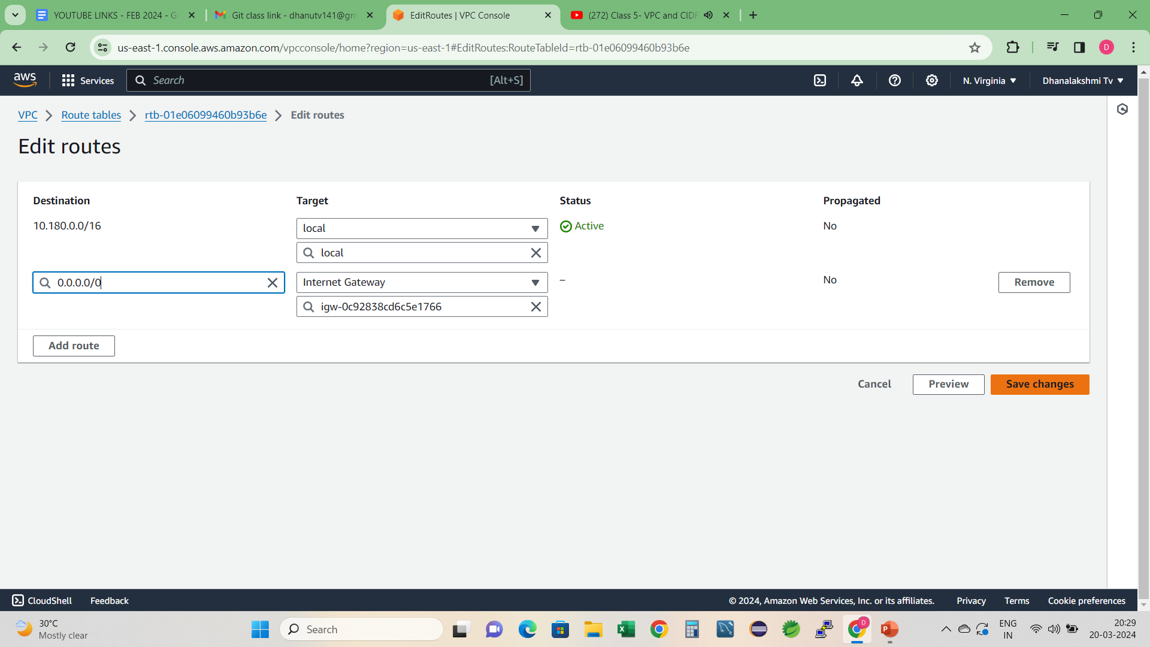
Connect public routetable with IGW by editing route

Slide 13
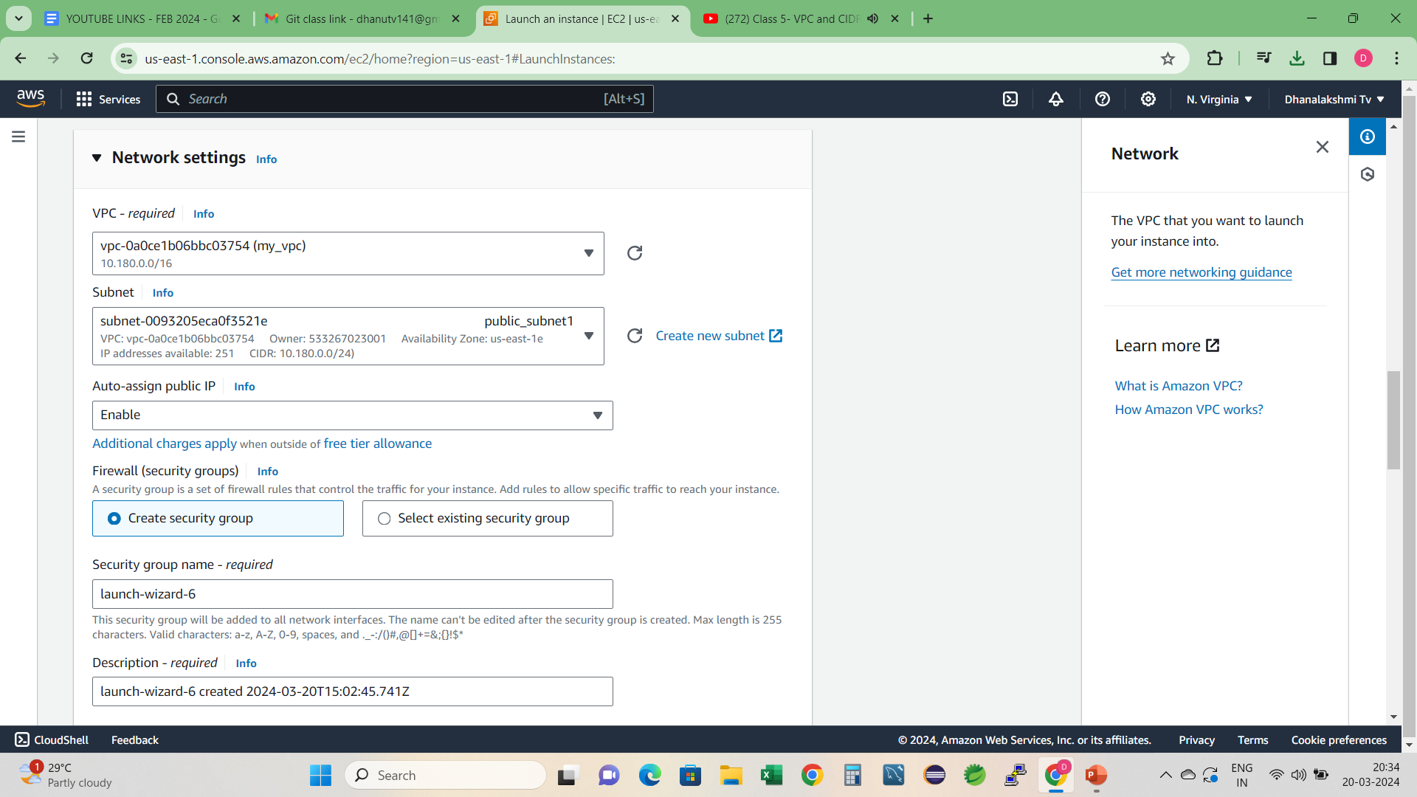
Create EC2 instance for public and private subnets attached to it in network setting attached vpc to ec2 , similarly create ec2 instances for all subnets

