Slide 1
Face Recognition Using PCA, 2D-PCA and K-PCA
MATHEMATICS FOR INTELLIGENT SYSTEMS - 3
TEAM MEMBERS:-
ARYAN KAMULAGARI - AM.EN.U4AIE20014
NEHITH SAI VEMULAPALLI - AM.EN.U4AIE20053
PALADUGULA PRUTHVI - AM.EN.U4AIE20054
Y.DHANVANTH REDDY - AM.EN.U4AIE20077

Slide 2
INTRODUCTION
The growing need for effective biometric identification is widely acknowledged. Human face recognition is an important area in the field of biometrics. It has been an active area of research for several decades but still remains a challenging problem because of the complexity of the human face.
The PCA is an orthogonal linear transformation that maps the data to a new coordinate system, in which most of the variance is explained on the first new components. The change of base matrix used to make this projection is composed of the eigenvectors of the covariance matrix of the input data. In the case of the face recognition task, this eigenvector is also known as eigenfaces
The 2D-PCA has the same aim as the standard PCA. However, the PCA needs a matrix as input data, while the 2D-PCA can be applied directly to a tensor(Mathematical object that can be used to describe physical properties). This approach results be useful in specific cases, such as the recognition of color faces. Instead of using SVD in this case is used the eigendecomposition strategy. This process consists in finding the covariance matrix of the tensor and calculating its eigenvectors ordered by decreasing the order of the correspondent eigenvalues.
Kernel Principal Component Analysis (K-PCA) is a non-linear dimensionality reduction technique. It is an extension of Principal Component Analysis (PCA) - which is a linear dimensionality reduction technique - using kernel methods. Sometimes the structure of the data is nonlinear.

Slide 3
DESCRIPTION
Principal component analysis (PCA) was invented in 1901 by Karl Pearson. PCA is a variable reduction procedure and is useful when obtained data have some redundancy. This will result in a reduction of variables into a smaller number of variables which are called Principal Components which will account for most of the variance in the observed variable.
Two-dimensional principal component analysis (2D-PCA) has the same aim as the standard PCA. However, the PCA needs a matrix as input data, while the 2D-PCA can be applied directly to a tensor(Mathematical object that can be used to describe physical properties). This approach results be useful in specific cases, such as the recognition of color faces. Instead of using SVD in this case is used the eigendecomposition strategy. This process consists in finding the covariance matrix of the tensor and calculating its eigenvectors ordered by decreasing the order of the strategy. These correspondent eigenvalues.
Kernel Principal Component Analysis (KPCA) is a non-linear dimensionality reduction technique. It is an extension of Principal Component Analysis (PCA) - which is a linear dimensionality reduction technique - using kernel methods. Sometimes the structure of the data is nonlinear, and the principal components will not give us the optimal dimensionality reduction, so we use non-linear methods like KPCA. The idea of KPCA relies on the intuition that many datasets, which are not linearly separable in their space, can be made linearly separable by projecting them into a higher dimensional space. The added dimensions are just simple arithmetic operations performed on the original data dimensions.

Slide 4
METHODS IMPLEMENTED
Dimensionality Reduction.
Eigen Face Approach.
Eigen Values and Eigen Vectors.
Principal Component Analysis.
2D-Principal Component Analysis.
Kernel Principal Component Analysis.
PROGRAMMING LANGUAGE :
We used python for making the face recognition using PCA, 2D-PCA, and K-PCA project using ML which includes training, testing, and then the approach to accuracy, precision, and the image match.
DATASET :
We used the Olivetti faces dataset.

Slide 5
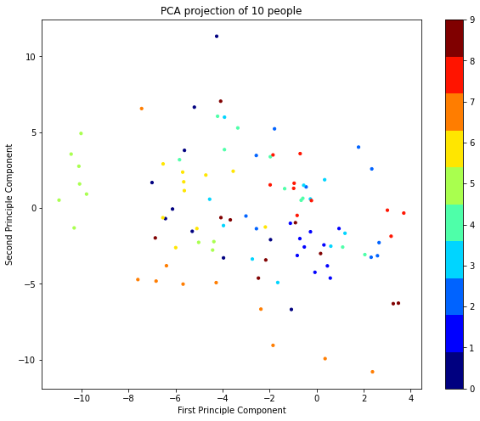
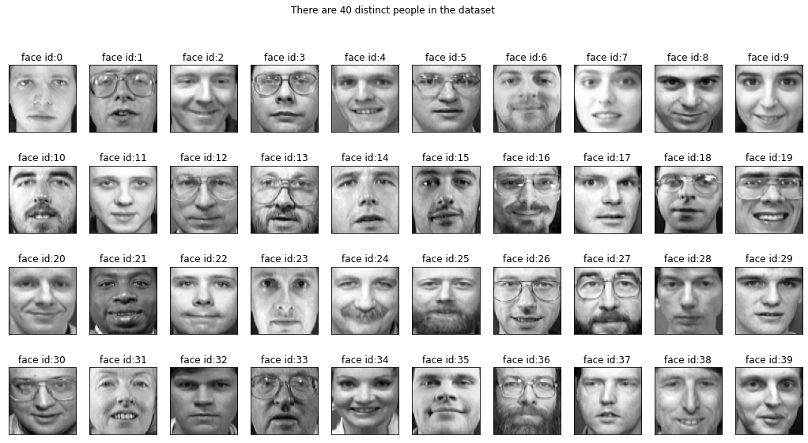
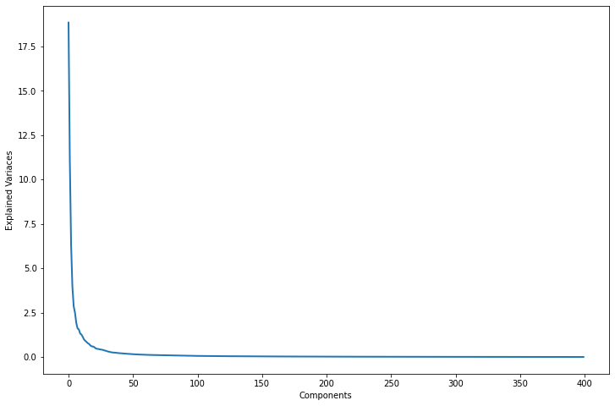
RESULTS AND OUTPUT

Slide 6
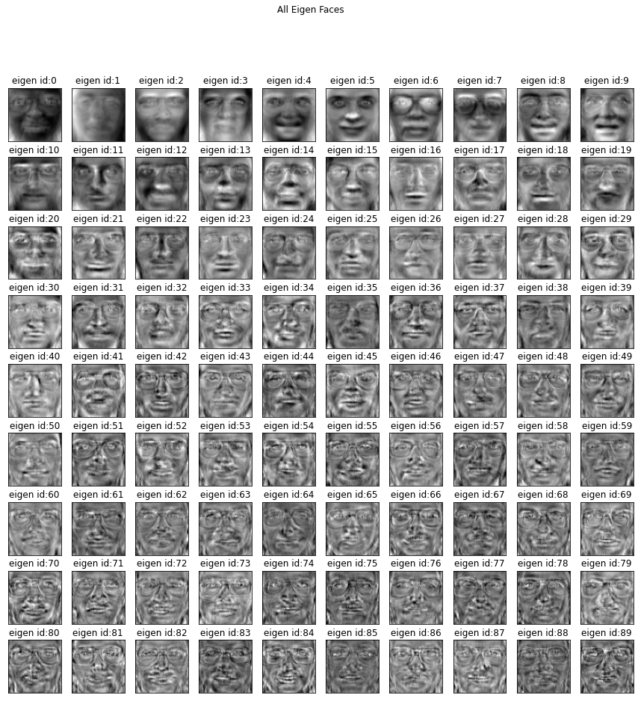

Slide 7
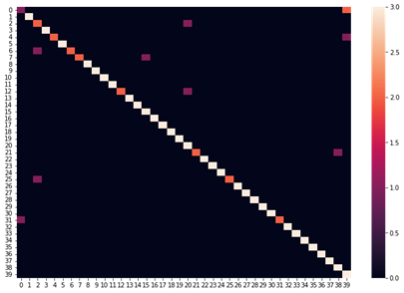
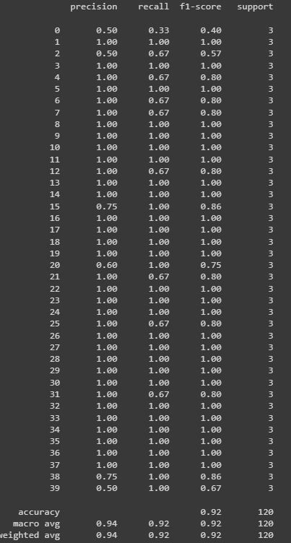
Confusion Matrix
Classification report

Slide 8
CONCLUSION
The major advantage of PCA in using it in the eigenface approach is it helps in reducing the size of the database for recognition of test images. The images are stored as their feature vectors in the database which are found out projecting every trained image to the set of Eigenfaces obtained. PCA is applied to the Eigenface approach to reduce the dimensionality of a large data set.2D-PCA can overcome the limitations of PCA the accuracy precision is higher compared to PCA. By the use of integral kernel function, one can efficiently compute principal components in high dimensional feature spaces, related to input space by some nonlinear map. The polynomial kernel was used. The experimental results demonstrate that the KPCA is not only good at dimensional reduction but also available to get better performance than conventional PCA. The highest rate is 90%.
After the analysis of all the methods, KPCA is the most efficient among the three. We have freedom of dimension in KPCA.

Slide 9
THANK YOU

