Slide 1
Recommendation System: Collaborative Filtering
KADIYALA MONISH MITHRA
KONIJETI SRI VYSHNAVI
SESHABHATTAR SRI VASTAV
SRUNGARAPU JATIN ABIT SAI
YERRAMREDDY DHANVANTH REDDY
AM.EN.U4AIE20038
AM.EN.U4AIE20042
AM.EN.U4AIE20065
AM.EN.U4AIE20069
AM.EN.U4AIE20077

Slide 2
The Problem we are addressing In our Project….
Problem Definition :-
The topic collaborative Filtering deals with the users , items and the result prediction using various methods. We are creating a recommender system for giving recommendations on movies watched by various users . So we are including a matrix taking users and movies of dimensions 943 and 1682 which gives the ratings of various users to given movies and which are not been rated are taken as zero . So that the collaborative filtering model will be taking it for predicting the rating . The predicted rating will match approximately but not perfectly, the difference in the approximation is taken as the accuracy on the model we designed.
Description :-
Collaborative Filtering Is the most famous application suggestion engine and is based on calculated guesses;
The people who liked the product will enjoy the same product in the future.
This type of algorithm is also known as a product based collaborative shift.
In this Filtering, users are filtered and associated with each User In place of items.
In this system, only users’ behavior is considered.
Only their content and profile information is not enough. The User giving a positive rating to products will be associated with other User’s behavior giving a similar rating.

Slide 3
Implementation of our Project
Methods :-
We used Alternating Least Squares method to train the predictions in our Collaborative Filtering Model.
ALS is an iterative optimization process where we for every iteration try to arrive closer and closer to a factorized representation of our original data.
We have our original matrix R of size u x I with our users, items and some type of feedback data.
We then want to find a way to turn that into one matrix with users and hidden features of size u x f and one with items and hidden features of size f x I.
In U and V we have weights for how each user/item relates to each feature. What we do is we calculate U and V so that their product approximates R as closely as possible: R Is congruent to U x V.
Methods Involved :-
Reading the Dataset
Dividing them into different matrices such as num_users,num_features,X,Y etc.
Applying the Alternative Least Square(ALS) in predicting the unknown ratings for recommendations.
Getting the result which are the predicted ratings .

Slide 4
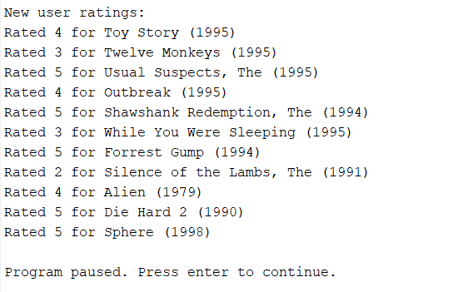
Discussion And Results
Discussion :- The dataset used contains users ratings and movies as a matrix and then a preference matrix is been created to check whether the movie is rated or not . If rated will be taken as 1 or else 0 will be taken .Then Alternating Least Squares model will be applied to the input matrix and get the required predictions . We need to give the input of movies which we watched and given rating so that the collaborative filtering model runs the iterations based on the method we applied for calculation and after normalizing the ratings the output predictions will be displayed for other movies.
Then we run iterations using collaborative filtering model we designed .

Slide 5
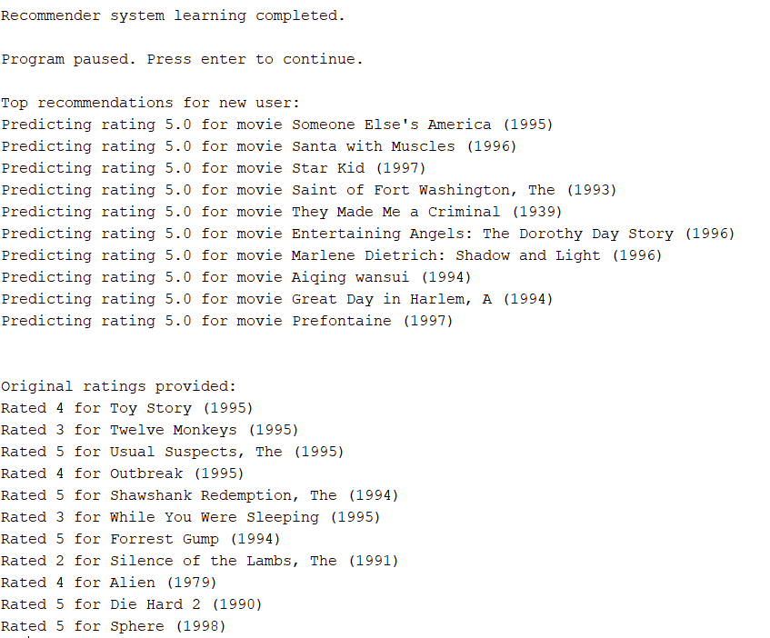
Output :-

Slide 6
REFERENCES
https://medium.com/radon-dev/als-implicitcollaborative-filtering-5ed653ba39fe
https://medium.com/ai-society/a-concise-recommendersystems-tutoria
https://tryolabs.com/blog/introduction-to-recommendersystems/
https://realpython.com/build-recommendation-enginecollaborative-filtering/wh
https://www.analyticsvidhya.com/blog/2020/11/createyour-own-movie-movie-recommendation-syste
https://towardsdatascience.com/how-to-build-a-movierecommendation-syste
https://www.kdnuggets.com/2019/09/machine-learningrecommender-systems.

