Slide 1
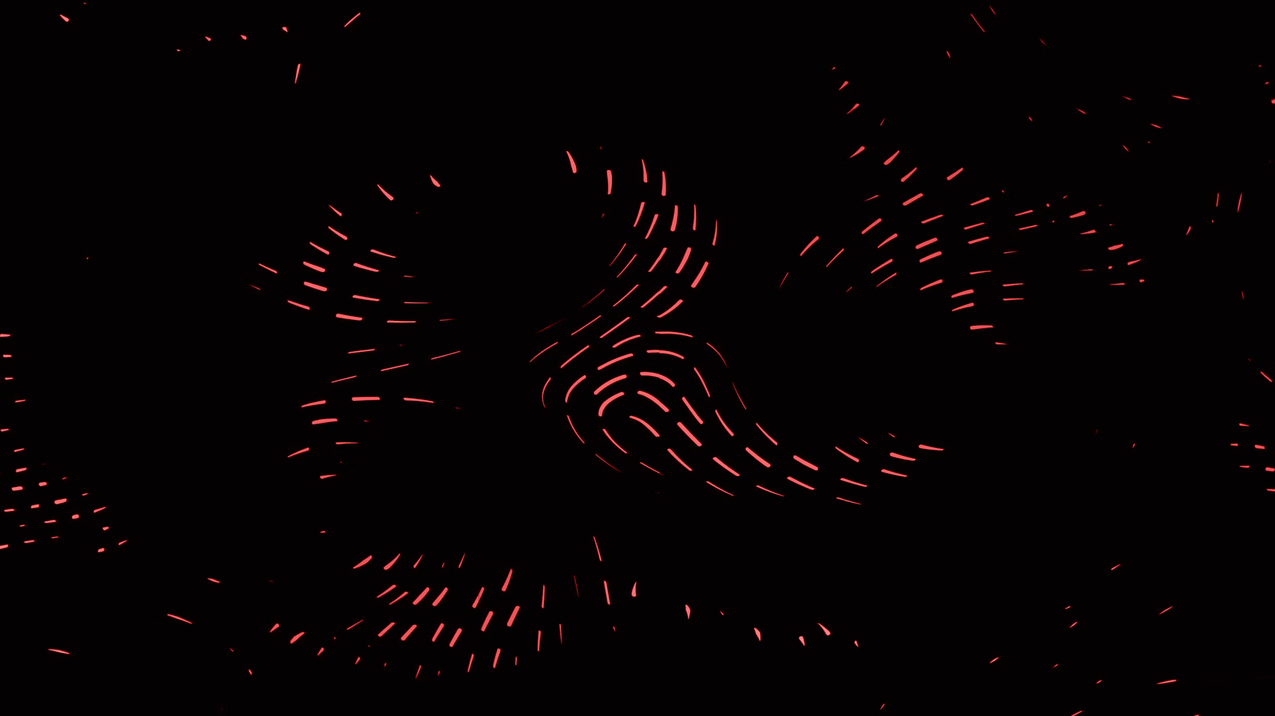

IntelliTrace 2026
Real-Time Cross-Channel Mule Account Detection Using Graph Intelligence
Team: Cyber Dynamos
Dhinith Pragalyan M • Dhanveer M • Elamaran B • Venkatesan S
Notes:
1

Slide 2

Abstract
Money mule networks exploit multi-channel banking systems by rapidly transferring funds across mobile apps, web platforms, wallets, and ATMs to obscure fraudulent trails. Traditional rule-based systems fail due to siloed data and lack of network-level visibility.
We propose a real-time Graph Intelligence Platform that unifies multi-channel logs into a structured entity graph and applies Graph Neural Networks (GNN) to detect high-velocity mule rings. The system generates explainable risk scores, supports compliance reporting, and enables proactive fraud prevention.
Notes:
2

Slide 3


Problem Statement
Multi-Channel Fraud
Hidden Patterns
Money mules move funds across App, Web, ATM, and UPI within minutes
Fraud patterns are obscured across multiple systems and channels
Rule-Based Limitations
Static rules detect isolated anomalies but miss relational fraud networks
Example Pattern
Victim → Account A → Wallet B → Account C → ATM Withdrawal (within 5 minutes)
Fraud becomes visible only at network level
Notes:
3

Slide 4
Limitations of Existing Systems
Siloed Transaction Logs
Static Threshold-Based Rules
Isolated data prevents holistic fraud view
Inflexible rules miss evolving patterns
No Relationship Intelligence
Limited Explainability
Missing account-device-IP connections
Black-box alerts lack audit trails
Result: Fraud rings operate undetected until significant financial loss occurs
Notes:
4

Slide 5
Proposed Solution Overview
01
02
Multi-Channel Log Ingestion
Unified Entity Graph Construction
Unified data collection from all banking channels
Structured graph of accounts, devices, IPs, and transactions
03
04
Feature Extraction
GNN-Based Classification
Relational pattern analysis and velocity metrics
Graph Neural Networks identify mule patterns
05
06
Real-Time Risk Scoring
Compliance Reporting
Immediate risk assessment with explainable scores
Regulator-ready documentation and audit trails
Goal: Detect and block mule rings in near real-time before funds exit the system
Notes:
5

Slide 6
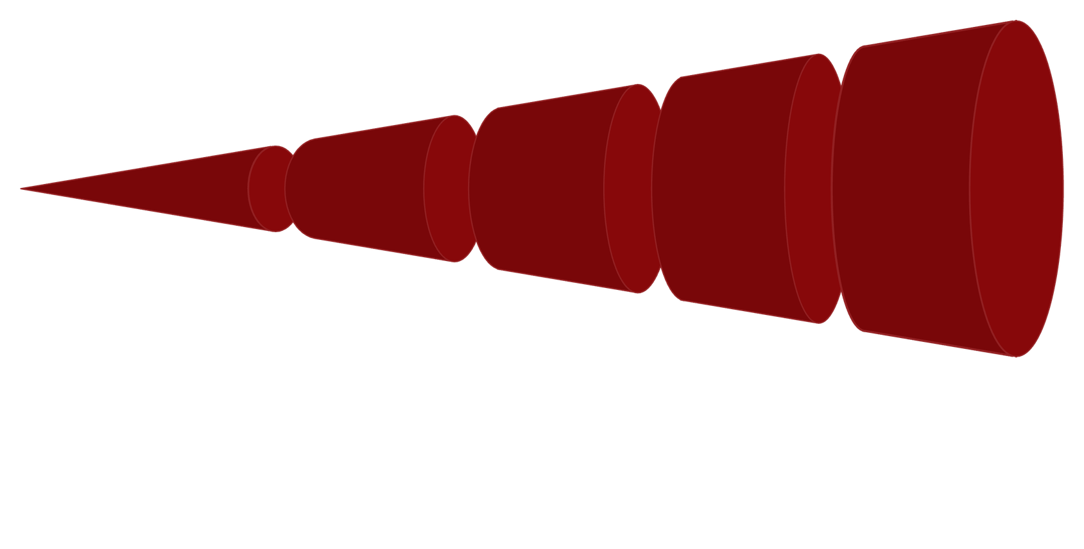
System Architecture
Source Logs
App, Web, ATM, UPI logs
Ingestion
Data ingestion & normalization
Entity Graph
Accounts, Devices, IPs, ATMs
Feature Layer
Feature engineering & aggregation
GNN & Scoring
GNN to risk scoring & reporting
The architecture processes transactions through multiple layers, from raw log ingestion through graph construction, feature engineering, and neural network analysis to generate real-time risk scores and compliance reports.
Notes:
6

Slide 7

Unified Entity Graph Model
Nodes
Edges
Bank Accounts
Wallets
Devices
IP Addresses
ATMs
Transaction
Login Event
Device Usage
Withdrawal Event
Shared Device Detection
Identifies accounts controlled by same device
Velocity Analysis
Multi-hop transfers flagged in real-time
Cluster Identification
Suspicious account groups automatically detected
Notes:
7

Slide 8
GNN-Based Fraud Detection Strategy
We apply Graph Neural Networks (GNN) to perform:
Node Classification
Relationship Strength Scoring
Cluster Risk Evaluation
Normal / Suspicious / Mule account labeling
Quantifies connection risks between entities
Network-level fraud pattern detection
Extracted Features
Transaction velocity
Degree centrality
Shared device count
Multi-hop transfer frequency
Jurisdiction-based risk weighting
Output: Risk Score (0–100) + Confidence Percentage
Notes:
8

Slide 9

Risk Scoring & Explainability
Risk Score
Cluster ID
0–100 scale with confidence level
Associated mule ring identifier
Transaction Timeline
Reason Codes
Complete trace visualization
Explainable detection logic
Example Alert
Risk Score: 92%
Reasons:
4 transfers in 3 minutes
Shared device with 3 flagged accounts
Member of high-risk cluster
Unusual ATM withdrawal sequence
Ensures compliance transparency and audit-ready documentation
Notes:
9

Slide 10
Prototype Development Plan
Phase 01
Design multi-channel transaction schema,simulate realistic banking data + mule scenarios,build unified enity graph(accounts,devicesIPs,ATMs)
Phase 02
Extract graph-based features (velocity, centrality, device sharing),Train GNN for node classification (Normal / Suspicious / Mule),Develop risk scoring logic with confidence metrics.
Phase 03
Implement real-time risk scoring pipeline,Detect mule rings using cluster analysis,Generate explainable reason codes & transaction traces.
Phase 04
Build interactive fraud monitoring dashboard,Visualize suspicious clusters & alerts,Generate regulator-ready compliance reports.

Slide 11

Innovation, Impact & Scalability
Real-Time Detection
Cross-channel fraud identification as it happens
Network Intelligence
Relationship-based fraud pattern analysis
Reduced False Positives
Context-aware scoring minimizes false alarms
Early Disruption
Mule ring blocking before funds exit
Future Scope
Integration with core banking systems
Cross-bank intelligence federation
Cross-border risk scoring
Cloud-based deployment
Advanced behavior-based sanctions screening
Impact: Transforms reactive fraud detection into proactive fraud prevention
Notes:
10

Slide 12

Conclusion
Our solution transforms siloed transaction monitoring into a unified, graph-driven intelligence platform capable of detecting high-velocity mule networks in real time
By integrating multi-channel logs, leveraging Graph Neural Networks, and providing explainable risk scoring, we enable proactive fraud prevention, regulatory transparency, and scalable enterprise deployment.
THANK YOU

