Slide 1
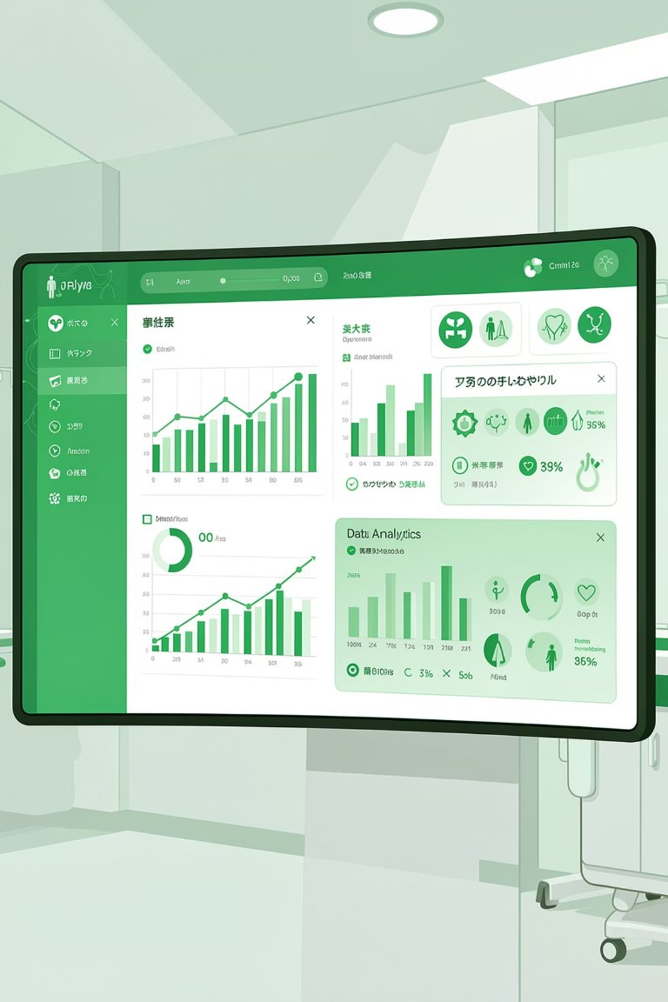
HEALTHCARE ANALYTIS
TEAM G-10
Diabetes Readmission Analysis
Analyzing Clinical & Demographic Patterns
to Reduce 30-Day Hospital Readmissions
Team Members
Dhanvin (Team Lead), Ayush Mittal ,Tanish Garg, Gargi Srivastava, Sumit Yadav , Lakshya
Faculty Mentor: Archit Raj
GitHub: SectionCG10_DiabetsReadmission
Tableau Dashboard

Slide 2
Context & Problem Statement
Why this matters — and what we set out to answer
Sector Context
Problem Statement
Objective
US hospitals face multi-million dollar penalties under the Hospital Readmissions Reduction Program (HRRP)
Avoidable 30-day readmissions signal failures in discharge quality and post-acute care
Diabetic patients face compounded risk due to multiple comorbidities (circulatory, metabolic)
Value-based care mandates demand measurable outcome improvements
How can clinical history, medication patterns, and demographics accurately predict 30-day readmission risk in diabetic patients?
Which patient segments are most likely to return within 30 days of discharge?
What specific clinical interventions reduce return rates most efficiently?
Decision: Move from generic discharge protocols to a risk-stratified approach
Support CMOs in identifying high-risk patients before discharge
Empower CFOs with data-backed penalty avoidance strategies
Provide Discharge Planners with actionable, patient-level risk flags
Newton School of Technology | DVA Capstone | Team G-10 (Section C)
G-10

Slide 3
Data Engineering: Source to Pipeline
UCI Diabetes 130-US Hospitals Dataset | Python ETL | GitHub
101,763
54
10 Yrs
130
Patient Encounters
Columns (Post-Clean)
Data Span (1999–2008)
US Hospitals
ETL Pipeline Steps:
1
Extract
2
Clean
3
Standardize
4
Feature Engineer
Ingested raw UCI dataset (101,766 rows × 50 cols). Notebook: 01_extraction.ipynb
Converted '?' → NaN. Dropped Weight (>90% null) & Medical Specialty (>40% null). Removed 3 duplicate rows.
Mid-point mapped age bins ([70-80) → 75). Mapped Admission Type IDs to readable strings (e.g., '1' → 'Emergency').
Classified 700+ ICD-9 codes into 17 clinical groups (Circulatory, Respiratory, Metabolic…) via Python dict logic. Capped meds at 99th percentile (43).
Python: ICD-9 Diagnosis Mapping (02_cleaning.ipynb)
Key Data Dictionary Fields
def classify_icd9(code):
val = float(code)
if 390 <= val <= 459 or val == 785: return 'Circulatory'
elif 460 <= val <= 519 or val == 786: return 'Respiratory'
else: return 'Other'
readmitted_under_30 — Binary target (1 = readmitted <30 days)
prior_inpatient — Prior admissions in the past year
diag_1_group — Mapped ICD-9 clinical category
num_medications — Count of distinct drugs prescribed
Newton School of Technology | DVA Capstone | Team G-10 (Section C)
G-10

Slide 4
KPI & Metrics Framework
Primary, Secondary, and Tertiary KPIs — linked to the business problem
101,763
71,515
11.16%
Patient Encounters
Unique Patients
30-Day Readmission Rate
Primary KPI: 30-Day Readmission Rate (%)
Secondary KPI: Average Length of Stay (LOS)
Tertiary KPI: Medication Change Rate (%)
Link to Problem: Directly measures discharge failure and HRRP penalty risk
Formula: SUM(readmitted_under_30) / COUNT(encounters)
Computation: Python Pandas aggregations — notebook 03_eda.ipynb
Benchmark: Current rate 11.16%; target is <9% post-intervention
Link to Problem: Shorter stays increase efficiency but may raise readmission risk if premature
Formula: AVG(time_in_hospital) across all encounters
Computation: Aggregated from encounter records; segmented by diagnosis group
Finding: Readmitted patients averaged 0.8 days longer than non-readmitted
Link to Problem: Acts as a proxy for clinical instability during the hospital encounter
Formula: SUM(change == 'Ch') / COUNT(encounters)
Computation: Derived from medication change field in 03_eda.ipynb
Finding: Change group had 11.82% readmission vs. 10.59% for no-change group
Newton School of Technology | DVA Capstone | Team G-10 (Section C)
G-10

Slide 5
Key Insights: Exploratory Data Analysis
Translated to business language — from 03_eda.ipynb
High-Frequency Returners
01
Circulatory Conditions Dominate
02
The Young-Adult Risk Paradox
03
Patients with ≥3 prior inpatient visits have a ~50% readmission rate — 4.5× higher than the general cohort average of 11.16%. This single segment drives disproportionate penalty exposure.
Circulatory diagnoses (heart failure, arrhythmia) account for ~30% of all 30-day returns. The 75–85 age group with circulatory comorbidities is the highest-volume risk cluster.
A secondary risk peak exists at age 25–35, likely driven by unmanaged Type 1 Diabetes and a failure in outpatient support systems for young adults post-discharge.
Mid-Length Stay Is the Danger Zone
04
Medication Complexity = Risk
05
Emergency Admissions Lead Risk
06
Most readmissions occur among patients who stayed 4–7 days — not extreme outliers. This 'mid-length' window is the critical discharge planning moment.
Strong positive correlation between number of medications and readmission status. More drugs signal more complex patients — 20+ medications increases risk materially.
53.05% of all encounters are Emergency admissions. ER-based readmissions are more likely to involve Circulatory and Metabolic diagnoses than elective admissions.
Newton School of Technology | DVA Capstone | Team G-10 (Section C)
G-10

Slide 6
Advanced Analysis: Statistical Validation
Hypothesis Testing · Feature Importance · Segmentation — scipy, statsmodels, sklearn
Mann-Whitney U Test
P < 0.0001
Random Forest Feature Importance (sklearn)
Tested whether prior inpatient visit count differs significantly between readmitted vs. non-readmitted groups. Result confirms prior history is the single strongest clinical predictor of return visits.
Prior Inpatient Visits
Num. Lab Procedures
Number of Medications
Time in Hospital (LOS)
Independent T-Test (Length of Stay)
Δ = +0.8 days
Age (Midpoint)
Readmitted patients had an average LOS 0.8 days longer than non-readmitted. Insight: Longer stays reflect higher underlying patient severity — they are NOT preventing readmissions.
New Understanding from Advanced Analysis
Prior visits is not just correlated — it is 4.5× more predictive than any demographic variable
Longer LOS does NOT reduce readmissions — it reflects severity, not quality
Emergency admission + Circulatory diagnosis = highest-risk compound segment
Libraries: scipy.stats (U-test, t-test), sklearn (Random Forest), pandas (aggregations)
Chi-Square Test (Admission Type)
P < 0.01
Confirmed statistically significant association between admission type (Emergency vs. Elective) and 30-day readmission status. Emergency admissions carry materially higher return risk.
Newton School of Technology | DVA Capstone | Team G-10 (Section C)
G-10

Slide 7
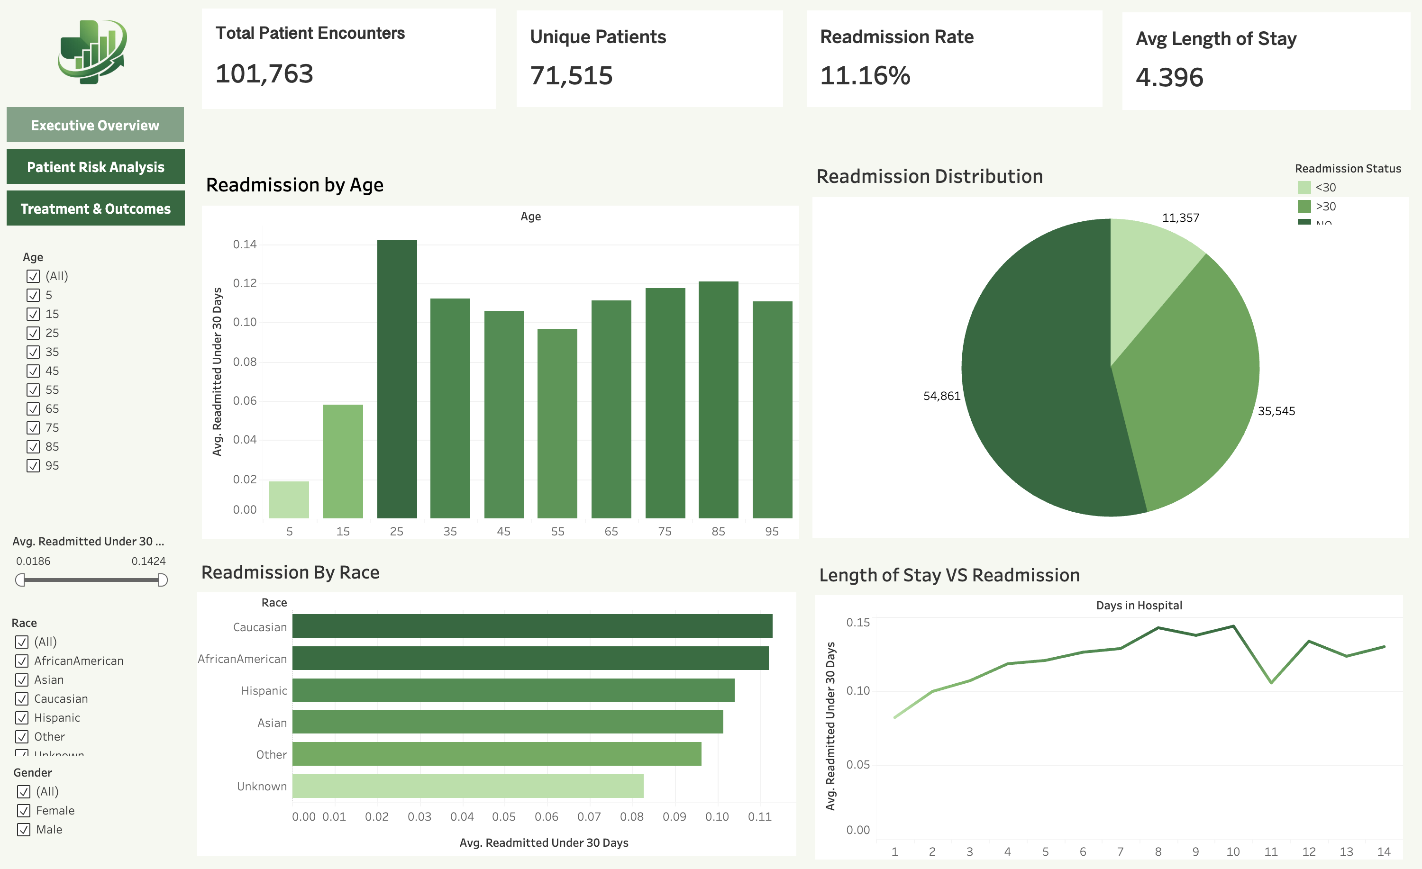
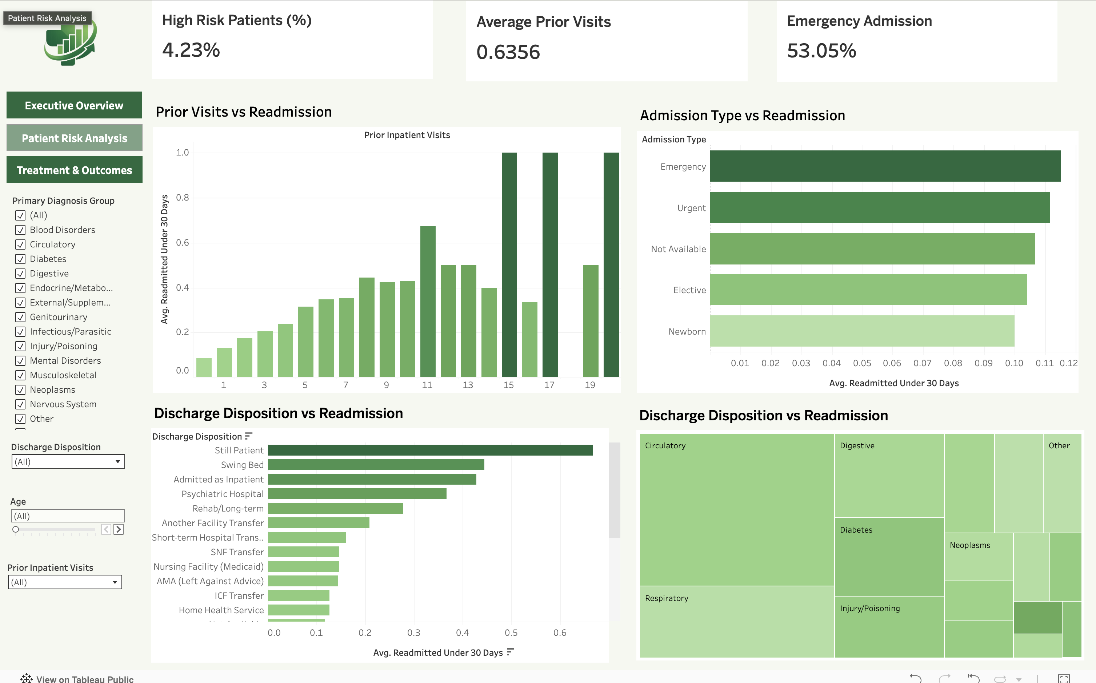
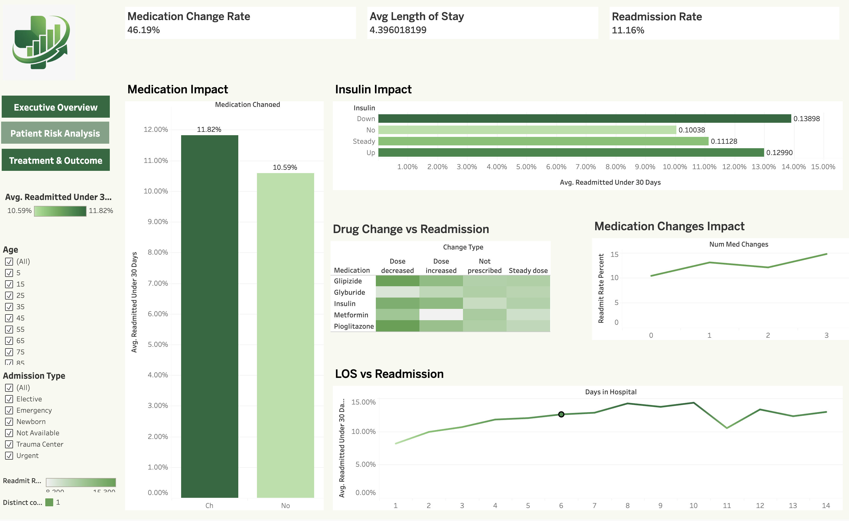
Tableau Dashboard Walkthrough
Three-layer decision support suite — built for CMO, CFO & Discharge Planners
1
Executive Overview
2
Patient Risk Analysis
3
Treatment View
What a CEO sees
What an analyst drills into
Clinical signal deep-dive
KPI header cards: 11.16% readmission rate, 101,763 encounters, Avg. LOS 4.4 days
Age-segmented readmission bar chart — highlights 75–85 peak and 25–35 secondary peak
Race breakdown showing Caucasian vs. African-American volume differences
Global filters: Age Range, Race, Admission Source — updates all views in <1 sec
Treemap of diagnosis groups — sized by encounter count, colored by readmission rate
Prior visits bar chart: 0 visits = 10%, 3+ visits = ~50% readmission rate
Admission type breakdown: Emergency (53%) vs. Urgent vs. Elective
Interactive: clicking 'Emergency' updates diagnosis treemap for ER-only view
Medication change effect: Changed = 11.82% vs. No Change = 10.59% readmission
Insulin dosage breakdown: Down 13.9% · Up 13.0% · Steady 11.1% · None 10.0%
Down-titrated insulin is the highest single treatment risk signal identified
Filter: Isolate insulin-adjusted patients to view their diagnosis group profile
Tableau Dashboard URL:https://public.tableau.com/app/profile/ayush.mittal4873/viz/DVACapstoneDiabetesReadmissionAnalysis_v2025_3/Dashboard_Executive_Overview?publish=yes
Newton School of Technology | DVA Capstone | Team G-10 (Section C)
G-10

Slide 8
From Insight to Action: Three Targeted Recommendations
Each recommendation traces directly from a statistical finding
1
Targeted Follow-up Program
Insight Insight (Slide 5): Patients with ≥3 prior inpatient visits have a ~50% readmission rate — 4.5× the cohort average.
Recommendation Recommendation: Implement a mandatory 48-hour post-discharge nurse callback program for all patients flagged with ≥3 prior inpatient visits. Flag this automatically in the EMR system at admission.
Expected Impact Expected Impact: High | Feasibility: Easy | Est. prevention of up to 40% of avoidable early returns in this segment
2
Heart-Diabetes Clinical Pathway
Insight Insight (Slide 5 & 6): Circulatory comorbidities drive ~30% of all 30-day returns, especially in the 75–85 age cohort.
Recommendation Recommendation: Develop a specialized 'Heart-Diabetes' discharge checklist. Mandate secondary review by a clinical pharmacist for all Circulatory-flagged patients before discharge authorization.
Expected Impact Expected Impact: High | Feasibility: Medium | Targets the single largest diagnosis driver of readmissions
3
Insulin Stability Signoff Rule
Insight Insight (Slide 6): Down-titrated insulin = 13.9% readmission rate — the highest single treatment signal. Medication changes broadly elevate risk from 10.59% → 11.82%.
Recommendation Recommendation: Require attending physician signoff if a patient's insulin is down-titrated within 24 hours of planned discharge. Mandate pharmacist review for all 'Changed' medication encounters.
Expected Impact Expected Impact: Medium | Feasibility: Easy | Directly addresses the highest-risk treatment instability marker
Newton School of Technology | DVA Capstone | Team G-10 (Section C)
G-10

Slide 9
Impact & Value: The Business Case for Action
Quantified savings, efficiency gains, and cost of inaction
$1.2M
2,000+
40%
Annual HRRP Penalty
Savings
Bed-Days Freed
Per Year
Avoidable Returns
Preventable
5% reduction in 30-day readmissions eliminates this much in regulatory penalties per hospital
Preventing avoidable returns releases ~0.2 days per patient stay across the full encounter volume
Targeted nurse callbacks to the '≥3 prior visits' cohort could prevent up to 40% of early readmissions in that group
⚠ Cost of Inaction
Maintaining the current 11.16% readmission rate ensures ongoing HRRP margin compression, declining hospital quality ratings, and continued unnecessary patient harm. Every 30-day readmission that could have been prevented represents a direct failure in the duty of care — and an avoidable financial penalty. The cost of inaction compounds annually.
Newton School of Technology | DVA Capstone | Team G-10 (Section C)
G-10

Slide 10
Limitations & Next Steps
What the data cannot tell us — and what we build next
Current Limitations
Strengthening Findings & Next Steps
No SDOH Data
Real-Time Predictive Model
Dataset lacks ZIP codes, income levels, and Social Determinants of Health — known to be strong hidden drivers of readmission that are absent from our model.
1
Build an XGBoost classifier that flags high-risk patients at the moment of admission — enabling proactive rather than reactive discharge planning. Incorporate EMR text notes via NLP.
No Mortality Data
SDOH Data Integration
Absence of out-of-hospital death records may artificially lower the readmission rate for high-severity patients who never returned because they passed away.
2
Enrich with ZIP-code-level income and healthcare access data to model social risk alongside clinical risk. Map 'Readmission Hotspots' geographically by city and neighborhood.
Retrospective Design
Extended Dataset Scope
10-year historical data (1999–2008) may not reflect current treatment protocols, insurance structures, or post-ACA care patterns at US hospitals.
3
Integrate post-2008 data to capture ACA-era changes, telemedicine adoption, and updated diabetes treatment protocols. Move from retrospective to near-real-time analysis.
No Outpatient Follow-up
Live Tableau + EMR Integration
Dataset only captures inpatient encounters. We cannot measure whether patients received post-discharge care or had access to primary care providers.
4
Connect Tableau to live EMR feeds for real-time dashboard updates. Move from static historical reporting to proactive prevention — alert discharge planners at the bedside.
Newton School of Technology | DVA Capstone | Team G-10 (Section C)
G-10

