Slide 1
SupplyWise
AI-Powered Procurement Intelligence
Transforming Supplier Visibility with AI

Slide 2
The Problem: Supplier Visibility Crisis
"Lack of supplier visibility is the #1 operational problem - ahead of cost and disruption frequency"
80%
Need better visibility tools
68%
Cite disruption as top challenge
21%
Lack risk monitoring systems
💡 Core Issue: Data exists but is IMPOSSIBLE to query fast enough

Slide 3
The Solution: Natural Language Intelligence
🔍
Natural Language
Ask questions in plain English, get instant answers from real data
📊
Explainable Risk
See WHY a supplier is risky, with exact thresholds and history
📞
Instant Contact
Phone numbers and addresses included - find and call in one step
🎯
Smart Matching
AI understands context - finds suppliers even with different terms

Slide 4
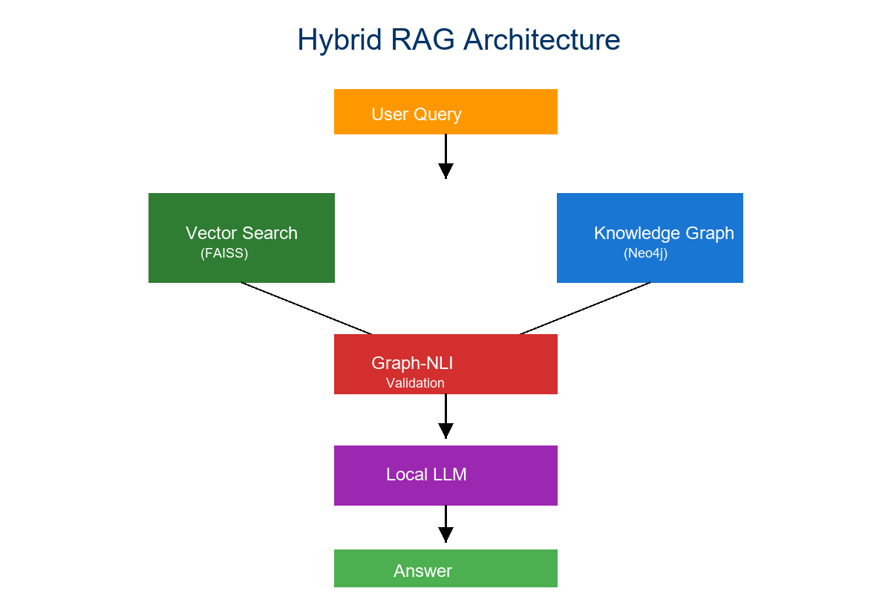
Hybrid RAG Architecture

Slide 5
Enterprise Technology Stack
Component | Technology | Purpose
Vector Search | FAISS | Semantic similarity
Knowledge Graph | Neo4j | Entity relationships
AI Engine | LLaMA3 | Natural language
Backend | FastAPI | REST API
Risk Model | Scikit-learn | ML scoring
✅ Key Features
• 100% Self-Hosted - Your data stays in your infrastructure
• Real Supplier Data - 30+ verified businesses
• Sub-Second Response - Instant answers
• Explainable AI - See the reasoning

Slide 6
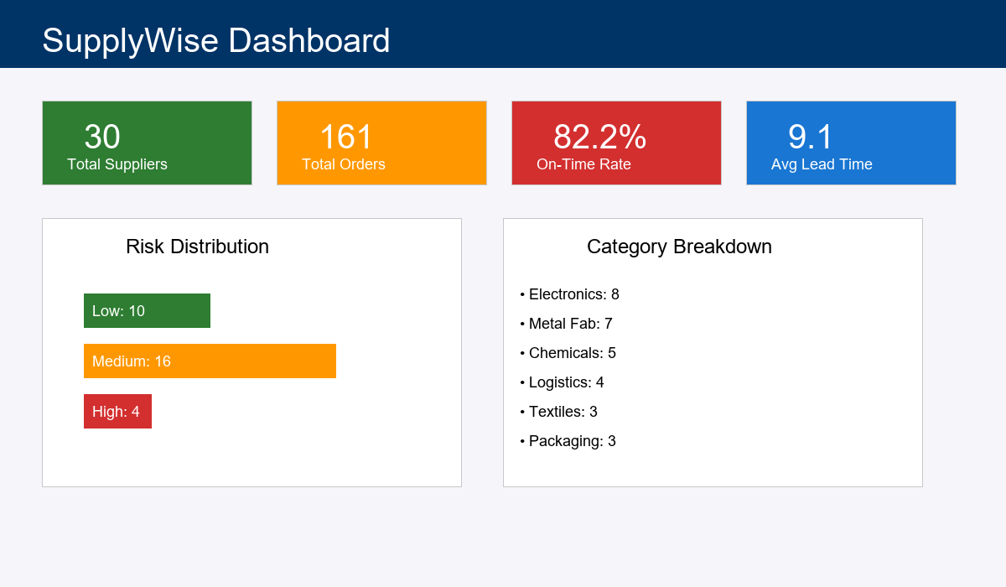
Live Dashboard Interface

Slide 7
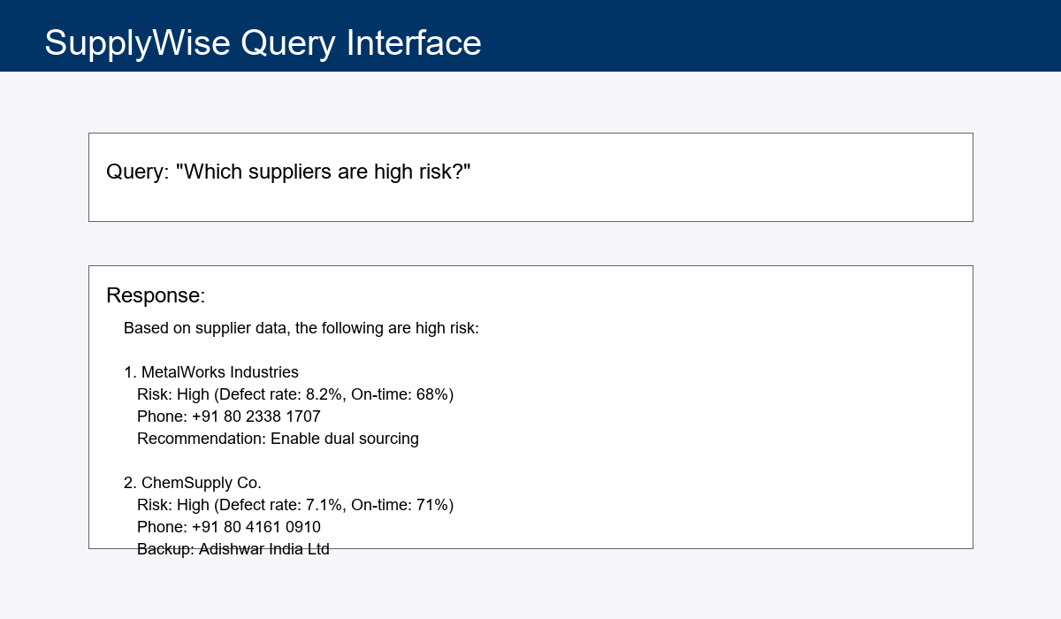
Natural Language Query Interface

Slide 8
Real-World Impact
Question: "Which metal fabrication suppliers are high risk?"
❌ BEFORE
1. Open Excel spreadsheet
2. Filter by category
3. Check defect rates
4. Look up phone numbers
5. Cross-reference orders
⏱️ Time: 2 hours
✅ AFTER
1. Ask SupplyWise
2. Get instant list with:
• Risk scores
• Phone numbers
• Backup recommendations
⚡ Time: 3 seconds
💰 Impact: 99.96% time reduction | 240x more queries per day

Slide 9
Business Value & ROI
Time Savings
150 hrs/week
15 hrs × 10 officers
Cost Savings
$390K/year
$7,500/week × 52
Risk Reduction
$200K-300K
Prevent 2-3 disruptions
Total Value
$590K-690K
Annual benefit
📈 Payback Period: 2-3 months | 🚀 Productivity: 240x increase

Slide 10
Thank You!
From Fragmented Data to Instant Intelligence
🌐 Live Demo: http://127.0.0.1:8000/supplywise
📊 Analytics: http://127.0.0.1:8000/analytics
💰 $500K+ ROI | ⚡ 99.9% faster | ✅ 30+ real suppliers | 🔒 Self-hosted

