Slide 1



PAGE 1
DATAQUEST 2.0 — DQCS_3
Automated Data Leak Prevention (DLP) System for Internal Files
Team: NextGen

Slide 2



PAGE 2
Problem Statement
Organizations struggle to prevent sensitive data from leaking through internal file shares or email systems.
Manual monitoring is inefficient and error-prone.
Challenge: Create an automated tool that detects transmission of sensitive data (like passwords, PII, or intellectual property).
Must take actions in real-time such as blocking or alerting.

Slide 3
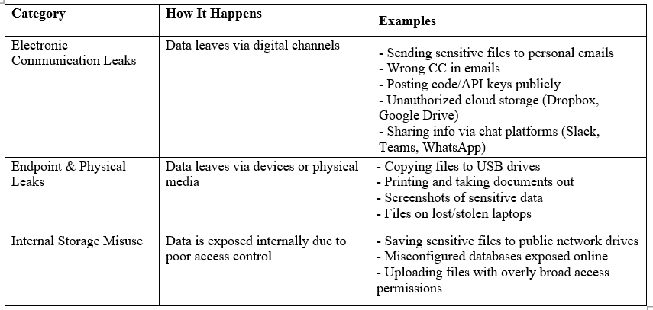
Categories of Internal Data Leak Problems

Slide 4
PAGE 3
Project Objective
Build an automated DLP system to detect sensitive data in files and emails.
Classify files/emails based on sensitivity levels.
Generate real-time alerts or block suspicious transmissions.
Maintain audit logs for compliance and forensic analysis.

Slide 5

PAGE 6
How We Solve It
Use regex patterns to scan files and emails for sensitive data signatures (e.g., credit card numbers, SSNs).
Train machine learning models to classify files/emails as confidential, internal, or public.
Implement an automated policy engine for real-time actions (alerts/blocks).
Maintain audit logs for traceability and compliance.

Slide 6

PAGE 7
Project Architecture
Input: Files / Emails
Step 1: Regex Scanner (Email, Credit Card, SSN)
Step 2: ML Classifier (Confidential / Internal / Public)
Step 3: Policy Engine (Alert / Block)
Step 4: Logging System (Audit logs / Forensics)
Output: Alerts / Blocked files / Logs

Slide 7
PAGE 8
Detect sensitive data in files & emails.
Classify content using ML zero-shot classifier.
Automated actions: alert or block suspicious files.
Audit logs: track user activity for compliance.
Extensible: new patterns or ML models can be added easily.
Key Features

Slide 8
PAGE 9
Tools & Technologies
Programming Language: Python
Web Framework: Flask / FastAPI
ML Library: Hugging Face Transformers (facebook/bart-large-mnli)
Regex Engine: Python re module
Logging: SQLite / JSON
Frontend: HTML, CSS
Version Control: Git + GitHub

Slide 9
PAGE 10
PROJECT OUTCOME
The system automates detection of sensitive data in files and emails.
Reduces manual monitoring efforts.
Provides real-time alerts and audit logging for compliance.
Scalable and extensible for future improvements.

