Slide 1
LOANLINESS
Predicting Loan Repayment Ability with Machine Learning
Implementation of the reference paper on the Home Credit Default Risk dataset
PES1UG24CS149 · PES1UG24CS170
UE24CS352A – Machine Learning (Mini-Project)
Notes:
Introduce the project: we reproduce the Loanliness workflow end to end on Home Credit data.

Slide 2
Predicting who can repay is hard
307,511
8.07%
402
loan applicants in application_train
defaulters (TARGET = 1): heavy class imbalance
features after merging 6 history tables
Task: binary classification of repayment ability from application and credit-history data.
Challenge 1: many missing or invalid entries.
Challenge 2: a 92 / 8 class split, so accuracy alone is misleading.

Slide 3
From seven tables to one feature matrix
1
2
3
4
5
Aggregate
Merge
Drop sparse
Prepare
Encode + scale
Count, mean, min, max per applicant (SK_ID_CURR)
Join onto application data: 122 → 402 columns
Remove 256 features with more than 30% missing
Drop ID and TARGET: 144 features
One-hot + standardise: 239 features
Sources: application_train, bureau, bureau_balance, previous_application, POS_CASH_balance, installments_payments, credit_card_balance. Split: stratified 80/20 (246,008 train / 61,503 test). Preprocessing is fit on training data only.

Slide 4
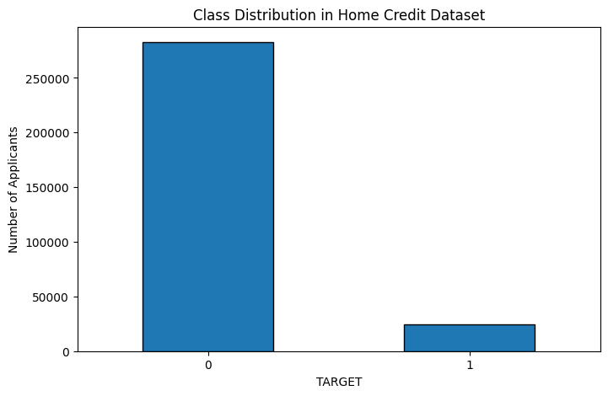
Class imbalance and three ways to fix it
Down-sampling
Majority cut to 19,860 to match the minority
SMOTE up-sampling
Synthetic minority: 226,148 per class
Class weights
balanced inverse-frequency weighting
Main models are trained on the down-sampled set (39,720 rows).

Slide 5
LightGBM leads on ROC-AUC
Model | Acc | Prec | Recall | F1
LightGBM | 0.697 | 0.168 | 0.696 | 0.270
Logistic Reg. | 0.693 | 0.164 | 0.686 | 0.265
MLP | 0.696 | 0.164 | 0.673 | 0.264
Random Forest | 0.697 | 0.164 | 0.674 | 0.264
Naive Bayes | 0.339 | 0.096 | 0.853 | 0.172
Naive Bayes flags most applicants as defaulters (recall 0.85, precision 0.10).

Slide 6
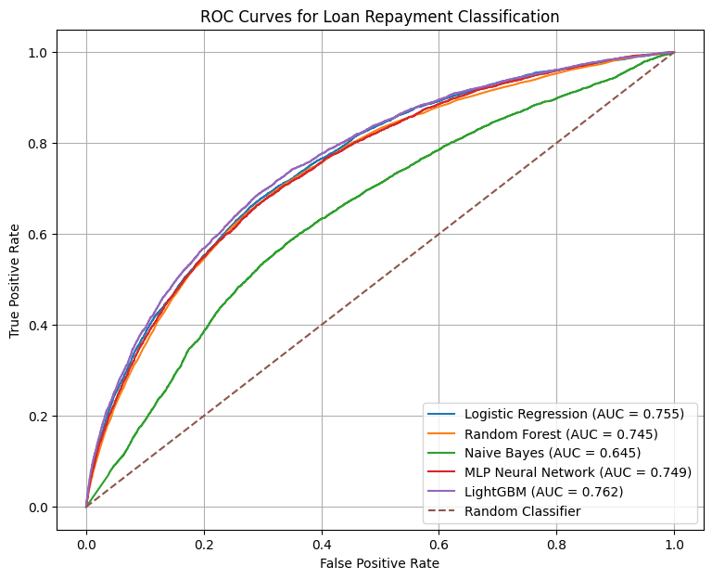
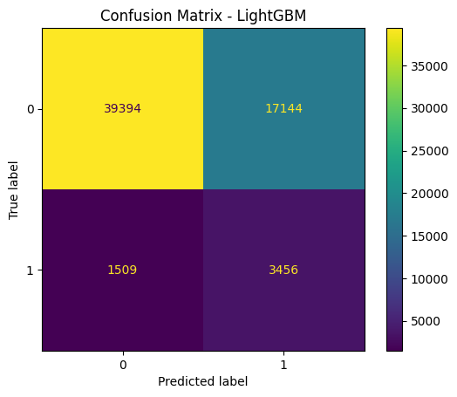
ROC curves: modest but real separation
AUC range 0.645 to 0.762
Top four models sit within 0.016 AUC of each other.
Best-model confusion matrix
LightGBM catches ~70% of defaulters but also flags ~30% of good borrowers.

Slide 7
Balancing rescues recall, not AUC
91.95%
accuracy on original data, with only 1.6% recall
ROC-AUC is nearly identical across strategies (0.751 to 0.756). Balancing changes the threshold behaviour, not the ranking quality. Class weights match down-sampling without discarding data.

Slide 8
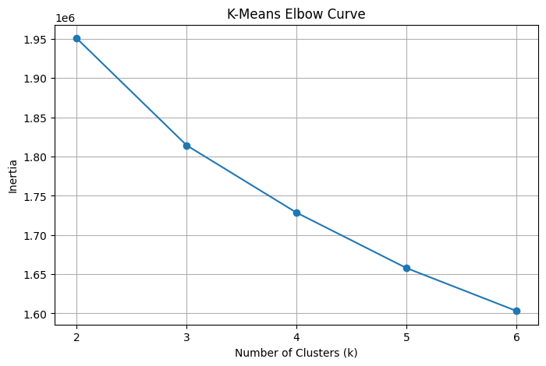
Polynomial features and K-Means
Polynomial transform
K-Means clustering
0.643
ROC-AUC, down from 0.755
Elbow curve for k = 2 to 6; k = 4 chosen per the paper.
Degree-2 expansion of only 10 features (10 → 65) gave no gain. Expanding all 239 features is computationally impractical.
Cluster sizes: 5,075 / 3,626 / 12,251 / 9,048. One LightGBM model was trained per cluster on a 30,000-row PCA-reduced sample.

Slide 9
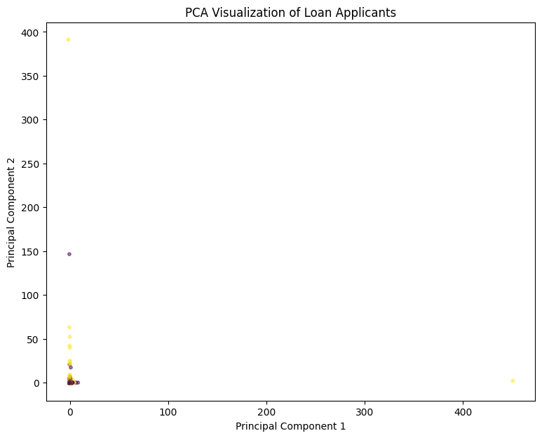
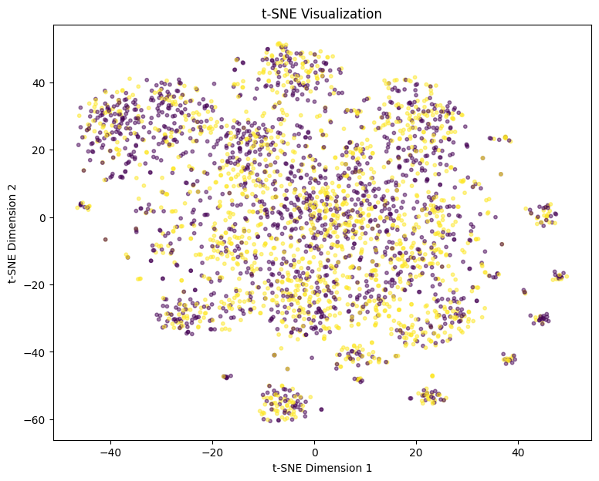
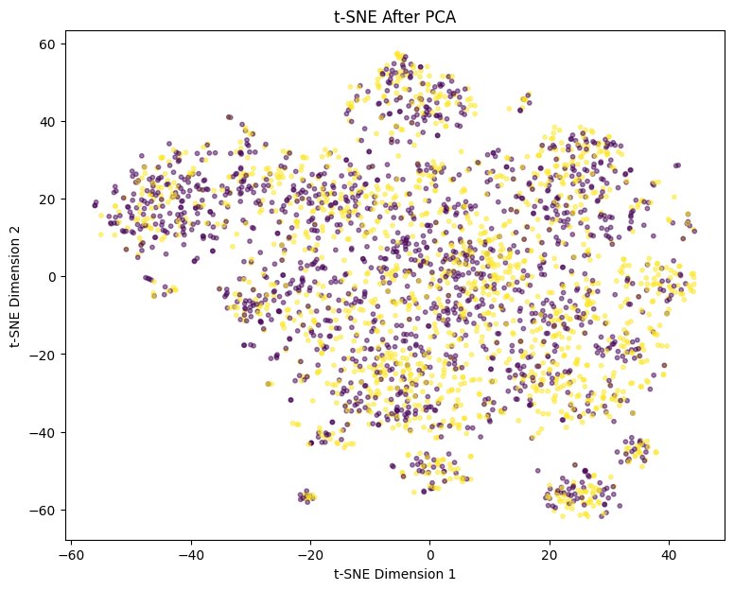
PCA and t-SNE: classes overlap heavily
PCA (2 components)
t-SNE
t-SNE after PCA
The first two principal components explain only 23.8% of variance, and neither projection shows clean separation. This matches the modest AUC: repayment ability is not easy to separate from these features.

Slide 10
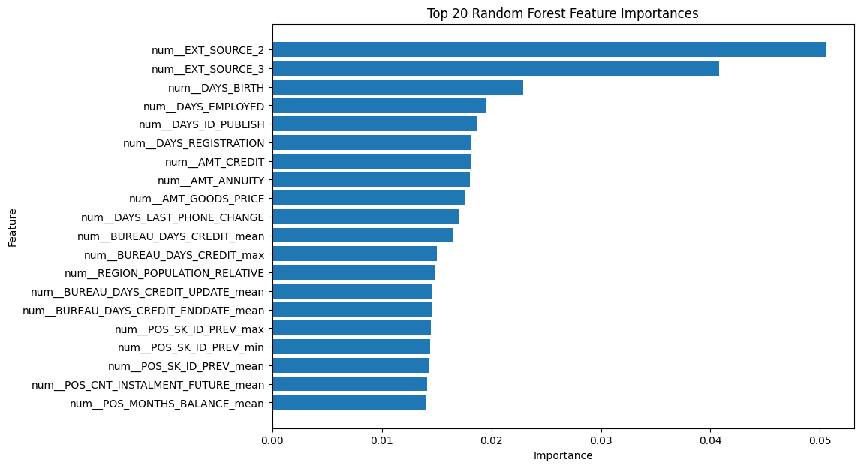
What drives repayment: external scores and age
EXT_SOURCE_2 and _3
are the two strongest features (0.051, 0.041).
Next: days since birth, employment, ID publish and registration, plus credit and annuity amounts.
Bureau and POS history features also appear in the top 20.
Random Forest importance, top 20 of 239 processed features.

Slide 11
Our results versus the reference paper
Logistic Regression matches the paper almost exactly (69.3%). Our tree and neural models score higher, likely due to differences in aggregation, preprocessing and hyperparameters. The paper ranks LightGBM lower; we rank it first on AUC and F1.

Slide 12
Conclusions
Preprocessing matters
Accuracy misleads
256 of 402 features were dropped for missing data; 239 remained after encoding.
92% accuracy on raw data hid 1.6% recall; balancing lifts recall to about 68%.
LightGBM is best
Limits of the data
AUC 0.762, F1 0.270, though gains over Logistic Regression are small.
PCA and t-SNE show overlap; the ceiling is around 0.76 AUC with these features.
Future work: tune LightGBM, evaluate the cluster-specific models on held-out data, expand polynomial features.

