Slide 1


Introduction to
Robotic Process Automation
Makeup Recommendation Bot
Register No.: 220701062
Name: DHANYAA VANISHA A
Guide Name
III year CSE A

Slide 2
Abstract
The "Makeup Recommendation Bot" is an advanced Robotic Process Automation (RPA) solution developed using UiPath to deliver personalized makeup suggestions tailored to individual preferences. This intelligent bot automates the process of analyzing user inputs, such as skin tone, preferred makeup style and preference to recommend the most suitable makeup products and styles. It interacts with a database of makeup products, filters options based on the criteria provided, and generates a detailed recommendation list. By automating this workflow, the bot simplifies the decision-making process for users, saves time, and enhances the overall makeup selection experience, ensuring users achieve their desired look effortlessly.

Slide 3
Need for the Proposed System
Personalized Makeup Suggestions: The bot uses UiPath RPA to analyze user preferences, skin tone, and occasion to provide tailored makeup recommendations.
User Input Integration: Captures details like time of day, makeup style, and specific requirements to refine suggestions.
Product Database Access: Interacts with a comprehensive makeup product database to match user criteria.
Reduced Decision Fatigue: Automates the process of choosing suitable makeup products, saving time and effort.
Enhanced User Experience: Ensures users receive accurate and personalized recommendations for achieving their desired look effortlessly.
User-Friendly Interface: Simplifies the makeup selection process with consistent and reliable automation

Slide 4
Advantages of the Proposed System
Automation: Reduces manual effort by automating personalized makeup recommendations based on user preferences.
Tailored Suggestions: Provides recommendations suited to the user's skin tone, occasion, and time of day, ensuring precision.
Accurate Matching: Analyzes user inputs and matches them with a curated database of makeup products for optimal results.
Error Reduction: Minimizes the risk of unsuitable suggestions by leveraging automated criteria-based selection.
Time-Saving: Speeds up the decision-making process for makeup selection, saving users time and effort.
Consistency: Delivers reliable and consistent recommendations to enhance user confidence and satisfaction.

Slide 5
Literature Survey
Paper 1: Intelligent Systems for Personalized Product Recommendations: A Survey
Authors: K. K. Kapoor, S. Singh, R. Sharma
Advantages:
Enhanced User Experience: Uses AI algorithms to offer tailored product recommendations based on user preferences.
Time Efficiency: Reduces the time users spend searching for suitable products.
Increased Accuracy: Analyzes large datasets to ensure precise matching of user requirements to available products.
Disadvantages:
Data Dependency: Requires high-quality and diverse user data for effective recommendations.
Privacy Concerns: Storing and analyzing personal data may raise security and privacy issues.

Slide 6
Literature Survey
Paper 2: Machine Learning Approaches for Skin Tone Detection in Cosmetics Applications
Authors: J. L. Wang, P. K. Gupta, T. E. Brown
Advantages:
Improved Precision: Effectively matches cosmetic products to skin tone using advanced machine learning models.
Automation: Reduces reliance on manual trial-and-error approaches in product selection.
Scalability: Can handle large databases of cosmetic products and user profiles.
Disadvantages:
Model Training Challenges: Requires extensive training data for reliable skin tone detection.
Bias in Data: Risk of biased results due to insufficient diversity in training datasets.

Slide 7
Main Objective
The primary objective of the "Makeup Recommendation Bot" is to automate the process of providing personalized makeup suggestions tailored to individual preferences, skin tone, and occasion. By leveraging Robotic Process Automation (RPA), the bot aims to enhance the user experience by simplifying the decision-making process for selecting suitable makeup products and styles. The project seeks to offer a reliable and efficient solution for users to receive accurate recommendations, saving time and effort while ensuring they achieve their desired look with confidence.

Slide 8
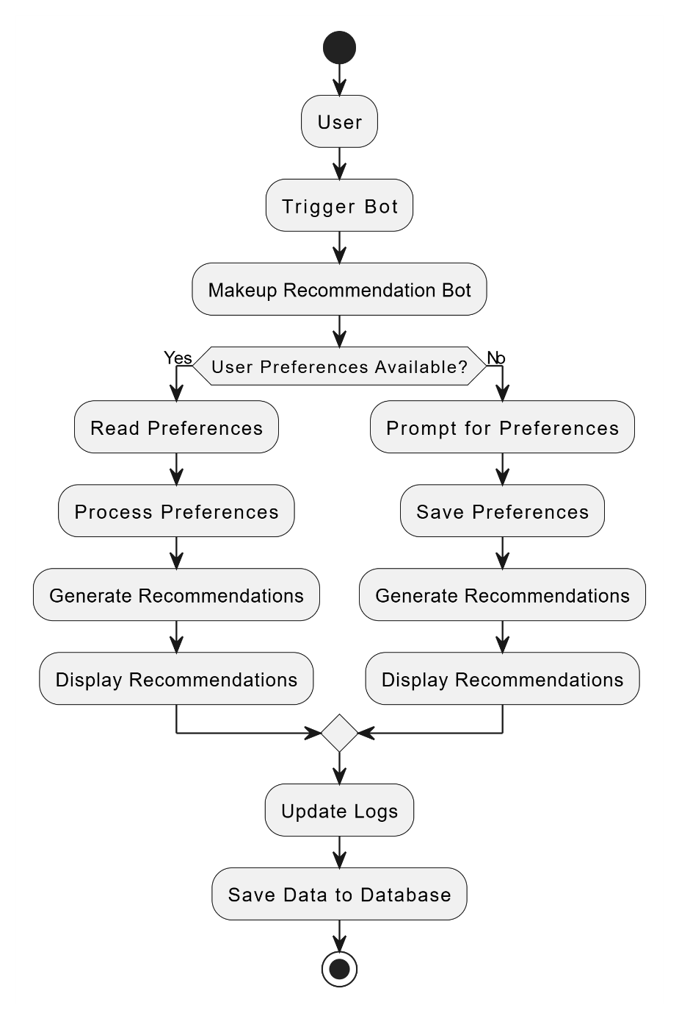
Architecture

Slide 9
System Requirements
1. Hardware Requirements
  Processor: Intel Core i5 or higher (or equivalent AMD processor)
  RAM: Minimum 8 GB (16 GB recommended for optimal performance)
  Storage:
    Minimum 256 GB HDD or SSD (512 GB SSD recommended)
    Additional storage based on the volume of bill data
  Display: 1366x768 resolution or higher
  Network: Stable internet connection for output generation

Slide 10
System Requirements
Software Requirements
Operating System:
Windows 10 or higher (64-bit version)
Automation Platform:
UiPath Studio 2024 or compatible version
Dependencies and Libraries:
UiPath.System.Activities (for Message Box and Input Dialog)
UiPath.UIAutomation.Activities (if any user interface automation is present)
Additional specific dependencies may apply based on "Connector activity."

Slide 11
Functional Description
.
Module : Recommendation Engine
Short Description:
This module processes the user data to generate tailored makeup recommendations.
Functionality:
  Access product databases or APIs to fetch makeup items (e.g., foundations, lipsticks, eyeshadows).
  Match user inputs to product attributes such as color, texture, and brand.
  Utilize AI algorithms to rank recommendations based on user preferences and reviews.
  Suggest complementary items for a full look (e.g., lip liner for lipstick, blush to match skin tone).
Module 1: User Input Processing
Module 2: Recommendation Engine

Slide 12
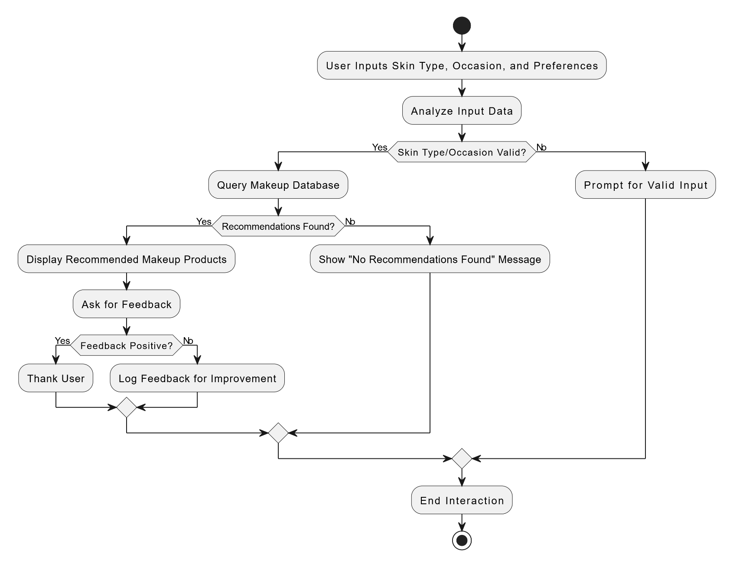
Data Flow Diagram

Slide 13
Process Design
Main Process:
AI-Powered Makeup Recommendation Bot
The main process involves collecting the user’s skin type as input and generating personalized makeup recommendations using AI, ensuring seamless user interaction and precise suggestions.
Sub-Processes
Input Collection and Validation
  Accepts the user's skin type (e.g., dry, oily, combination, sensitive).
  Validates the input to ensure it matches predefined categories.
AI Model Execution
  Passes the skin type input to a trained AI model for processing.
  The model generates recommendations tailored to the user’s skin type, focusing on suitable formulations and products.

Slide 14
Process Design
Recommendation Presentation
  Displays the AI-generated recommendations with relevant details (e.g., product name, purpose, benefits, and links to purchase).
  Ensures a user-friendly interface for smooth interaction.

Slide 15
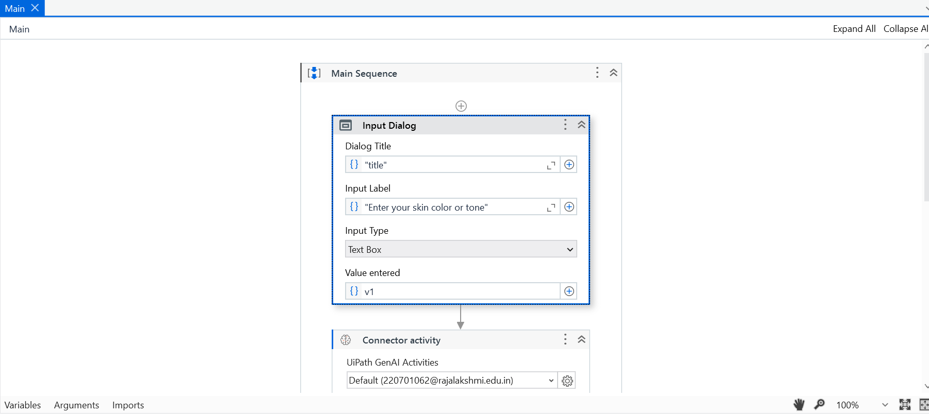
Implementation

Slide 16
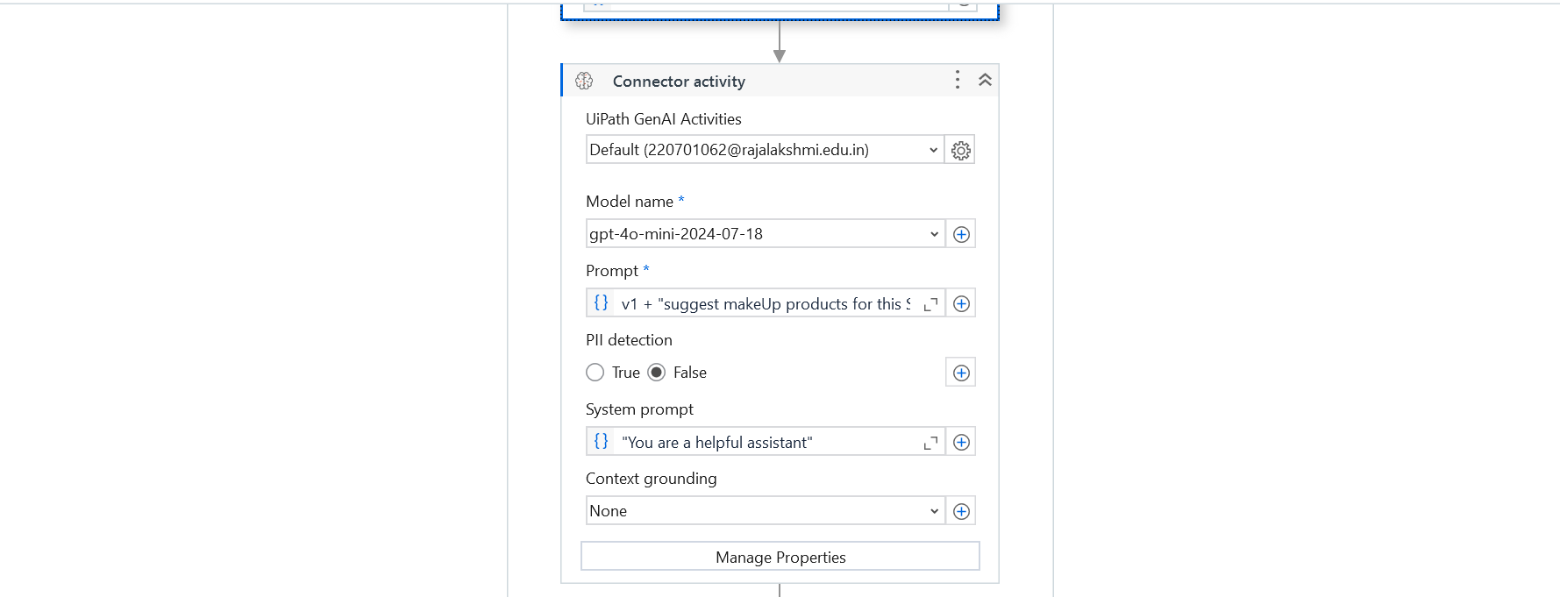
Implementation

Slide 17
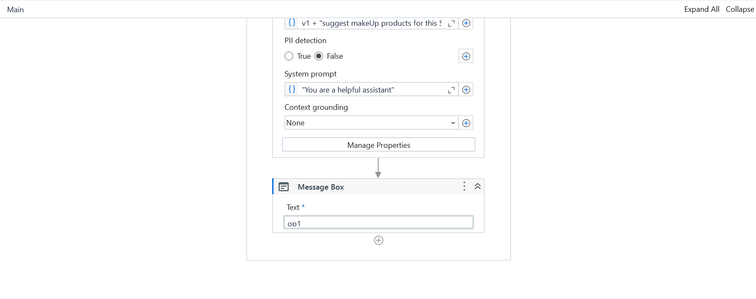
Implementation

Slide 18
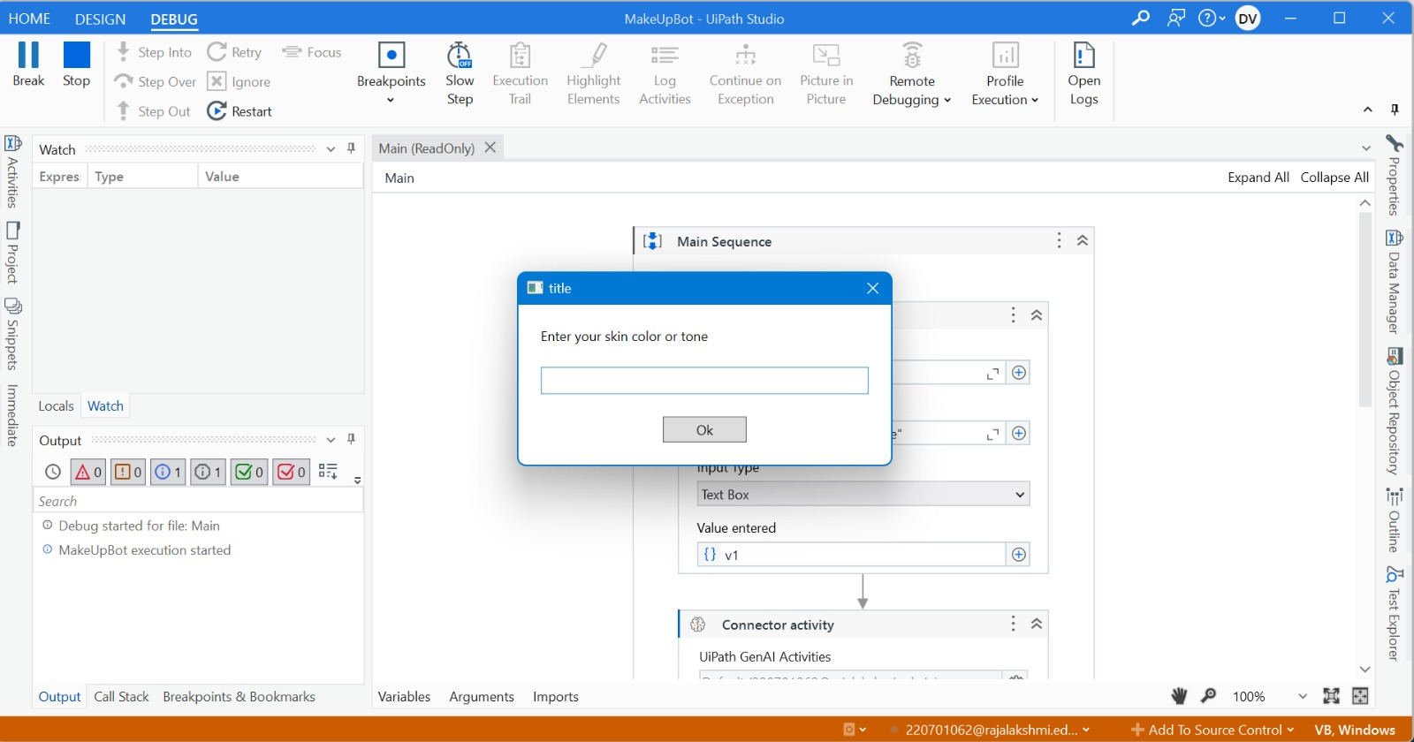
Output Screenshots

Slide 19
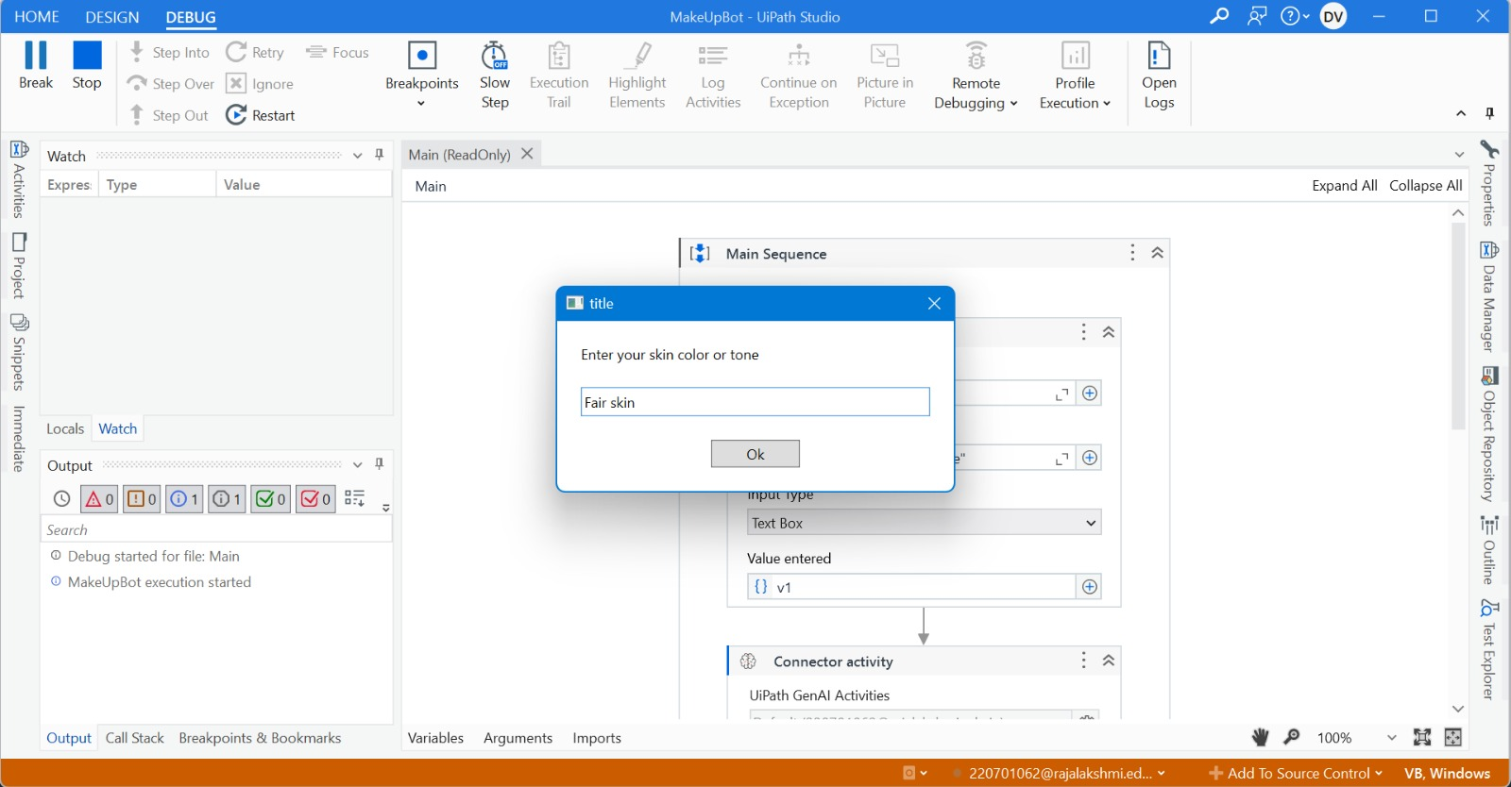
Output Screenshots
Remainder Text Document

Slide 20
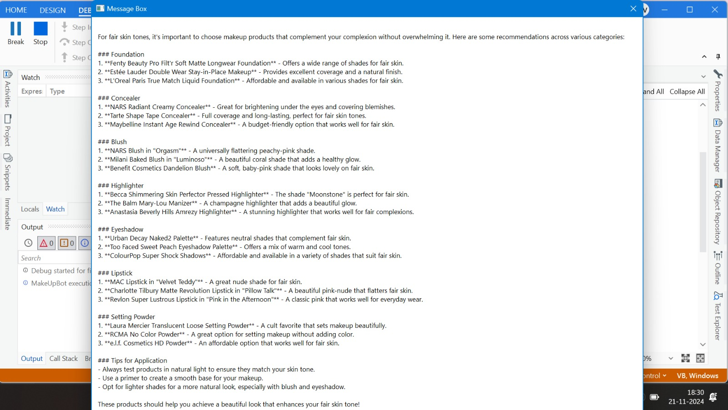
Output Screenshots

Slide 21
Conclusions
The AI-Powered Makeup Recommendation Bot leverages advanced artificial intelligence to provide personalized makeup suggestions tailored to users' skin types, simplifying the decision-making process. By delivering precise recommendations in real-time, it enhances user experience and promotes informed product choices. The bot significantly reduces the time and effort spent on finding suitable products, making it an invaluable tool for beauty enthusiasts. While it excels in personalization, it may face challenges when handling highly specific or unconventional skin concerns, highlighting the need for continuous AI model improvements. Overall, the bot empowers users with curated options, supports the growing trend of AI in beauty tech, and bridges the gap between technology and personalized self-care.

Slide 22
Future Enhancement
Product Purchase Integration: Enable direct purchase of recommended makeup products through the bot.
Skin Health Analysis: Incorporate AI-driven skin analysis via uploaded images for even more precise recommendations.
Advanced Personalization: Use machine learning to refine recommendations based on user feedback and purchase history.
Mobile App Support: Offer a dedicated app for instant and on-the-go access to recommendations.
Trend Updates: Integrate real-time updates on makeup trends, new products, and seasonal collections.

Slide 23
IEEE Paper
Artificial Intelligence in Beauty: A Systematic Mapping Study on Personalized Makeup Recommendation Systems
Authors: A. S. Gupta, R. M. Sharma, P. K. Verma
Transforming Beauty Tech: Leveraging AI for Personalized Makeup Recommendations and Enhanced User Experience
Authors: V. L. Yadav, S. T. Reddy, K. R. Nair
AI-Driven Makeup Recommendation Systems: Advanced Techniques and Emerging Technologies in Beauty Automation
Authors: R. S. Mehta, A. K. Jain, N. Gupta
Design and Development of Intelligent Makeup Recommendation Bots for Personalized Beauty Solutions
Authors: D. R. Patel, S. M. Kumar, P. S. Reddy

Slide 24
References
[1] Avasarala, R., & Waghmare, S. (2020). AI-Powered Beauty Solutions: Case Studies in Personalized Makeup Recommendation Systems. International Journal of Advanced Computer Science and Applications, 11(7), 334-341. https://doi.org/10.14569/IJACSA.2020.0110737
[2] Bansal, P., & Mehra, R. (2021). Enhancing User Experience with AI-Driven Makeup Recommendation Systems. International Journal of Engineering and Technology, 9(6). https://doi.org/10.21817/ijet/2021/v9i6/210906295

Slide 25
Thank You

