Slide 1
Azure Devops
Self-Hosted Agent

Slide 2
Agent pools:
Please login to Azure portal and click on organization settings.
To create new agent pool left side of menu we can observe agent pools please click on that option.
Now we are in Agent pools page, As per our requirement we will create the pool name (Ex. Dev,QA,staging) by clicking on Add pool on right side of the page.
Once pool has created, Click on the pool name, Now we are creating the Agent which helps us to run azure pipelines in self-hosted agents.
Top right side of the page we can see New Agent, click on that to create agent.

Slide 3
New Agent:
Now we will get one popup, In that we can see based on our OS they have mentioned the steps to follow. (Ex. macOS, windows, Linux)
Please select your OS where we need to run our agent. After selecting the OS. Please follow the steps.
Linux flow:
Copy the URL to clipboard right after download agent click on copy option.
Please login to your linux server and run below commands where your myagent should install. (Ex. cd /opt or cd /home

Slide 4
Once you are in the path to install please run below commands
Do not run myagent with root user. Please use normal user
Commands:
cd /opt
mkdir myagent
Chown –R normaluser:normaluser myagent (Ex.normaluser=test,idcdev)
wget https://vstsagentpackage.azureedge.net/agent/2.214.1/vsts-agent-linux-x64-2.214.1.tar.gz
tar –xzvf vsts-agent-linux-x64-2.214.1.tar.gz

Slide 5
Configuration Steps:
Please go inside of myagent directory and run below commands
./config.sh
Please read options while configuring the agent.
It will asks for server URL is
https://dev.azure.com/{your-organization}
Now hit enter for PAT token, which we need to create in azure portal
After creating PAT token enter in linux server.
If agent should run as service then follow below steps
sudo ./svc.sh install [username]
sudo ./svc.sh start
sudo ./svc.sh status

Slide 6
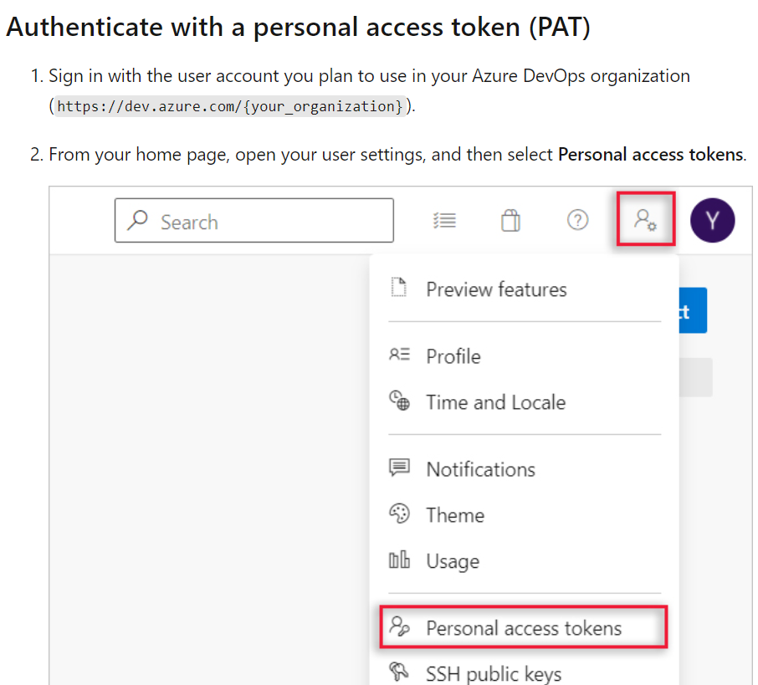
Please follow below document for setup
https://learn.microsoft.com/en-us/azure/devops/pipelines/agents/v2-linux?view=azure-devops

Slide 7
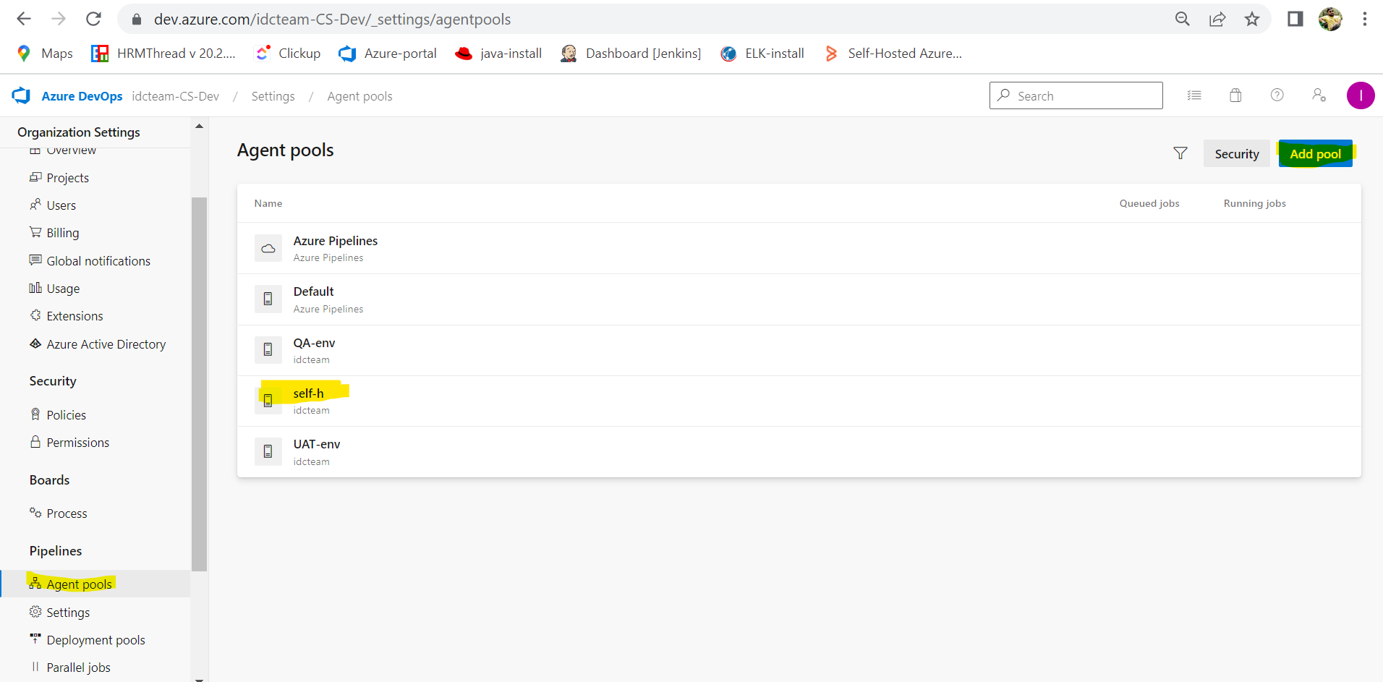

Slide 8
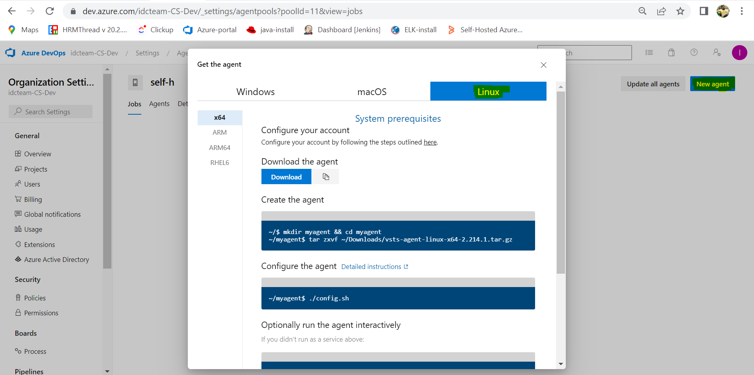

Slide 9
Azure Pipeline CI/CD
CI/CD will help us if any developer pushes the code to repository. As we enabled auto trigger pipeline. If new code will push to repo, our pipeline will trigger and perform the CI/CD.
Currently in our project we have multiple projects as below:
CraftSilicon – Front-end code
Craft Silicon Backend - Backend code
Craft Silicon Mobile
Craft Silicon Libraries Backend libraries

Slide 10
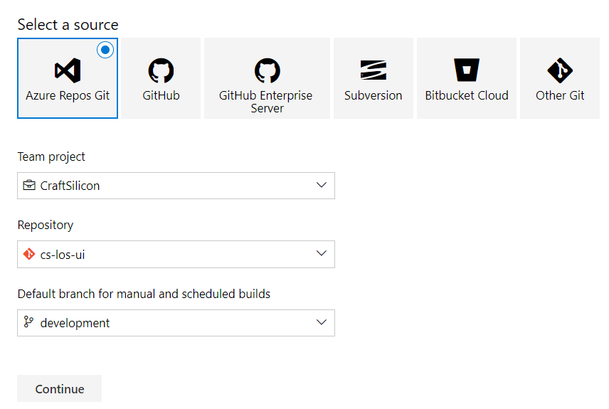
CraftSilicon:
Front-end code we are using CraftSilicon project and we have single repository called cs-los-ui
Pipeline Steps:
project -- pipelines – New pipeline – use classic editor –
After classic editor please check attached image
select a source and repository and branch to run pipeline.
Click on continue

Slide 11
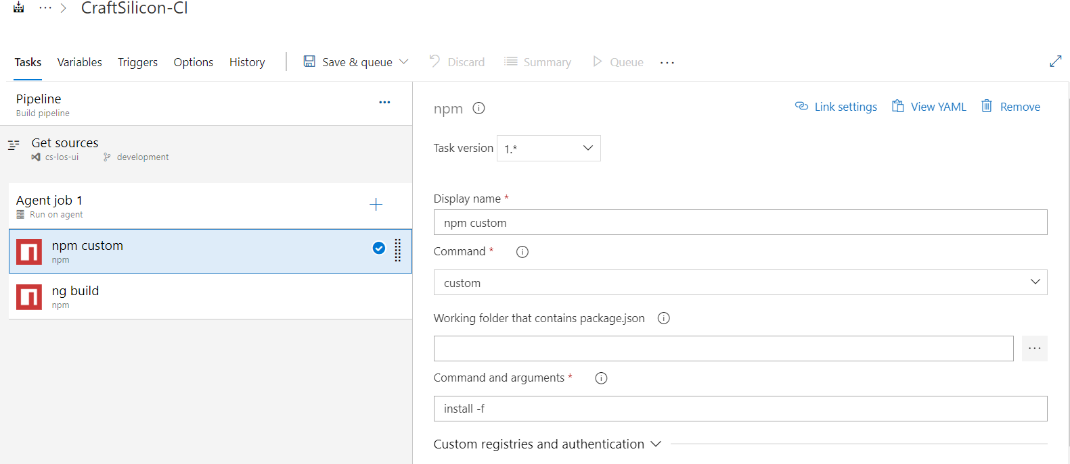
Select a template which is based on code. (Ex. .Net, Angular, Maven)
If we select for angular please follow below
Select template as empty job
Fill pipeline name
Agent pool where it should run (dev,qa,uat)
Agent job task also please change inherit to our pool name.
Create task by clicking on + button on agent job 1 and search for npm

Slide 12
Deployment
After successfully completed the job we will get output in below path
/home/idcdev/myagent/_work/6/s/dist/login-portal
We have two pipelines for front-end
login-portal
Admin-portal
These both latest output of dist we have to copy in below paths.
Login-portal output to copy: /usr/share/nginx/html
Admin-portal dist to copy: /usr/share/nginx/admin

Slide 13
Backend Pipeline
project--pipelines--New pipeline--classic editor– select repository--branch--click on continue
Please search in template section as maven and select and apply.
Please fill pipeline name and click on agent pool drop-down and select which environment we want to run pipeline.
Agent job name also rename with pipeline name and again select agent pool option.
Next task maven pom.xml fill goals section (Ex:clean install)
In Maven pom.xml task click on Advance dropdown and select maven version as custom path.

Slide 14
Maven paths:
Dev – 192.168.1.115 - /home/idcdev/maven
QA or sit – 192.168.1.108 - /opt/maven
UAT - 192.168.1.109 - /home/idcuat/maven/
Please provide path in maven version custom path.
Add new task under publish artifact. Search in task download pipeline artifact
In download artifact task please change destination directory, where all our backend jars are available. If we fill below path our latest jar file will download to the given path.
Dev - /home/idcdev/Backendjars

Slide 15
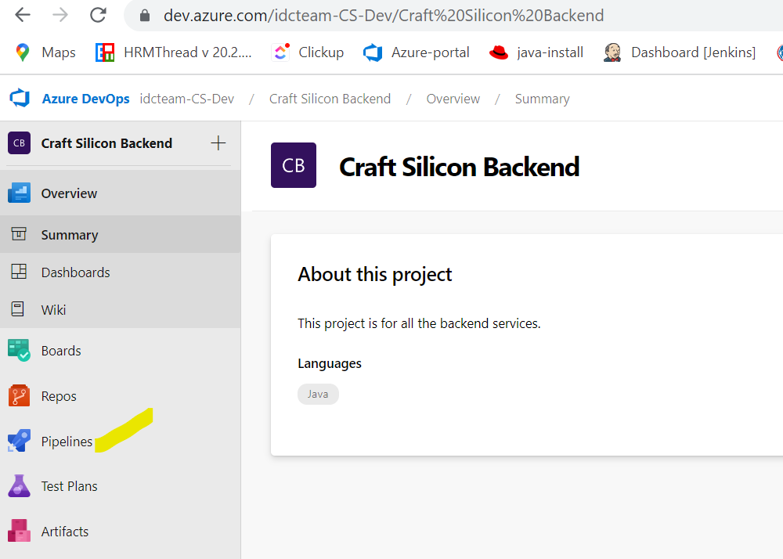

Slide 16
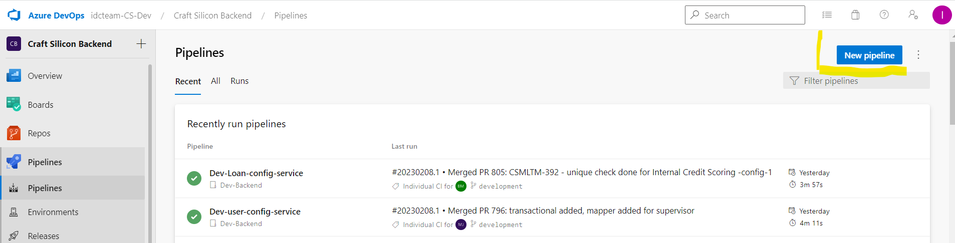

Slide 17
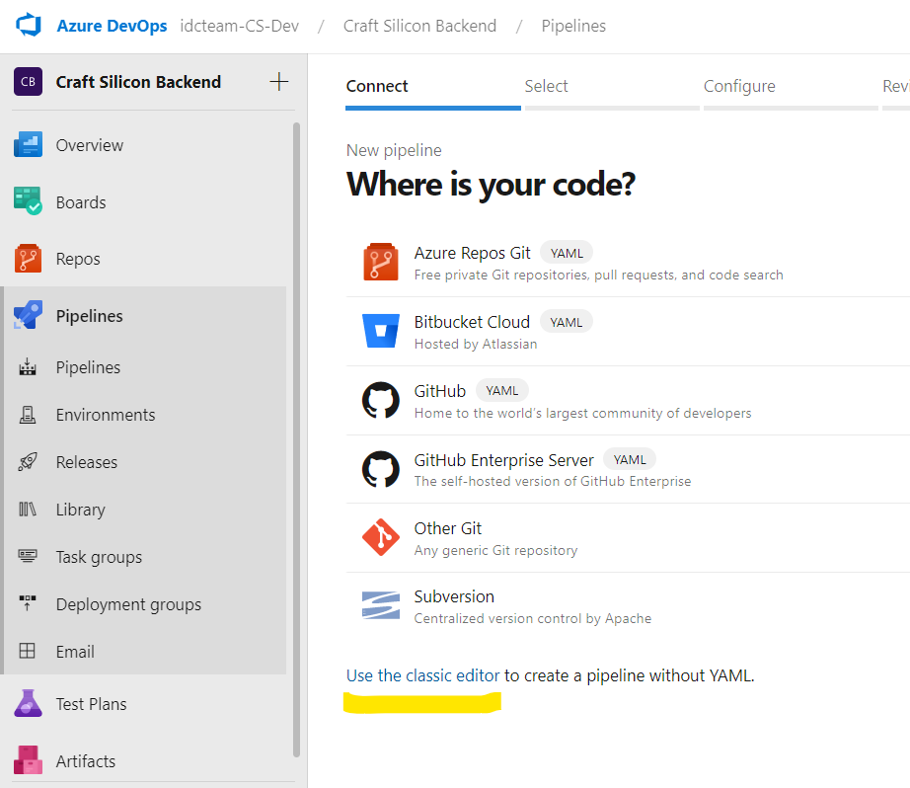

Slide 18
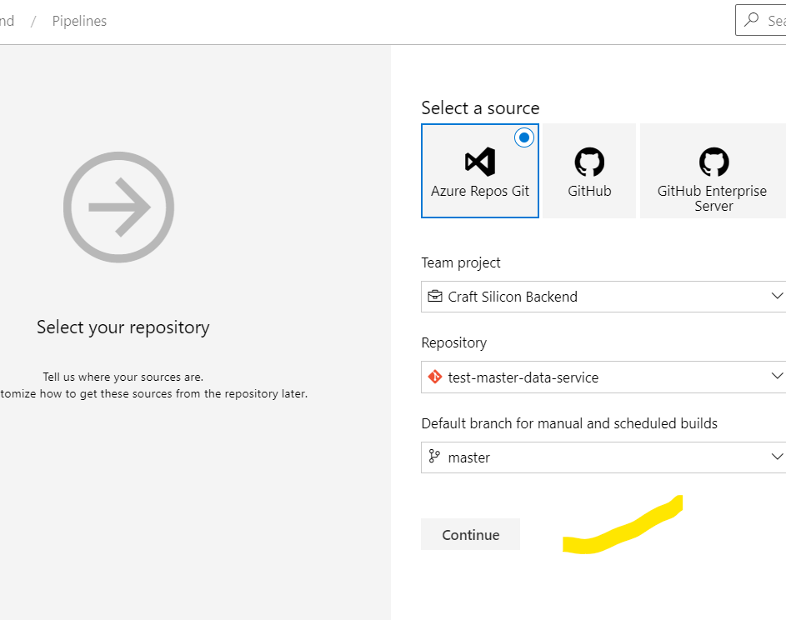
Please select source of code option
Select team project by clicking on dropdown.
Select repository name from which repo pipeline should run.
Select branch of the repository by clicking on dropdown. So that pipeline will run from particular branch code.
Click on continue, bottom of the page.

Slide 19
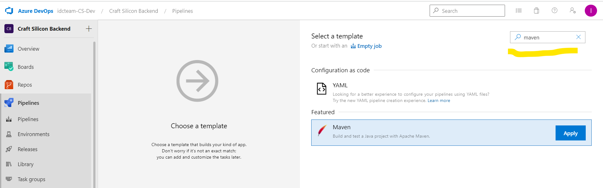

Slide 20
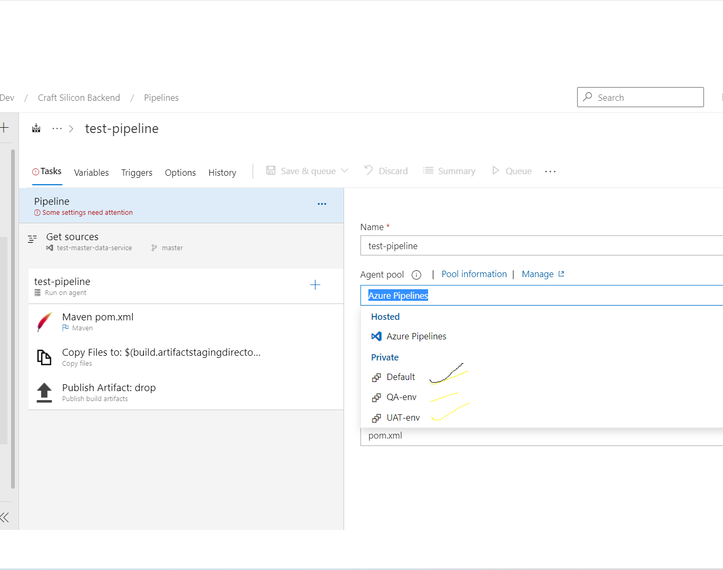
After clicking on maven task and apply.
We will land to this page and fill required details like pipeline name as required.
Select Agent pool in two places one is starting pipeline task and run on agent task we need to select agent pool, In which env our pipeline should run. Ex: DEV,QA,UAT

Slide 21
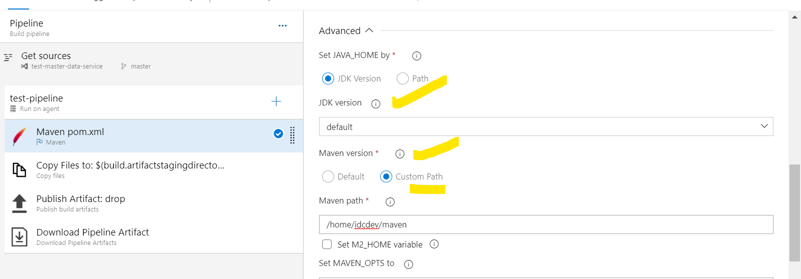
In Maven task need to fill goals field like clean install, After that in advance section please select JDK version by default which is running in our agent or select custom path and insert path of the JDK.
Please fill Maven path by selecting custom path. Please run mvn –v in server we come to know exact maven path and fill as above highlighted.

Slide 22
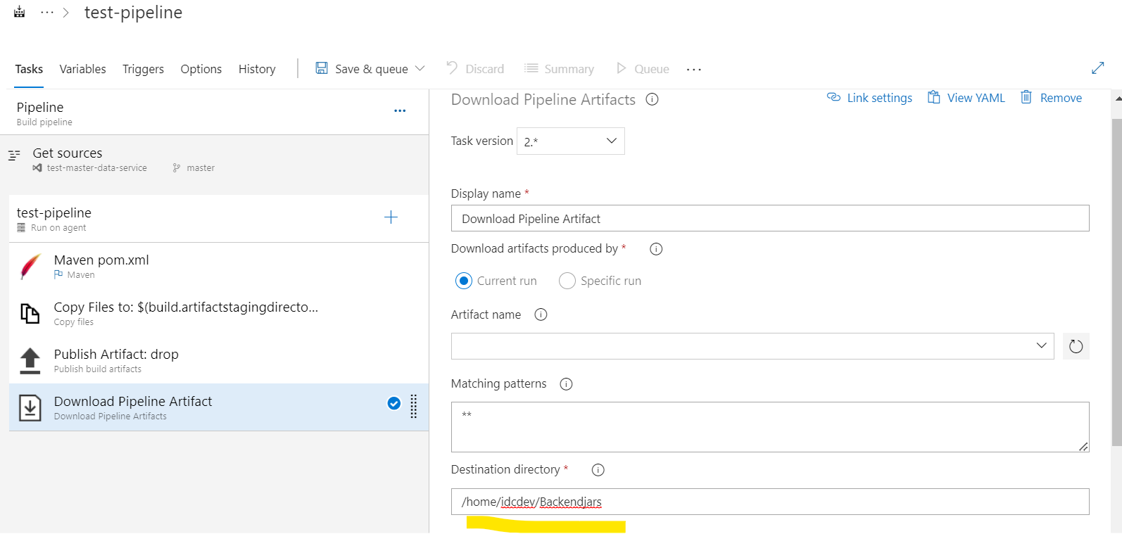

Slide 23
In Previous image have added new task under publish artifact. Because after successfully generated JAR file am downloading to my server in given location.
After that added new task bash script, which will perform whenever new code commits pipeline will start and we will get new JAR file in given location. This script will restart the service with new JAR file.

Slide 24
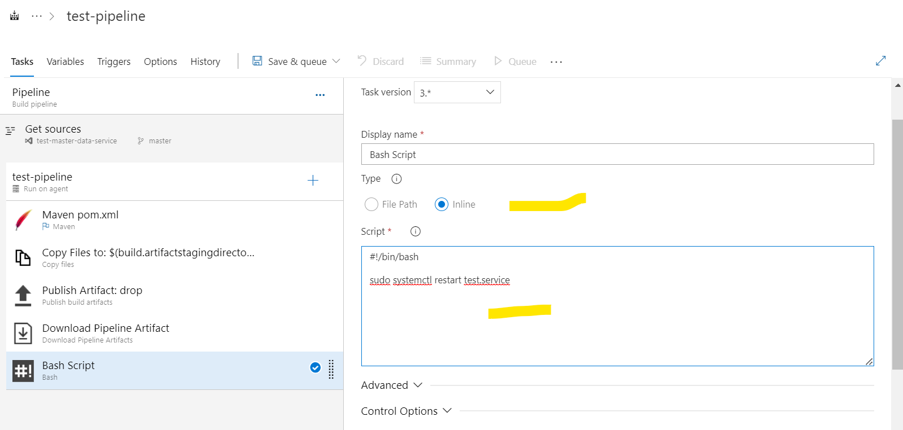

Slide 25
Output Paths:
Jar files: /home/idcdev/Backendjars/drop/target
Script path: /home/idcdev/craftjars-script
Create Service: /etc/systemd/system

Slide 26
Deployment in Server:
After successfully running new pipeline and we will get new jar file in below path
/home/idcdev/Backendjars/drop/target
Please create new .sh file with the name of service in below path
/home/idcdev/craftjars-script
(EX: inside script we are executing command for jar file to run.
#!/bin/sh
java -jar -Dspring.profiles.active=dev user-configuration-service-1.0.0.jar
Now please create service in below path
cd /etc/systemd/system/

Slide 27
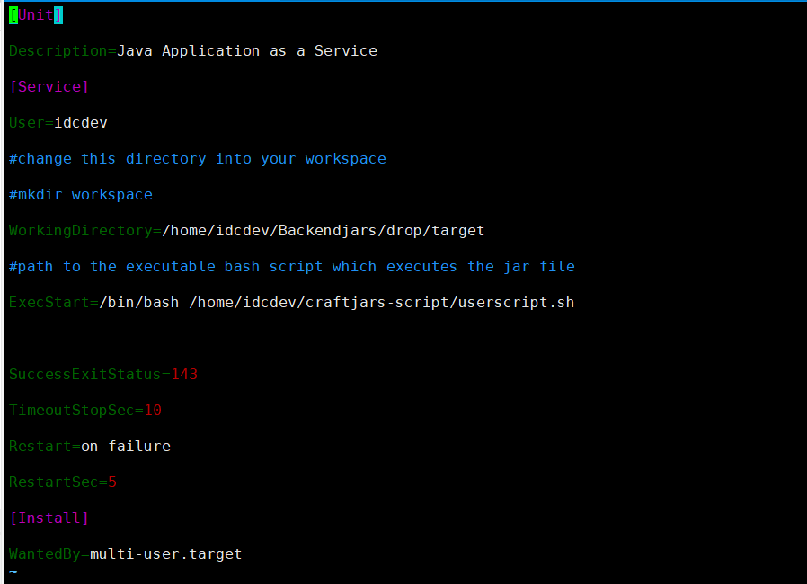
cd /etc/systemd/system vim user.service

Slide 28
In Above image working directory will be same for all the jar files.
In Execstart task script file name will change as per our new service name.
Commands:
systemctl enable servicename.service
systemctl start servicename.service
systemctl status servicename.service

Slide 29
