Slide 1
Deep Convolutional Neural Networks and Data augmentation for Environmental sound classification
Article and Work by: Justin Salamon and Juan Pablo Bello
Presented by : Dhara Rana

Slide 2

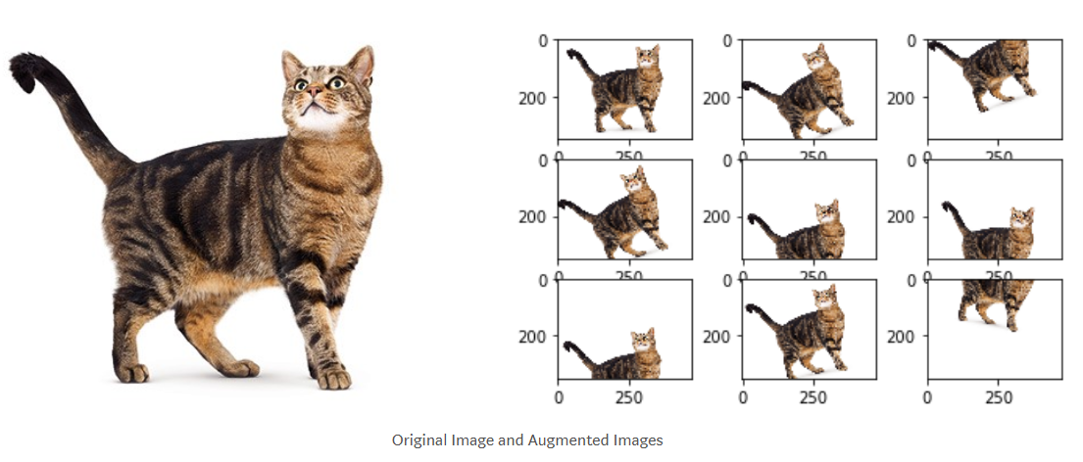
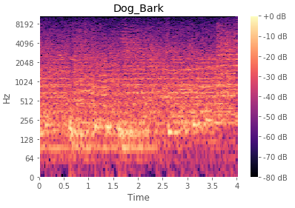
Overall Goal of Paper
Create a way to classify environmental sound given an audio clip
Other methods of sound classification: (1) dictionary learning and (2) wavelet filter banks
Author solution: Deep Convolutional Neural Network with data augmentation
Input:
Sound Clip
Data Augmentation & segmentation:
Log-mel spectrogram
Trained Convolutional Neural Network
Output:
Dog Bark

Slide 3
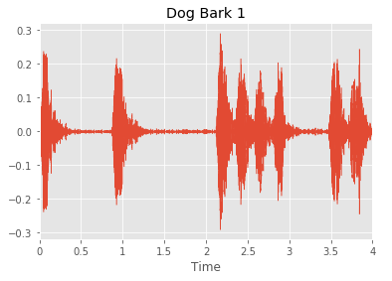
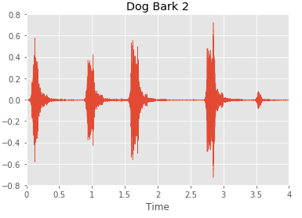
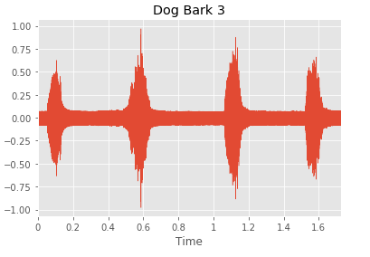
Data
Urban Sound 8k
Size: 8732 labeled sound clips
Duration: ~ 4 seconds
10 Classes:
0 = air_conditioner 1 = car_horn 2 = children_playing 3 = dog_bark 4 = drilling 5 = engine_idling 6 = gun_shot 7 = jackhammer 8 = siren 9 = street_music
Notes:
All excerpts are taken from field recordings uploaded to www.freesound.org. The files are pre-sorted into ten folds (folders named fold1-fold10) to help in the reproduction of and comparison with the automatic classification results reported in the article above.

Slide 4
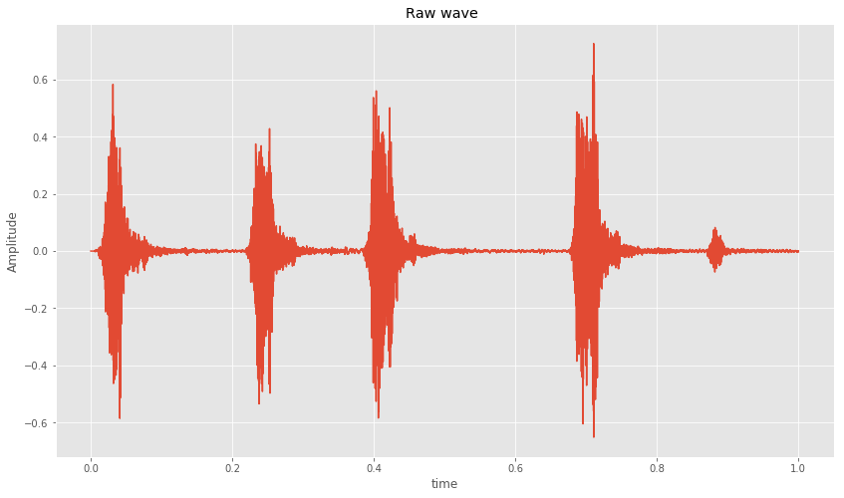
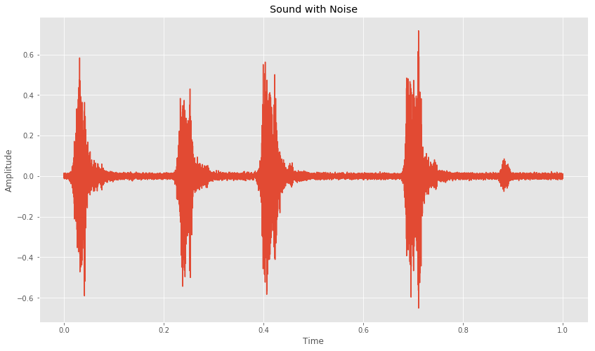
Data Augmentation
Application of one or more deformation to a collection of annotated training samples which results new, additional training data
Types of Audio data augmentation:
(1) Time stretching
(2) Pitch Shifting
(3) Dynamic range compression
(4) Background Noise
Notes:
Time stretching :
Slow down or speed up the audio signal, while keeping pitch unchanged
Pitch Shifting
Raise or lower the pitch of audio sample
Dynamic range Compression
Compress the dynamic range of the sample using 4 parameterizations ???
Background noise
Mix the sample with another recording containing background sounds from different type of acoustic scenes
Cat Image from: https://towardsdatascience.com/image-augmentation-for-deep-learning-histogram-equalization-a71387f609b2

Slide 5
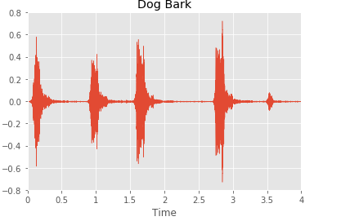
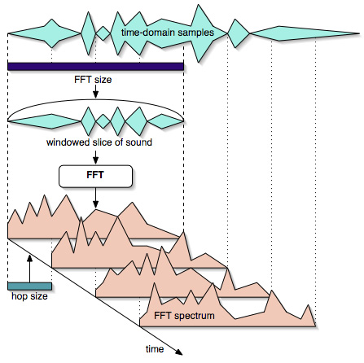
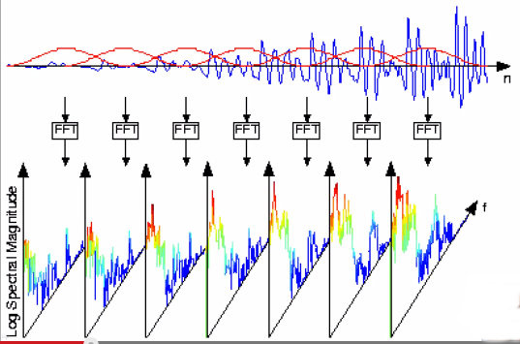
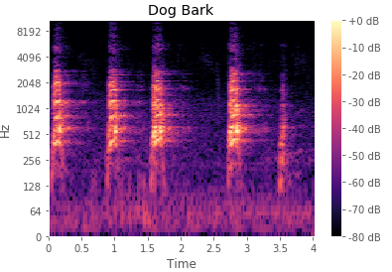
Data processing: Spectrogram
Sampling Frequency: 44100 sample/sec
Window size: 1024 samples/sec; ~23 ms
Hop Size: 1014 s/s
Fames: 128
Freq. Component: 128
Notes:
Short-time fourier transform
Image from:
https://cycling74.com/tutorials/the-phase-vocoder-%E2%80%93-part-I
https://utkarsh15.files.wordpress.com/2015/03/stft.png

Slide 6
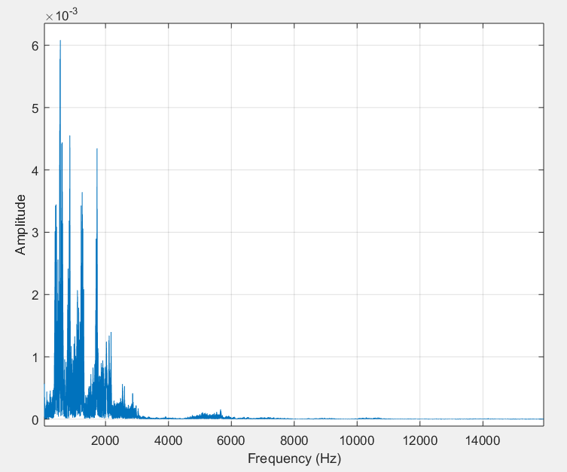
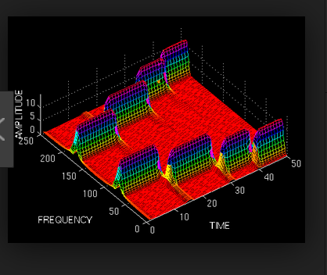
Spectrogram: Another Representation

Slide 7
Proposed Deep CNN (aka SB-CNN)
Layer 1
Convolutional layer: 24 filters with receptive field (5,5)
Pool layer: Max pooling (4,2)
Rectified linear unit (ReLU) activation: h(x)=max(x,0)
Layer 2
Convolutional layer: 48 filters with receptive field (5,5)
Pool layer: Max pooling (4,2)
Rectified linear unit (ReLU) activation: h(x)=max(x,0)
Layer 3
Convolutional layer: 48 filters with receptive field (5,5)
Rectified linear unit (ReLU) activation: h(x)=max(x,0)
Layer 4
Fully Connected Layer: 64 Hidden Layer
Rectified linear unit (ReLU) activation: h(x)=max(x,0)
Layer 5
Fully Connected Layer: 10 Hidden Layer
Softmax Activation ~ 0-1
Notes:
The softmax function squashes the outputs of each unit to be between 0 and 1, just like a sigmoid function. But it also divides each output such that the total sum of the outputs is equal to 1 (check it on the figure above).
Constant Learning rate of : 0.01
Dropout is applied to the input of the last 2 layers wwith probability of 0.5
L2 regularization is applied to weights of the last 2 layers with penalty factor of 0.001
Model is trained

Slide 8

Tuning the Deep CNN
CNN is implemented in Python using Lasagne
Constant Learning rate of 0.01
Dropout is applied to the input of last 2 layers with probability of 0.5
L2 regularization applied to the last 2 layers
Model is trained for 50 epochs
10-fold cross validation
Notes:
Constant Learning rate of : 0.01
Dropout is applied to the input of the last 2 layers wwith probability of 0.5
L2 regularization is applied to weights of the last 2 layers with penalty factor of 0.001
Model is trained
Image from:
https://simplelivingover50.com/2015/04/18/fine-tuning-and-making-adjustments-to-my-diet-and-workout-routine/

Slide 9
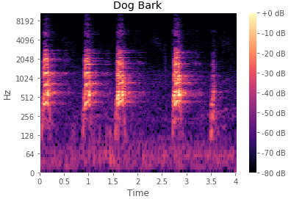
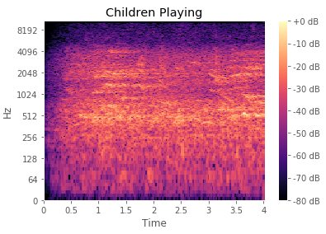
Why deep Convolutional Neural Networks?
(1) Small receptive fields of convolutional kernels (filters) = Better learning and identification of different sound classes
(2) Capable of capturing energy modulation patterns across time and frequency of the spectrogram
Notes:
(1) CNN are capable of capturing energy modulation patterns across time and frequency when applied to spectrogram like inputs

Slide 10
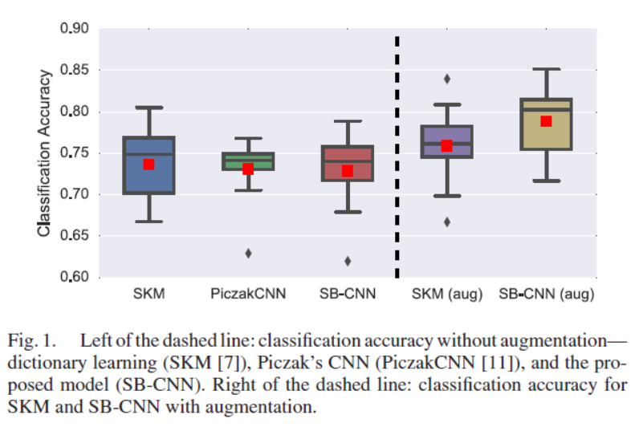
Results: CNN with and Without Data Augmentation
SB-CNN performs comparably to SKM and PiczakCNN when training on original dataset
Mean accuracy:
SKM—0.74
PiczakCNN—0.73
SB-CNN—0.73
With data augmentation, SB-CNN significantly outperforms SKM (p=0.0003)
Mean accuracy:
SB-CNN—0.79
Notes:
NOTE;
The CNN model cannot outperform the SKM approach is because the original data set is not large/ varied enough
P value is measured using two-sided t-test
Increasing the capacity of the SKM model (by increasing the size of the k=2000 to k=4000) DID NOT yield any further improvement in classification accuracy

Slide 11
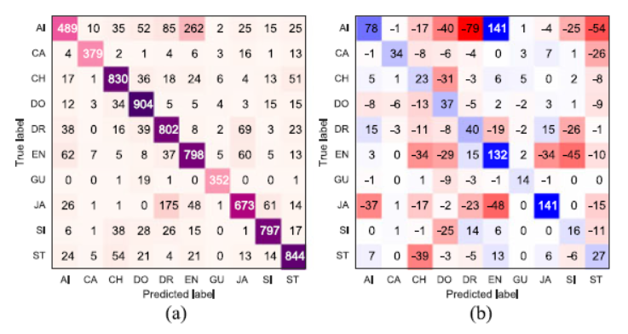
Results: Confusion Matrix classification
Off the diagonal,
Negative values (Red) = Confusion reduced with augmentation
Positive values (Blue) = Confusion increased with augmentation
Along Diagonal,
Positive Values (Blue)= Overall classification improved for all classes with augmentation
Augmentation can have detrimental effect on the confusion between specific pairs of class
Idle engine and air condition

Slide 12
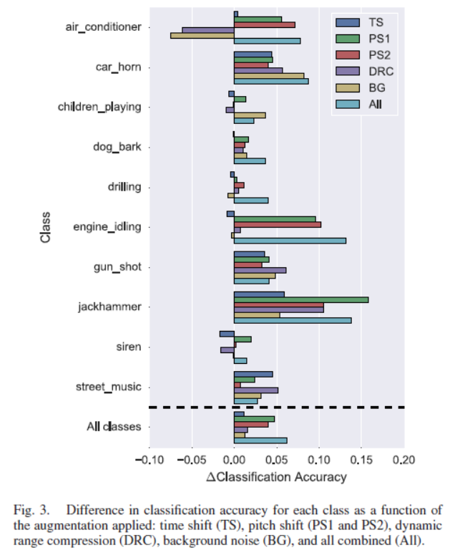
Results: Audio Data Augmentation Accuracy
Most classes are affected positively by most augmentation types but there are exceptions
Air conditioner class is negatively affected by dynamic range compression and background noise.
Pitch augmentation
Greatest positive impact on performance
Only augmentation that did not have a negative impact on any of the classes
Half of the classes benefit from applying all augmentation than a subset of augmentation

Slide 13
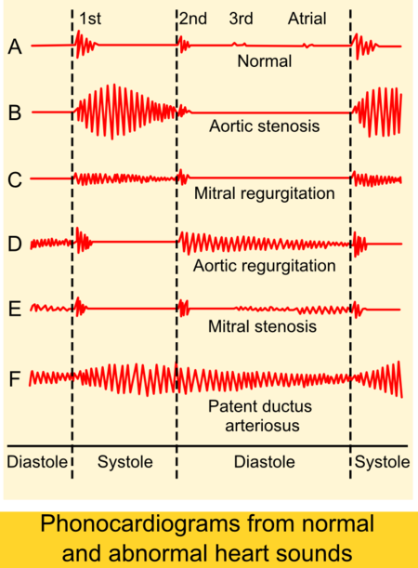
Future Works and Applications
Future Works:
Use validation set to identify which argumentations improve the model’s classification accuracy for class
Then selectively augment the training data accordingly
Applications:
Heart Sound Classification
Snoring Sound Classification
Notes:
Different Heart conditions , such as detecting valve defects, results in murmurs
Image from :

Slide 14


Slide 15
Reference
Salamon, J., & Bello, J. P. (2017). Deep convolutional neural networks and data augmentation for environmental sound classification. IEEE Signal Processing Letters, 24(3), 279-283.
Schnupp, J., Nelken, I., & King, A. (2011). Auditory neuroscience: Making sense of sound. MIT press.
Data Augmentation: https://www.kaggle.com/CVxTz/audio-data-augmentation
Data Augmentation: https://github.com/drscotthawley/audio-classifier-keras-cnn/blob/master/augment_data.py
Dokur, Z., & Ölmez, T. (2008). Heart sound classification using wavelet transform and incremental self-organizing map. Digital Signal Processing, 18(6), 951-959.
Amiriparian, S., Gerczuk, M., Ottl, S., Cummins, N., Freitag, M., Pugachevskiy, S., ... & Schuller, B. (2017, August). Snore sound classification using image-based deep spectrum features. In Proc. of INTERSPEECH (Vol. 17, pp. 2017-434).

Slide 16
Image Reference
https://towardsdatascience.com/image-augmentation-for-deep-learning-histogram-equalization-a71387f609b2
https://cycling74.com/tutorials/the-phase-vocoder-%E2%80%93-part-I
https://utkarsh15.files.wordpress.com/2015/03/stft.png
https://simplelivingover50.com/2015/04/18/fine-tuning-and-making-adjustments-to-my-diet-and-workout-routine/
https://en.wikipedia.org/wiki/Heart_sounds

