Slide 1
Urban Sound Classification with a Convolution Neural Network
Presenter: Dhara Rana
Project Members:
Joseph Chiou

Slide 2
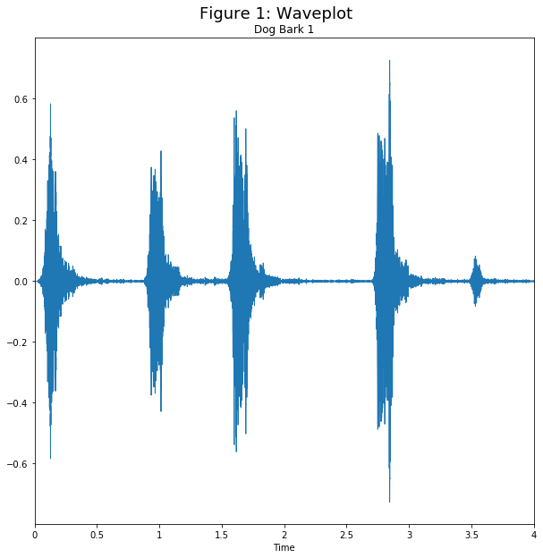
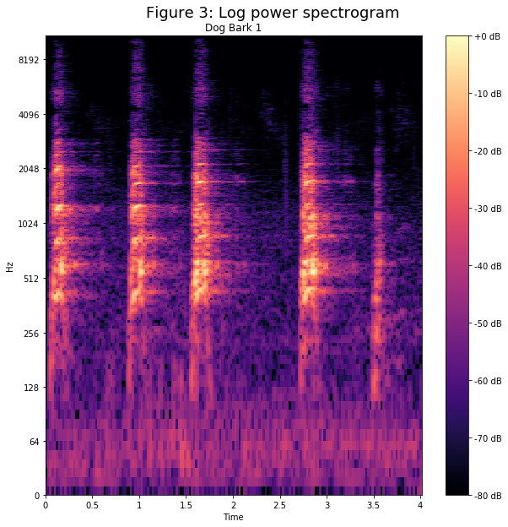
Recap: Overall Goal
Create a way to classify environmental sound given an audio clip
Data Cleaning/Processing: Convert each sound signal into a log-scaled spectrogram
Training Data on Spectrograms (128 frequency bands by 128 frame by 2 channels)
Important libraries/packages: keras, librosa, sklearn

Slide 3
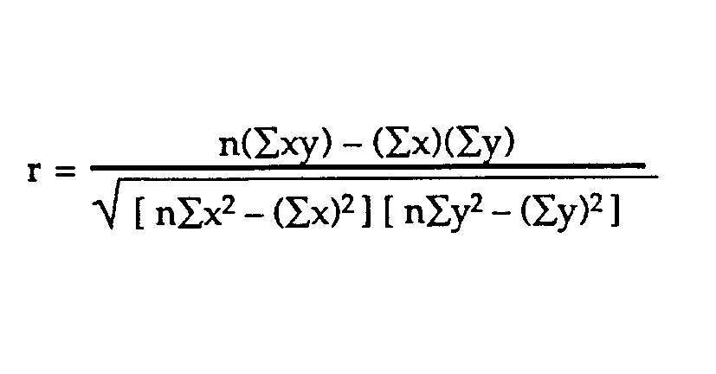
Feature Selection for baseline Model
Domain Specific Features
Pearson Correlation
5 Sound Features:
(1) Chromagram—12 features
(2) Mel-frequency cepstral coefficients—40 features
(3) Melspectrogram—128 features
(4) Tonnetz—6 features
(5) Spectral Contrast—7 features
Total features: 193
Basic statistically tool to figure out the relation between two variables
Highest 193 |r| values were taken
Notes:
Chromagram—Shows the pitches in a sound
Mel-frequency cepstral coefficients—measures to describe scpetral properties of sound; These features give a good representation of information solely about vocal tract filer and cleanly separated from information about the glottal source.
Melspectragram– creates a mel-scaled spectrogram of 128 components--approximates the mapping of frequencies to patches of nerves in the cochlea
Tonnetz– arranges sounds according to pitch relationships into independent spatial and temportal structures
Spectral Contrast: the decibel difference between peaks and valleys in the spectrum

Slide 4
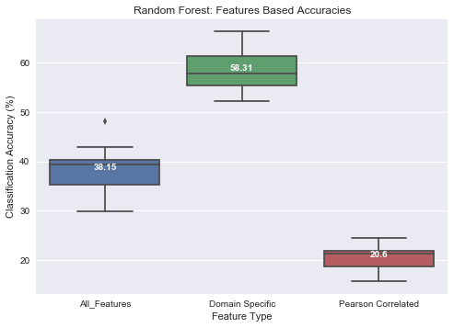
Update~Baseline model: random forest
Parameters:
Number of tree: 500
Max Depth: 20
Validation Method:
10-Fold Cross Validation
Average Runtime
With 193 Domain Specific Features: ~5 min
With 193 Pearson Correlation Selected Features: ~4min 30sec
With All Features: ~51 min
Average Accuracy
With 193 Domain Specific Features: 58.3%
With 193 Pearson Correlation Selected Features:
~ 20.6%
With All Features : 38.15%
Notes:
Domain Specific Feature dataset performed better, so it will be used to compare with the CNN results
10-fold Cross Validation:
The dataset is already split into 10 folders with similar distribution of each class.
So when I did cross fold validation I would train on folders 1-9 and test on 10 and then train on folders 2-10 and test on folder 1; etc
This was also done to validate SVM

Slide 5
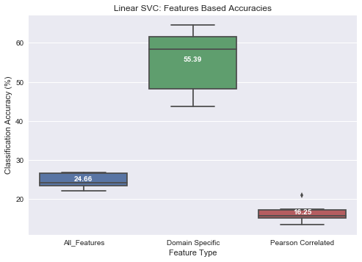
Update~Baseline model: SVM
Parameters:
C=0.01
Max iteration: 3000
Validation Method:
10-Fold Cross Validation
Average Runtime
With 193 Domain Specific Features: ~1.54 min
With 193 Pearson Correlation Selected Features: < 1sec
With all features: ~37min
Average Accuracy
With 193 Domain Specific Features: 55.4%
With 193 Pearson Correlation Selected Features: 16.3%
With All Features: 24.66%
Notes:
Domain Specific Feature dataset performed better, so it will be used to compare with the CNN results

Slide 6
Dense Convolutional Neural Network: Architecture
Layer 1
Convolutional layer: 24 filters with receptive field (5,5)
Pool layer: Max pooling (4,2)
Rectified linear unit (ReLU) activation: h(x)=max(x,0)
Layer 2
Convolutional layer: 48 filters with receptive field (5,5)
Pool layer: Max pooling (4,2)
Rectified linear unit (ReLU) activation: h(x)=max(x,0)
Layer 3
Convolutional layer: 48 filters with receptive field (5,5)
Rectified linear unit (ReLU) activation: h(x)=max(x,0)
Layer 4
Fully Connected Layer: 64 Hidden Layer
Rectified linear unit (ReLU) activation: h(x)=max(x,0)
Dropout: 50% probability
L2 regularizer: 0.001
Layer 5
Fully Connected Layer: 10 Hidden Layer
L2 regularizer: 0.001
Softmax Activation ~ 0-1
Notes:
This architecture is similar to the salamon and bello paper:
Salamon, J., & Bello, J. P. (2017). Deep convolutional neural networks and data augmentation for environmental sound classification. IEEE Signal Processing Letters, 24(3), 279-283.

Slide 7
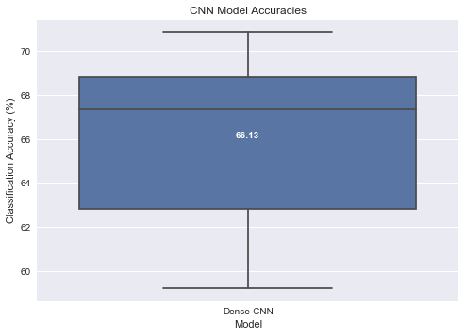
Convolutional Neural Network: Results
Parameters:
Epochs: 40
Batch size: 30
Validation Method:
10-Fold Cross Validation
Average Runtime
~1hr 50min
Average Accuracy
66.10%
Notes:
10-fold Cross Validation
Exmaple:
Train on folders 1-8
Validate on folder 9
Test on folder 10
So the test accuracy on the test folder that was never seen by the CNN during training
To see the training and test accuracy of the CNN for test on folder 10, which showed the highest accuracy see towards the end of presentation

Slide 8
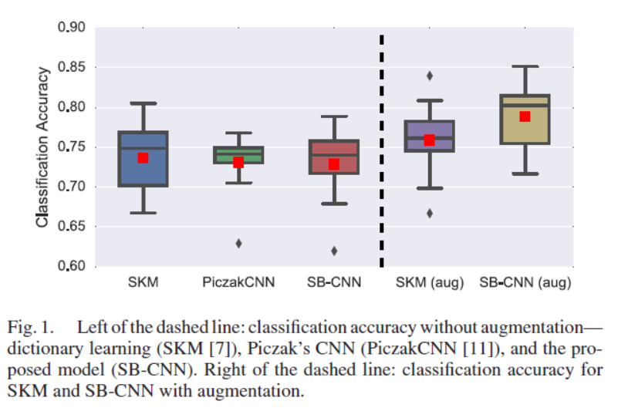
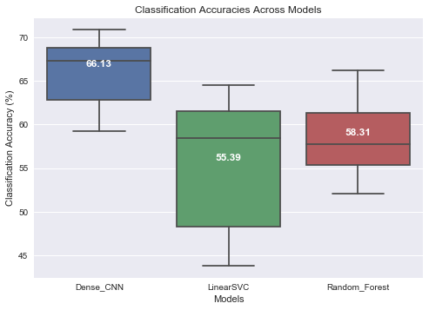
Result Comparison
Compared to Salamon and Bello Paper
Mean Accuracy: 73%
Dense CNN performs better than LinearSVC and random forest
Why?
(1) Small receptive fields of convolutional kernels (filters) = Better learning and identification of different sound classes [1]
(2) Capable of capturing energy modulation patterns across time and frequency of the spectrogram[1]
Notes:
CNN are capable of capturing energy modulation patterns across time and frequency when applied to spectrogram like inputs

Slide 9
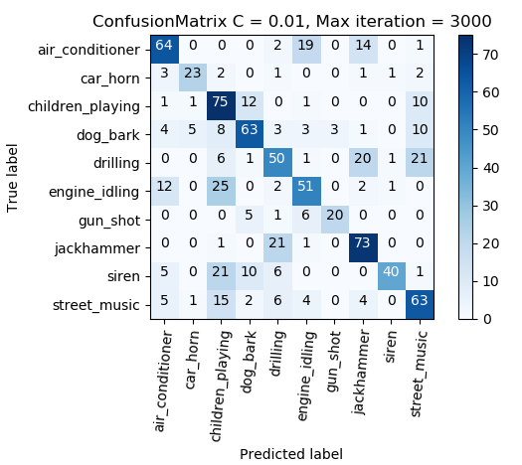
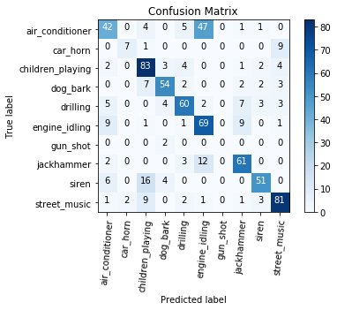
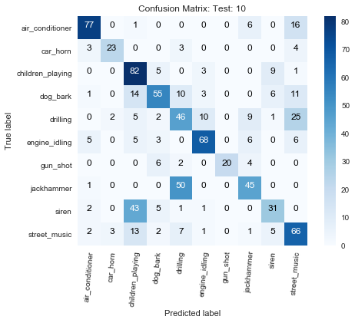
Confusion Matrix for Test Folder 10
Random Forest (Acc: 61.29%)
SVM (Acc: 62.49%)
CNN (Acc: 70.85%)
RF is better at identifying between engine idling and air conditioner
All models had hard time identifying between children playing and siren
CNN is must better at identifying noise urban sound such as street music
CNN is better identifying between jackhammer and drilling
Notes:
Confusion Matrix of the cross validation that gave the best classification: testing on 10
Classification Accuracy for Cross fold on testing folder 10
Dense CNN: 70.85%
Random Forest: 61.29%
SVM: 62.49%
See class distribution of testing folder 10: towards the ends of the presentation

Slide 10


Slide 11
References
Salamon, J., & Bello, J. P. (2017). Deep convolutional neural networks and data augmentation for environmental sound classification. IEEE Signal Processing Letters, 24(3), 279-283.

Slide 12
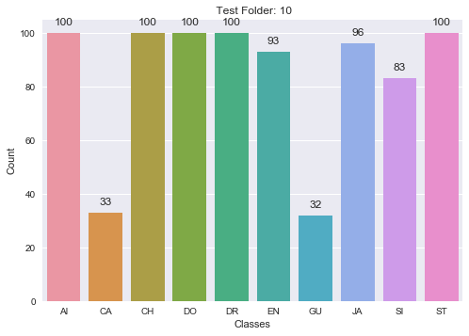
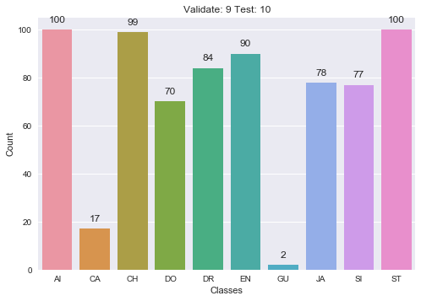
Appendix: Test 10 Class distribution
Test distribution for 193 domain specific features
Test distribution for 128x 128 x2 features
Notes:
The reason why there is less class sound in the 128 x 128 x2 is because
To create the 128 frame the window size is 65024 sample/sec; window_size= 512*(frames-1); note 512 is the hop size
So if the window size is small it will not consider it.

Slide 13
Appendix: Per class Accuracy
 | Test Fold 10 Accuracy
Sound Type | Dense CNN | Random Forest | SVM
Air Conditioner | 0.72 | 0.77 | 0.61
Car Horn | 0.57 | 0.70 | 0.70
Children Playing | 0.69 | 0.82 | 0.53
Dog Bark | 0.86 | 0.55 | 0.62
Drilling | 0.33 | 0.46 | 0.54
Engine Idling | 0.49 | 0.73 | 0.62
Gun Shot | 0.5 | 0.62 | 0.85
Jackhammer | 0.76 | 0.47 | 0.64
Siren | 0.88 | 0.37 | 0.75
Street Music | 0.79 | 0.66 | 0.62

Slide 14
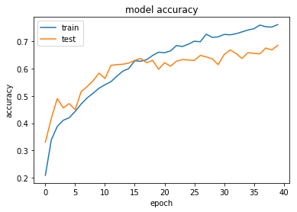
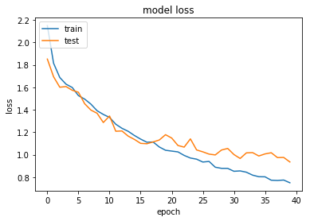
Appendix: CNN Test and Validation Accuracy and loss for Test Folder10

Slide 15
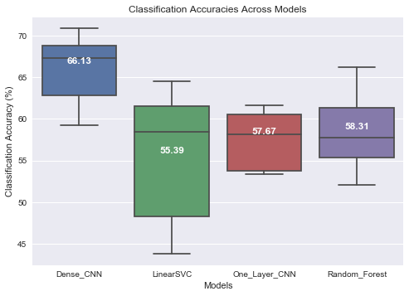
Appendix: Model Accuracies Across models

