Slide 1



A CENTER FOR INTER-DISCIPLINARY RESEARCH
2021-22
TITLE
“WEDLOCK”
SUPERVISED BY
“SREENILAY DASARI & HARSHA VARDHINI K”
GOKARAJU RANGARAJU
INSTITUTE OF ENGINEERING AND TECHNOLOGY
AUTONOMOUS

Slide 2
Advanced Academic Center
( A Center For Inter-Disciplinary Research )
This is to certify that the project titled
“WEDLOCK”
is a bonafide work carried out by the following students in partial fulfilment of the requirements for Advanced Academic Center intern, submitted to the chair, AAC during the academic year 2021-22.

Slide 3
NAME | ROLL N0 | BRANCH
SRIJA CHERUKURI | 21241A3209 | CSBS
AKSHITA AJJURI | 21241A3201 | CSBS
DHARA VIVEK SAMINENI | 21241A66J4 | CSM
BODDU KESHAV SRI SAI | 21241A66E3 | CSM
This work was not submitted or published earlier for any study
Dr/Ms./Mr.
Dr.B.R.K.Reddy
Program Coordinator
Dr. G. Ramesh
Dean, AAC
Project Supervisor

Slide 4
ACKNOWLEDGEMENTS
We express our deep sense of gratitude to our respected Director, Gokaraju Rangaraju Institute of Engineering and Technology, for the valuable guidance and for permitting us to carry out this project.
With immense pleasure, we extend our appreciation to our respected Principal, for permitting us to carry out this project.
We are thankful to the Associate Dean, Advanced Academic Centre, for providing us an appropriate environment required for the project completion.
We are grateful to our project supervisor who spared valuable time to influence us with their novel insights.
We are indebted to all the above mentioned people without whom we would not have concluded the project.

Slide 5
ABSTRACT
A no-broker website helping customers avail all the wedding related necessities easily.
Logo: Every page of the website contains logo at top right.
Featured Vendors: Top vendors will be featured on home page of the website along with price and a image.
3) Categories: The categories are listed below.
Catering
Tent-house
Make-up
Decorations
Photography
Dance choreography
Accessories
Combos
4) Vendor’s list: According to the category , the list of vendors available is shown to the customers.
5) Selected vendor: A page with all the details of the selected vendor will be shown.
6) Contact info: If interested, the customer can leave their contact details to the respective vender.
Description(optional)
Phone number
Email

Slide 6
INTRODUCTION
The business of planning weddings is a serious one, therefore , it requires utmost dedication expertise and support.
Moreover there is plenty of competition and options in this field,
So make this clear and easy we introduce wedlock, a platform that brings various options and categories for wedding preparation at one place .
It is a no broker website helping customers avail all the wedding related necessities easily.
This helps cut down most of the hussle during a wedding cause u can contact different and rated wedding service providers easily Online.
Just by visiting the website you will be provided with the information about the most of the wedding requirements , including decoration, wedding halls etc. All you need to do is choose accordingly
An indian wedding consist of many events , many arrangemts , necessities from the smallest of items to the halls for the event every thing should be taken care with utmost care and value.
This process can get easier and effective with wedlock , where we provide categories like These not only can be used for weddings but also for other indian ceremonies

Slide 7
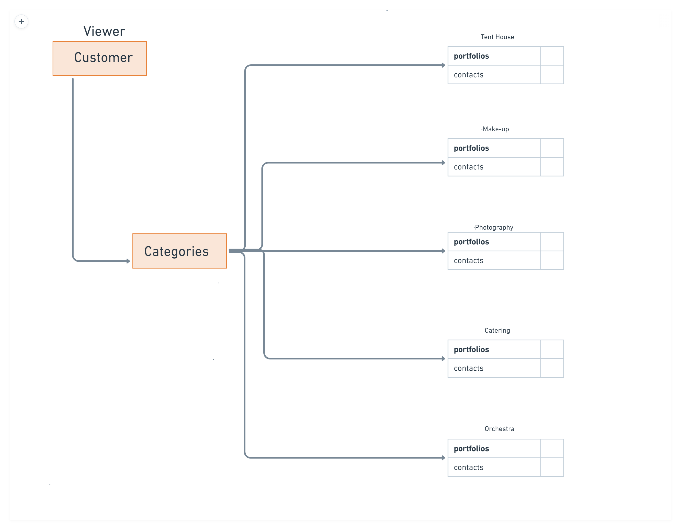
PROJECT WORKFLOW
A page with all the vendors and categories in the navbar, on selection it directs to the respective category and vendors in that category, on clicking on a vendors card it directs to the contact information of the respective vendor

Slide 8
Code
The code mainly consits of html, css and javascript,
Html
<!DOCTYPE html>
<head>
<meta charset="UTF-8">
<meta name="description" content="Pellismanulu">
<meta name="viewport" content="width=device-width, initial-scale=1.0">
<title>Pelli samanulu</title>
<link href='https://fonts.googleapis.com/css?family=Poppins' rel='stylesheet'>
<style>
body {
font-family: 'Poppins';font-size: 22px;
}
</style>
<link rel="stylesheet" href="css/bootstrap.css">
<link rel="stylesheet" href="css/bootstrap.min.css">
<link rel="stylesheet" href="css/font-awesome.css">
<link rel="stylesheet" href="css/style.css">
<link rel="stylesheet" href="css/responsive.css">
<link href='https://unpkg.com/boxicons@2.1.2/css/boxicons.min.css' rel='stylesheet'>
</head>
<body>
<!--topnavabr html start-->
<section class="py-0 topnav_section_main">
<div class="container">
<div class="row">
<div class="col-6 col-sm-6 col-md-6 col-lg-6">
<a class="pelli-logo m-0" href="index.html"><img class="m-0 pt-2" src="./images/p-logo.png"></a>
</div>
<div>
<img src="images/wed1-removebg-preview.png" alt="" style="height: 60%;padding-top: 1%;padding-left: 100%;">
</div>
</a>
</li>
</div>
</div>
</div>
</section>
<!--topnavbar html end-->

Slide 9
<!--navbar start html-->
<section class="py-3 navabr-section_main">
<div class="container">
<nav class="navbar navbar-expand-lg navbar-light p-0">
<button class="navbar-toggler" type="button" data-toggle="collapse" data-target="#navbarSupportedContent" aria-controls="navbarSupportedContent" aria-expanded="false" aria-label="Toggle navigation">
<span class="navbar-toggler-icon"></span>
</button>
<div class="collapse navbar-collapse" id="navbarSupportedContent">
<ul class="navbar-nav mr-auto">
<li class="nav-item active">
<a class="nav-link" href="photography.html">Photography <span class="sr-only">(current)</span></a>
</li>
<!-- <li class="nav-item dropdown">
<a class="nav-link dropdown-toggle" href="#" id="navbarDropdown" role="button" data-toggle="dropdown" aria-haspopup="true" aria-expanded="false">
Dropdown
</a>
<div class="dropdown-menu" aria-labelledby="navbarDropdown">
<a class="dropdown-item" href="#">Action</a>
<a class="dropdown-item" href="#">Another action</a>
<div class="dropdown-divider"></div>
<a class="dropdown-item" href="#">Something else here</a>
</div>
</li> -->
<li class="nav-item active">
<a class="nav-link " href="makeup.html">Make-up</a>
</li>
<li class="nav-item active">
<a class="nav-link " href="mehendi.html">Mehendi</a>
</li>
<li class="nav-item active">
<a class="nav-link " href="decoration.html">Decoration</a>
</li>
<li class="nav-item active">
<a class="nav-link " href="catering.html">Catering</a>
</li>
<li class="nav-item active">
<a class="nav-link " href="dance-music.html">Dance & Music</a>
</li>
<li class="nav-item active">
<a class="nav-link " href="cards&gitfts.html">Cards & Gifts</a>
</li>
<li class="nav-item active">
<a class="nav-link " href="combos.html">Combos</a>
</li>

Slide 10
<!-- </li>
<li class="nav-item active">
<a class="nav-link " href="https://dharavivek.github.io/combos_aac14/">Combos</a>
</li>-->
</ul>
</div>
</nav>
</div>
</section>
<!--navbar end html-->
<!--banner caurosel start-->
<section>
<div id="carousel" class="carousel slide" data-ride="carousel">
<div class="carousel-inner" role="listbox">
<div class="carousel-item active" o style=" height:500px; opacity: 0.7; background-image: url('./images/Indian-Wedding-Photography-Boston-PTaufiq-Couple-portrait5-scaled.jpg')">
<div class="caption">
<div><h4 style="opacity:2.0 ; color: #f6c453;" >Choose your perfect wedding photographer within the Budget</h4></div>
</div>
</div>
<div class="carousel-item" style="height:300px; background-image: url('./images/Indian-Wedding-Photography-Boston-PTaufiq-Couple-portrait5-scaled.jpg')">
<div class="caption">
<h4>Find Make-up artists Near you with good reviews</h4>
<!-- <a class="big-button" href="" title="">Create Project</a>
<div class="clear"></div>
<a class="view-demo" href="" title="">View Demo</a> -->
</div>
</div>
<div class="carousel-item" style=" height:300px; background-image: url('./images/Indian-Wedding-Photography-Boston-PTaufiq-Couple-portrait5-scaled.jpg')">
<div class="caption">
<h4>Find Mehendi artists Near you</h4>
</div>
</div>
</div>
</div>
</section>

Slide 11
<!--banner caurosel start-->
<!--service html start-->
<section class="featured_venders_main">
<div class="container">
<h2 class="featured-ttl mb-3">FEATURED VENDORS</h2>
<div class="row">
<div class="col-sm-12 col-md-6 col-lg-4 mb-4">
<div class="wedding-decoration">
<a href="indexv.html" ><img src="https://images.unsplash.com/photo-1601482441062-b9f13131f33a?ixlib=rb-1.2.1&ixid=MnwxMjA3fDB8MHxzZWFyY2h8NHx8d2VkZGluZyUyMGRlY29yfGVufDB8fDB8fA%3D%3D&w=1000&q=80" height="315px" class="pb-0 w-100" alt="service1"></a>
<div class="p-2 fv-text">
<div class="featured-text pb-2">
<h4 class="p-0 m-0 wdding-ttl">wedding Decoration by Partywaala</h4>
<P class="mb-1">Hyderabad</P>
</div>
<div class="featured-text1">
<p class="m-0">starting price</p>
<span class="d-flex"> <h4 class="px-2 m-0">&#8377 40,000</h4>for indoor decor</span>
</div>
</div></div>
</div>
<div class="col-sm-12 col-md-6 col-lg-4 mb-4">
<div class="wedding-decoration">
<a href="indexv2.html" ><img src="https://image.wedmegood.com/resized-nw/600X/wp-content/uploads/2020/06/henna-mehendi-london.jpg" height="315px" class="pb-0 w-100" alt="service1"></a>
<div class="p-2 fv-text">
<div class="featured-text pb-2">
<h4 class="p-0 m-0 wdding-ttl">Shehnaaz mehendi art</h4>
<P class="mb-1">Hyderabad</P>
</div>
<div class="featured-text1">
<p class="m-0">starting price</p>
<span class="d-flex"> <h4 class="px-2 m-0">&#8377 2,000</h4>per day</span>
</div>
</div> </div>
</div>

Slide 12
<div class="col-sm-12 col-md-6 col-lg-4 mb-4">
<div class="wedding-decoration">
<a href="indexv3.html" ><img src="https://www.southindiafashion.com/wp-content/uploads/2019/08/south-indian-bridal-makeup-artists.jpg" height="315px" class="pb-0 w-100" alt="service1"></a>
<div class="p-2 fv-text">
<div class="featured-text pb-2">
<h4 class="p-0 m-0 wdding-ttl">Makeup by Aarthi</h4>
<P class="mb-1">Hyderabad</P>
</div>
<div class="featured-text1">
<p class="m-0">starting price</p>
<span class="d-flex"> <h4 class="px-2 m-0">&#8377 2,000</h4>per day</span>
</div>
</div></div>
</div>
<div class="col-sm-12 col-md-6 col-lg-4 mb-4">
<div class="wedding-decoration">
<a href="indexv4.html" ><img src="https://cdn0.weddingwire.in/article/3954/3_2/1280/jpg/74593-summer-makeup-trends-pratishtha-arora-lead.webp" height="315px" class="pb-0 w-100" alt="service1"></a>
<div class="p-2 fv-text">
<div class="featured-text pb-2">
<h4 class="p-0 m-0 wdding-ttl">Bridal Makeup by heena</h4>
<P class="mb-1">Hyderabad</P> </div>
<div class="featured-text1">
<p class="m-0">starting price</p>
<span class="d-flex"> <h4 class="px-2 m-0">&#8377 4,000</h4>for indoor decor</span>
</div>
</div>
</div>
</div>
<div class="col-sm-12 col-md-6 col-lg-4 mb-4">
<div class="wedding-decoration">
<a href="indexv5.html" ><img src="https://i0.wp.com/www.snapscue.com/xovirdee/2020/01/Ramya-Satish-Post-Wedding-008.jpg?fit=2048%2C1365&ssl=1" height="315px" class="pb-0 w-100" alt="service1"></a>
<div class="p-2 fv-text">
<div class="featured-text pb-2">
<h4 class="p-0 m-0 wdding-ttl"> Arun photography</h4>
<P class="mb-1">Hyderabad</P>
</div>
<div class="featured-text1">
<p class="m-0">starting price</p>
<span class="d-flex"> <h4 class="px-2 m-0">&#8377 60,000</h4>for indoor decor</span>
</div>
</div>
</div>
</div>

Slide 13
<div class="col-sm-12 col-md-6 col-lg-4 mb-4">
<div class="wedding-decoration">
<a href="indexv6.html" ><img src="https://www.bookeventz.com/blog/wp-content/uploads/2020/11/South-Indian-Wedding-Mandap-1-1200x900.png" height="315px" class="pb-0 w-100" alt="service1"></a>
<div class="p-2 fv-text">
<div class="featured-text pb-2">
<h4 class="p-0 m-0 wdding-ttl"> Happyevents</h4>
<P class="mb-1">Hyderabad</P>
</div>
<div class="featured-text1">
<p class="m-0">starting price</p>
<span class="d-flex"> <h4 class="px-2 m-0">&#8377 45,000</h4>for indoor decor</span>
</div>
</div>
</div>
</div>
</div>
</div>
</section>
<!--servic html end-->
<script src="js/popper.js"></script>
<script src="js/jquery.js"></script>
<script src="js/bootstrap.bundle.min.js"></script>
<script src="js/bootstrap.min.js"></script>
</body>
</html>

Slide 14
/*topnavbar css start*/
*{
font-family: 'Poppins';font-size: 22px;
}
.pelli-logo img{
color: #fff;
width:12%;
}
.dropdown-menu .hide {
display: none;
}
.navbar-light .navbar-nav .active>.nav-link, .navbar-light .navbar-nav .nav-link.active, .navbar-light .navbar-nav .nav-link.show, .navbar-light .navbar-nav .show>.nav-link {
color: #183A1D;
font-size: 15px;
}
.topnav_section_main{
background-color: #f6c453;
}
.wdding-ttl{
font-size: 18px;
}
input{
outline: none;
border: none;}
.near-btn{
background-color: #183A1D;
outline: none;
border: none;
margin-top: 10px;
padding: 20px;
width: 100%;
font-weight: 700;
color: #fff;
}
.location-main{
background-color:cadetblue;
padding-top: 20px;
margin-top: 50px;
position: relative;
right: -400px;
padding-bottom: 20px;
}

Slide 15
.dropdown-menu {
position: absolute;
will-change: transform;
top: 0px;
left: 310px !important;
transform: translate3d(310px, 53px, 0px);
}
.enter-ttl{
font-size: 20px;
}
.nav-link {
display: block;
padding: 0 1rem;
}
.login{
text-align: end;
}
.login a{
font-size: 35px;
}
#drop-down{
font-size: 20px;
}
.login-img{
color: black;
}
.fa_search{
font-size: 30px;
}
.navabr-section_main{
background-color: #E1eedd;
}
.location-btn{
background-color: #183A1D;
border-radius: 3px;
border: 2px solid #000;
color: #000;
}
p{
font-size: 12px;
}
span{
font-size: 12px;
}

Slide 16
/*banner css start*/
.carousel-inner {
width: 100%;
display: inline-block;
position: relative;
}
.carousel-inner {
padding-top: 25.25%;
display: block;
content: "";
}
.carousel-item {
position: absolute;
top: 0;
bottom: 0;
right: 0;
left: 0;
background: #FEFBE9;
background: no-repeat center center scroll;
-webkit-background-size: cover;
-moz-background-size: cover;
-o-background-size: cover;
background-size: cover;
margin-top: 15px;
}
.price-range{
border: 2px solid #f6c453;
padding: 11px 20px;
}
.caption {
position: absolute;
top: 50%;
left: 50%;
transform: translateX(-50%) translateY(-50%);
width: 60%;
z-index: 9;
margin-top: 20px;
text-align: center;
}
.caption h4 {
color: #fff;
font-size: 52px;
font-weight: 700;
margin-bottom: 23px;
}

Slide 17
.carousel-indicators .active {
background: #fff;
}
.carousel-indicators li {
background: rgba(255, 255, 255, 0.4);
border-top: 20px solid;
z-index: 15;
}
/*banner css end*/
/*service css start*/
.featured_venders_main{
padding: 30px 0px;
}
.wedding-decoration{
border:2px solid grey;
}
.send-btn{
background-color: aquamarine;
padding: 10px 70px;
border: 2px solid #000;
border-radius: 5px;
font-size: 20px;
margin-right: 15px;
}
.cnct{
color:#000
}
.social-iconss li a i{
justify-content: center;
}
.cnct1 i{
font-size: 40px;
color: #000;
}
.contact-details-page{
border: 2px solid #183A1D;
background-color: #E1EEDD;
}
.love{
font-size: 50px;
}
.customer-id{
background-color: aquamarine;
border-radius: 20px;
}
.photographer{
border: 1px solid gray;
padding: 0px 20px;
}

Slide 18
.featured-ttl{
padding-right:50px;
padding-left: 50px;
padding-bottom:40px;
color: #183A1D;
text-align: center;
}
.featured-text{
border-bottom: 1px solid #000;
}
.search-iecon i{
color: #183A1D;
font-size: 30px;
}
.fv-text{
border: 1px solid grey;
}
.location-btn{
background-color: cadetblue;
padding: 0px 15px;
border-radius: 2px solid #183A1D;
}
.filters_box{
border: 1px solid grey;
}
.filetrs-ttl{
color: black;
}
.filters_box{
padding: 20px;
}
.reviews{
color: #000;
}
.reviews:hover{
color: #000 ;
}
/*service css end*/

Slide 19
Future developments
Vendor Side : where vendor can register , fill their details and display the services they offer in the website to improve their bussiness
Login : Login page will be added to establish communication between user and vendor through website and make communication happen between the vendors to co-ordinate
Chat option for user to vendor will be available
User Profile Database : To store all the user activity and requirements a database will be created to store the details
User wishlist : All the required and shortlisted vendors and items will be store in database , so that user can revisit them later
Vendor Database : All the items list and description about them will be stored in vendor database. Amount of items available and all the details related to vendors will be stored so that user can contact vendor only if the items are available.
Location : an option for both vendors and custormers to select their location to make the whole process easier
Filters : Filters will be added to better understand the users according to their needs, location and filters.

Slide 20
REFERENCES
https://www.w3schools.com/html/
https://www.youtube.com/c/TraversyMedia
https://www.youtube.com/watch?v=yfoY53QXEnI
https://www.youtube.com/watch?v=UB1O30fR-EE
https://www.youtube.com/watch?v=5GcQtLDGXy8
https://www.youtube.com/watch?v=jV8B24rSN5o
https://www.youtube.com/watch?v=jV8B24rSN5o

