Slide 1
My Dog (Assistant App for android)
By RAD-DJ
Danny Pham, Jaidyn Jong, Ryan Harris and Dharal Patel

Slide 2

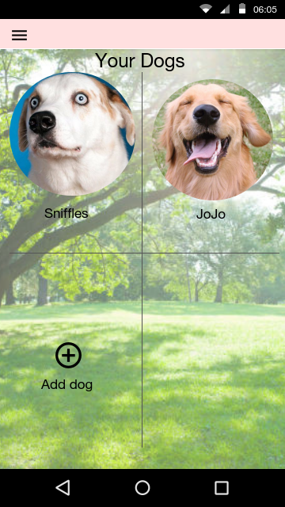
So what is the App?
In essence, our app will strive to assist dog owners who find it difficult to keep track of their dogs needs such as walk times or feeding schedules.
It will also allow families to share a dog across different devices
The app will contain two different features:
The ‘WALK’ function
And the Feeding function

Slide 3
Our motivation
The motivation for this app stemmed from group members issues with caring for a dog in a family household. This App strives to:
Keeping track of if the dog has been fed without yelling around the house
Making sure the dog spends enough time walking
Increase ease of caring for a dog

Slide 4
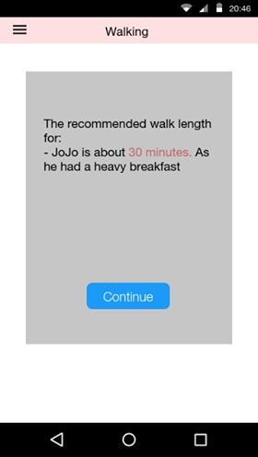
Competitive Advantage
Competitors:
Dog Walker, Dog Walk Tracker and Hungry Dog Controller
Our app gains competitive advantage by:
Having both function in one app
Linking the walk and feed function together

Slide 5
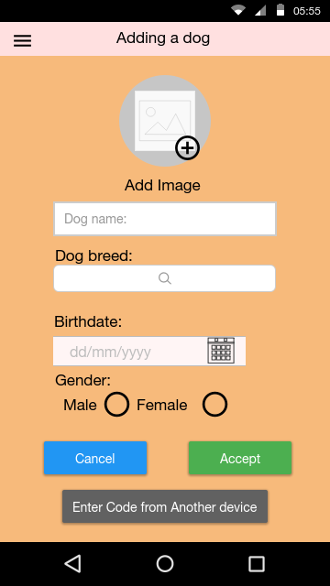
How will it work?
The app will function by using the “DogFile” created by the user to tailor the dogs required walking and feeding times by referencing this information.
So what is the DogFile? The DogFile is the profile that the user will create for their pet, it will include:
Name
Breed
Age
Gender
Multiple profiles can be created and even shared across devices through a unique code for each pet!

Slide 6
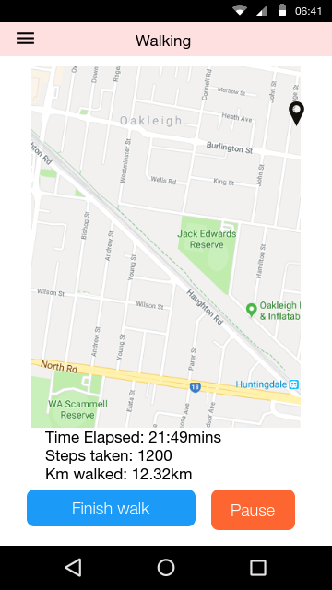
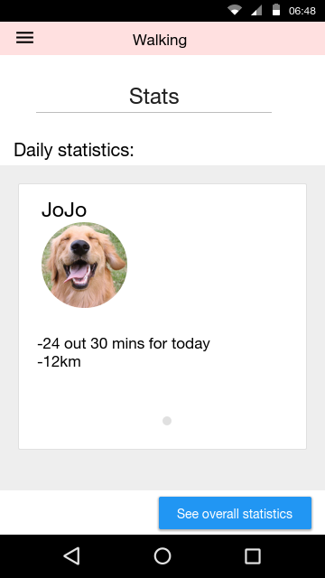
The walk function
This functions primary aim is to:
Track the distance of a dogs walk
This information can be displayed on a map
It will also Provide statistics of all walks
As well as provide recommendations for distance and time to walk, depending on dog breed and age

Slide 7
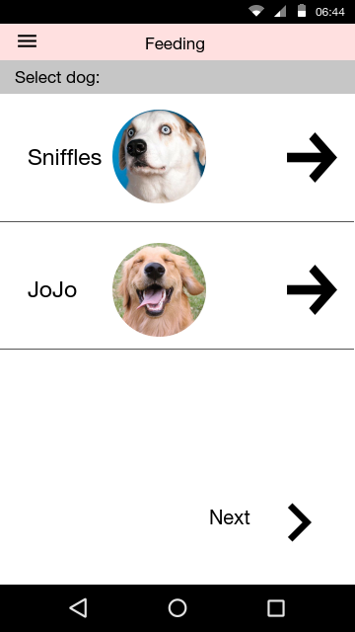
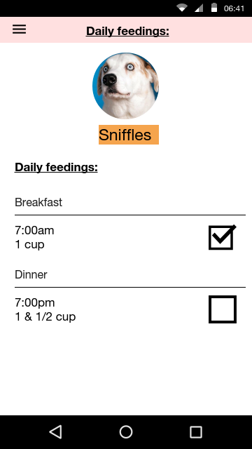
Feeding
This function will work by having the user input a time and size of food, which acts like an alarm. It will include:
Checkbox for when dog has been fed
Cloud based notifications
Notifications at an adjustable time before and after feeding

Slide 8
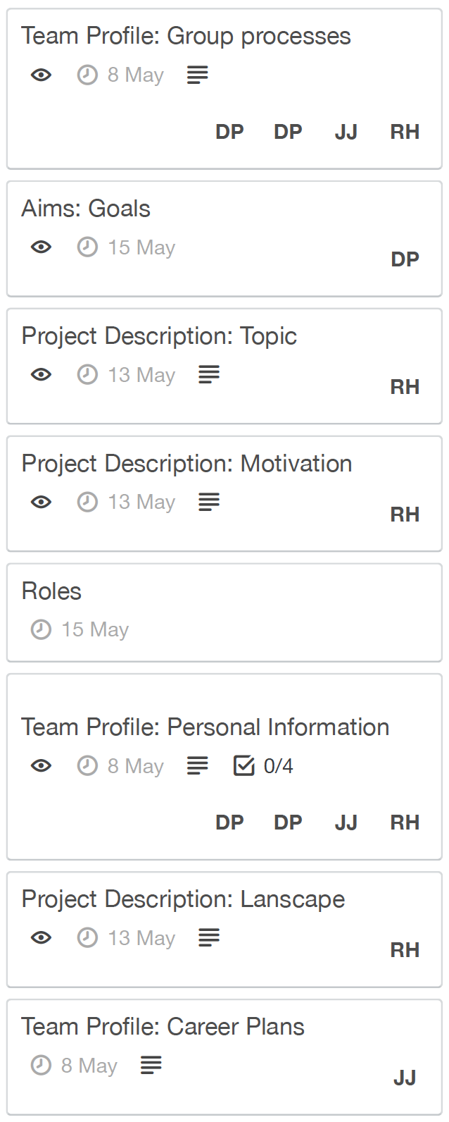
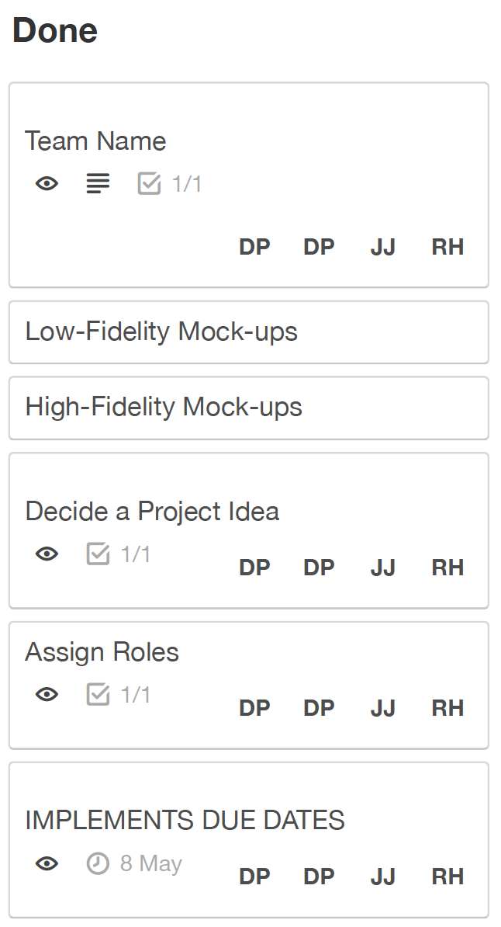
So Far…

Slide 9
The future
User Testing
Creating a job advertisement for a programmer
Hire a programmer to program the app.

Slide 10
THE End
Thanks for listening

