Slide 1


DEVELOPMENT OF A MULTI-PROTOCOL
INDUSTRIAL COMMUNICATION GATEWAY
TEAM 07 (QUANTUM FORGE)
DHARANEESWARAN M – 9925005044 (TL)
SAKTHI MURUGAN M V - 9925005134
AAKASH M - 9925005084
KODIESWARAN R - 9925005083
GITHUB LINK : https://github.com/Dharaneesh2826/Multiple_Protocol_Industrial_Communication_Gateway/tree/main

Slide 2
01 | Problem statement
A two-node ESP32 gateway that demonstrates sensor acquisition and parallel serial communication.
Problem
Proposed solution
Gateway output
Industrial systems use different communication interfaces.
A gateway must collect device data, transport it and monitor link health.
Node 1 reads motion data from an MPU6050.
The same packet is sent to Node 2 using UART and software SPI.
Node 2 validates packets, tracks protocol status and selects an active path.
OLED and browser dashboard present live information.
Core idea
Acquire once → transmit over two interfaces → validate at the gateway → monitor communication health.
2

Slide 3
02 | Objectives
What the prototype is designed to demonstrate.
• Read acceleration and angular-velocity data from an MPU6050 using I²C.
• Transmit a common sensor packet from Node 1 to Node 2 through UART and software SPI.
• Decode and validate the received packet using a defined message format.
• Monitor UART and SPI availability using packet timestamps and a timeout.
• Select UART as the preferred path and SPI as the backup when link status changes.
• Display live readings and communication statistics on an OLED and a local web dashboard.
3

Slide 4
03 | System Architecture
Two ESP32 nodes with sensor-side I²C and two node-to-node communication paths.
OLED
UART
Local display
NODE 1 • ESP32
NODE 2 • ESP32
MPU6050
I²C
I²C sensor read
Packet creation
UART + software SPI TX
UART + software SPI RX
Packet validation
Protocol monitoring
Motion sensor
SPI
Wi-Fi AP + Web
Local browser dashboard
HTTP / JSON
Node 1 publishes the same MPU6050 measurement packet over both links. Node 2 receives and monitors each path.
4

Slide 5
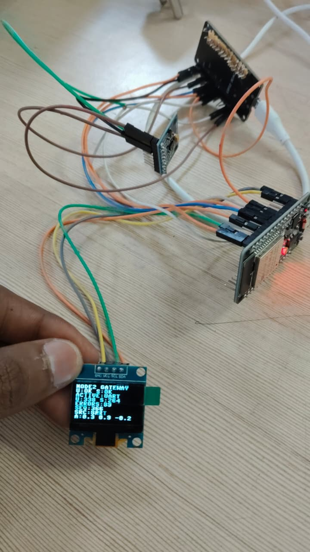

Slide 6
04 | Hardware & Pin Connections
Connections used in the working prototype.
Node 1
Node 2
Inter-node wiring
ESP32 DevKit V1 (ESP32-WROOM-32)
MPU6050 connected over I²C
SDA → GPIO 21
SCL → GPIO 22
UART TX → GPIO 17
UART RX → GPIO 16
SPI MOSI → GPIO 23
SPI SCLK → GPIO 18
SPI CS → GPIO 5
ESP32 DevKit V1 (ESP32-WROOM-32)
SSD1306 OLED over I²C
OLED SDA → GPIO 21
OLED SCL → GPIO 22
UART RX → GPIO 16
UART TX → GPIO 17
SPI MOSI input → GPIO 23
SPI SCLK input → GPIO 18
SPI CS input → GPIO 5
Node 1 TX17 → Node 2 RX16
Node 1 RX16 ← Node 2 TX17
Node 1 MOSI23 → Node 2 GPIO23
Node 1 SCLK18 → Node 2 GPIO18
Node 1 CS5 → Node 2 GPIO5
Connect both ESP32 GND pins
SPI MISO is not used in this one-way link
5

Slide 7
05 | Communication Protocols
Each protocol has a distinct role in the prototype.
I²C • Sensor interface
UART • Primary link
Software SPI • Backup link
Used between Node 1 and MPU6050.
Two signal lines: SDA and SCL.
Node 1 reads 14 bytes starting at register 0x3B.
Acceleration and gyroscope values are scaled into engineering units.
Asynchronous serial communication.
115200 baud, 8 data bits, no parity, 1 stop bit.
Node 1 sends a newline-terminated text packet.
Node 2 buffers bytes until a complete line is received.
Synchronous serial communication, Mode 0.
Node 1 generates MOSI, SCLK and CS using GPIO.
Node 2 samples MOSI on SCLK rising edges.
Frame uses a preamble followed by a fixed-size payload.
6

Slide 8
06 | Sensor Packet & Framing
A common payload is used on both communication paths.
UART message
SPI frame
M,seq,ax,ay,az,gx,gy,gz
Example: M,43,1.01,0.06,0.03,0.51,2.06,1.50
The message ends with a newline character.
Preamble: AA AA AA AA 7E
Payload: 64 ASCII bytes, padded with spaces
Total frame: 5 + 64 = 69 bytes = 552 bits
Packet fields
M
seq
ax / ay / az
gx / gy / gz
Message marker
Sequence number
Acceleration
Angular velocity
7

Slide 9
07 | Node 2 Gateway Processing
Receive → decode → validate → update monitoring and displays.
01 Receive
02 Synchronize
03 Decode
UART line buffer or SPI bit capture
SPI preamble search: 0xAA7E
Convert bytes into the text packet
04 Validate
05 Update
06 Present
Check 8 fields and numeric values
Counters, timestamps, sensor values
OLED and web dashboard
A valid packet updates the latest sensor values and the counter for its source protocol.
8

Slide 10
08 | Protocol Health & Selection
Node 2 uses the time of the last valid packet to determine link status.
Health rule
Selection rule
Priority
A protocol is OK when a valid packet was received within 6 seconds.
Otherwise its status becomes LOST.
Before the first packet, status is WAIT.
If UART is OK → ACTIVE: UART.
Else if SPI is OK → ACTIVE: SPI.
If neither is OK → ACTIVE: NONE.
UART is the preferred path.
SPI is selected as the backup when UART is LOST.
Node 1 continues transmitting on both paths.
Important implementation detail
This prototype performs health-based protocol selection and status reporting at Node 2. It does not yet command Node 1 to stop a failed interface, nor does it filter all displayed sensor values exclusively to the selected path.
9

Slide 11
09 | Local Web Dashboard
Node 2 can host a browser dashboard over its Wi-Fi access point.
Access details
Dashboard information
Data flow
Wi-Fi SSID: INDUSTRIAL_GATEWAY
Password: gateway123
Node 2 AP address: 192.168.4.1
Browser URL: http://192.168.4.1
HTTP endpoint: /api
UART and SPI status
Selected active protocol
MPU6050 acceleration and gyroscope
UART / SPI packet counts
Invalid packet count and latest sequence
Browser requests the Node 2 web page.
JavaScript polls /api periodically.
Node 2 returns current values as JSON.
Dashboard updates without a separate PC server.
Demo note: connect the laptop/phone to the ESP32 access point first. The dashboard is a local network page and does not require internet.
10

Slide 12
10 | Experimental Results
Observed results from the working Node 2 serial monitor.
UART reception
SPI reception
Monitoring
Packets received and validated.
Sequence numbers advanced continuously.
Sensor values decoded successfully.
SPI capture reported 552 bits per frame.
Preamble synchronization and decoding succeeded.
Packets validated with matching sequence numbers.
OLED showed U:OK and S:OK.
Active protocol selection displayed UART.
Packet counters and error count updated.
Example observed serial output
UART #252 ... OK
SPI BITS: 552 (full frame = 552)
SPI #252 ... OK
Replace or supplement this slide with photos of your actual hardware, OLED and browser dashboard.
11

Slide 13
11 | Advantages & Applications
What this prototype demonstrates and where the concept can be extended.
Advantages
Potential applications
Demonstrates multiple communication interfaces in one gateway.
Uses a common sensor packet across two paths.
Includes packet validation and link-health monitoring.
Provides local OLED and browser-based visibility.
Built using ESP32 and MicroPython.
Industrial sensor gateways.
Machine-condition monitoring prototypes.
Educational demonstrations of serial protocols.
Multi-interface data acquisition systems.
Future integration with cloud or plant monitoring systems.
12

Slide 14
12 | Limitations & Future Improvements
Current prototype boundaries and realistic next steps.
Current limitations
Future improvements
SPI receiver is implemented by software GPIO polling, not a hardware SPI-slave peripheral.
Software-timed SPI can be sensitive to Wi-Fi and other processing load.
The present selection logic reports the preferred healthy link; it is not a sender-controlled switchover.
The prototype uses a single MPU6050 sensor and a short-range local Wi-Fi dashboard.
Add a source-specific data buffer and display only the selected path.
Add acknowledgement / retransmission or sender-side failover control.
Measure packet delivery ratio, latency and error rate under controlled tests.
Add more sensor nodes and industrial interfaces.
Add secure Wi-Fi access and optional cloud logging.
13

Slide 15
13 | Conclusion
Summary of the prototype.
A two-node ESP32 gateway was developed to acquire MPU6050 data and deliver it to a second ESP32 through UART and software SPI.
• I²C is used for sensor interfacing.
• UART and SPI provide two independent data paths.
• Node 2 validates packets and monitors link health.
• OLED and a local web dashboard provide system visibility.
Thank you | Questions?
14

Slide 16
Backup | Key Technical Specifications
Quick reference for the project viva / Q&A.
Controller
2 × ESP32 DevKit V1 (ESP32-WROOM-32)
Sensor
MPU6050, I²C address 0x68
Display
SSD1306 OLED, 128 × 64, I²C address 0x3C
UART
UART2, 115200 baud, 8-N-1; TX17 / RX16
Software SPI
MOSI23, SCLK18, CS5; Mode 0, MSB first
SPI frame
5-byte preamble + 64-byte payload = 552 bits
Monitoring timeout
6 seconds since last valid packet
Dashboard
Node 2 AP; 192.168.4.1 (when AP mode is running)
15

