Slide 1
IOT Based Digital LCD Notice Board
GUIDED BY
Mrs.K.Neeraja
Assistant Professor
CSE Department
PRESENTED BY
CSE 3-2 BATCH 5
G. Anjali -23SS1A0518
G. Dharani – 23SS1A0520
K. Poojitha - 23SS1A0531
P. Komali Kavya - 23SS1A0548

Slide 2
Table of Contents
Abstract
Introduction
Existing system
Literature survey
Problem Statement
Proposed System
Hardware Requirements
Software Requirements
System Architecture
UML diagrams
Algorithms Specialization
Results
Conclusion
Future scope
References

Slide 3
Abstract
The IoT Based Digital LCD Notice Board System is a smart embedded system designed to display notices electronically using internet communication. The system allows authorized users to send messages through a web or mobile interface. These messages are stored in a cloud database and retrieved by a Wi-Fi-enabled microcontroller such as NodeMCU (ESP8266/ESP32).
The received data is displayed on an LCD screen in real-time. This system eliminates manual effort, reduces paper consumption, ensures instant updates, and enhances communication efficiency in organizations.

Slide 4
Introduction
Traditional notice boards often lead to delays, wastage of paper, and manual effort to update announcements. Our IoT-Based Digital LCD Notice Board eliminates these hassles by enabling staff to post updates remotely via a web interface.
The notices are instantly displayed on the LCD screen, ensuring timely communication. This smart solution streamlines information sharing, reduces administrative workload, and promotes a paperless environment.
With the rapid advancement of the Internet of Things (IoT), physical systems can now be connected to the internet for real-time data transmission and remote control.

Slide 5
Existing System
Traditional notice boards:
Paper-based.
Manual updates, time-consuming.
Inefficient for urgent information.
Computer-controlled digital boards:
Require local system connection;
No remote accessibility.
GSM/SMS-based display systems:
Messages sent via SMS ;limited scalability and additional communication.
Overall limitations:
No real-time centralized control
High manual effort
Slow information dissemination
Limited flexibility and automation

Slide 6
Literature Survey
IoT-Based Notice Board Using Wi-Fi (IJERT)
IoT-based notice board with Wi-Fi and LCD display for remote updates.
Problem: Limited Wi-Fi range, requires stable internet.
GSM-Based Wireless Display Board (IJARCET)
GSM-based display board for sending notices via SMS.
Problem: Relies on GSM network, may have message delay.
IoT-Based Digital Notice Board with Android App (IJITEE)
Notice board with Android app for remote updates.
Problem: Requires app installation, compatibility issues.
Research Gap:
Limited focus on institutional-specific customization and scalability.

Slide 7
Problem Statement
Traditional notice boards face several operational challenges:
Delays in updating information
Manual effort required for posting notices
Paper wastage and environmental impact
Risk of notices being removed or damaged.
There is a need for an automated, real-time, and remotely accessible notice display system.
Increased operational cost due to printing
Limited scalability

Slide 8
Proposed System
We are overcoming the existing system problems by implementing the following enhanced features:
1.Remote Notice Upload & Management
• Authorized users (Admin/staff) can send notices through a web or mobile interface.
• Secure login authentication ensures controlled access.
• Notices can be added, edited, or deleted in real-time.
• Multiple notice boards can be managed from a single dashboard.
2.Real-Time Notice Display
• The system displays notices instantly on the LCD screen once uploaded.
• Messages are fetched dynamically from the cloud server using Wi-Fi.
• Supports automatic scrolling for lengthy messages.

Slide 9
3.Cloud-Based Data Storage
All notices are stored securely in a cloud database (Firebase/MQTT/IoT platform).
Data synchronization between server and display unit.
Ensures reliability and centralized control.
Enables access from anywhere via the internet.
4.Faculty Control & Access Management
Only authorized faculty can manage notices through secure login.
Role-based control prevents unauthorized modifications.
Faculty can:
Create notices
Edit notices
Delete notices

Slide 10
5.User-Friendly Interface​
Simple and clean web interface for faculty.​
Easy notice creation using text input.​
Responsive design supports desktop and mobile devices.​
Fast navigation between login, dashboard, and homepage.​
Designed for minimal technical knowledge.​
6.Cost-Effective & Eco-Friendly System​
Eliminates paper usage for notice dissemination.​
Reduces manual effort and maintenance cost.​
Uses low-power IoT hardware components.​
Long-term operational efficiency for institutions.​
Environmentally sustainable communication solution.​

Slide 11
Hardware Requirements
ESP8266 Microcontroller
16×2 LCD Display (I2C Module)
Wi-Fi Internet Connection
Jumper Wires
USB Cable / Power Adapter
Computer/Laptop for programming.

Slide 12
Software Requirements
Arduino IDE (for ESP programming)
Firebase / Cloud Database
Embedded C / Arduino Programming Language
HTML ,CSS ,JavaScript (Frontend Interface)
Web Browser (Chrome/Edge/Firefox)

Slide 13
System Architecture
Staff/Faculty
Web Page
(Add, Update, Delete)
WI-FI(HTTPS/REST)
/REST
Internet (Wi-Fi/Mobile data)
Cloud database; Firebase
(Stores latest notices)
WIFI Request (HTTP)
16x2 LCD Display (I2C)
(Notice Display + Scrolling)
ESP8266 / ESP32 | Wi-Fi Client+ Controller
(Fetch latest notice)
I2C Communication
13

Slide 14
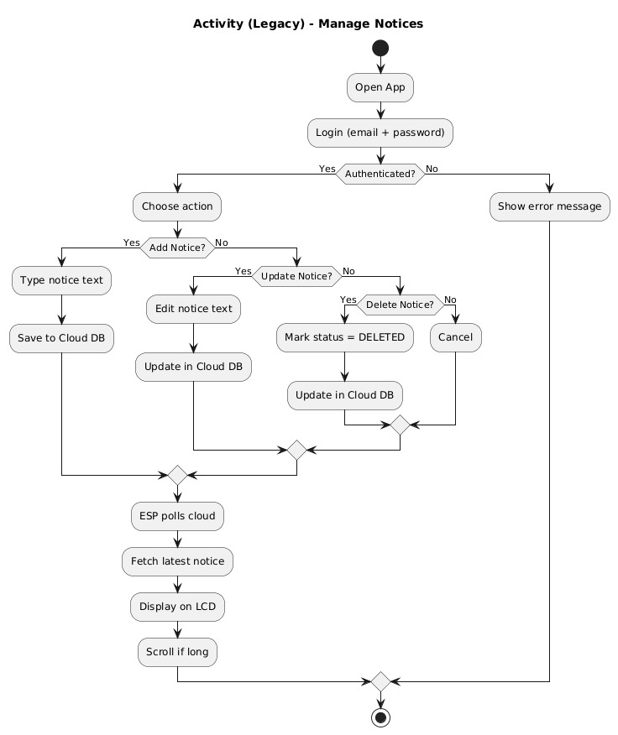
Activity Diagram

Slide 15
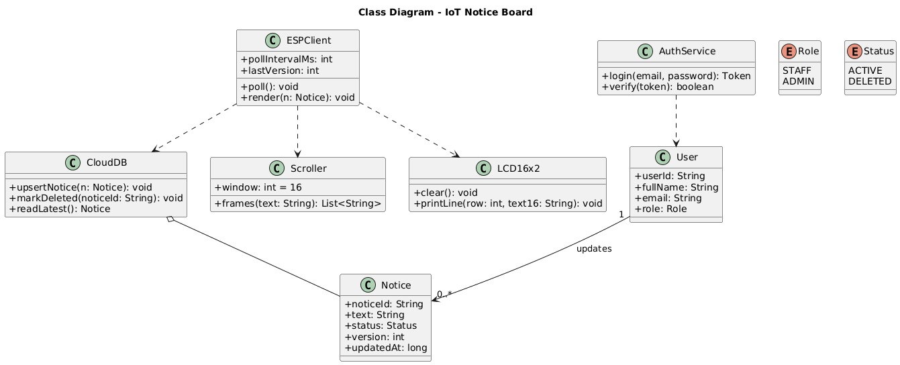
Class Diagram

Slide 16
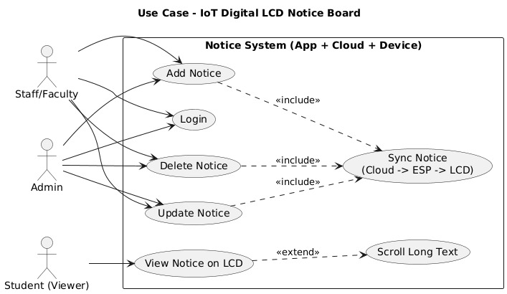
Use Case Diagram

Slide 17
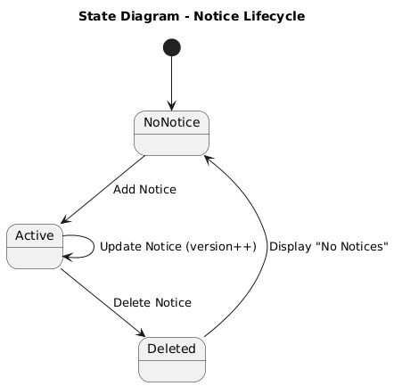
State Diagram

Slide 18
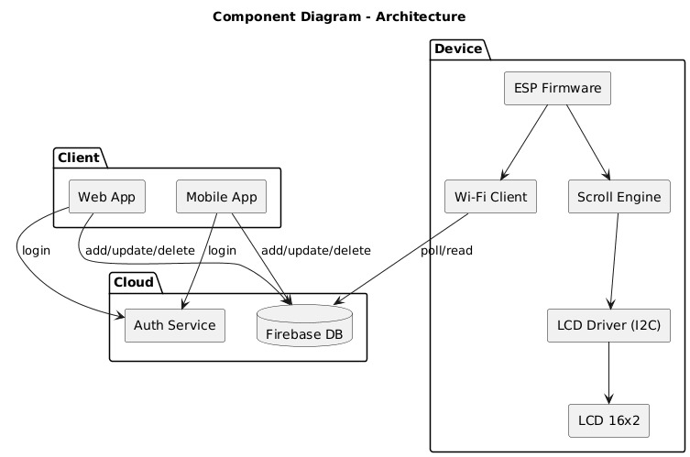
Component Diagram

Slide 19
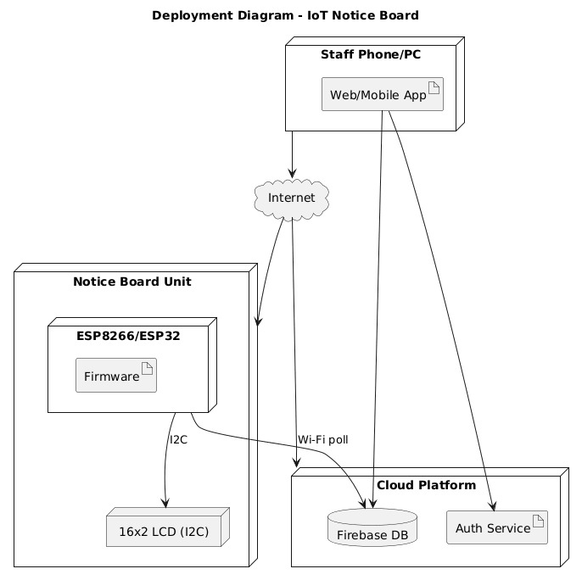
Deployment Diagram

Slide 20
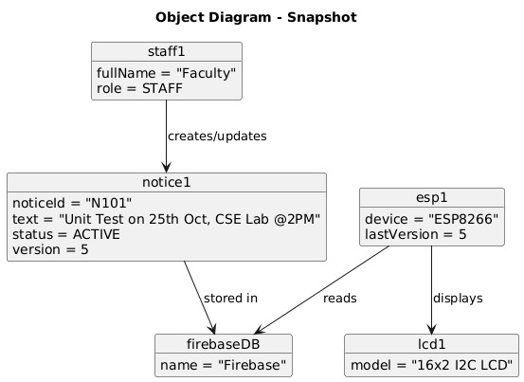
Object Diagram

Slide 21
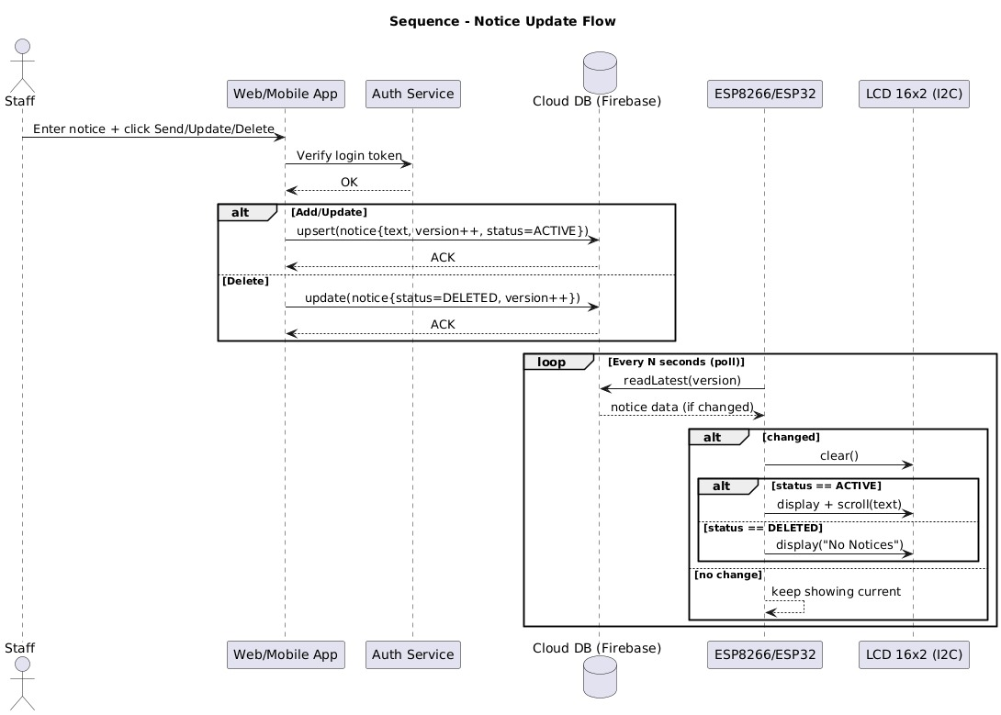
Sequence Notice Update Flow

Slide 22
Workflow
Start the system and load the home page.
The system initializes and opens the home page.
Faculty navigates to the login page.
Only faculty members are allowed to post or manage notices.
Faculty enters valid login credentials.
Authentication ensures that only authorized users access the dashboard.
Redirect faculty to the dashboard after successful.
The dashboard provides controls to manage notices.
Faculty creates, edits, or deletes a notice.
Faculty can add new notices, update existing ones, or remove outdated notices.

Slide 23
Save the notice data in the system storage. The notice content and details are stored for display and future reference.
Update the notice list on the home page. Any change made by the faculty is immediately reflected on the home page.
ESP8266 fetches the latest notice wirelessly. The IoT controller retrieves updated notices using a Wi-Fi connection.
Check the length of the notice message. The system verifies whether the message fits on the LCD screen.
Enable scrolling if the message is too long. Long messages are scrolled smoothly from right to left for readability.
Display the notice on the LCD screen. The notice is shown clearly on the 16×2 LCD module.
Continuously monitor for updates. The system keeps checking for changes so new notices appear instantly.

Slide 24
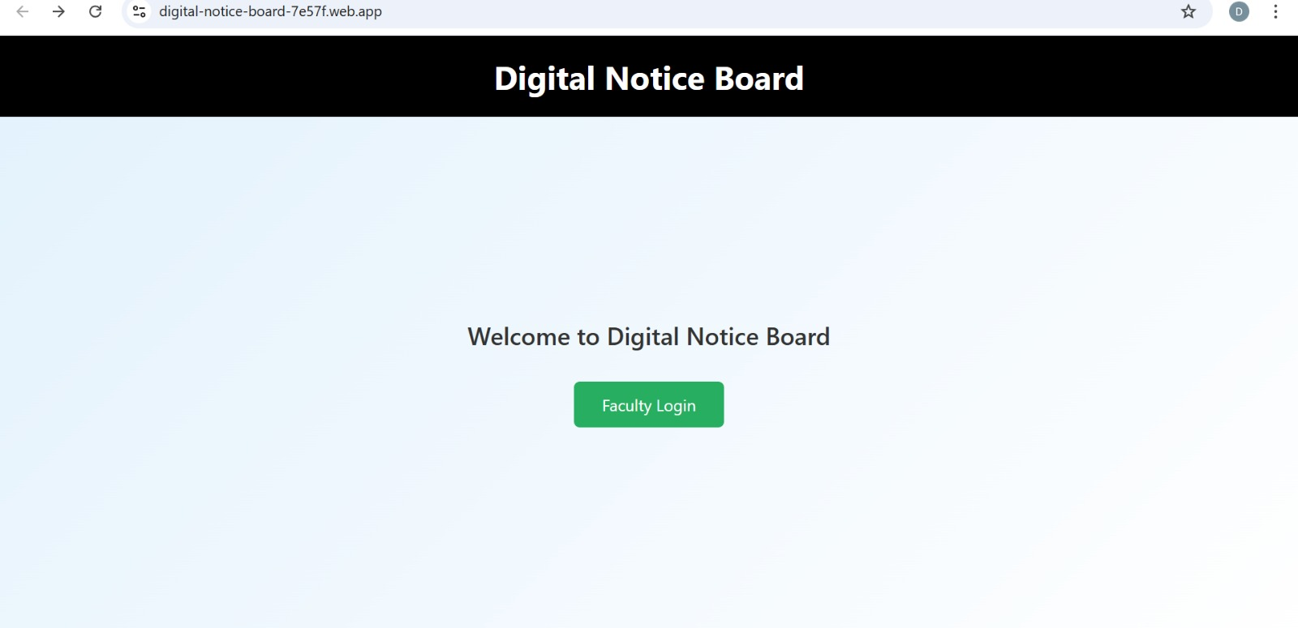
Results

Slide 25
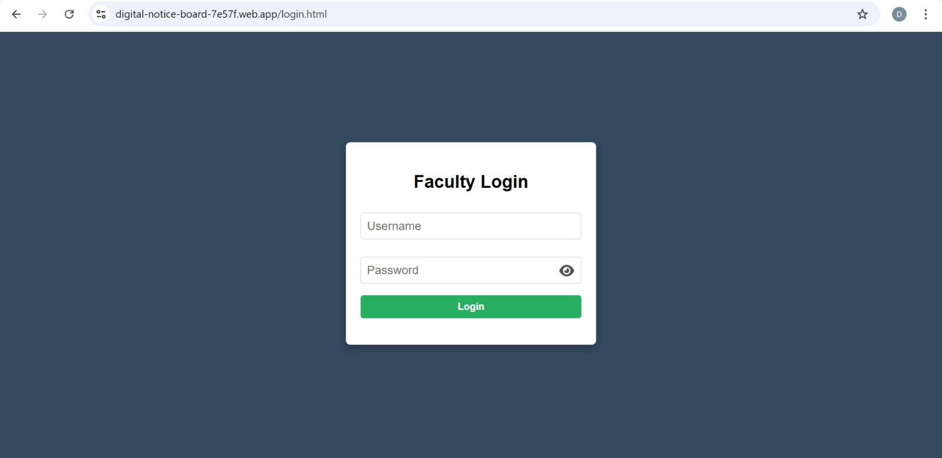
Login page

Slide 26
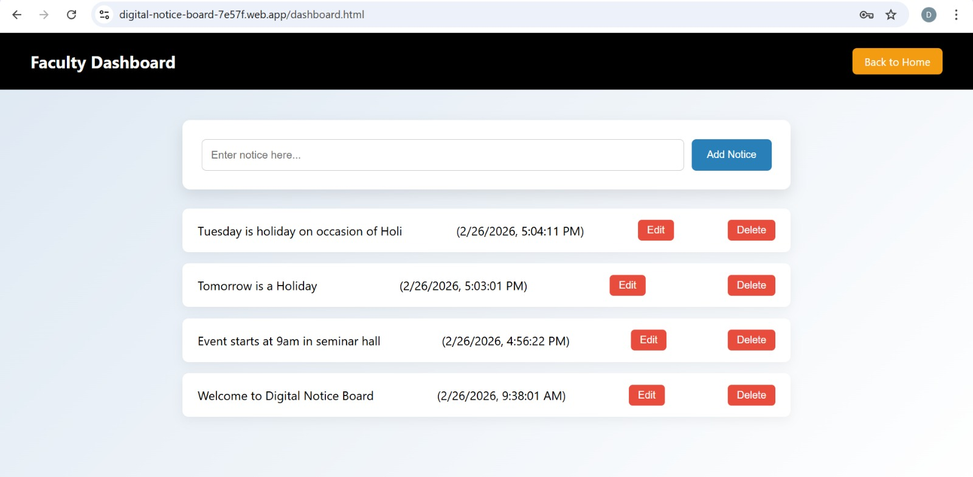
Faculty Dashboard

Slide 27
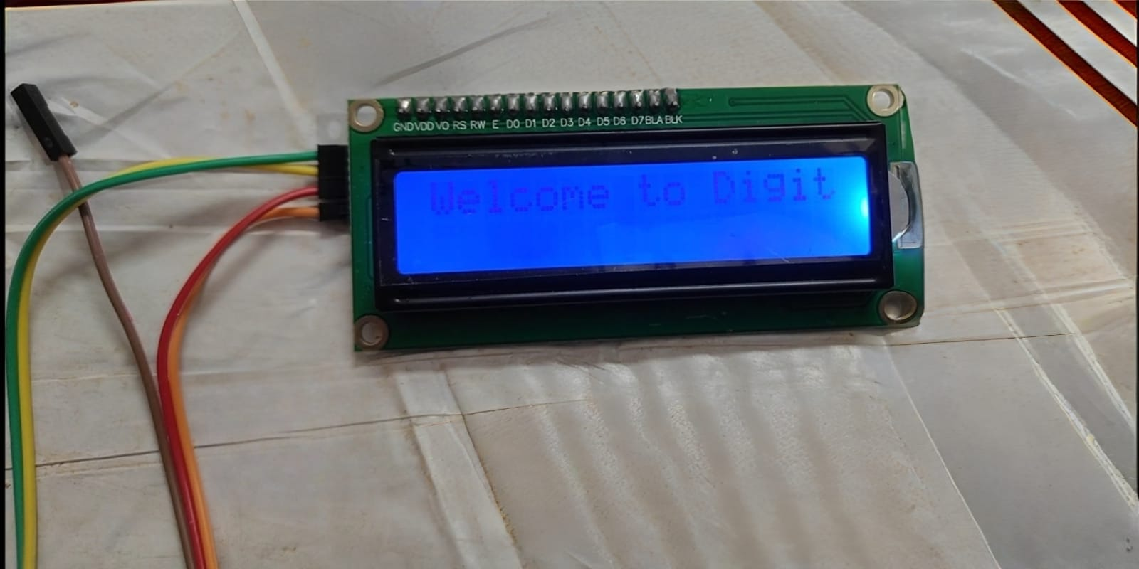
LCD Display

Slide 28
Conclusion
The proposed system replaces traditional paper-based notice boards with a smart digital solution that enables real-time, wireless updates. It significantly reduces manual effort and paper usage while improving communication speed and efficiency. By using IoT and cloud integration, the system ensures centralized control and easy accessibility. It can be further extended with mobile applications and advanced cloud features, making it highly suitable for colleges, offices, and other public institutions.

Slide 29
Future scope
Mobile App Integration
Develop Android/iOS apps for instant notice updates from anywhere.
Push notifications to users along with display updates.
AI-Based Smart Scheduling
Automatically prioritize and display important notices.
Use AI to analyze user engagement and optimize display timing.
Voice Control & Assistants
Integration with voice assistants like Google Assistant or Amazon Alexa.
Admins can update notices using voice commands. Security Enhancements
Implement authentication (OTP, biometric, login systems).
Prevent unauthorized access and hacking.

Slide 30
References
[1] IoT Based Smart Notice Board Research Inventy International Journal of Engineering and Science
[2] IoT Based Smart Notice Board, ResearchGate Publication
[3] IoT Web Controlled Smart Notice Board using ESP8266, How2Electronics
[4] Firebase Official Documentation – Realtime Database
[5] ESP8266 Official Datasheet – Espressif Systems
[6] Arduino IDE Official Documentation

Slide 31
THANK YOU

