Slide 1
STYLE TRANSFER USING CNN
Presented by…
P.Dharaneeswari,
Department of artificial intelligence and data science,
Sir Issac newton college of engineering and technology.

Slide 2
AGENDA
PROJECT STATEMENT
PROJECT OERVIEW
PROJECT MODELLING
RESULTS
SOLUTION AND ITS PROPOSITIONS
WOWS IN MY SOLUTION
APPLICATION AREAS

Slide 3
PROJECT OVERVIEW
Neural Style Transfer is a technique that allows us to generate an image with the same "content" as a base image, but with the "style" of our chosen picture.
Style transfer is based on the principle of fusion, which extracts the style of one picture and applies it to another in order to combine one image's content with another's aesthetic qualities and generate a brand-new image.
Data Collection
Data Preprocessing
Model Architecture Design
Compile a model
Model Training
Model evaluation
Fine-tuning and Optimization
Deployment
Monitoring and Maintenance

Slide 4
PROJECT MODELING
Style transfer is the process of finding outlier values in a series of data.
That process assumes you have data that falls within a certain understood range (based on historical data, for example), and that occasional values outside that range happen fairly infrequently.
Basic knowledge of deep learning with Keras library, the Tkinter library for GUI building, and Python programming are required to run this amazing project.
Commands to Install the necessary libraries for this project:
pip install numpy
pip install tensorflow
pip install keras
pip install pillow

Slide 5
The MNIST dataset
Among thousands of datasets available in the market, MNIST is the most popular dataset for enthusiasts of machine learning and deep learning.
Above 60,000 plus training images rom zero to nine and more than 10,000 images for testing are present in the MNIST dataset.
So, 10 different classes are in the MNIST dataset.
Import libraries and dataset
At the project beginning, we import all the needed modules for training our model.
We can easily import the dataset and start working on that because the Keras library already contains many datasets and MNIST is one of them.
We call mnist.load_data() function to get training data with its labels and also the testing data with its labels.

Slide 6
Its time for the creation of the CNN model for this Python-based data science project.
A convolutional layer and pooling layers are the two wheels of a CNN model.
The reason behind the success of CNN for image classification problems is its feasibility with grid structured data.
We will use the Adadelta optimizer for the model compilation.
To start the training of the model we can simply call the model.fit() function of Keras.
It takes the training data, validation data, epochs, and batch size as the parameter.
The training of model takes some time.
To evaluate how accurate our model works, we have around 10,000 images in our dataset.
In the training of the data model, we do not include the testing data that’s why it is new data for our model.
Around 99% accuracy is achieved with this well-balanced MNIST dataset.

Slide 7
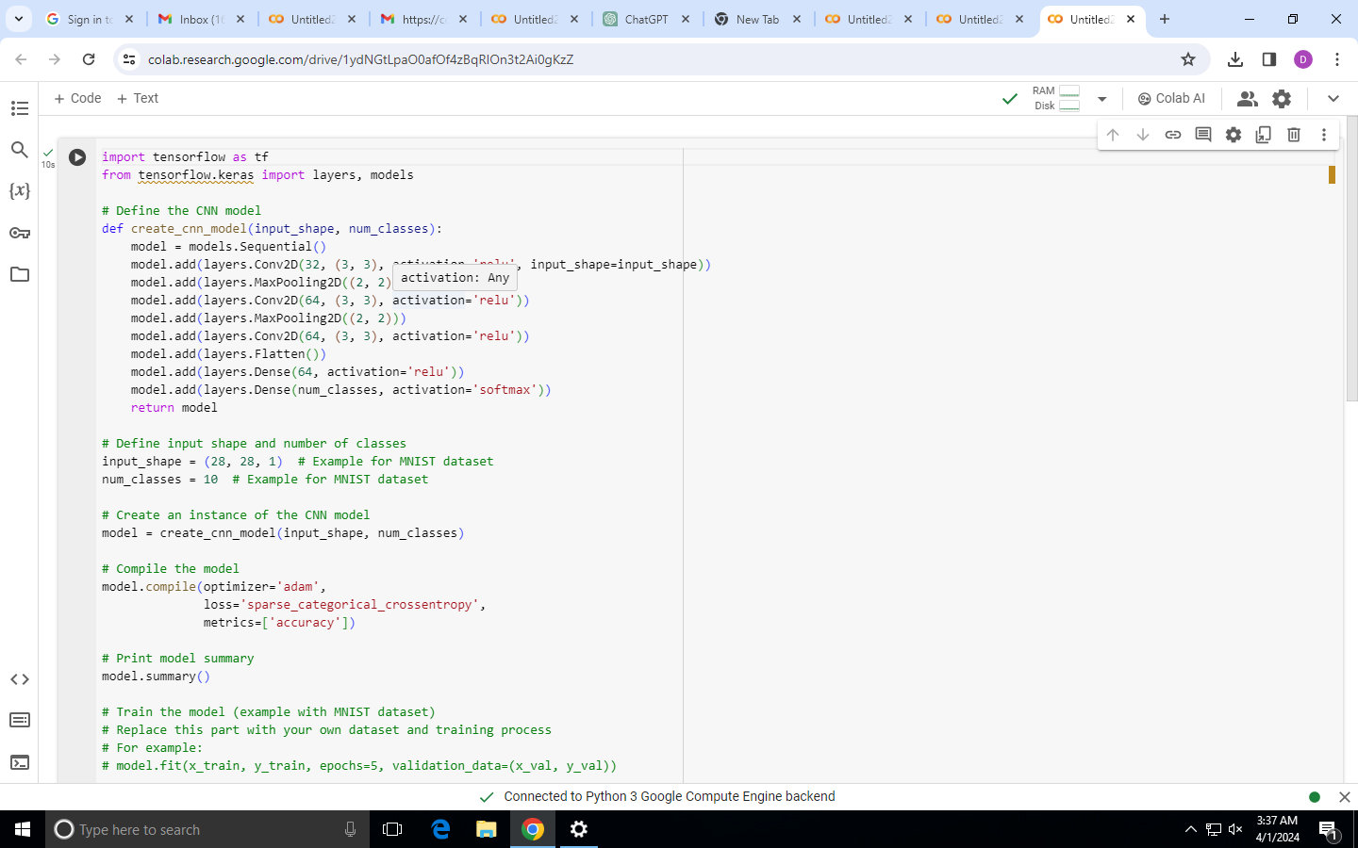
PROJECT MODELLING

Slide 8
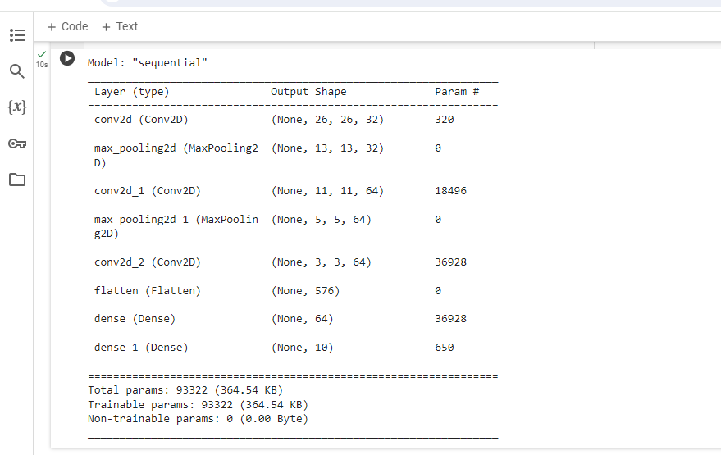
Result

Slide 9
Style Transfer is a technique in computer vision and graphics that involves generating a new image by combining the content of one image with the style of another image.
Approach:
We will approach this project by using a three-layered Neural Network.
The input layer: It distributes the features of our examples to the next layer for calculation of activations of the next layer.
The hidden layer: They are made of hidden units called activations providing nonlinear ties for the network.
A number of hidden layers can vary according to our requirements.
The output layer: The nodes here are called output units.
It provides us with the final prediction of the Neural Network on the basis of which final predictions can be made.

Slide 10
WOWS IN MY SOLUTION
Fashion
Arts
Gaming
Technology
Manufacturing
Retail and sales
Designing
modelling

Slide 11
APPLICATIONS
What is the practical application of style transfer?
The most common application of NST is in the field of art, where AI can generate unique and impressive artwork, opening up new possibilities in the field.
For example, the style of famous artists can be combined with any content you want to generate new works of art.
Style transfer is a computer vision technique that allows us to recompose the content of an image in the style of another.
If you've ever imagined what a photo might look like if it were painted by a famous artist, then style transfer is the computer vision technique that turns this into a reality.

Slide 12
THANK YOU!!

