Slide 1
Analysis of the Book Rating Dataset by Data Warehouse Implementation
Group 8
Dharani Aningi, Jiayi Liang, Rohini Sidharth Kulkarni, Sai Keerthana Kattige, Ying Liu

Slide 2
INTRODUCTION
We may observe how recommendation algorithms significantly influence the content users to interact with throughout their everyday lives.
The project is based on a book ratings dataset and we are implementing on a cloud data warehouse.
We will use a Cloud Data Warehouse to implement our data, because a cloud data warehouse provides more powerful computing capabilities and it is simple to scale as the data storage grows, and it does not require hardware and space that is traditional.

Slide 3
DATA DESCRIPTION & Cloud SQL
Books with Ratings and users information
278,858 users
1,149,780 ratings on about 271,379 books
Users
Books
Ratings
This dataset is important because it has a large amount of data that can be used to build a book recommendation system that can better target customers and increase business profit.
We decided to use Google Cloud SQL MySQL instance to be our source database.

Slide 4
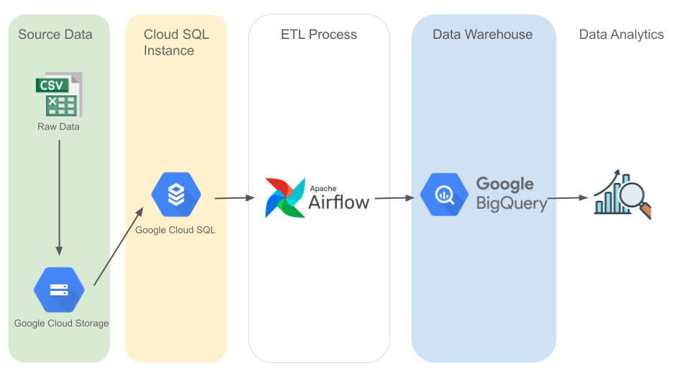
PROJECT ARCHITECTURE

Slide 5
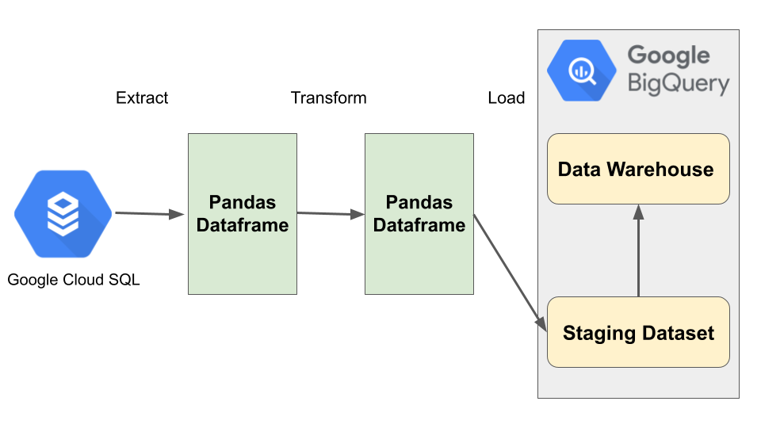
ETL PROCESS
EXTRACT: The source data is extracted from Google Cloud SQL instance MySQL database using pymysql connector.
TRANSFORM: Transform the extracted data into a single format. Handle with NULL values, add a new column.
LOAD: Load the transformed data into staging dataset in Google BigQuery using cloud client libraries. Then fetch data from staging tables to the tables in the Data Warehouse.

Slide 6
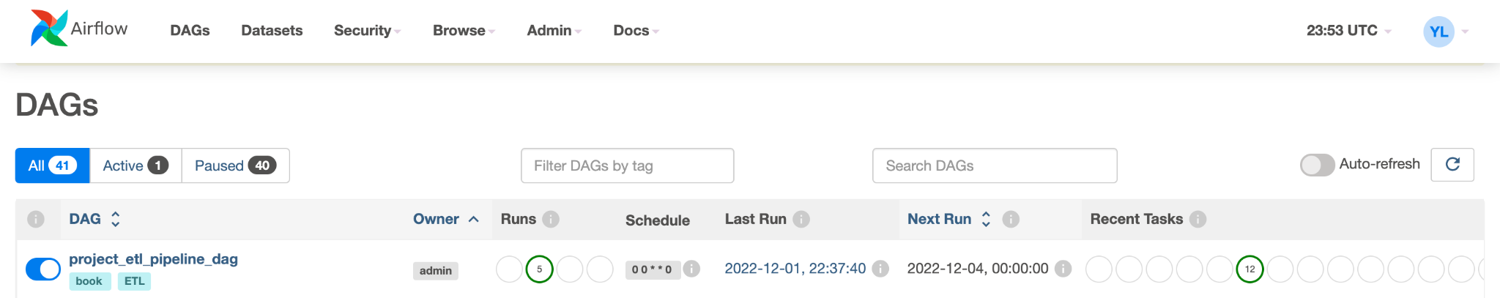
AIRFLOW PIPELINE
A DAG file: design our ETL process, schedule the workflow.
The ETL pipeline is scheduled to run once a week.

Slide 7
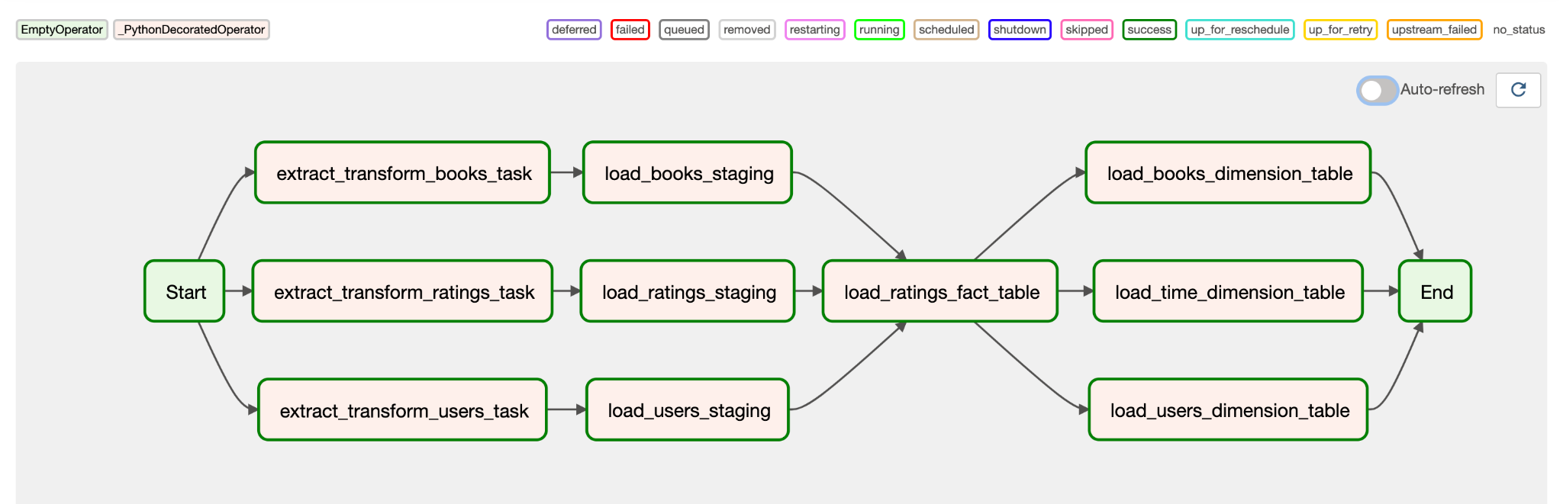
AIRFLOW PIPELINE
Direct Acyclic Graph script architecture
In our DAG file, there are 12 tasks for ETL pipeline.

Slide 8
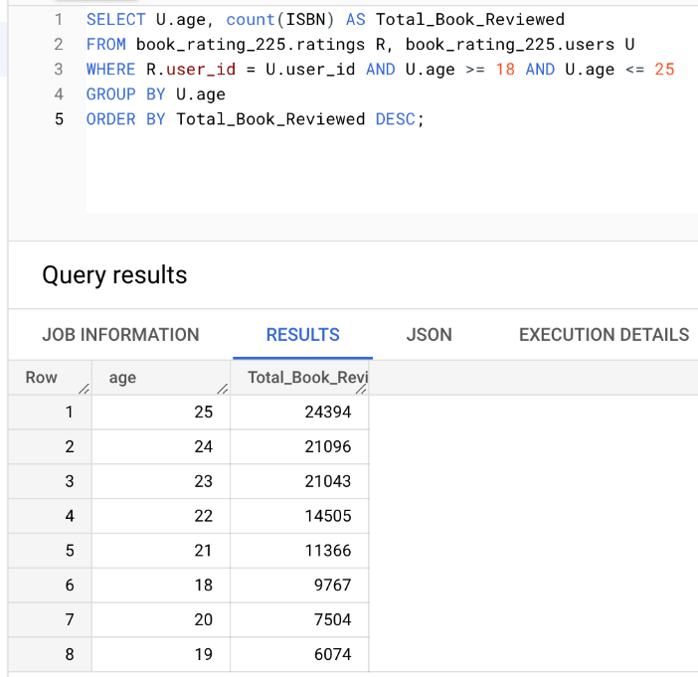
DATA ANALYTICS WITH QUERIES
Number of books that the users age from 18 - 25 reviewed

Slide 9
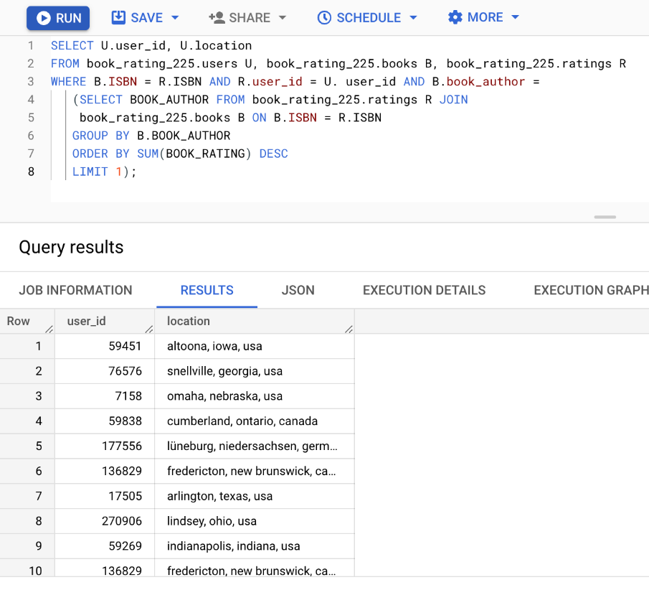
Users’ demographic who read the books of highest sum ratings author

Slide 10
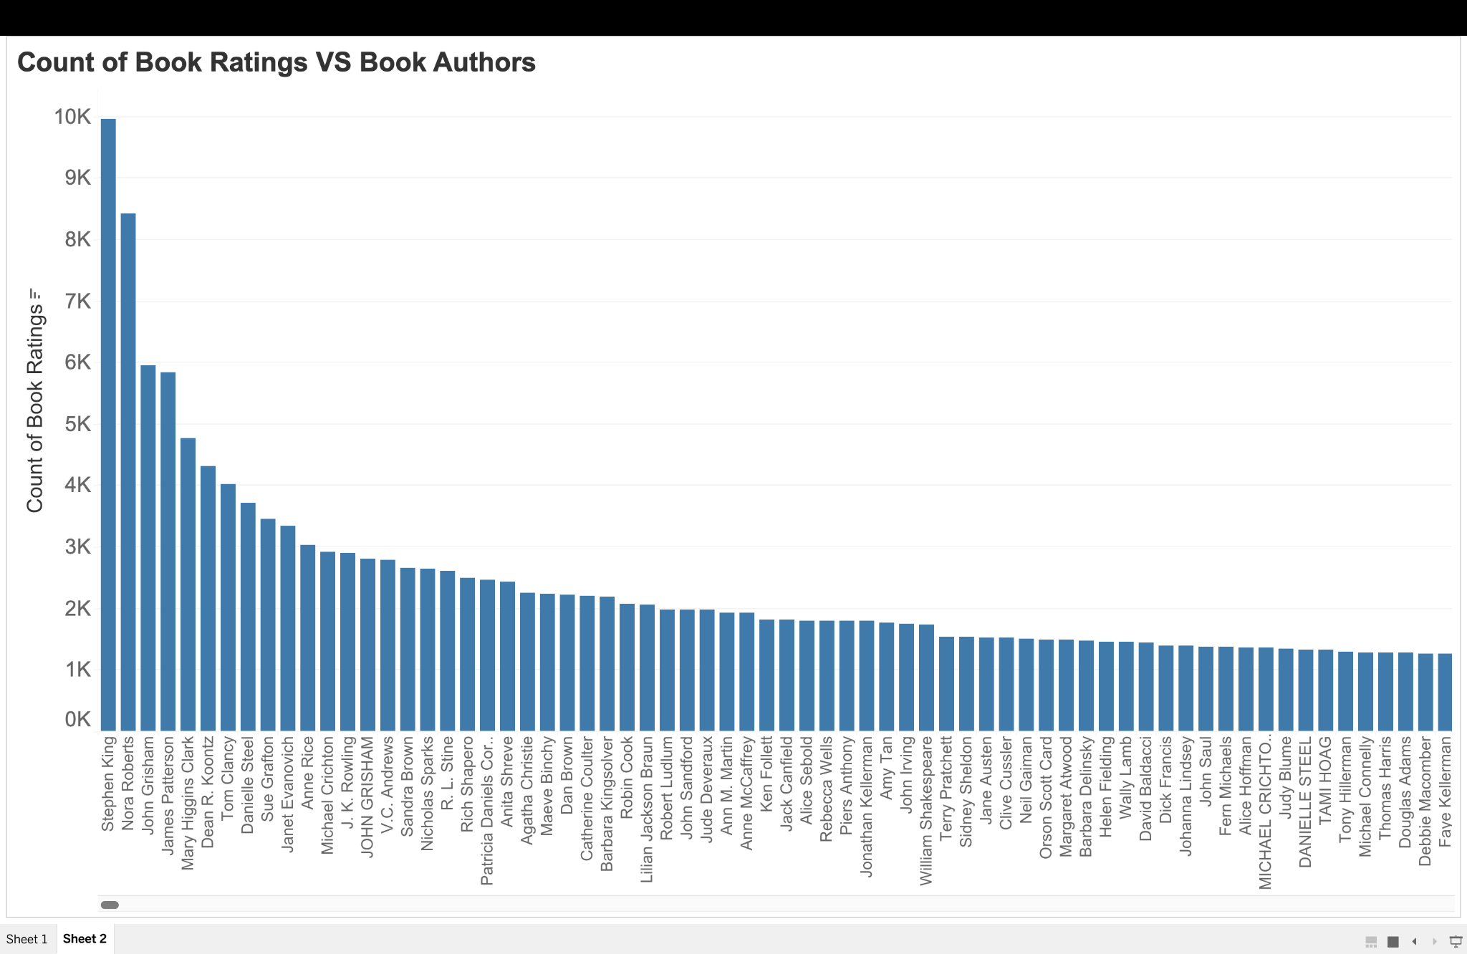
Visualization

Slide 11
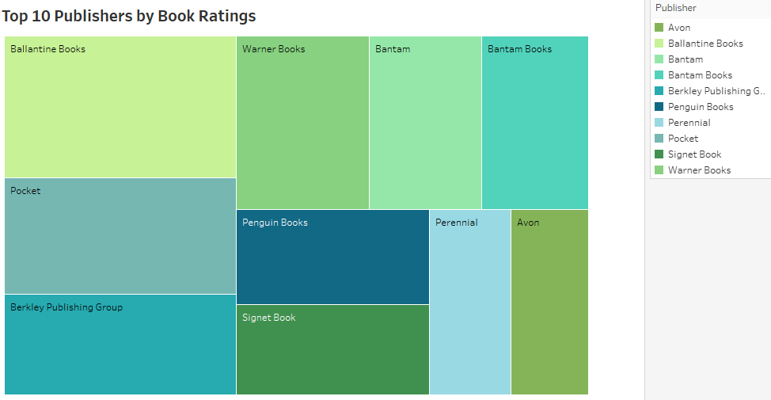

Slide 12
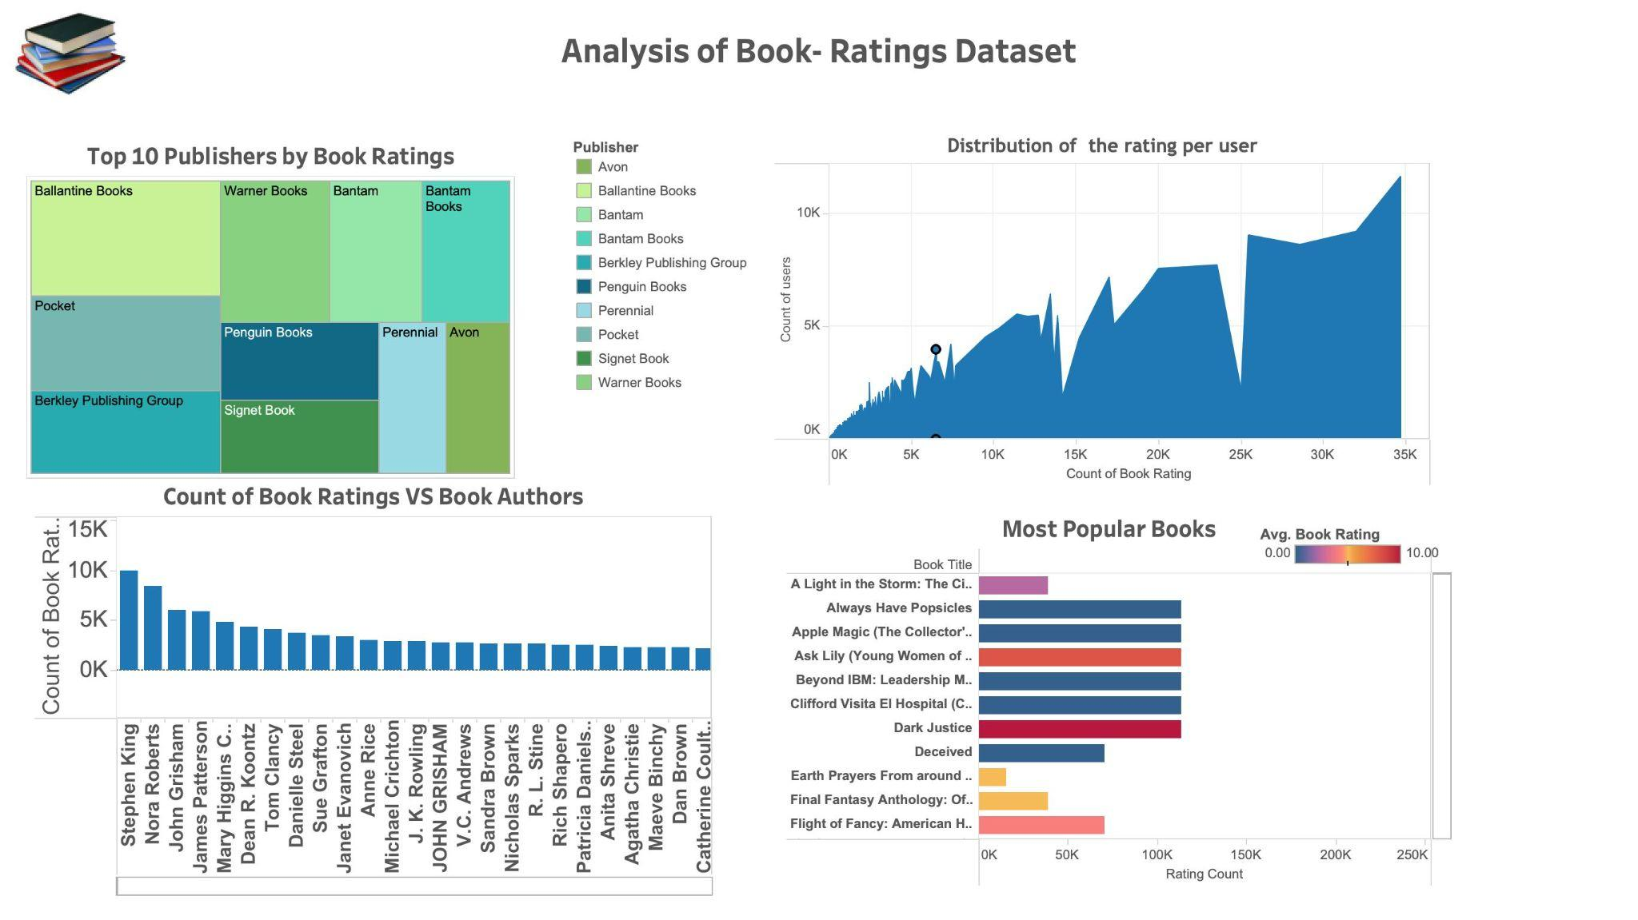

Slide 13
KEY TAKEAWAYS
Handling the ETL process for a large data set.
Implementing a Data warehouse using Google BigQuery.
Understanding the Apache Airflow workflow and designing a DAG File.
Connecting the Big Query to perform Queries on a large dataset.
Performing Visualization Insights by connecting BigQuery to Tableau.

Slide 14
Conclusion
Finally, our project successfully implemented a data warehouse on Google BigQuery and performed book recommendation analytics.
Real-time analytics is a crucial element of business intelligence since it consolidates both recent and historical data in one location and is made to provide a long-term perspective on data throughout time.
However, given the data that was available to us, as well as the results our various approaches produced, our systems were largely successful, providing insight into how the different systems we regularly use work and the varying with process that make that possible.

Slide 15


