Slide 1
CS5551 Advanced Software Engineering
Tutorial (Add number)
Express Js – Routing, Middleware

Slide 2
What is Express?
Express is a minimal and flexible Node.js web application framework that provides a robust set of features for web and mobile applications (Lets make it simple!)
Features – Why it is robust..
Provides a minimal interface to build applications
Supports HTTP methods – GET/POST/PUT/DELETE
Supports dynamic routing
Used for session handling & Authentication
MongoDB integration, acts as a Middleware
Error Handling etc.,

Slide 3


Installing Express
Make sure you have installed Node JS (verify you Node js installation before you proceed)
Open terminal/command prompt and type “npm” or “npm -v” to check the installation
Create a new directory -> npm init
or
use an existing node directory
To install Express
To temporarily installing Express
https://expressjs.com/en/starter/installing.html

Slide 4
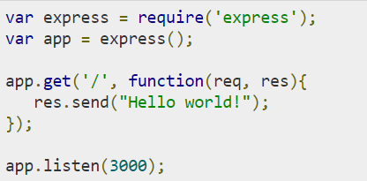
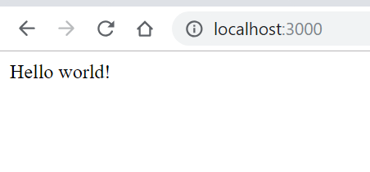
“Hello World” in Express
Create a file index.js as shown below
From the terminal, run “node index.js”
App responds with “Hello World!” for requests to the root URL (/)
For every other path, it will respond with a 404 Not Found
https://expressjs.com/en/starter/hello-world.html

Slide 5
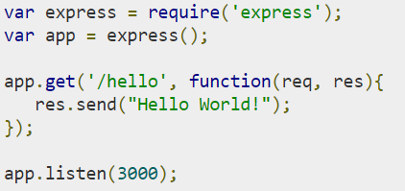
Express – Routing
Routing is used to access resources such as HTML pages, scripts, images etc.,
Syntax : app.method(Path, Handler)
This METHOD can be applied to any one of the HTTP methods – get, post, put, delete.
Path is the route at which the request will run
Handler is a callback function that executes
when a matching request type is found on
the relevant route
https://expressjs.com/en/starter/basic-routing.html

Slide 6
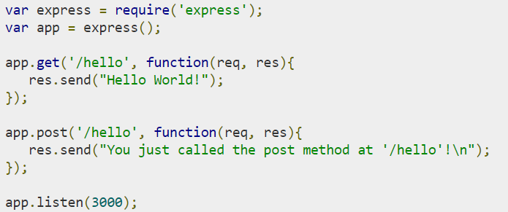
Express – Routing (..ctd2)
We can have multiple methods at the same route.
For example – index.js
To test it, from terminal run : curl –X POST “http://localhost:3000/hello”
Result

Slide 7
Express – Routing (..ctd3)
A special method, all, is provided by Express to handle all types of http methods at a particular route using the same function
* Some useful routing guidelines at - https://expressjs.com/en/guide/routing.html
How to Use routes other JS files ? – Express.Router
Use the express.router class to create modular, mountable route handlers
Router instance is a middleware & routing system
Also called mini-app
Create 2 JS files in the same directory
1. ase.js
2. cs.js as shown in the next slide

Slide 8
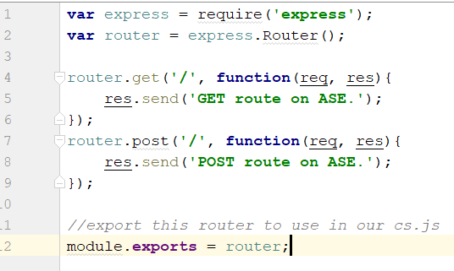
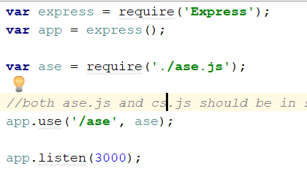
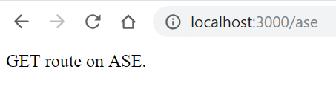
Express – Routing (..ctd4)
1. ase.js 2. cs.js
The app.use function call on route ’/ase' attaches the ase router with this route. Any requests our app gets at ‘/ase', will be handled by our ase.js router. The '/' route in ase.js is actually a subroute of ‘/ase’
Test : run cs.js and open localhost:3000/ase in the browser

Slide 9
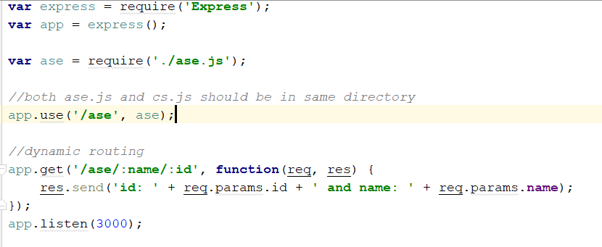
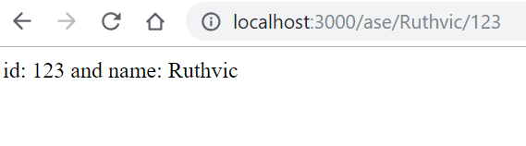
Express – Dynamic Routing
Dynamic routing is possible in Express using URL Binding
The previous routes used are static/fixed
Using dynamic routes allows user to pass parameters and bind them to the URL.
Ex : a user specific webpage/ web content can be retrieved after successful login
To the previous cs.js add the highlighted block of code
https://www.tutorialspoint.com/expressjs/expressjs_routing.htm

Slide 10
Express – Middleware
Definition : Middleware functions are functions that have access to the request object (req), the response object (res) , and the next function in the application’s request-response cycle.
The next function is a function in the Express router which, when invoked, executes the middleware succeeding the current middleware
Middleware functions can perform the following tasks:
Execute any code.
Make changes to the request and the response objects.
End the request-response cycle.
Call the next middleware in the stack.

Slide 11
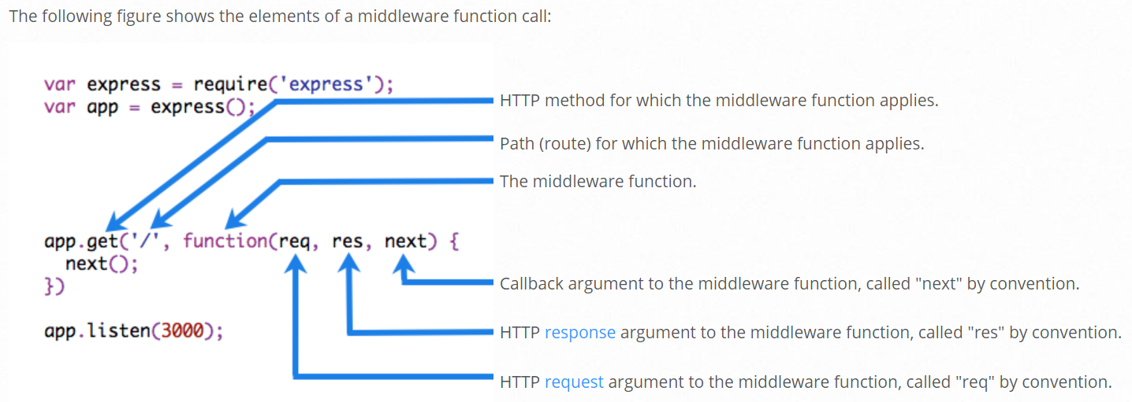
Express – Middleware(..Ctd2)
Fig taken from - https://expressjs.com/en/guide/writing-middleware.html

Slide 12
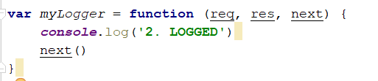
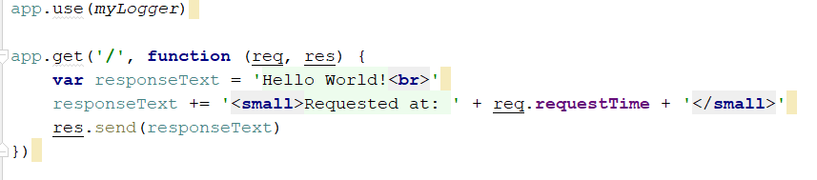
Express – Middleware(..Ctd3)
A simple middleware function
Notice the call above to next(), calling this function invokes next middleware function in the app
To load this middle ware function, call app.use() before any route is processed

Slide 13
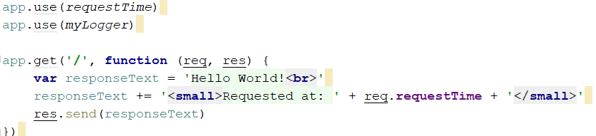
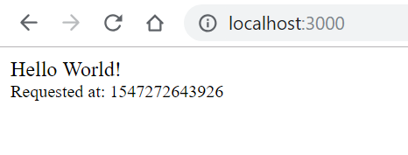

Express – Middleware Ordering
The order of middleware loading is important: middleware functions that are loaded first are also executed first.
Example : we have 2 middleware functions – mylogger,requestTime.
If myLogger is loaded after the route to the root path, the request never reaches it and the app doesn’t print “LOGGED”, because the route handler of the root path terminates the request-response cycle.

Slide 14
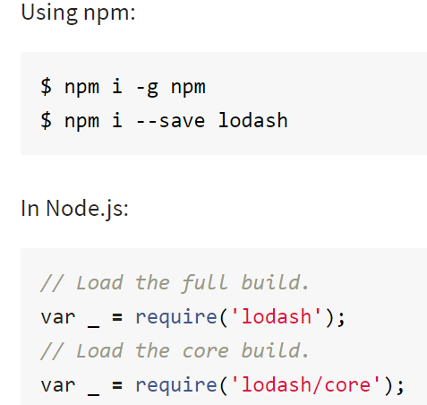
Express – CRUD Application(Note_App)
Install npm package ‘lodash’
What is lodash ? Why lodash ?
Definition: Lodash makes JavaScript easier by taking the hassle out of working with arrays, numbers, objects, strings, etc.Lodash’s modular methods are great for:
Iterating arrays, objects, & strings
Manipulating & testing values
Creating composite functions
For more information - https://lodash.com/, https://www.npmjs.com/package/lodash

Slide 15

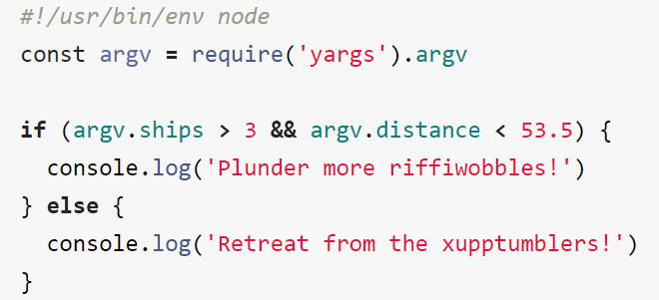
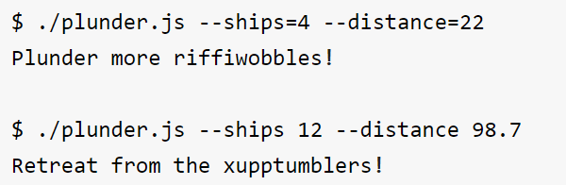
YARGS – NPM package
Yargs
Yargs helps you build interactive command line tools, by parsing arguments
Installing yargs
A simple example from https://www.npmjs.com/package/yargs

Slide 16

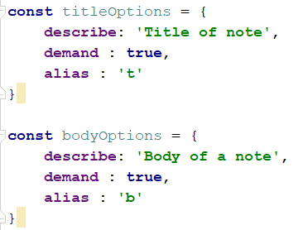
Note_App
We use fs, yargs & lodash npm packages for creating a note app to perform CRUD
Create app.js as explained here
Note consists of a title & its body. So create those as shown here

Slide 17
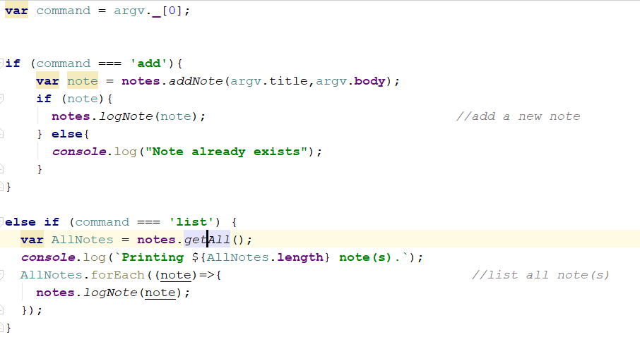
Note_App (..ctd2)
Reading from command line

Slide 18
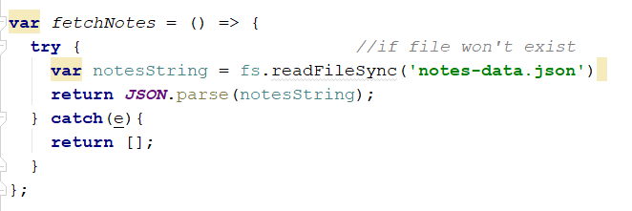

Note_App (..ctd3)
note.js
Create a json file to store title & body for the notes to be added. Fetch notes is a utility function for this purpose
Writing the data to json file

Slide 19
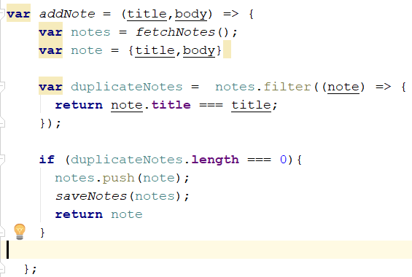

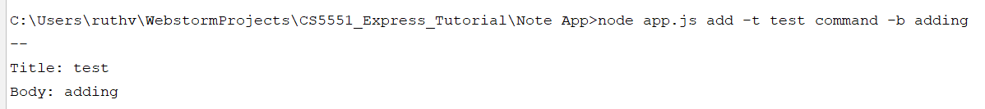
Note_App (..ctd4)
Adding a new note Output
These are utility functions to be created in note.js to add/remove a note.

Slide 20
In Class Exercise
Understand the source code – app.js, note.js
Create a method (in app.js) to delete an existing note, if the note is not present throw a corresponding not found error to the user
No UI is needed, create functions using the given source code & express framework

Slide 21
THANK YOU

