Slide 1
Web Component

Slide 2
Vipra Shuttle Service
Register your Organization
Organization Name
Organization Type
Full Name
Password
Confirm Password
Sign Up

Slide 3
Vipra Shuttle Service
Login your Organization
Organization Name
Password
Login

Slide 4
Vipra Shuttle Service
Shuttle List
Vehicle Model | License Plate Number | Driver Name | Driver Contact Number
Customer List
Email Address | Full Name | Customer Contact Number
Rides
Pick Up Location | Drop Location | Customer E Address | Customer Number | Vehicle License Number | Driver contact Number

Slide 5
Mobile Component for Customer

Slide 6
Vipra Shuttle Service
Sign Up
Full Name
Email Address
Contact Number
Organization
Password
Confirm Password
Sign Up

Slide 7
Vipra Shuttle Service
Login
Email Address
Password
Login

Slide 8
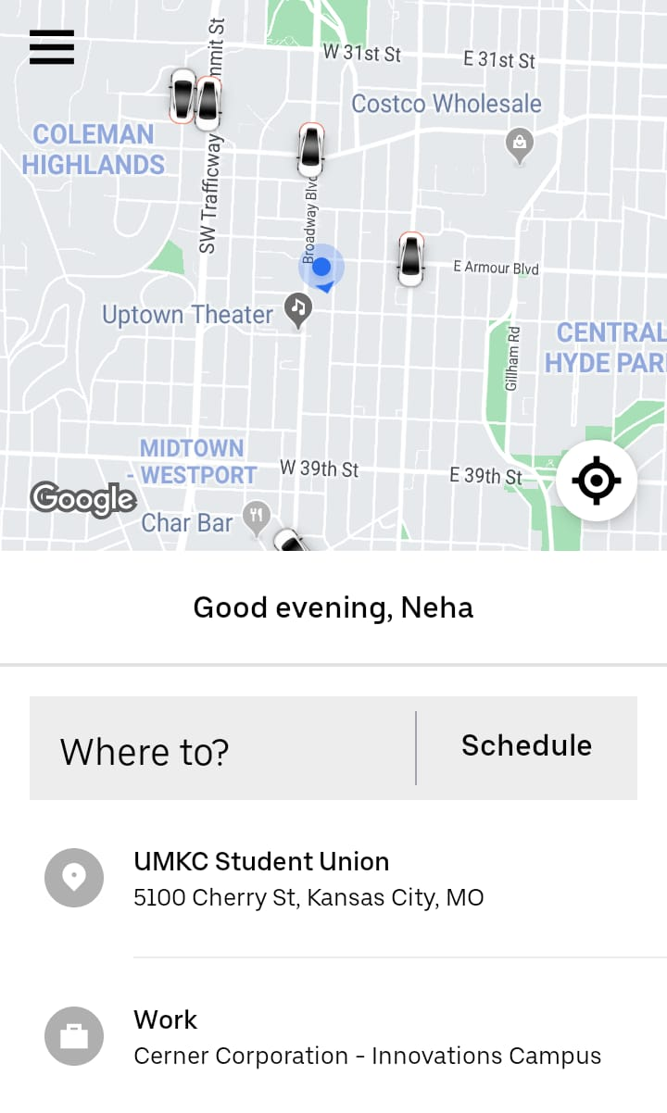
Login

Slide 9
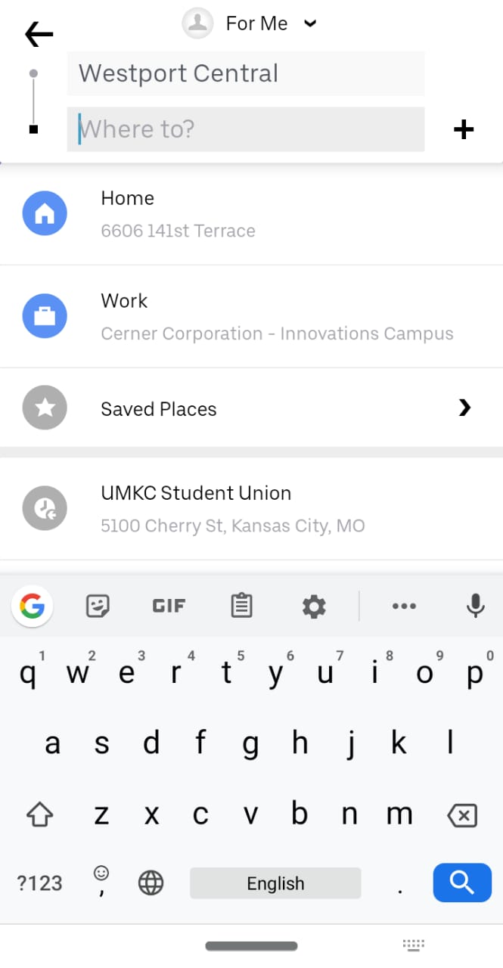
Login

Slide 10
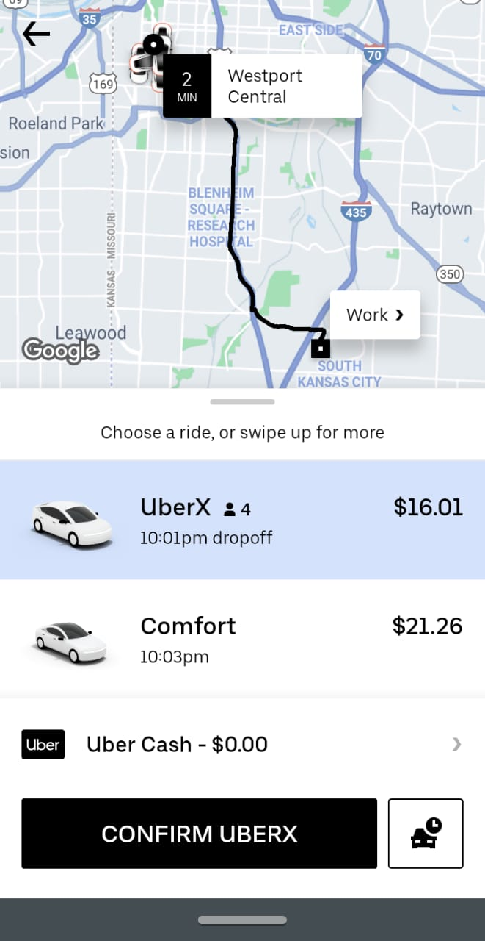
Once click on ‘Request a ride’, request will go to nearest driver and once he approves the screen will show his current location in map along with estimated time of arriaval
Login
Request a Ride

Slide 11
Mobile Component for Driver

Slide 12
Vipra Shuttle Service
Register Shuttle
Full Name
Vehicle Model
Vehicle License Number
Contact Number
Organization
Password
Confirm Password
Sign Up

Slide 13
Vipra Shuttle Service
Login
License Number
Password
Login

Slide 14
Login
Neha has requested for a Ride to UMKC Student Union
Approve
Reject

Slide 15
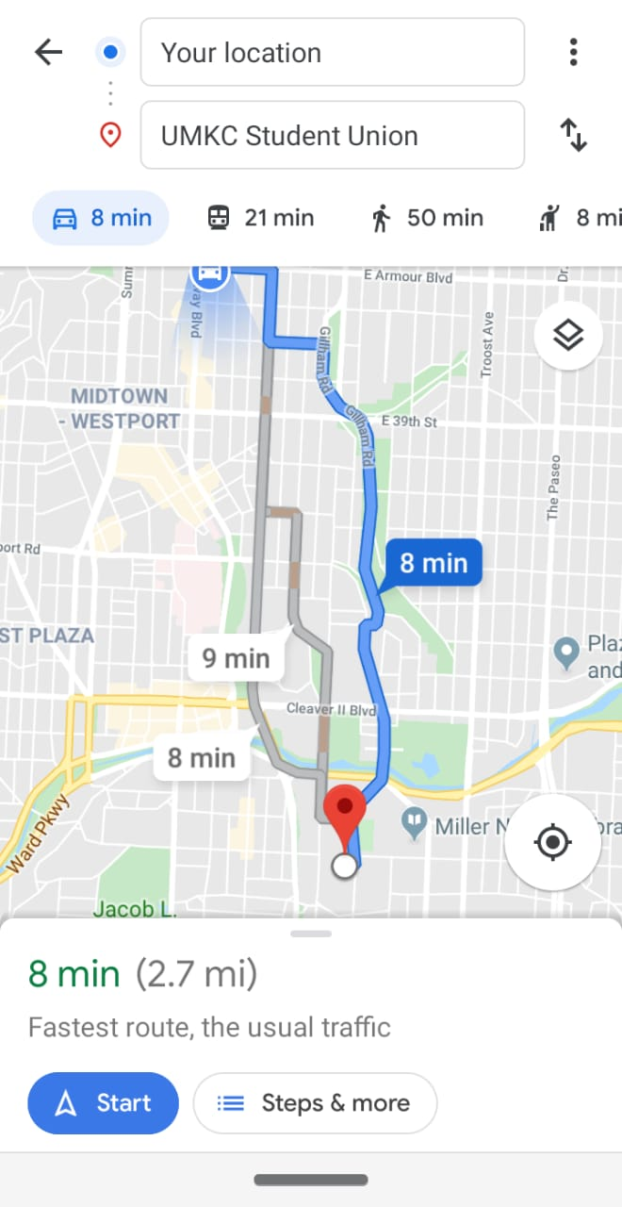
Login

Slide 16
Database Design

Slide 17
Organization Table
Column Name | Type
Organization Name | String
Organization Type | String
Full Name | String
Password | String
Confirm Password | String

Slide 18
Customer Table
Column Name | Type
Full Name | String
Organization | String
Contact Number | number
Email Address | String
Password | String
Confirm Password | String

Slide 19
Driver Table
Column Name | Type
Full Name | String
Vehicle Model | String
License plate number | String
Contact Number | Number
Organization | String
Password | String
Confirm Password | String

Slide 20
Rides
Column Name | Type
Pick Up location | String
Drop location | String
Customer email address | String
Contact Number | number
Vehicle license number | string
Driver contact number | number
Ride status | String (queue, ongoing, completed)

