Slide 1


Word Embedding
Keras for Deep Learning Research

Slide 2
Feedback is greatly appreciated!

Slide 3
Let's quickly review what we've covered so far!

Slide 4
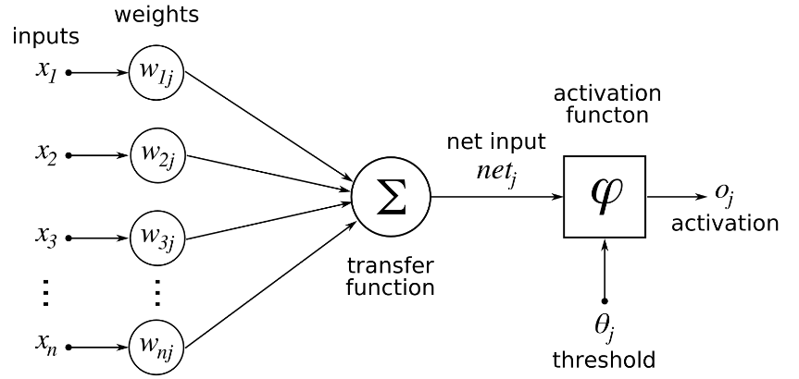
Deep Learning
Single Neuron
We now understand how to perform a calculation in a neuron
w · x + b = z
a = σ(z)
Source: https://www.udemy.com/complete-guide-to-tensorflow-for-deep-learning-with-python/learn/v4/overview

Slide 5
Deep Learning
Activation Functions
Threshold Function/Step Function
Sigmoid
Rectifier
Hyperbolic Tangent(tanh)
Source: https://www.udemy.com/complete-guide-to-tensorflow-for-deep-learning-with-python/learn/v4/overview

Slide 6
Deep Learning
Connecting Neurons to create a network
Source: https://www.udemy.com/complete-guide-to-tensorflow-for-deep-learning-with-python/learn/v4/overview

Slide 7
Deep Learning
Neural Network
Input Layer
Hidden Layers
Output Layer
More layers → More Abstraction
Source: https://www.udemy.com/complete-guide-to-tensorflow-for-deep-learning-with-python/learn/v4/overview

Slide 8
Deep Learning
To "learn" we need some measurement of error.
We use a Cost/Loss Function
Quadratic
Cross-Entropy
Source: https://www.udemy.com/complete-guide-to-tensorflow-for-deep-learning-with-python/learn/v4/overview

Slide 9
Deep Learning
Once we have the measurement of error, we need to minimize it by choosing the correct weight and bias values.
We use gradient descent to find the optimal values.
Source: https://www.udemy.com/complete-guide-to-tensorflow-for-deep-learning-with-python/learn/v4/overview

Slide 10
Deep Learning
We can then backpropagate the gradient descent through multiple layers, from the output layer back to the input layer.
Source: https://www.udemy.com/complete-guide-to-tensorflow-for-deep-learning-with-python/learn/v4/overview

Slide 11
Why do we use word embeddings in NLP?
Natural language processing (NLP) is a sub-field of machine learning (ML) that deals with natural language, often in the form of text, which is itself composed of smaller units like words and characters
Dealing with text data is problematic, since our computers, scripts and machine learning models can’t read and understand text in any human sense

Slide 12
So, how should textual input be sent to our models? Computers can handle numerical input well, so let’s rephrase the question to:
How can we best numerically represent textual input?

Slide 13
Word Embedding
Why do we need any complex methods to represent words at all?
What is the simplest way to represent words numerically, and why isn’t this sufficient?
What exactly do we mean by embeddings “mapping words to a high-dimensional semantic space”?
How can word embeddings be visualised and intuitively understood?

Slide 14

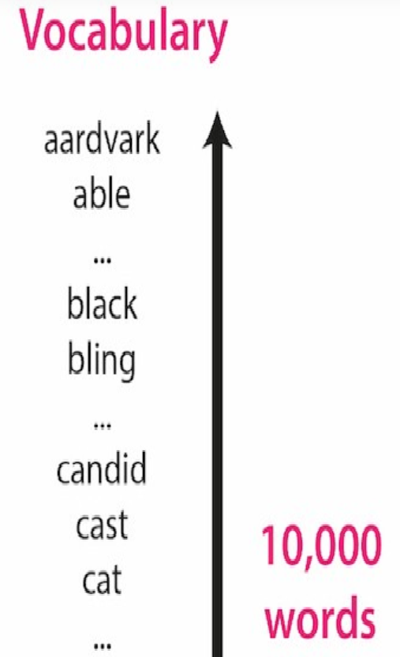
A world without word embeddings
Given this vocabulary of 10,000 words, what’s the simplest way to represent each word numerically?

Slide 15
Well, you could simply assign an integer index to each word:
Given this word-to-integer mapping, we could then represent a word as a vector of numbers as follows:
Each word will be represented as an n-dimensional vector, where n is the vocabulary size
Each word’s vector representation will be mostly “0”, except there will be a single “1” entry in the position corresponding to the word’s index in the vocabulary.

Slide 16
The vector representation for our first vocabulary word “aardvark” will be [1, 0, 0, 0, …, 0], which is a “1” in the first position followed by 9,999 zeroes.
This process is called one-hot vector encoding.

Slide 17
Now, say our NLP project is building a translation model and we want to translate the English input sentence “the cat is black” into another language.
We first need to represent each word with a one-hot encoding
We would first look up the index of the first word, “the”, and find that its index in our 10,000-long vocabulary list is 8676.

Slide 18
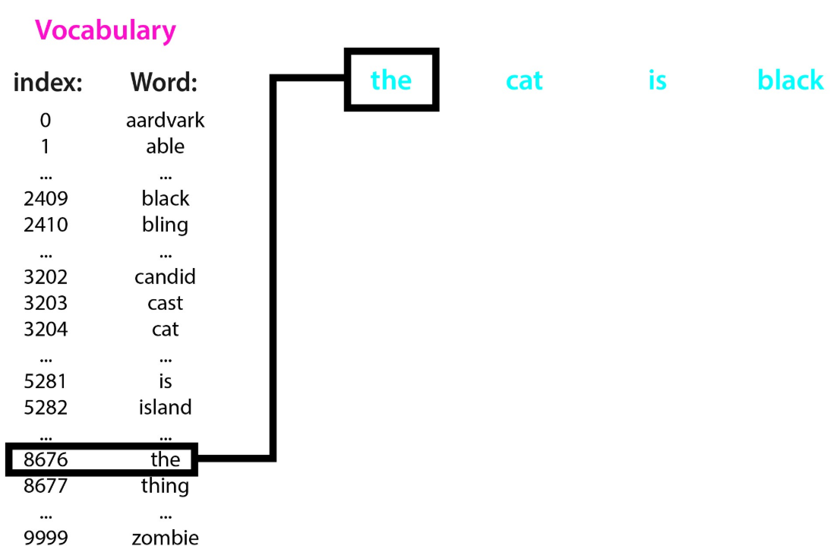
We could then represent the word “the” using a length 10,000 vector, where every entry is a 0 aside from the entry at position 8676, which is a 1.
We do this index look-up for every word in the input sentence, and create a vector to represent each input word.
These one-hot vectors are a quick and easy way to represent words as vectors of real-valued numbers.

Slide 19
The problems with sparse one-hot encodings
The similarity issue.
The vocabulary size issue.
The computational issue.

Slide 20
1.One-hot vectors are high-dimensional and sparse
2.Feature vector grows with the vocabulary size
3.Semantic and syntactic information are lost

Slide 21
the core idea is that words that are used in similar contexts will be given similar representations. That is, words that are used in similar ways will be placed close together within the high-dimensional semantic space–these points will cluster together, and their distance to each other will be low.

Slide 22
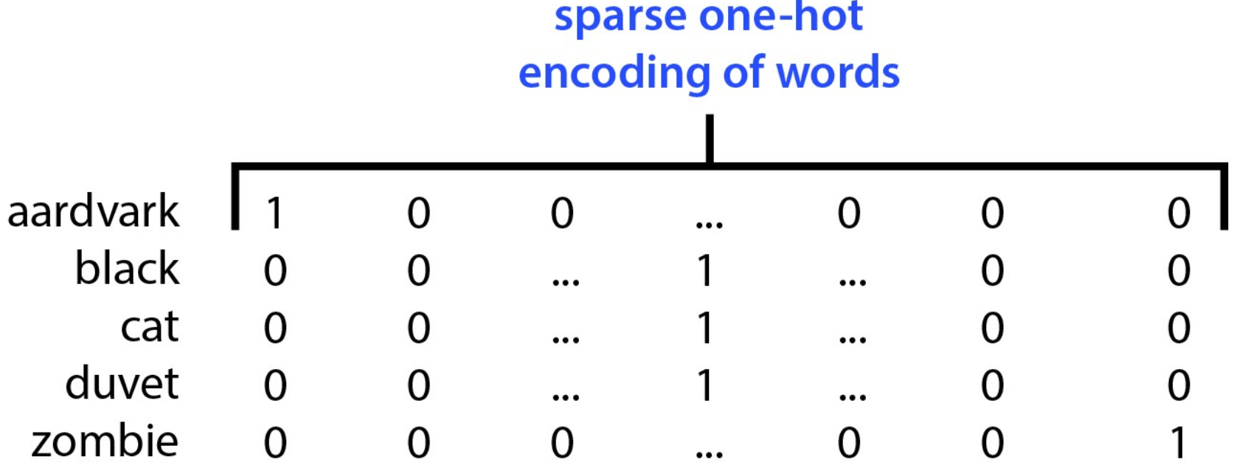
Example on one hot encoding

Slide 23
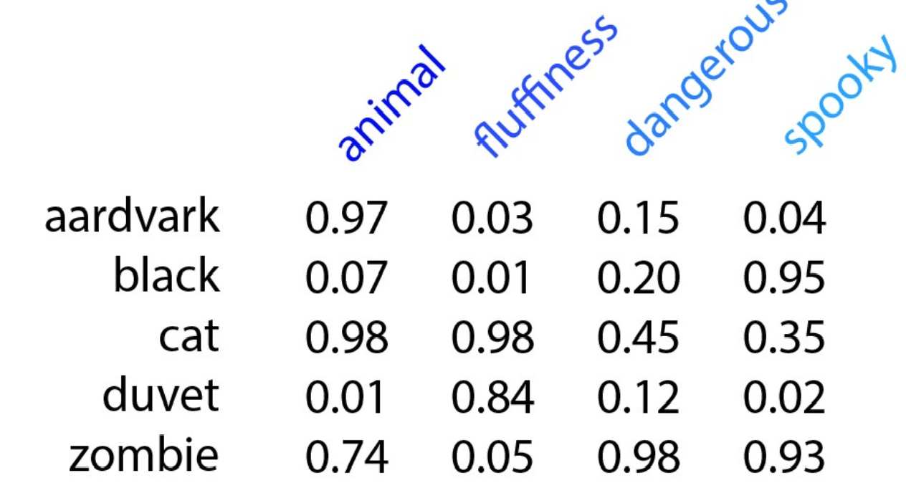
Equivalent Word embedding

Slide 24
Types of Word Embeddings
Word embeddings can be broadly classified into two categories
Frequency based Embedding
Count Vector
TF-IDF Vector
Co-Occurrence Vector
Prediction based Embedding
word2vec
CBOW (Continuous Bag of words)
Skip-Gram Model
GloVe: Global Vectors for Word Representation
Source: https://www.analyticsvidhya.com/blog/2017/06/word-embeddings-count-word2veec/

Slide 25
Two different architecture for word2vec
CBOW:
The input to the model is the preceding and following words of the current word
The output of the neural network will be Wi
Skip-gram:
The input to the model is wi and
The output is the words around it

Slide 26
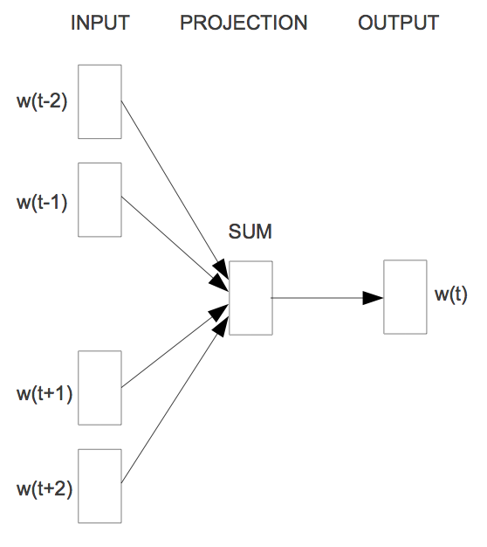
Word2vec - CBOW (Continuous Bag of words)
The way CBOW work is that it tends to predict the probability of a word given a context.
Let us start with an example (Tweet):
"When your dream becomes reality"
One approach is to treat ("When", "your", "becomes", "reality“) as a context and from these words, be able to predict or generate the center word "dream".
When
your
dream
becomes
reality
window size: 5
Source: https://www.analyticsvidhya.com/blog/2017/06/word-embeddings-count-word2veec/

Slide 27
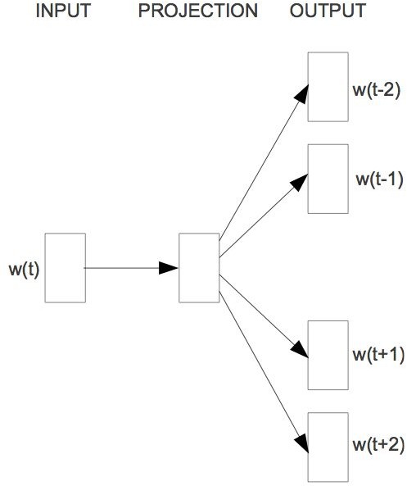
Word2vec - Skip-Gram Model
The aim of skip-gram is to predict the context given a word.
Let us check with same example (Tweet):
"When your dream becomes reality"
The approach is to create a model such that given the center word "dream", the model will be able to predict or generate the surrounding words ("When", "your", "becomes", "reality"). Here we call the word "dream" the context.
When
your
dream
becomes
reality
window size: 5
Source: https://www.analyticsvidhya.com/blog/2017/06/word-embeddings-count-word2veec/

Slide 28
Word2Vec Skip-gram model

Slide 29
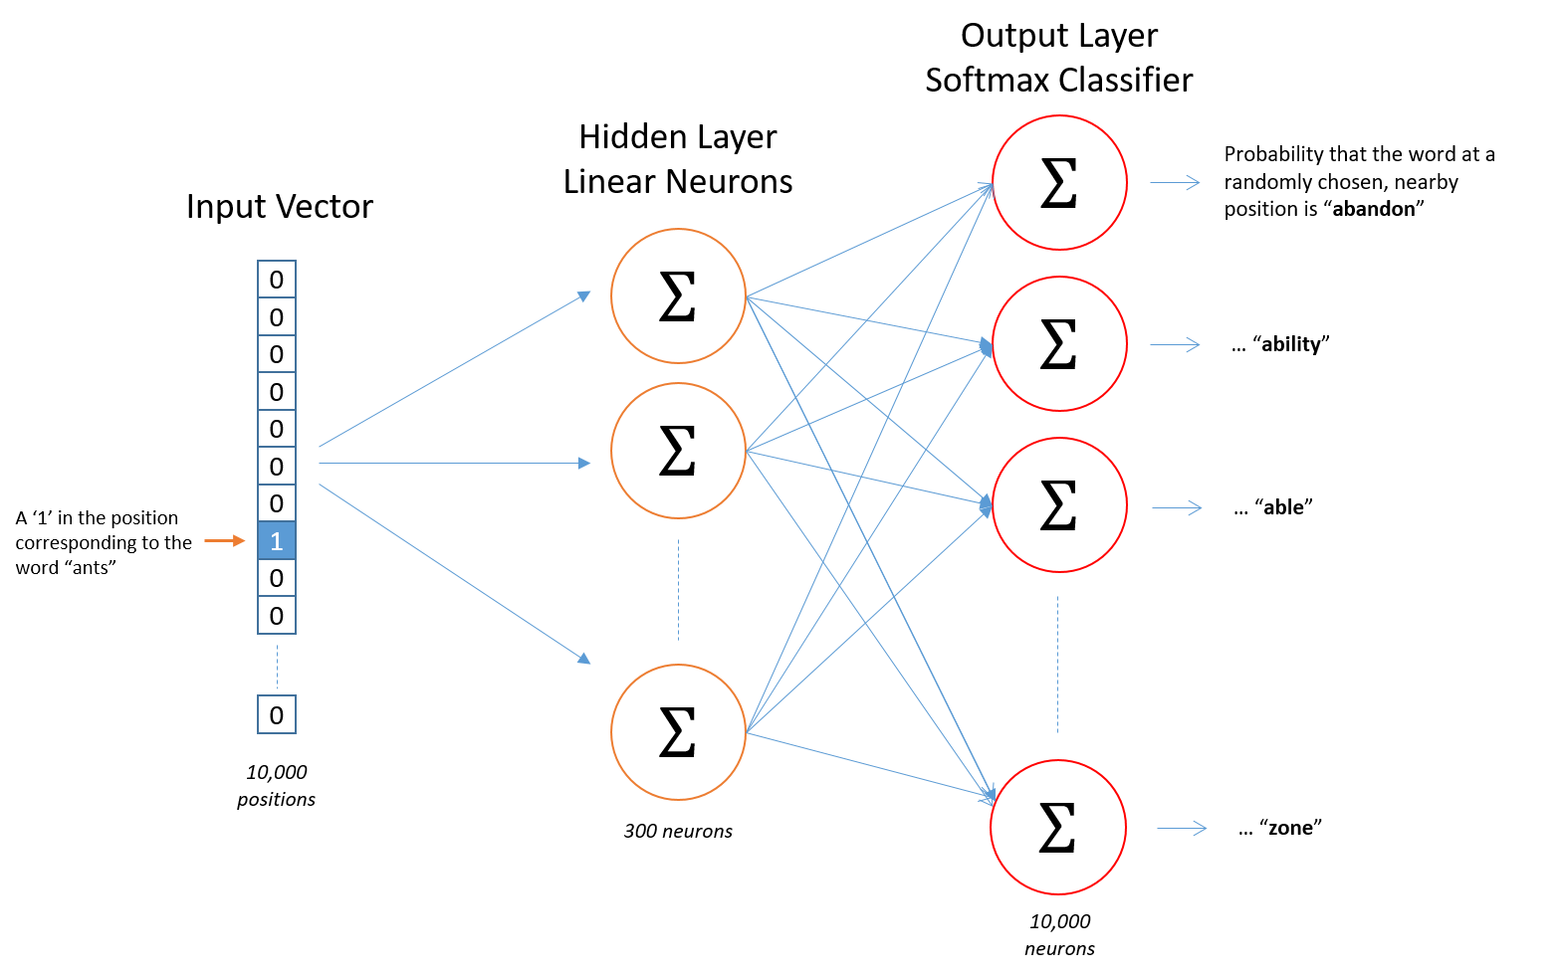
word2vec. skip-gram model

Slide 30
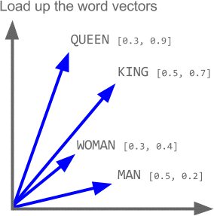
Properties of word2vec
.

Slide 31
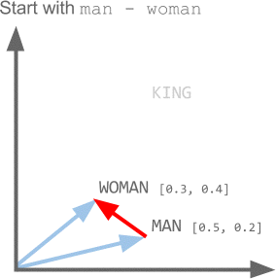

Slide 32
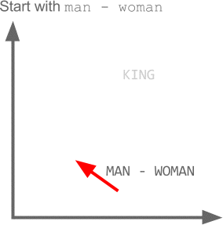

Slide 33
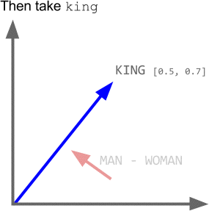

Slide 34
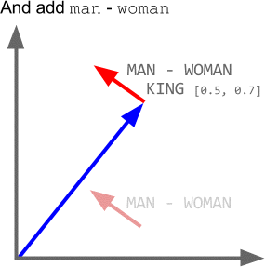

Slide 35
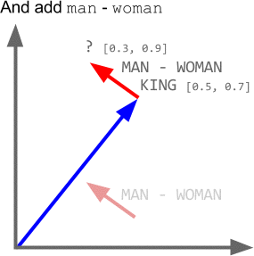

Slide 36
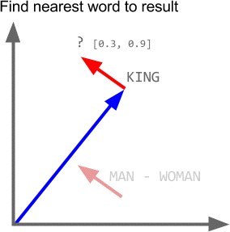

Slide 37
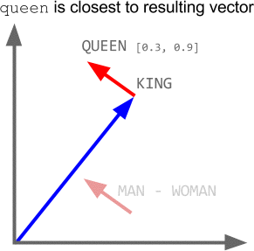

Slide 38
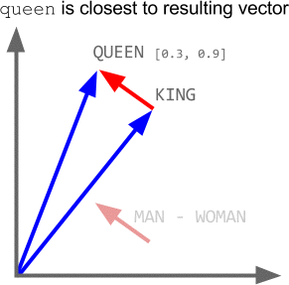

Slide 39
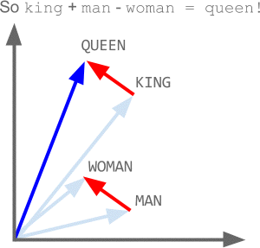

Slide 40
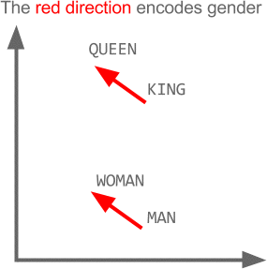

Slide 41
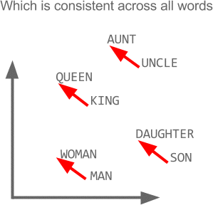

Slide 42
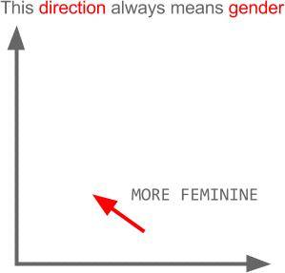

Slide 43
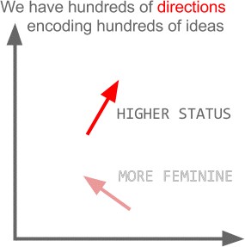

Slide 44
Overfitting in machine learning
Overfitting refers to a model that models the training data too well.
Overfitting happens when a model learns the detail and noise in the training data to the extent that it negatively impacts the performance of the model on new data

Slide 45
Underfitting in Machine Learning
Underfitting refers to a model that can neither model the training data nor generalize to new data.
An underfit machine learning model is not a suitable model and will be obvious as it will have poor performance on the training data.

Slide 46
Arguably, Machine Learning models have one sole purpose; to generalize well
Generalization is the model’s ability to give sensible outputs to sets of input that it has never seen before

Slide 47
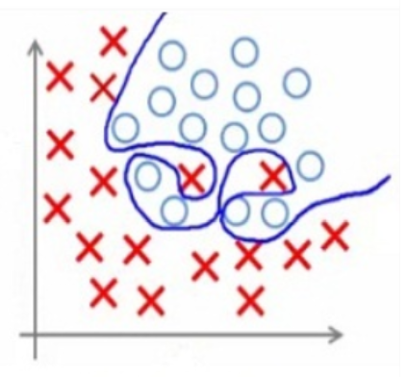
Overfitting
Overfitting is the case where the overall cost is really small, but the generalization of the model is unreliable. This is due to the model learning “too much” from the training data set.

Slide 48
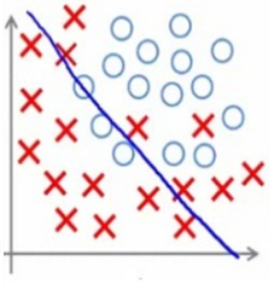
Underfitting

Slide 49
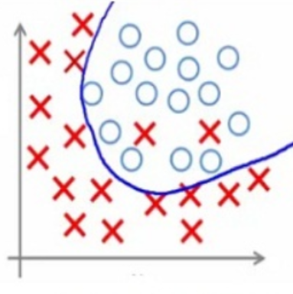
Best fitted

Slide 50
How to overcome it?
Cross-validation (K-fold cross validation)
Train with more data
Early stopping (mostly in deep learning model)
Regularization: Regularization refers to a broad range of techniques for artificially forcing your model to be simpler.(The method will depend on the type of learner you’re using. For example, you could prune a decision tree, use dropout on a neural network, or add a penalty parameter to the cost function in regression.)
Ensembling

Slide 51
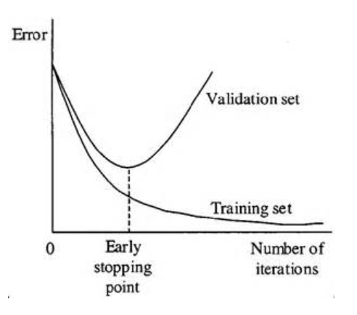
Early stopping

Slide 52



Regulizer: Dropout
Training:
.
Each time before updating the parameters
Each neuron has p% to dropout

Slide 53
Programming

Slide 54
Embedding layer in Keras
input_dim: This is the size of the vocabulary in the text data.
For example, if your data is integer encoded to values between 0-10, then the size of the vocabulary would be 11 words.
output_dim: This is the size of the vector space in which words will be embedded. It defines the size of the output vectors from this layer for each word. For example, it could be 32 or 100 or even larger.
input_length: This is the length of input sequences, as you would define for any input layer of a Keras model. For example, if all of your input documents are comprised of 1000 words, this would be 1000.

Slide 55
Embedding layer in Keras
Preparing data for embedding layer:
Adding embedding layer in keras:
max_review_len = max([len(s.split()) for s in sentences]) vocab_size = len(tokenizer.word_index)+1 sentences = tokenizer.texts_to_sequences(sentences) padded_docs = pad_sequences(sentences,maxlen=max_review_len)
model.add(Embedding(vocab_size, 50, input_length=max_review_len))

Slide 56
Tensorboard
Tensorflow, the deep learning framework from Google comes with a great tool to debug
It hosts a website on your local machine in which you can monitor things like accuracy, cost functions
and visualize the computational graph that Tensorflow is running based on what you defined in Keras
Pip install tensorboard

Slide 57
Tensorboard
tensorboard = TensorBoard(log_dir="logs/{}".format(time())) model.fit(x_train, y_train, verbose=1, callbacks=[tensorboard])
You need to create a new TensorBoard instance and point it to a log directory where data should be collected.
Next you need to modify the fit call so that it includes the tensorboard callback.
Then the following command in the separate terminal
tensorboard --logdir=logs/
http://localhost:6006/

Slide 58
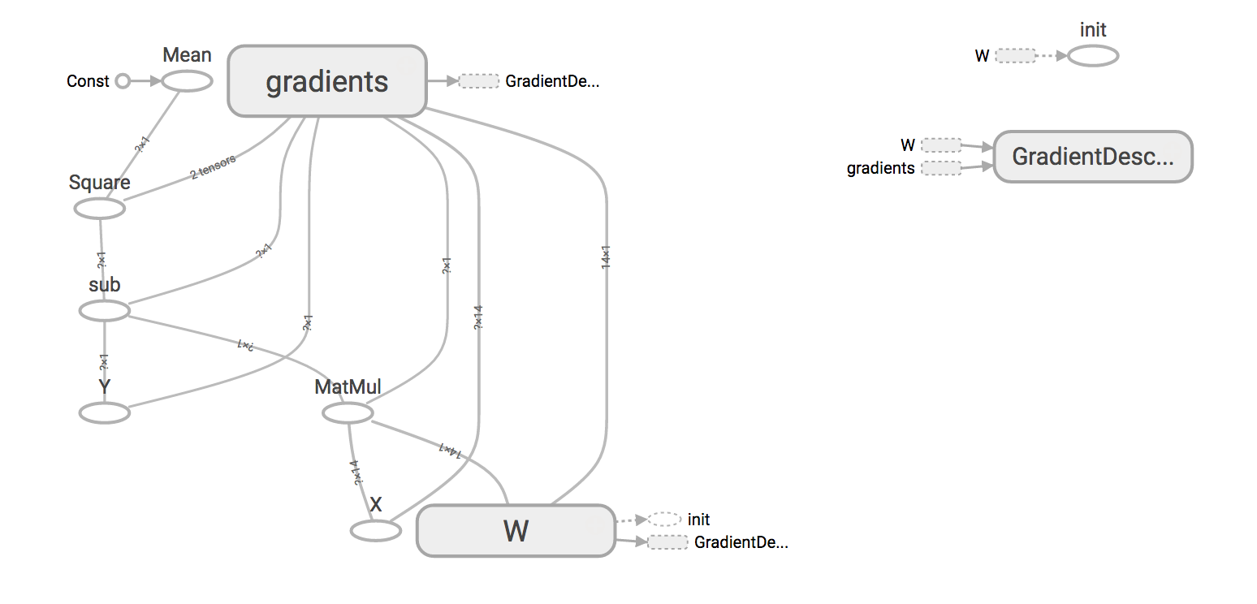
Tensorboard

Slide 59
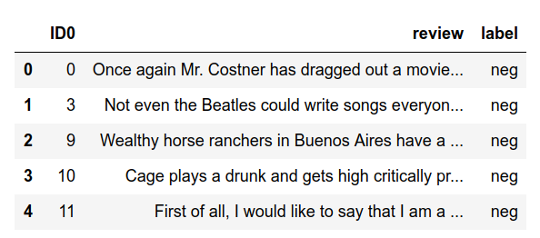
Use case: Sentiment Classification, IMDB dataset

Slide 60
Reading the data
df = pd.read_csv('imdb_master.csv',encoding='latin-1') sentences = df['review'].values y = df['label'].values

Slide 61
Steps to prepare the text data (review column)
Keras provides the Tokenizer class for preparing text documents for deep learning.
The Tokenizer must be constructed and then fit on either raw text documents or integer encoded text documents.
tokenizer = Tokenizer(num_words=2000) tokenizer.fit_on_texts(sentences)

Slide 62
Encoding the target column
le = preprocessing.LabelEncoder() y = le.fit_transform(y)

Slide 63
Creating and fitting the model
What is input_dim here?
.
model = Sequential() model.add(layers.Dense(300,input_dim=input_dim, activation='relu’))
model.add(layers.Dense(5, activation='sigmoid')) model.compile(loss='sparse_categorical_crossentropy',optimizer='adam',metrics=['acc']) model.fit(X_train,y_train, epochs=5, verbose=True, validation_data=(X_test,y_test), batch_size=256)
Is this number of neurons for the last layer is correct?
Is this activation function for the last layer is correct?

Slide 64
References
https://deeplearning4j.org/word2vec.html
https://towardsdatascience.com/tagged/word2vec
https://medium.com/@Aj.Cheng/word2vec-3b2cc79d674
https://medium.com/tag/word2vec
https://www.analyticsvidhya.com/blog/2017/06/word-embeddings-count-word2veec/
http://mccormickml.com/2016/04/19/word2vec-tutorial-the-skip-gram-model/
https://becominghuman.ai/how-does-word2vecs-skip-gram-work-f92e0525def4

